Slide 1
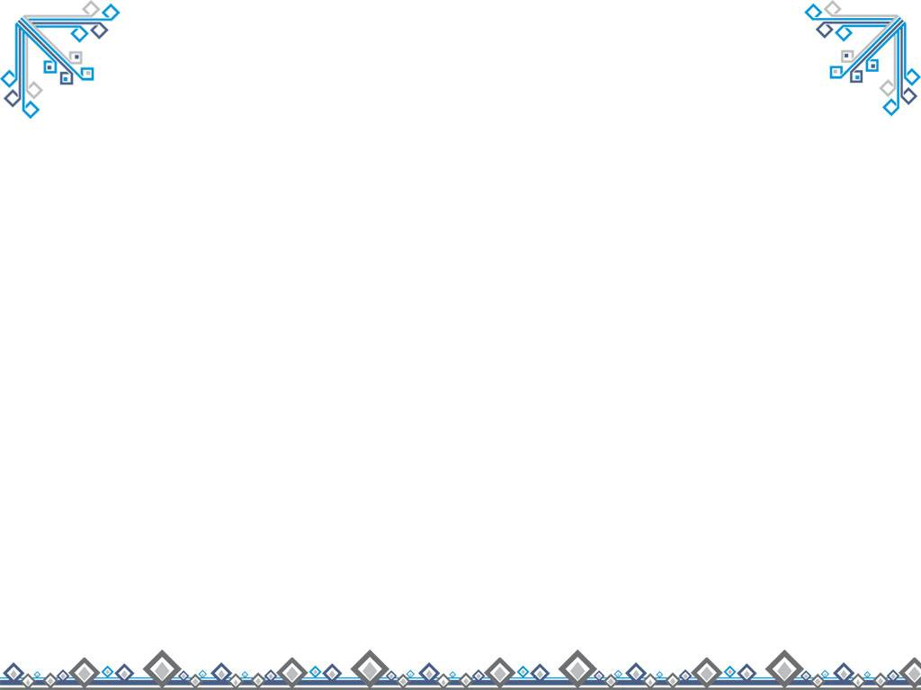

Module 6
Old and New

Slide 2
Grammar
Non-defining relative clauses
Contraction of relative clauses

Slide 3

GRAMMAR 1 Non-defining relative clauses
1
a Mao Zedong wrote a poem in which he dreamed of “walls of stone to hold back clouds and rain”.
b The Three Gorges Dam,which is the biggest construction project in China since the building of the Treat Wall and the Grand Canal, has been built to control flooding.

Slide 4
c Sun Yat-sen, who was the leader of the 1911 Revolution, first suggested the idea in 1919.
d More than a million people who lived in the region have moved from their homes.

Slide 5
Now answer these questions.
1 Which of the relative clauses (in italics)contain essential information about the subject and which contain extra information?
2 If you take away the relative clauses ,do the sentences still make sense?Why or why not?
3 Which sentences have commas, the ones with essential information or the ones with extra information?
( a,d )
( b,c )
( a and d don’t , b and c do .because the meaning stands without the extra clauses)
The ones with the extra information

Slide 6
When a relative clause merely describes an object without having the function of defining or identifying to which object the speaker or writer is referring, the clause must be placed between commas. Such a clause can be called a non-defining or non-limiting relative clause, i.e., a non-defining relative clause gives extra information about a noun or noun phrase and has commas at both ends.

Slide 7
(非限定性定语从句和先行词关系松散，只是对先行词做附加说明，如果省去，主句的意思仍然完整或清楚。非限定性定语从句和主句之间用逗号隔开。)

Slide 8
2
Read these sentences. Add commas if necessary.
1 SunYat-sen, who became President of the Republic of China in 1912, died in 1925.
2 The building of the Grand Canal, which is the world’s longest canal, began in 486 BC.
3 The section of the canal, which was built in the seventh century, was mainly used for rice transportation.

Slide 9
3
Add information to sentence 1-3,using extra information A-C
1 The Yangtze River is the third longest river in the world.
2 The Three Gorges Dam is the biggest construction project in China .
3 Mao Zedong wrote a peom about a dam across the Yangtze River.

Slide 10
A which is more than 6,000 kilometres long
B who is a great leader of China
C which will generate a large amount of energy

Slide 11
, A,
1 The Yangtze River is the third longest river in the world.
2 The Three Gorges Dam is the biggest construction project in China .
3 Mao Zedong wrote a peom about a dam across the Yangtze River.
, C,
, B,

Slide 12


高考链接
1. His movie won several awards at the film festival, _____ was beyond his wildest dream. (2007上海)
A. which B. that
C. where D. it

Slide 13
高考链接
2. Chan’s restaurant on Baker Street, ______ used to be poorly run, is now a successful business. (2007浙江)
A. that B. which
C. who D. where

Slide 14


GRAMMER 2 Contraction of relative clauses
1
Read the sentences and answer the questions.

Slide 15
a I met a man my grandfather worked with thirty years ago.
b I met a man who my grandfather worked with thirty years ago.
c I wanted to visit the house that my grandparents lived in.
d The bus which I took back to my birth place was full of visitors from other parts of China.

Slide 16
1 Do the first two sentences mean the same thing?
2 In the first two sentences, who is the subject of the verb work ----the man or the grandfather?
3 Can the words that and which be removed from the third and forth sentences without changing the meaning?
Yes, they do.
The grandfather.
Yes, they can.

Slide 17
2
Study these two sentences. Notice the words in brackets can be deleted without affecting the meaning of the sentence.
The valley is now part of the reservoir (which was ) created by the Three Gorges Dam.
The people (who were )living in the village have moved to other places.

Slide 18
3
Cross out the relative pronouns where possible.
1 They came from a village that was submerged in the reservoir.
2 There are many people who prefer to live in villages.
3 The dam ( that ) we saw in the film wasn't the Three Gorges Dam.

Slide 19
4 I've got a book that has lots of information about Zigui County.
5 The students ( that ) I met near the reservoir were from Vietnam.
6 I received an email from my cousin who lives near the Three Gorges Dam.

Slide 20
4
Make each pair of sentences into one sentence.
1 The dam provides a large amount of power. They built it on the river.
2 The power station was very modern. We visited it.
3 The village is near the lake. My grandparents used to live in it.
4 The boat went from Wuhan to Zigui. I took it .

Slide 21
Keys for reference
1 The dam which they built on the river provides a large amount of power.
2 The power station which we visited was very modern.
3 The village which my grandparents used to live in is near the lake.
4 The boat which I took went from Wuhan to Zigui.

Slide 22

高考链接
1. The Town Hall ____ in the 1800’s was the most distinguished building at that time. (2007上海)
A. to be completed
B. having been completed
C. completed D. being completed

Slide 23
高考链接
2. Jenny hopes that Mr. Smith will suggest a good way to have her written English in a short period. (2007福建)
A. improved B. improving
C. to improve D. improve

Slide 24
高考链接
3. She wants her paintings in the gallery, but we don t think they would be very popular. (2007上海春)
A. display B. to display
C. displaying D. displayed

Slide 25
高考链接
4. —Come on, please give me some ideas about the project.
—Sorry. With so much work my mind, I almost break down. (2007福建)
A. filled B. filling
C. to fill D. being filled

Slide 26
高考链接
5. The children went home from the grammar school, their lessons _____ for the day. (2007重庆)
A. finishing B. finished
C. had finished D. were finished

