Slide 1

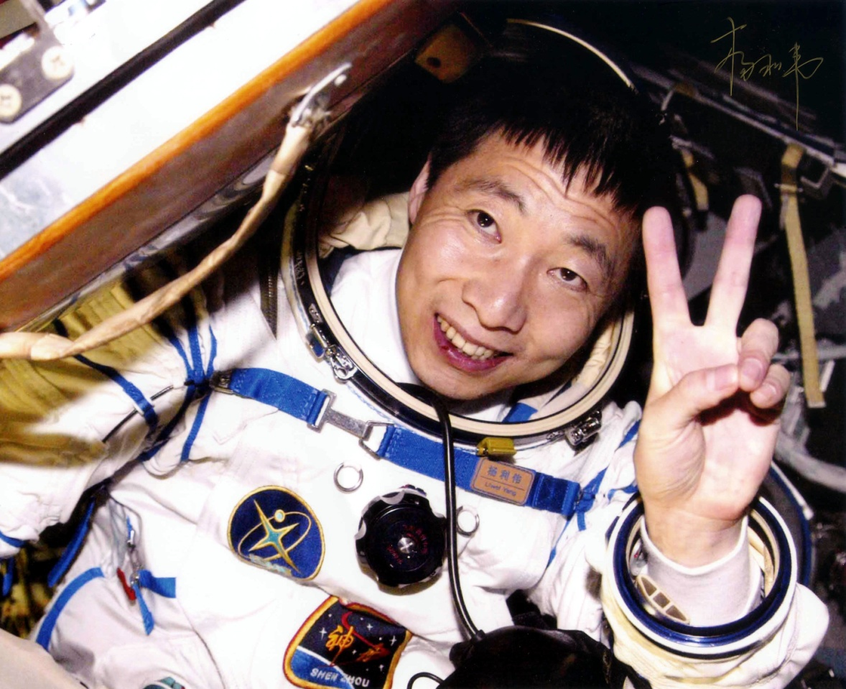
Module 5
Reading and Vocabulary

Slide 2
headline n. 大字标题
我只来得及看报纸的大字标题。
I only had time to read the headlines of the newspaper.
photograph n. 照片, 相片
对照相来说天太暗了。
It's getting too dark to take photographs.
vt. & vi.(给…)拍照
我不知道她在照片上是什么模样。
I wonder what she photographs like.
celebrity n. (尤指娱乐界的)名人, 名流
许多名人出席了电影的首映式。
Lots of celebrities were at the film premiere.

Slide 3
名声, 名誉
她说在美国社会阶层主要由名声决定。
She said social class in America was largely decided by celebrity.
economy n. 节约, 节省, 经济体制, 经济状况
新经济不仅仅是科技经济。
New economy is not merely an economy of technology.
要头等舱还是经济舱？
First class or economy?
politics n. 政治活动, 政治学
我在大学里学习政治学。
I am studying politics at university.

Slide 4
政论, 政见; 党派倾向
你的政见如何?
What are your politics?
权术; 派别之争
他们并非关心福利问题, 完全是党派之争。
They're not concerned with welfare; it's all politics!
photographer n. 摄影者; (尤指)摄影师
摄影师仔细为这组人摆好姿势。
The photographer posed the group carefully for the picture.
cosmonaut , astronaut, taikonaut
universe n. 宇宙; 天地万物
引力是宇宙中一个非常重要的力。
Gravitation is a very important force in the universe.

Slide 5
orbit n. 轨道
他们把一颗气象卫星送入环绕地球的轨道。
They put a weather satellite into orbit round the earth.
vt. & vi. 在…轨道上运行, 环绕轨道运行
有一架飞机在机场上空盘旋。
A plane orbited over the landing field.
capsule n. 胶囊
医生建议我今天早晨服一粒胶囊。
The doctor advised me to take a capsule this morning.
航天舱, 密封舱
宇航员在航天舱里工作生活。
The astronauts work and live in the space capsule.

Slide 6
flight n.飞翔, 飞行
在人们真正能上天飞行之前, 飞行这种想法早已存在数百年了。
The idea of flight had been kicking around for centuries before man actually achieved it.
航班, 航机
我为你预订了直飞巴黎的航班。
I've booked you on a direct flight to Paris.
楼梯的一段
一段阶梯通向前门。
A flight of steps led up to the front door.
congratulation n. 祝贺, 恭喜

Slide 7
我对你的成功致以最热烈的祝贺。
I send you my warmest congratulations on your success.
贺词
见到她时请转达我的祝贺。
Please give her my congratulations when you see her.
aboard prep. 在(船、飞机、车)上, 上(船、飞机、车)
昨天夜里他们都在船上。
They were all aboard the ship last night.
adv. 在船(或飞机、车)上, 上船(或飞机、车)
内燃机发出轰鸣声, 列车员跳上车厢, 火车开走了。
The diesels roared, the conductors jumped aboard, and off the train went.

Slide 8
welcome vt. 欢迎, 迎接
他欢迎你去做客。
He welcomed you to enjoy his hospitality.
adj.受欢迎的; 可喜的; 来得正好的, 被允许的;
你可随意用我的书。
You are welcome to the use of my books.
n. 欢迎; 迎接
主人欢迎他。
The host bids him welcome.
historical adj. 历史(学)的
这本书是根据历史事件写成的。
The book is based on historical events.

Slide 9
achievement n.成就; 成绩; 功绩
总而言之，我们的成绩是很大的。
Altogether, our achievements are very great.
达到; 完成
这样的一个目标是不可能完成的。
Such a goal is impossible of achievement.
replace vt. 取代, 代替; 更换, 替换
他把它们捡了起来, 放回包里。
He picked them up and replaced them in the bag.
alien adj. 外国的, 外国人的
他们是外国人。
They are alien people.

Slide 10
陌生的
他很快适应陌生的环境。
He quickly adjusts to the alien environment.
外星人
吉姆在这部电影里是个外星人
Jim is an alien in this film.
amateur adj. 业余的, 非职业的
和业余戏剧小组一起演出可能是有趣的。
Acting with an amateur theatrical group can be fun.
n. 业余爱好者
虽然汤姆只是个业余爱好者, 但却是一流的高手。
Although Tom's only an amateur, he's a first-class player.

Slide 11
autograph n. 亲笔签名
我有许多著名足球运动员的亲笔签名。
I have got lots of famous footballers' autographs.
vt. 在…上亲笔签名
我请求这位政治家为我的一本回忆录签名。
I had requested the statesman to autograph my copy of memoir.
backstage adv. 后台,秘密地, 背地里, 在幕后
他在幕后活动以获取人们对他的提议的支持。
He worked backstage to gain political support for his proposal.
part n.一部分; 局部

Slide 12
整体由部分组成, 部分构成整体。
A whole consists of parts, the parts constitute the whole.
零件
她将一些机器零件从这个城市运送到那个城市。
She carried some machine parts from this city to that one.
角色
演员们都熟悉他们的角色吗?
Do the actors all know their parts yet?
vt. & vi. (使)分裂成几部分, 断裂
缆索突然断裂。
The cable suddenly parted.

Slide 13
politician n. 政治家
市长是一位老练的政治家。
The mayor is a skilled politician.
政客, 玩弄权术者
你要获得成功, 就需要有一点政客的手腕。
You need to be a bit of a politician to succeed.
belief n. 相信, 信任, 信念, 信仰
别试图把你的信仰强加在别人头上。
Do not try to impose your belief upon others.
他认为情况会好转，这纯粹是推测而已。
His belief that things will improve is pure supposition.
disbelief n. 不相信, 怀疑

Slide 14
他的同事们满怀疑团地听他讲冒险的经过。
His fellow workers listened to his adventure story with/ in disbelief.
evidence n. 证词; 证据; 迹象
科学家必须提供证据以支持其理论。
A scientist must produce evidence in support of a theory.
cultural adj. 文化的, 与文化有关的
我们新的文化中心将设在这里。
Our new cultural centre will be located here.
深化文化体制改革，积极发展文化事业和文化产业。
We should deepen structural reform in the cultural field and actively develop cultural undertakings and cultural industries.

Slide 15
financial adj. 财政的, 金融的
该公司陷入了严重的财务困难。
The company was in deep financial difficulties.
finance n. 财政, 金融
她是一名财政专家。
She is an expert in finance.
财源, 资金, 财务情况
这家公司的财务状况是可靠的。
The firm's finances are sound.
vt. 为…供给资金, 从事金融活动
谁给这个组织提供资金?
Who finances this organization?

Slide 16
review n. 回顾; 检查; 检讨; 重新考虑
这几项安排须定期检查。
These arrangements are subject to periodic reviews.
评论性刊物, 评论
学院出版了一份戏剧评论刊物。
The college published a drama review.
检阅
士兵们身着全套军礼服准备接受检阅。
The soldiers were in full uniform for the review.
vt. 回顾
海伦在入睡以前回想了当天发生的事情。
Before falling asleep, Helen reviewed the day's happenings.

Slide 17
vt. & vi. 写…的评论文章
他在业余时间写评论文章。
He reviews articles in his spare time.
royal adj. 国王的, 女王的
他被授予由王冠做标志的皇家权力。
He is invested with royal power as symbolized by a crown.
忠诚
狗对主人很忠诚。
Dogs are royal to their masters.
found vt. 创办, 成立; 建立
他们自己创办了这家公司。
They founded the company themselves.

Slide 18
produce vt. & vi. 生产, 产生, 出产
那是一口不再出油的井。
That is an oil well that no longer produces.
制作, 创作
这位著名的作家近几年来作品甚少。
This famous author has produced little in the last few years.
vt.出示, 提供, 拿出
当验票时, 他出示了火车票。
He produced his railway ticket when asked to do so.
引起; 导致
努力工作就会成功。
Hard work produces success.

Slide 19



Individual activity

Slide 20

Quiz I: Retell the passage.
On October 15th, 2003, China’s first taikonaut Yang Liwei ____ ___ in the Shenzhou V_______ from Jiuquan in northwest China at 9 am. And the next day he ______ safely in Inner Mongolia.
China became the _____ nation to send a man into space. Yang is the ______ person to travel in space, he was in space for
twenty-one and a half hours and made
14 _____ of the earth.
took off
capsule
landed
third
438th
orbits

Slide 21
Many countries around the world sent messages of ______________. Sean O’Keefe from _______ and Kofi Annan, the seventh Secretary-General of the ______ _______, gave a high evaluation about the travelling in space.
congratulations
NASA
United Nations

Slide 22
Quiz II: Translation.
1. 1969年人类首次登上月球。
The first men ______ ___ the moon in
1969.
2. 飞机起飞时，我才想起我没有带文件。
As the plane was ______ ___, I
remembered I didn’t take my file.
3. 让我们向他赢得诺贝尔奖表示祝贺。
Let’s ____ ___ _____________ __ him
on winning the Nobel Prize.
landed on
taking off
send our congratulations to

Slide 23
4. 那里总共可能有40人左右。
There were probably about 40 people there ___ ____.
5. 这不仅仅为北京带来了很大荣誉，而且是整个国家历史性的成就。
It was not only a great honour for
Beijing but also ________ ___________
for the whole nation.
in total
historical achievement

Slide 24





After the class
Time for Reflection
Think about what we’ve just learnt in today’s class.
Think in English
It’s the time where we stop the class and you look inward. It’s
a time of silence in a class.
Study without reflection is a waste of time.

Slide 25

Review
课时重点回顾
land safely 安全着陆
make an orbit of… 绕……运行
send one’s congratulations to sb.
向……表示祝贺
take off 起飞
send…into space 向太空发射……
send messages of congratulations to
向……发来贺电
wish sb. continuing success
祝愿……继续取得成功

Slide 26


Homework
Read the passage again and review
the new words and expressions.
2. 发挥想象，连词成文(50-100字)。
historical achievement, welcome,
wish sb. continuing success,
send one’s congratulations to sb.

Slide 27

Thank you.

