Slide 1

Unit 5
Canada — "The True North"

Slide 2
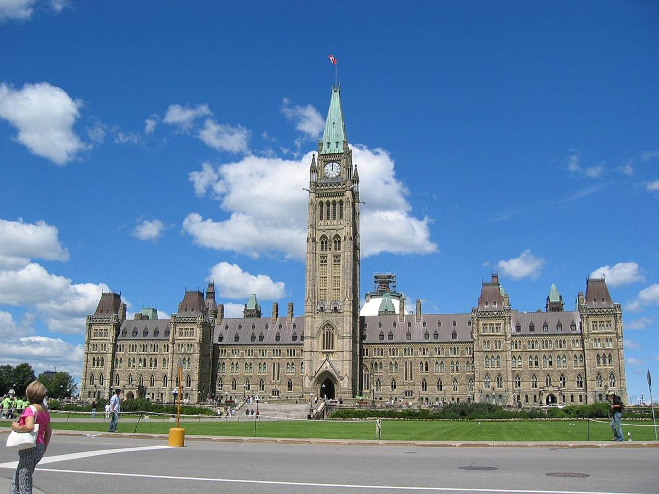
Language
points

Slide 3

重点词汇
1. ______ n. 测验；问答比赛
2. ________ n. 洲；大陆
3. ______ n. 风景；景色
4. ________ vt&vi. 包围；围绕
__________ adj. 周围的；附近的
__________ n. 环境
5. ______ vi&vt. 测量；衡量 n. 计量单位
6. ______ prep.&adv. 在船、飞机等上
7. ______ n. 边界；国界 vt&vi. 接壤，接近
quiz
continent
scenery
surround
surrounding
surroundings
measure
abroad
border

Slide 4
8. ______ adj. 轻微的；微小的
______ adv. 稍稍；轻微地
9. ______ adj.城市的；市镇的
_________ n.城市化；都市化
10. ______ vt&vi. 混合；调配
______ n. 混合物；混合状态
11. ________ vt. 证实；证明；批准
________ n. 确定；证实；证明书
12. _______ n. 薄雾
_______ adj. 有薄雾的；模糊的
slight
slightly
urban
urbanization
mix
mixture
confirm
confirmation
mist
misty

Slide 5
13._______ n. 传统；风俗
_______ adj. 传统的；习俗的
14._______ vt. 使恐怖；恐吓
_______ adj. 恐惧的；受惊吓的
_______ adj. 令人恐惧的
15. _______ vt. 使印象深刻；使铭记
________ adj. 给人印象深刻的；感人的
________ n. 印象
tradition
traditional
terrify
terrified
terrifying
impress
impressive
impression

Slide 6
Ⅱ.重点短语
1．rather _____ 与其；不愿；而不是
2. settle______ 定居；安稳下来；专心于
3．_______ to do 设法做；成功做
4．catch sight ___ 看见；瞥见
5．have a gift ____ 对......天赋
6．___ the distance 在远处
than
down
manage
of
for
in

Slide 7

1. rather than
与其；不愿；而不是
I'll have a cold drink rather than coffee.
The guys were screaming rather than
singing.
She would rather stay at home than go
outside.
注：rather than 前后要遵循平行结构。

Slide 8
[归纳拓展]
would rather ... than ...
宁愿......而不愿......
prefer to do... rather than do
宁愿做......而不愿做......
other than
or rather
more than
不同于；除了......以外
更确切地说
不仅仅，超过

Slide 9
[练习] 用 rather than;more than; other than;
or rather填空
1. Studying hard __________ daydreaming is
a key to your success.
2. She has no friend __________ you.
3. There are_________200 athletes taking
part in the competition.
4. He came home very late last night,_______
early this morning.
5. 翻译：周末我宁愿看书，也不愿上网聊天。
rather than
other than
more than
or rather
I would rather do some reading than chat online on weekends.

Slide 10
2. chat
vi&n. 聊天；闲聊
归纳拓展
chat ___ sb 与某人聊天
chat _____sth 闲聊某事
chat ___ sb. _____sth. 与某人聊某事
=have a chat with sb about sth.
__________ 网上聊天
with
about
with
about
chat online

Slide 11
[练习] 填上合适的介词
1. Some girls like to spend hours chatting on the phone ____ their friends.
2. Don't chat ____ others' private life.
with
about

Slide 12
3. surround vt&vi.
围绕；包围
根据例句归纳surround用法
① He surrounded the garden with a fence.
② The famous star was surrounded by reporters.
③ People in the surrounding villages live in a peaceful surroundings.

Slide 13
总结归纳
surround... ____... 用......包围......
be surrounded ______ 被......包围/环绕
___________ adj. 周围的；附近的
___________ n. 环境
with
by/ with
sorrounding
sorroundings

Slide 14
[练习] 1. 用surround恰当形式填空
① The thief ______________ by a couple of policemen, so he was unlikely to run away.
②__________by a couple of policemen, the thief was unlikely to run away.
③ I feel so lucky to live and work in such healthy ____________.
2. 翻译： 因为椰林环绕，文昌以“椰子之乡”而闻名。
Surrounded by the coconut trees, Wenchang is famous as the Home of Coconut.
was surrounded
Surrounded
surroundings

Slide 15
4. measure
vi.&vt. 测量；衡量；判定
n. 计量单位；尺寸；措施
根据句子判断measure的
① We can't measure success by wealth.
② The house measures ten metres long and six metres wide.
③ The government should take measures to protect the endangered animals.
衡量
测量(长短高，面积等)
措施

Slide 16
(1) measure...by...
be measured by/in
(2) sth measure+长宽高/面积等
某物的长宽高/面积是多少
(3) take measures/ steps/action to do sth.
采取措施做某事
make sth. to sb.'s measure
按照某人的尺寸做某物
用.....来衡量
用......来衡量/计算

Slide 17
(1) 语法填空
①Students' performance shouldn't_____________
(measure)purely by examination results.
② The buildings here are very tall, and they_________(measure) over 50 metres.
③ The buildings here are very tall, __________
(measure) over 50 metres.
(2) 翻译
为了保护环境，政府应该采取有效措施来限购私家车。
In order to protect the environment, the government should take effective measures to control the purchase of private cars.
be measured
measure
measuring

Slide 18

5. aboard prep.&adv
【归纳拓展】
(1)go aboard(the ship/plane/train)
上(船/飞机/火车)
(2) board
___board 在船（车/飞机等）
__________ 上船(车/飞机等)
(3) abroad adv. 在国外;到国外
________________ 国内外
在（船;飞机;火车等）上
上(船;飞机;火车等)
vt. 上船等
vi. 寄宿
on
go on board
at home and abroad

Slide 19
[练习] 完成句子
① Hurry up! There is little time left to __________.
快点！没剩多少时间登机了。
② He have decided to study________.
他决定出国留学。
③ MoYan is famous both _________________.
莫言享誉国内外。
go aboard / go on board
abroad
at home and abroad

Slide 20
6. settle down
安稳坐下;定居; 平静下来;专心于
根据句子判断settle down 含义
① It's too hard to settle the children down.
②There was so much noise that we were unable to settle down to studying.
使......安静下来
专心于

Slide 21
【拓展】
(1)settle down to (doing) sth.
静下来做某事
settle on/upon
决定;同意
(2) settle vt. 决定；解决
_________ n. 解决;定居
_________ n. 定居者;移民者
settlement
settler

Slide 22

7. manage to do
Eg. He managed to solve the problem.
[拓展]
manage to do = succeed in doing sth.
设法完成
manage it 设法完成
n. 经营;管理
adj.可处理的
n. 管理者
设法做
management
manageable
manager

Slide 23
[练习] 句型转换
(1) The soldiers succeeded in saving the injured
out of the ruins.
The soldires _________________ the injured out of the ruins.
managed to save

Slide 24
易混辨析
manage to do
try to do
表示设法做成某事，强调
结果，等于succeed in
doing
表示尽力做某事，成功与否
不确定
改错：
We managed to persuade him to stay, but he
wouldn't listen.
tried

Slide 25
8. catch sight of
When he caught sight of the head teacher, he pretended to do homework.
看见;瞥见
根据句子，总结sight的短语
① The young couple fell in love at first sight.
② The child stopped crying at the sight of his parents.
③ Keep it up! Final victory is in sight.
④ Out of sight, out of mind.
⑤ Only a short-sighted man will lose sight of the importance of education.

Slide 26
[总结归纳]
at first sight
at the sight of
in/with sight
out of sight
lose sight of
lose one's sight
初次见到；乍一看
一看见......就
在视野内;看得见
在视野之外;看不见
看不见;忽视
失明

Slide 27
[练习]
(1) 完成句子
She looked around wildly for help, but no one was _______.
(2) 改错
At sight of the moving scene, all the people present were moved to tears
in sight
^
the

Slide 28
9. have a gift for
= have a talent for
对......有天赋
[拓展]
(1) gift/talent n. 天赋;才能
a boy of many gifts/talents
多才多艺的男孩
(2) ____________ adj. 天才的;有天赋的
be gifted/talented at doing sth/ in sth.
擅长做某事
gifted/talented

Slide 29
[练习] 完成句子
(1) He _________________music.
他有音乐天赋。
(2) 翻译：
让我们惊讶的是她擅长处理各种各样的问题。
To our surprise, she is gifted/talented
at dealing with all sorts of problems.
What surprises us is that she is gifted/talented at dealing with all sorts of problems.
has a gift/ talent for

Slide 30
10.within
prep.在......之内;
adv. 在里面;在内部
You should give your speech within five minutes.
[拓展]
within one's power/ability
在某人的能力之内
within(one's) reach
触手可及

Slide 31
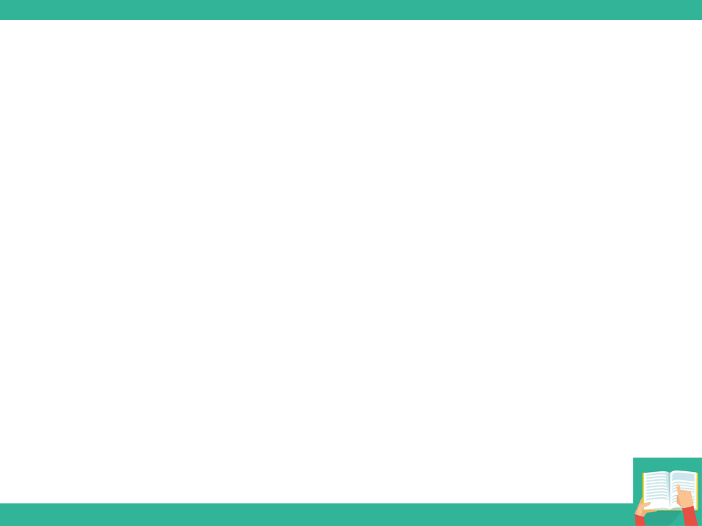
[练习]完成句子。
① I can do you a favor. The problem ________
__________.
我可以帮助你。这个问题在我能力范围之内。
② As long as you believe yourself, all hopes and dreams are___________.
只要你相信自己，所有希望和梦想都是触手可及的。
is within
my ability
within reach

Slide 32
句型： Going eastward, you'll pass mountains and thousands of lakes and forests, as well as wide rivers and large cities.
[句型分析]
going eastward 是____分词作______状语，
相当于时间状语从句_________________.
例：Lifting my head, I see the bright moonlight.
=(When I lift my head, I see the bright moonlight.
现在
时间
as you go eastward

Slide 33
[归纳拓展]
使用现在分词作状语条件
① 从句是状语从句
② 主从句主语一致
③ 从句主语与谓语：主动关系
注：现在分词作状语表示____、_____、_____、
____、_____ 等。
时间
原因
让步
条件
伴随

Slide 34
[练习]完成句子
(1)_______(see) those pictures, she remembered her childhood.
(2)_______ (ill), he didn't come to school yesterday.
(3) _______(tire) of playing football, he went back to the classroom.
(4) _______(work) hard, you will succeed.
(5) _______(work) hard and you will succeed.
Seeing
Being ill
Tired
Working
Work

Slide 35
2. It is so wet there that the trees are extremely tall, some measuring over 90 metres.
[句型分析]
some measuring over 90 metres 是________
结构。
例：The guide leeding the way, we had no trouble getting out of the forest.
= (Because the guide led the way, we had no trouble getting out of the forest. )
独立主格

Slide 36
[总结]
(1) 独立主格结构特点：
① 独立主格的逻辑主语与句子主语不同
② 名词、代词与分词、形容词、副词、不定式等是主谓关系。
③ 独立主格结构与主句用逗号分开
(2) 独立主格结构形式：
① 名词/代词+现在分词（表主动或正在进行）
② 名词/代词+过去分词（表被动或完成）
③ 名词/代词+不定式 （表将要发生的动作）
④ 名词/代词+形/副/介词短语（表性质/特征/状态）

Slide 37
[练习] 完成句子
(1) ________(be) sunday, the library dosen't open.
(2) Weather___________(permit), the football match will be held tomorrow.
(3) Lots of things________(settle), I have to stay at home all day.
It being
permitting
to settle

Slide 38
Lying
____(lie) in the northeast of Hainan Province, Wenchang _____________by coconut trees. The _______(native) here chat____ each other in Wenchang dialect. They are concerned about education as well as the_______(grow) of their children. And they are hardworking so that they do all they can ____ support their families. _______ faced with many difficulties, they still
manage ___deal with them. Besides, it seems that they has ____gift for volleyball. That's the reason ____ Wenchang is famous as the Home of Volleyball.
is surrounded
natives
with
growth
to
Although
to
a
why

Slide 39

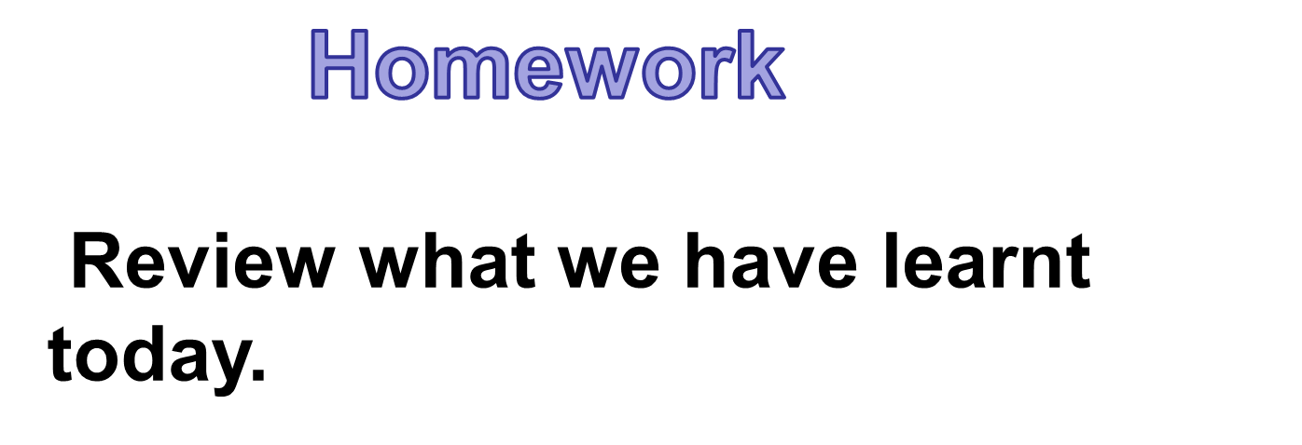

Slide 40
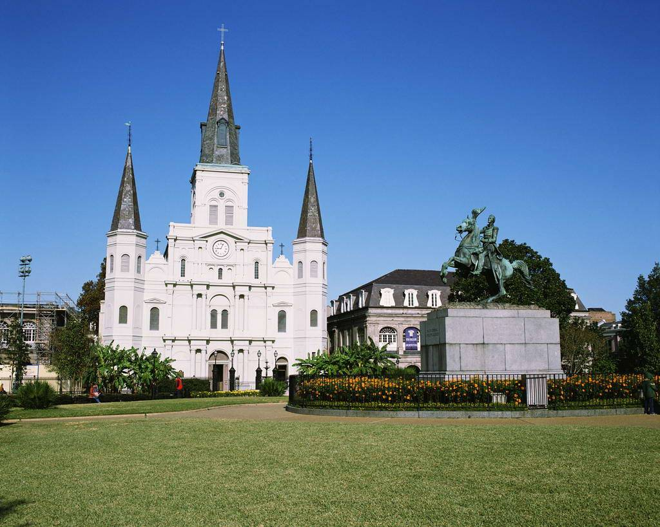
Using
Language

Slide 41

混合；混淆；搞混
1. mix vt./vi
________ n. 混合
【拓展】
1) mix up
弄乱；搞混；使迷惑
2) mix... with...
与......混合
mixture

Slide 42
[练习]
1. Oil can't mix ____ water.
2. Now you've mixed me____completely.
with
up

Slide 43
2. confirm
vt.证实;证明;确认
confirmation
n.证实;确定;确认
[拓展]
1)confirm sth./that从句
2)It has been confirmed that...
3) confirm sb. in sth.
证实
已确定
使某人确信某事

Slide 44
3. in the distance
at/from a distance
at a distance of
within walking distance
by distance
注：“by+名词” 表示 “按......”
by _______ 按重量
by _______ 按长度
by _______ 按体积
在远处
从远处，离一段距离
在......的距离
几步之遥的地方
按距离
weight
length
volume

Slide 45

[练习]填上合适的介词
1) The hotel is ___ a distance of 500meters from the entrance to Baishan Mount.
2) We can see the beautiful scenery ___the distance.
3) The price of taking a taxi is charged_____
distance.
at
in
by

Slide 46
4. terrify
vt. 使恐怖；恐吓
terrified
terrifying
adj. 恐惧的
adj. 令人害怕的
根据句子归纳terrify用法
1) The bad man terrified the child with a ghost story.
2) He is terrified of heights.

Slide 47
[拓展]
terrify sb. ____sth. 用某物吓唬某人
terrify sb.____ doing sth 恐吓某人做某事
be terrified ___ 对......感到惊恐
be terrified ______ 被......吓了一跳
with
into
of
at/with

Slide 48
[练习] 完成句子
1) The _________stories terribly ________the girl, which made her mother ________. (terrify)
2) He is terrified___ being alone in the room.
terrifying
terrified
terrified
of

Slide 49
6. impress
vt. 使印象深刻;使铭记
n.印象
adj. 印象深刻的
[用法]
impress sth. on/upon sb.
impress sb. with sth.
be impressed by/at/with
make/leave a/an...impression on sb.
给某人留下......印象
impression
impressive
使某人牢记某事
留下印象

Slide 50
[练习] 完成句子
1）Father __________________me the value of hard work.
= Father __________me ______ the value of hard work.
父亲向我强调努力工作的重要意义。
2) Her excellent performance leaves a deep impress on us.(改错)
3) 让我们印象最深刻的是，他把他的一生都献给了科学。
What impressed us most was that he devoted his life to science.
impressed on/upon
impressed
with
impression

