Slide 1

Unit 5
Canada —— “The True North”
Using language

Slide 2
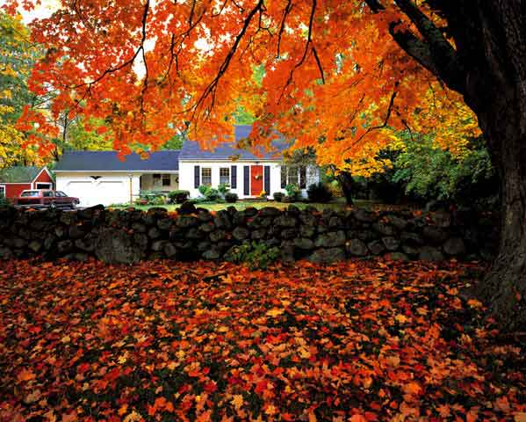


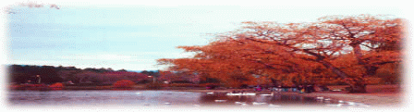


Slide 3
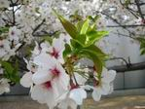
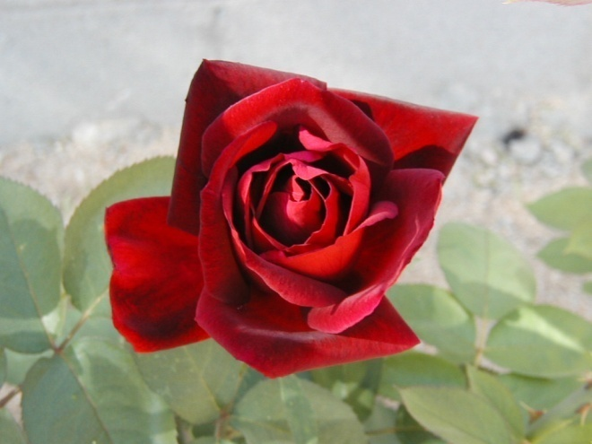

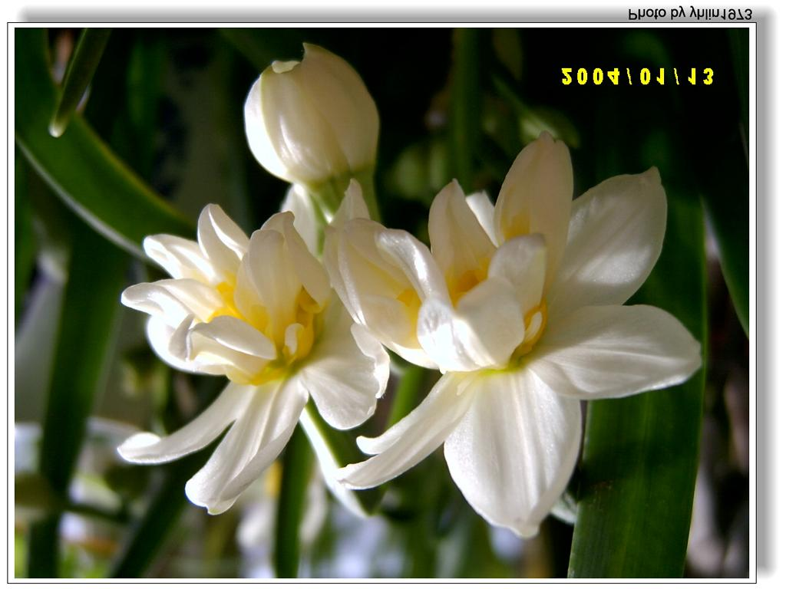
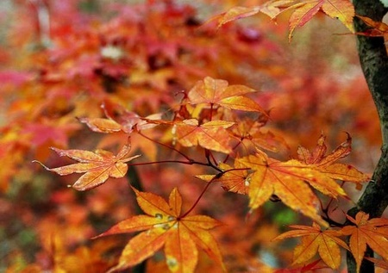
cherry rose
maple daffodil

Slide 4


How much do you know about Canada?
How much do you know about Canada?

Slide 5



“The True North”
from
Toronto
to
Montreal

Slide 6
GUESS
What is “The True North”?
“The True North” is the train that goes across Canada / the cross-Canada train.

Slide 7
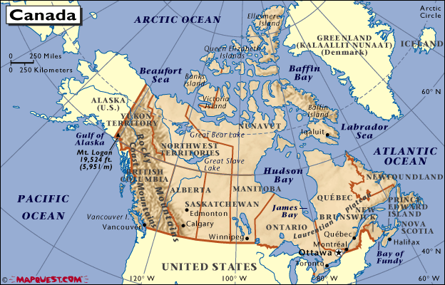
Find out the location of two cities

Slide 8
What did the cousins see in Toronto?
A :CN Tower
B:Niagara Falls
C:The Covered Stadium
D:Chinatown

Slide 9
What did the cousins see in Montreal?
A:Old Montrol
B:lovely shops
C:St Lawrence River
D:Above all

Slide 10
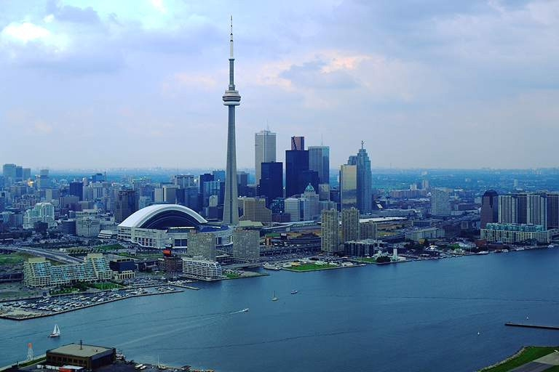
Toronto

Slide 11
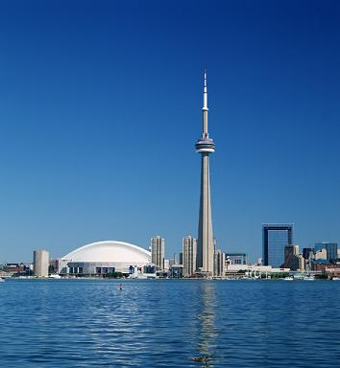
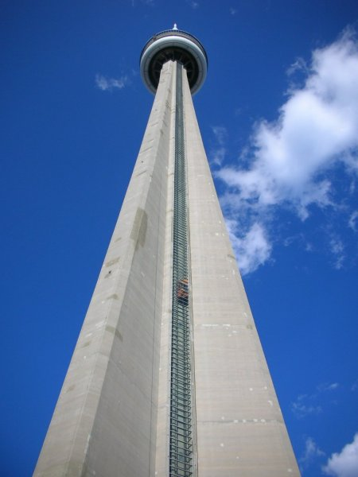
CN Tower

Slide 12
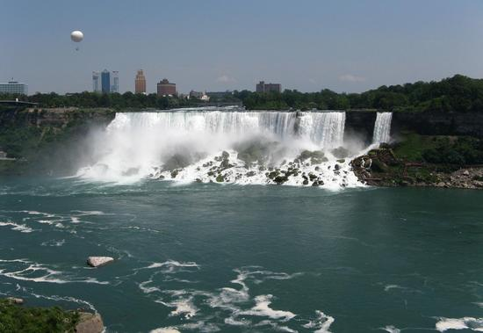
Niagara Falls

Slide 13
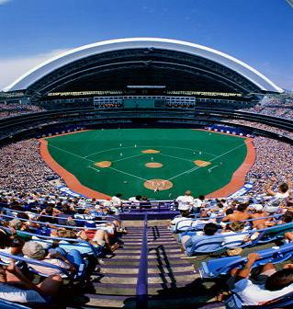
The Covered Stadium

Slide 14
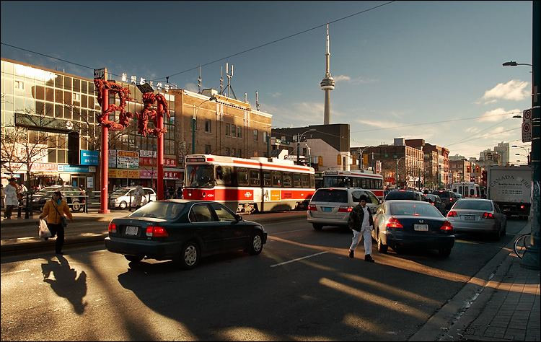
Chinatown

Slide 15
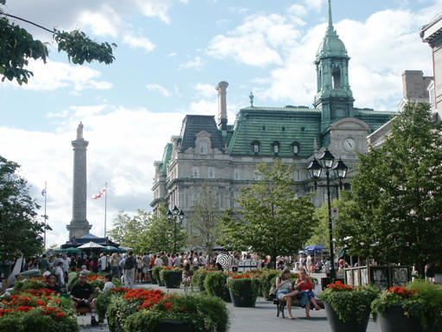
Montreal

Slide 16
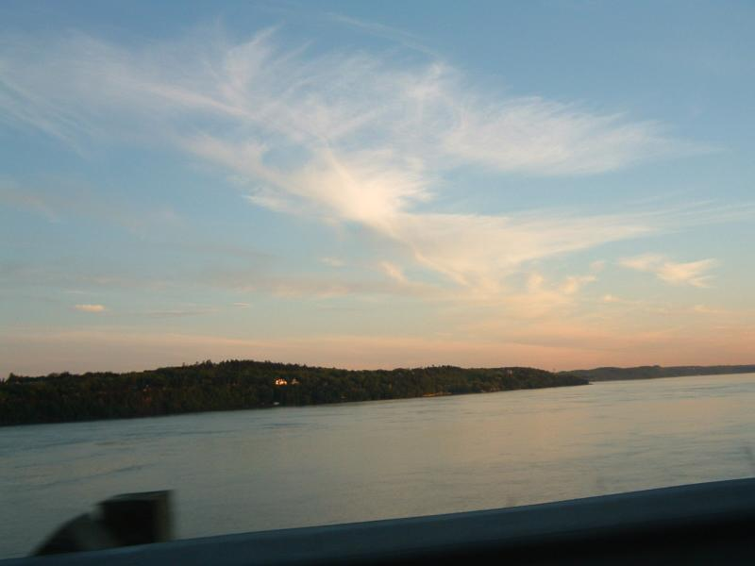
St Lawrence River

Slide 17
Detailed reading (5 minutes)
Read the passage for a second time and answer the following questions.
How do we know it is fall in Canada?
What can sometimes be seen from the CN Tower in Toronto?
Where does the water from the lake go?
Why is there good Cantonese food in Toronto?
Which direction is the train going from Toronto?
Why did the girls go to Old Montreal?
What three things show us that Montreal is a French city?

Slide 18

How do we know it is fall in Canada?
We know it’s fall in Canada because the maple trees are red and gold and orange, and there is frost on the ground.
2. What can sometimes be seen from the CN Tower in Toronto?
Sometimes the misty cloud that rises from Niagara Falls can be seen from the CN tower.

Slide 19
3. Where does the water from the lake go?
the water from the lake goes into the Niagara river and over the falls on its way to the sea.
4. Why is there good Cantonese food in Torono?
There is good Cantonese food in Toronto because most of the Chinese people there come from the south of china , especially Hong Kong.

Slide 20

5. Which direction is the train going from Toronto?
The train is going east from Toronto.
6. Why did the girls go to Old Montreal?
They went to Old Montreal because it is close to the water/ to see the lovely shops and the artists.

Slide 21
7. What three things show us that Montreal is a French city?
Good coffee, good bread and good music show that Montreal is a French city, also the signs and ads were in French.

Slide 22
Fill in the blanks according to the order things happened.

Slide 23
the next morning
they saw beautiful maple trees and realized that fall had come.
around noon
they arrived in Toronto.
late that night
the train left.
at dawn the next morning
they arrived in Montreal.
they spend the afternoon
in the lovely shops and visiting the artists in their workplaces beside the water.
the train was speeding down to the East Coast.
the night

Slide 24
根据课文内容，在下面短文的空白处填入适当的单词或短语。
The next morning the red, gold and orange _______ and maple trees outside their windows and the frost on the ground __________ that fall had arrived in Canada.
bushes
confirmed

Slide 25
After arriving in Toronto, the biggest and ____________ city in Canada, around noon, Li Daiyu and her cousins went on a tour of the city. Having climbed up the tall CN Tower, they looked across the lake. _____________, the _____ cloud rising from the great Niagara Falls, which is on the south side of the lake, could be seen.
most wealthy
In the distance
misty

Slide 26
As they walked north from the harbour area, Li Daiyu phoned Lin Fei, one of her mother’s old ___________ from a telephone _____ They met Lin Fei around dusk in downtown Chinatown, one of the three in Toronto and they chatted with each other at a restaurant.
schoolmates
booth

Slide 27
The train left late that night and arrived in Montreal at dawn the next morning. At a _____ restaurant, they were looking over the _____ St Lawrence River when they met a young man called Henri, who told them that most people in the city spoke both English and French, but the city had French culture and _________.
buffet
broad
traditions

Slide 28
That night as the train was speeding along the St Lawrence River toward the Gulf of St Lawrence and down to the distant east coast, the cousins dreamed of French restaurants and red maple leaves.

