Slide 1
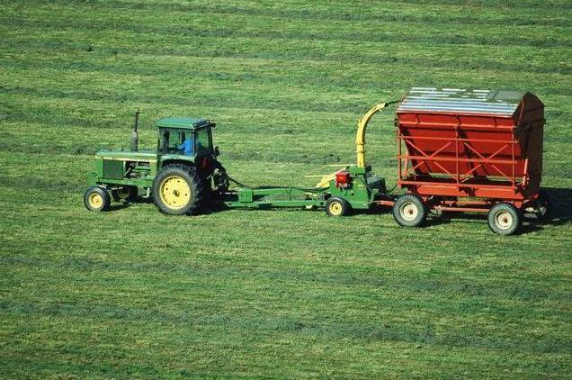
Unit 2
Working the land

Slide 2

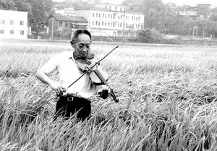
A PIONEER FOR
ALL PEOPLE

Slide 3

Words Review
sunburnt
struggle
decade
super
hybrid
output
strain
crop
adj. 晒黑的
vi. & n. 斗争；拼搏；努力
n. 十年；十年期
adj. 特级的；超级的
adj. 混合的；杂种的
n. 杂交种；混血儿
n. 产量；输出
n.（植物的）品种；种类
n. 庄稼；农作物；产量

Slide 4
Words Review
hunger
disturbing
expand
circulate
Vietnam
battle
rid
freedom
n. 饥饿；欲望
vt. & vi.（使）饥饿
adj. 引起烦恼的；令人不安的
vt. & vi. 使变大；伸展
vt. & vi. 循环；流传
n. 越南（东南亚国家）
n. 战役；战斗；较量；斗争
vt. & vi. 搏斗；奋斗
vt. 摆脱；除去
n. 自由；自主

Slide 5
Words Review
therefore
equip
sorghum
grain
peanut
export
nationality
occupation
personality
adj. 因此；所以；因而
vt. & vi. 配备；装备
n. 高粱
n. 谷物；粮食；颗粒
n. 花生
vt. & vi. 输出；出口
n. 国籍
n. 工作；职业；占领
n. 性格；个性；人格

Slide 6
Match
thanks to
rid … of
be satisfied with
would rather
对……感到满意
宁愿；宁可
幸亏；由于；因为
摆脱；除去

Slide 7
The main idea of the article
The reading is about an agricultural pioneer named Yuan Longping who worked hard to produce a new strain of rice.

Slide 8


Scanning for specific information

Slide 9



Scanning
Reading Comprehension IV
Complete the following notes about Yuan
Longping.
Name:
Nationality:
Age:
Occupation:
Education:
Dream:
Yuan Longping
Chinese
87 (as of 2017)
scientist/farmer
graduated from Southwest
Agricultural College in 1953
to export his hybrid rice so that it
can be grown around the globe

Slide 10
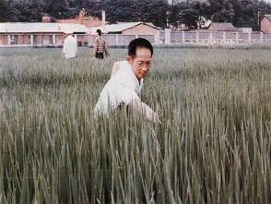
Achievements:
Hobbies:
produce better rice so no one need to go hungry again; spread this knowledge to other countries
listening to violin music,
playing mah-jong,
swimming
and reading

Slide 11
Scanning
Reading Comprehension VII
Paraphrase the sentences.
1. As a young man, he saw the great need
for increasing the rice output.
Even when he was a young man, he
knew how important it was to produce
bigger rice crops.
2. At that time, hunger was a disturbing
problem in many parts of the countryside.
During his early years, much of the
countryside was troubled by hunger.

Slide 12
3. Using his hybrid rice, farmers are producing
harvests twice as large as before.
As they use his hybrid rice, farmers are
producing twice as much rice as before.
4. Spending money on himself or leading a
comfortable life also means very little to him.
He is not interested in buying things for
himself or in having a comfortable life.
5. Just dreaming for things, however, cost
nothing.
It does not cost anything to dream for
something.

Slide 13
Critical thinking
1 Why did Yuan Longping want to
increase the rice output when he was
young?
2 Is Dr Yuan more of a scientist or more
of a farmer? Do you think he is a
businessman? Give your reasons.
3 What do you think is the main reason
for Dr Yuan’s success?

Slide 14
4 Dr Yuan thinks that a person with too
much money has more rather than fewer
troubles. Do you agree or disagree? Why?
Money is the root of all evil?
What kind of person is Yuan Longping?
considerate, kind, persistent, determined, unselfish, successful, a man of taste …

Slide 15

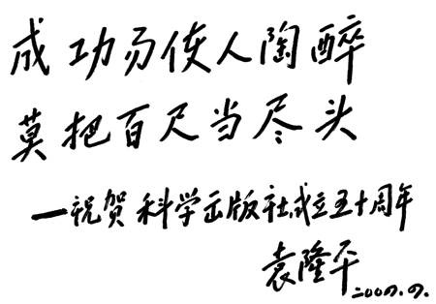

Slide 16

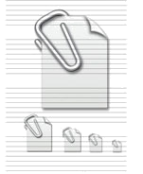
I. Complete the passage with proper
words, which will help you
retell the text.
注: 另附 word 文档。
点击此处链接
Yuan Longping is known as China’s “father of _______ rice”. Because Yuan Longping grows what is called ______ hybrid rice. ______ in 1930, Dr Yuan __________ from Southwest Agricultural College in _____. When Yuan Longping saw the great need
hybrid
super
Born
graduated
1953

Slide 17
increasing
for __________ the rice output, he ________ for a way to increase rice harvests without _________ the area of the fields. The increased harvests mean that 22% of the world’s people are ____ from just 7% of the farmland in China. He became the ______ agricultural _______ in the world to grow rice that has a high ______. Yuan devoted himself to the research into agriculture.
searched
expanding
fed
first
pioneer
output

Slide 18
translation
农作物就是这样的植物，如谷物，高粱，大豆和花生，它们是大量种植的食物。统计显示，超级杂交水稻是一种特殊的水稻，在同样的田里产量比普通水稻高很多。

Slide 19
Crops are such plants as grains, sorghums, soybeans and peanuts, which are grown in large quantities for food. Statistics show that super hybrid rice, a special strain of rice, has a much higher output than ordinary rice in the same fields.

Slide 20

袁隆平，一个脸庞和手臂被太阳晒得黝黑的农民科学家，通过几十年的努力开发出了自己的超级杂交水稻。当他年轻时，他知道饥饿在中国是一个令人不安的问题，所以他集中关注在不扩大农田面积的情况下增加稻米收成。

Slide 21
Yuan Longping, a farmer scientist with a sunburnt face and arms, has struggled for decades to develop his super hybrid rice. As a young man, he knew that hunger was a disturbing problem in China. Therefore, he focused on increasing rice harvests without expanding the area of the fields.

Slide 22

袁博士并不满意他所做的一切，他目前正在印度，越南和其他国家传播他的知识。他宁愿提供资金，去帮助他人作农业研究。由于他的研究，联合国在帮助欠发达国家摆脱饥饿中赢得了这场斗争。现在他有一个梦想，就是出口他的稻米，以便让它能够在世界各地种植。

Slide 23
Dr. Yuan is not satisfied with what he has done. He is now circulating his knowledge in India, Vietnam and many other countries. He would rather offer money to equip others for their research in farming. Thanks to his research, the UN has won the battle in helping the less developed countries get rid of hunger. He now has a dream to export his rice so that it can be grown around the world.

Slide 24
为了增加产量，农民喜欢使用化肥，而不使用有机肥。但化学品在杀死细菌和害虫的同时破坏了土壤，长时间堆积在人的身体上，导致癌症或其他疾病。用化肥种植的作物，含的营养过剩而维生素和矿物质不足。

Slide 25
Farmers prefer chemical fertilizers to organic ones in order to increase production. But chemicals damage the land by killing the bacteria and pests, build up in people’s bodies over time and lead to cancer or other illnesses. Crops grown with chemical fertilizers contain too much nutrition, but not enough vitamins and minerals.

Slide 26
有了这些发现后，农民不再对他们的耕种感到困惑。他们认识到一个健康的土壤能减少疾病，因此，他们设法让庄稼免受化肥的影响。否则的话，他们将后悔一生。

Slide 27
With these discoveries, farmers are no longer confused about their farming. They realize that a healthy soil reduces diseases. They therefore try to keep their crops free from chemicals. Otherwise, they will live to regret it.

