Slide 1
Subjunctive Mood (1)
Unit 1 Grammar

Slide 2
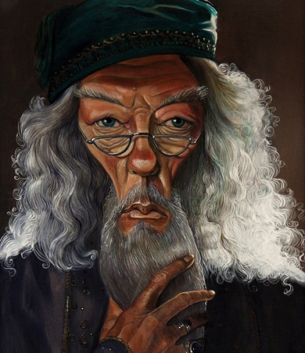
Have a look
Look at the following sentences.
1. If you could have three of these paintings on the walls of your classroom, which would you choose?
2. Have you ever wished you could paint as well as a professional artist?

Slide 3
3. If you were an artist, what kind of pictures would you paint?
4. What would you rather do — paint pictures, make sculptures, or design buildings? Why?
5. If the rules of perspective had not been discovered, no one would have been able to paint such realistic pictures.

Slide 4
6. Without the new paints and the new technique, we would not be able to see the many great masterpieces for which this period is famous.
7…, but without the Impressionists, many of these painting styles might not exist.
These are the sentences that use subjunctive mood from the text.

Slide 5
Subjunctive Mood
语气(mood)是用来表示谈话人的态度和看法的动词形式。
英语有三种语气:
①陈述语气(同陈述句)
②祈使语气(同祈使句)
③虚拟语气
虚拟语气不表示一个事实，而是表示一种假设情况(愿望<wish …>，建议<suggest …>，假设<if …>)。

Slide 6

虚拟语气用于条件状语从句
1 表示与现在事实相反的假设
条件状语从句用“一般过去式(be一般用
were)”，而主句谓语动词由
“would/should/could/might + 动词原
形”构成。
If I were a boy, I would join the army.

Slide 7

If条件句
虚拟情况 | 从句 | 主句
与现在事实相反
与过去事实相反
与将来事实相反
过去式(be的形式用were)
would / should / could / might +do
would / should / could / might + have done
had+过去分词
过去式/ should+
do/ were to do
would / should / could / might +do

Slide 8

虚拟语气中wish的用法
I wish I were a bird.
I wish I had been here last night.
I wish I could be of more use in the future.
现在：
过去：
将来：
did（were）
wish
had done
would (could) do
as if/ as though/ if only的用法与wish 一样。

