Slide 1

Unit 5
Traveling Abroad

Slide 2
If you could go anywhere in the world,
which country would you like to visit?
Why?

Slide 3



The United States (New York)

Slide 4


美国大峡谷 The Grand Canyon

Slide 5

Australia (Sydney Opera House )

Slide 6


The United Kingdom
Big Ben
Stonehenge

Slide 7


London

Slide 8




新西兰

Slide 9

Canada

Slide 10

Imagination:
If you are offered a chance to study abroad for a year, where would you like to go?

Slide 11



Pre-reading
Do you want to go abroad for a further study?
Oxford University

Slide 12


Cambridge University

Slide 13


Harvard University

Slide 14


麻省理工学院
Massachusetts Institute of Technology
世界理工大学之最

Slide 15


斯坦福大学 Stanford University

Slide 16


总统的摇篮
耶鲁大学 Yale University

Slide 17

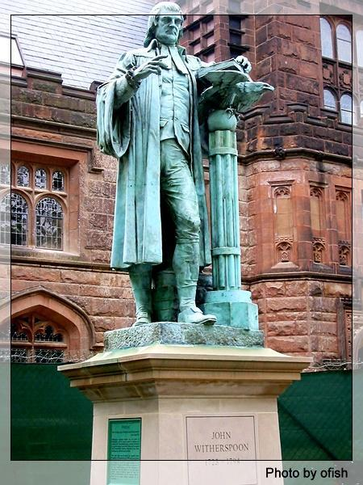
美国政治家的摇篮 33位诺贝尔奖得主
普林斯顿大学 Princeton University

Slide 18
Discussion:
What are the advantages and
disadvantages of studying abroad?

Slide 19
Advantages:
a. It’s fun to live in a new country.
b. It will help us to be independent.
c. easier to learn a foreign language;
d. easier to learn advanced knowledge and technology;

Slide 20
e. learn a lot about local customs and broaden our mind;
f. relax and get rid of anxiety;
g. People who leaves their native countries have many new experiences.

Slide 21
Disadvantages:
a: At first it is difficult to communicate with others;
b: cost a lot of money;
c: it may be tiring to live in a new country;
d: if a child studies alone in a new country,
he/she must look after himself/herself.

Slide 22
Reading
Keep it up, Xie Lei

Slide 23
I. Choose the best answer..
1. Why does Xie Lei have such a decision that she would
like boarding while studying in England?
A. She feels lonely while staying in a foreign country.
B. She is afraid to get used to a new life in a new country.
C. She can make good preparations for her courses.
D. She can have opportunities to learn more about life
and customs in a new country.
2.What dose the passage mainly tell us?
A. Idioms are not so difficult to understand.
B. Foreign students like Xie Lei need one year to prepare for their majors.
C. Chinese student Xie Lei adjusts to a whole new way of life and makes
progress in study.
D. Chinese student Xie Lei fits in well with her host family.

Slide 24
Comprehending
Exercise 1
Answer these questions about the text.
What is Xie Lei in England for? How long
has she been in England?
She is in England to study at a university.
She’s been in England for six months.

Slide 25
2. Why is she doing a preparation course first?
Because studying in England is different
from studying in China and she needs to
learn about these differences and improve
her English.

Slide 26
3. Why did Xie Lei feel like a child when she
first arrived in England?
Because she has to learn how to do everyday
things like using a telephone, paying on a bus,
finding her way around a strange city;
understanding English as spoken in real life;
learning how to write essays acceptable to her
British lecturer.

Slide 27
4. Which two types of people have helped
Xie Lei most since she came to England?
The host family and her teachers.
5. Why has Xie Lei decided to join a few clubs?
Because she thinks it’s important to have a balance between study and a social life, and she wants to make new friends.

Slide 28
Exercise 2
2 Read the passage again, and
fill in the diagram below.

Slide 29
of doing a preparation course
to learn how to fulfill Western academic
requirements.
to get used to a new way of life and
improve her English.
of living with a host family
to learn more about everyday life and customs.
to have people to explain things not understood
Benefits
of having a tutor
1. to explain about why you cannot use other people’s work without acknowledging it.
2. to encourage you to express your own ideas with reasons.

Slide 30
at the university
1. learning to read widely and analyze the texts.
2. expressing one’s own opinion with reasons.
Difficulties
of a new way of life
finding a balance between study and a social life
making new friends.

Slide 31
Expressions
1.apply for
2. get used to
3.take up
4. bus fare
5.get lost
6.ask a passer-by for directions
7.board with
8.refer to
9. feel at home
10.all the best
申请
习惯于
占据
公共汽车费
迷路
想过路人问路
寄宿
提及，参考
感觉自在
一切顺利

