Slide 1
Unit 5 Travelling abroad——境外游

Slide 2
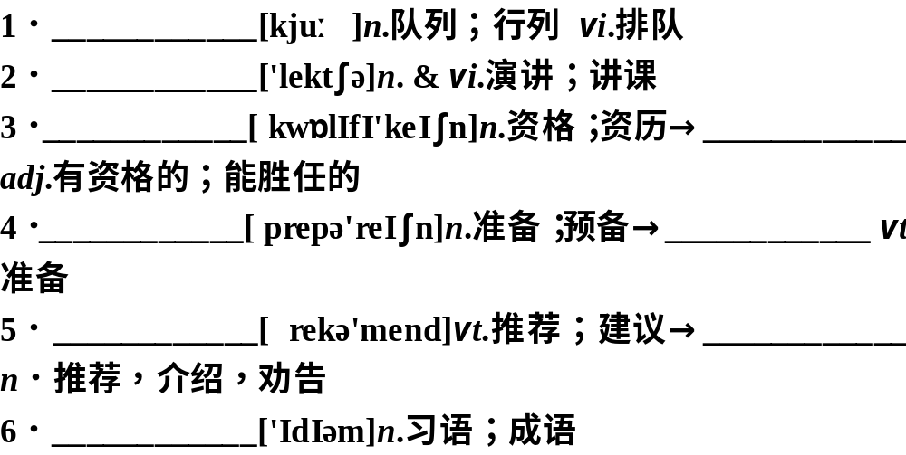
基础盘点自测自评
词汇与派生
queue
lecture
qualification
'
qualified
preparation
prepare
'
recommend
'
recommendation
idiom

Slide 3
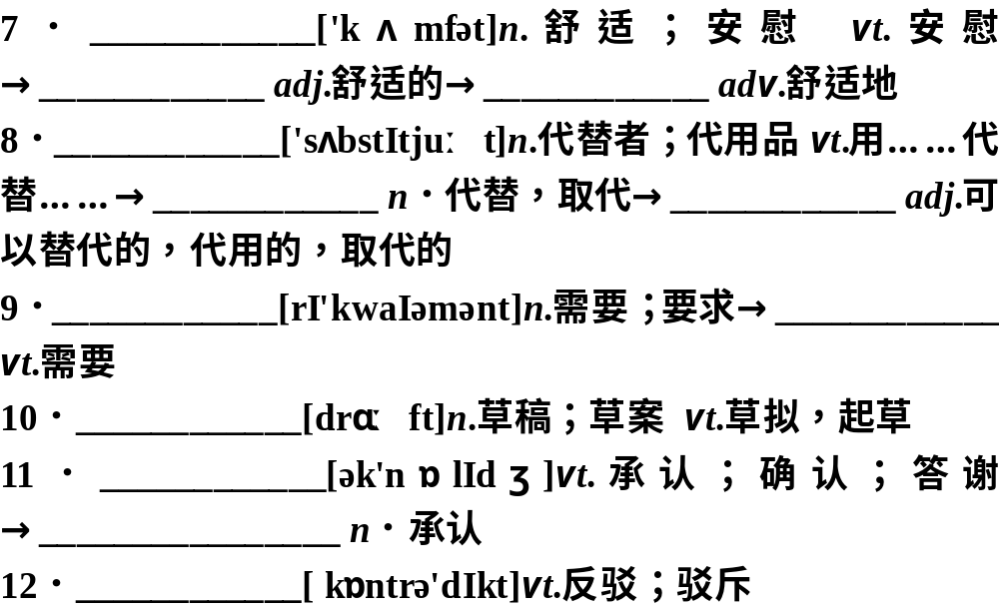
comfort
comfortable
comfortably
substitute
substitution
substitutive
requirement
require
draft
acknowledge
acknowledgement
contradict
'

Slide 4
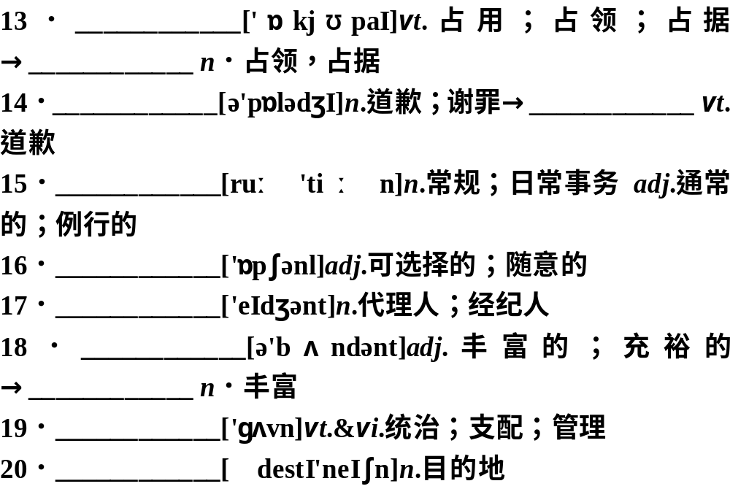
occupy
occupation
apology
apologize
routine
optional
agent
abundant
abundance
govern
destination
'

Slide 5
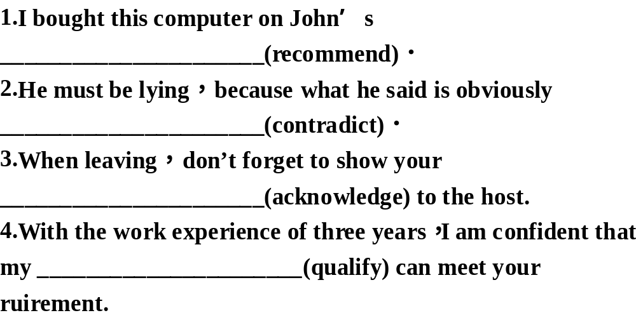
词形变换
recommendation
contradictory
acknowledgement
qualification

Slide 6
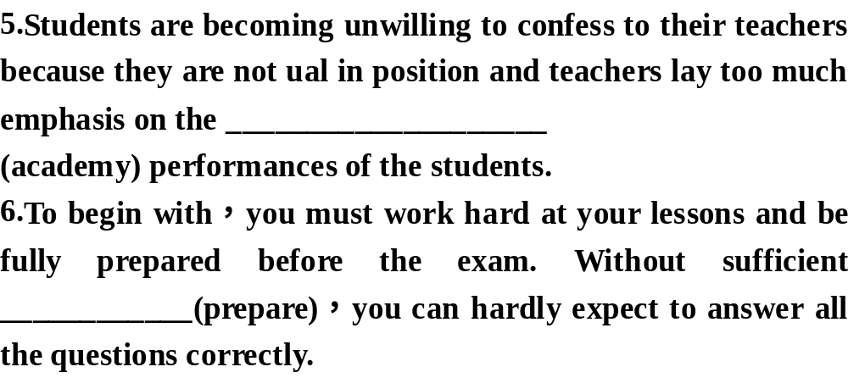
academic
preparation

Slide 7
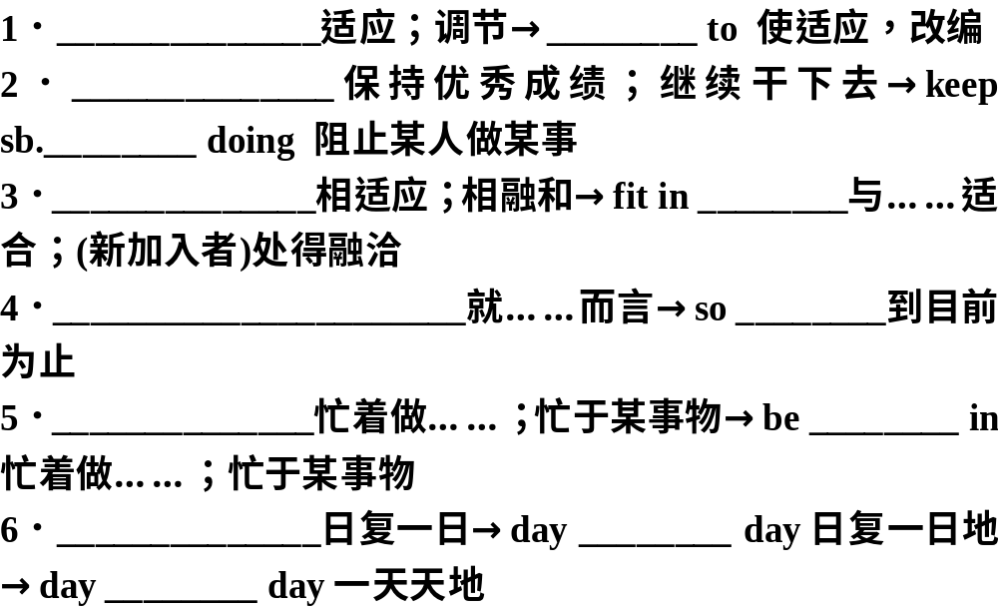
短语与拓展
adjust to
adapt
keep it up
from
fit in
with
as far as one is concerned
far
be occupied with
employed
day in and day out
after
by

Slide 8
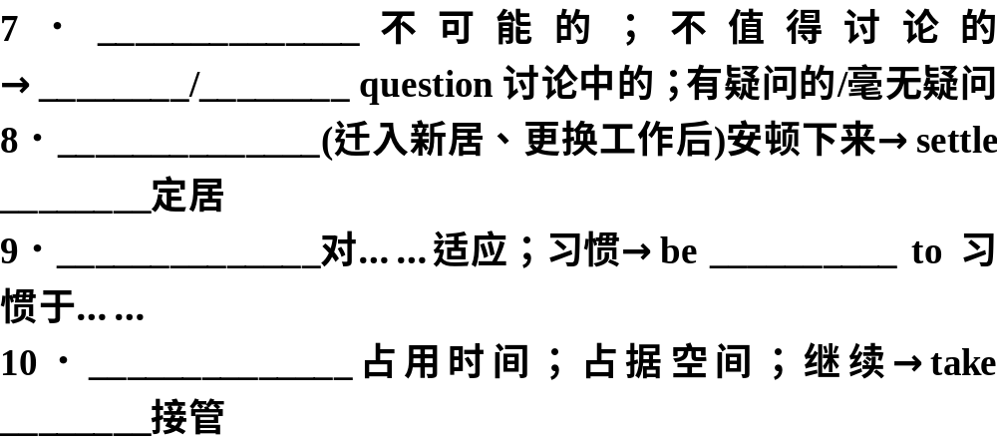
out of the question
in
out of
settle in
down
get/be used to
accustomed
take up
over

Slide 9
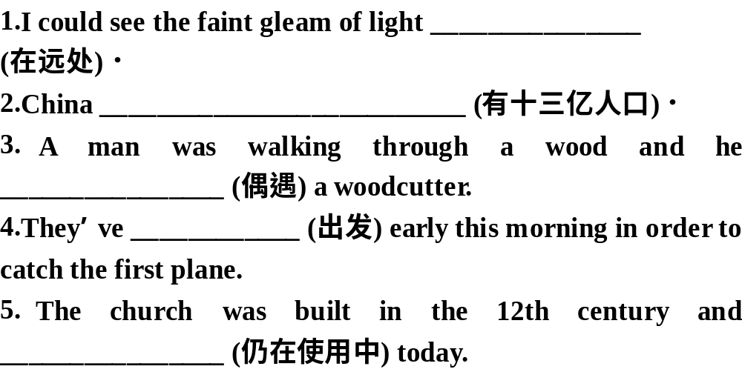
短语运用
in the distance
has a population of 1.3 billion
came across
set off
is still in use

Slide 10
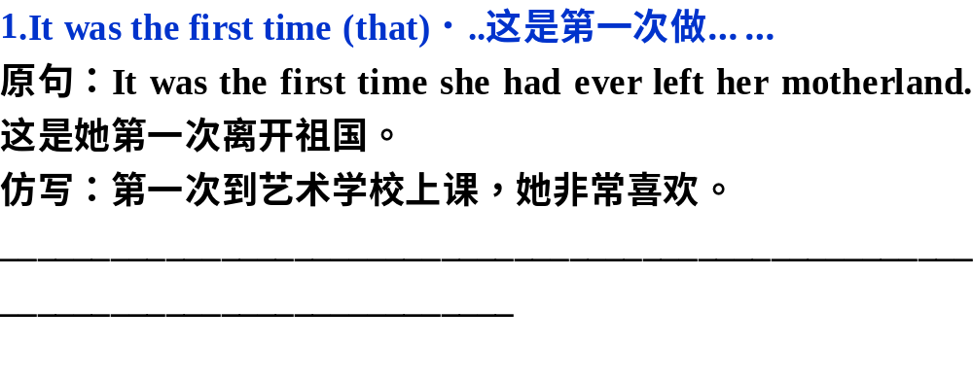
句式与仿写
It was the first time that she had been at an art school and she thoroughly enjoyed it.

Slide 11
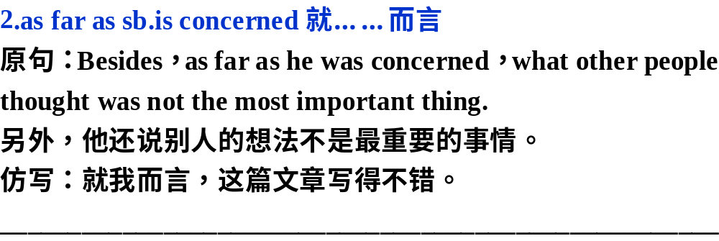
As far as I am concerned，the essay is all right.

Slide 12
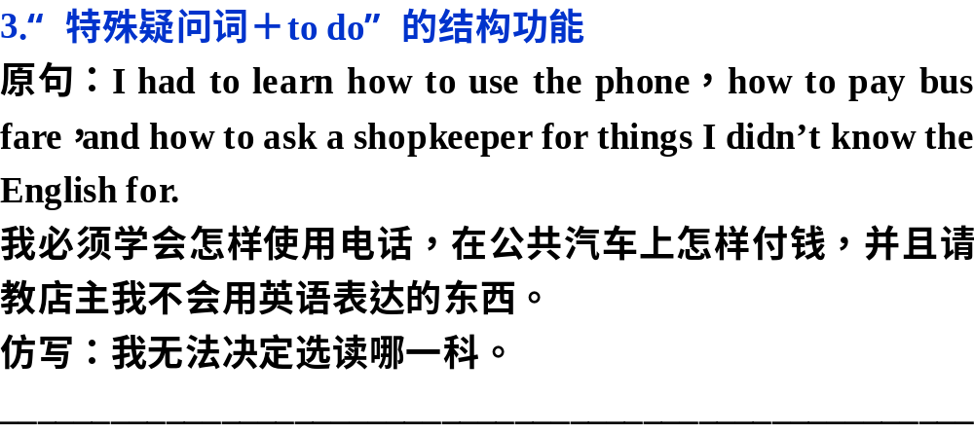
I couldn’t decides which subject to choose.

Slide 13
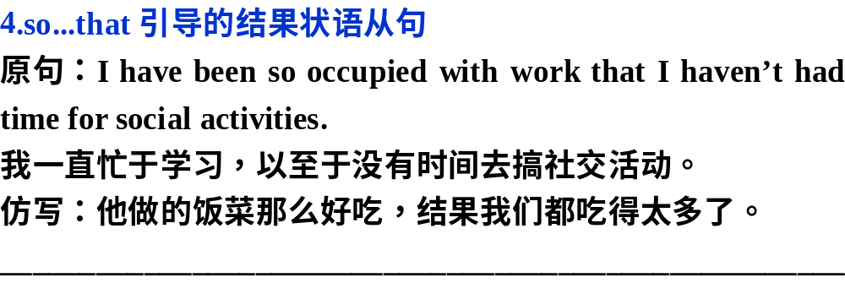
He made so good a meal that we ate far too much.

Slide 14
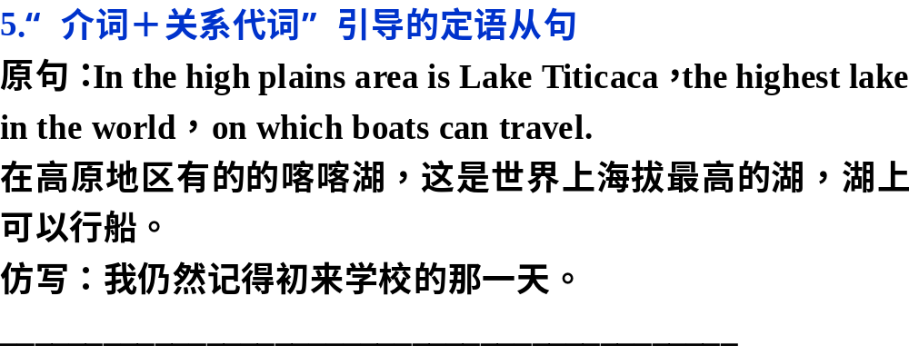
I still remember the day on which I first came to school.

Slide 15
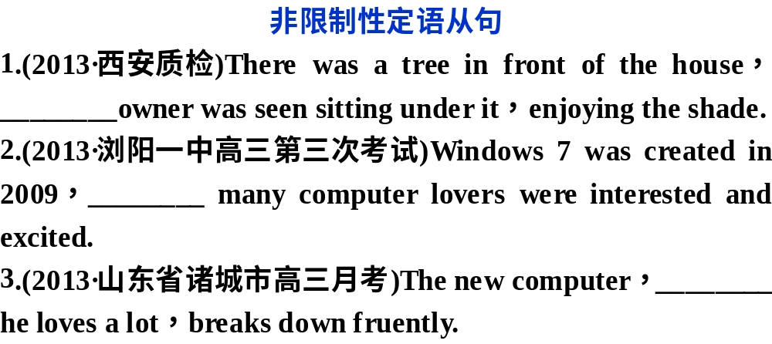
单元语法
whose
when
which

Slide 16
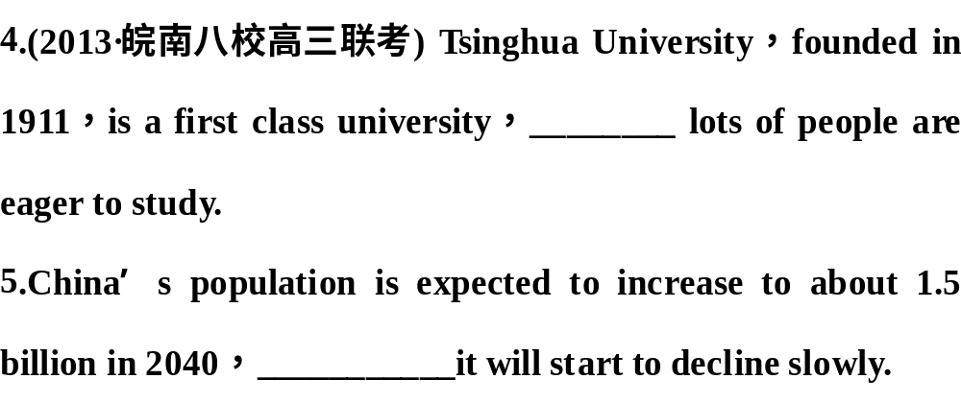
where
after which

Slide 17
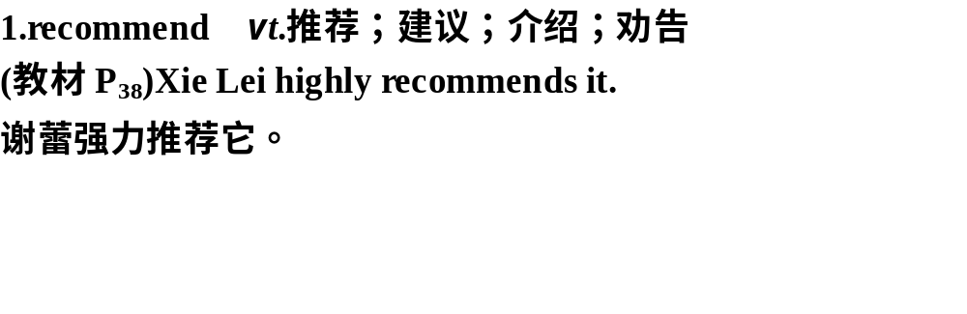
考点串讲讲练互动
单词精研

Slide 18
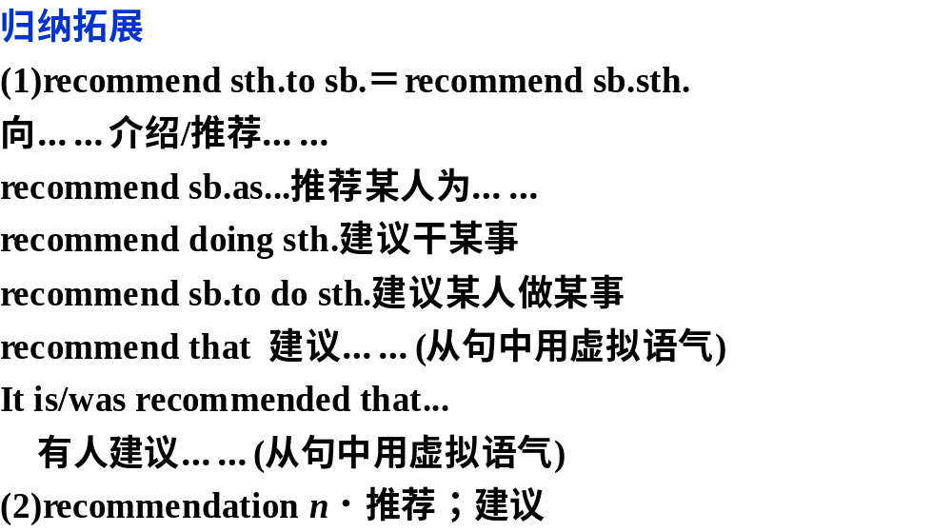

Slide 19
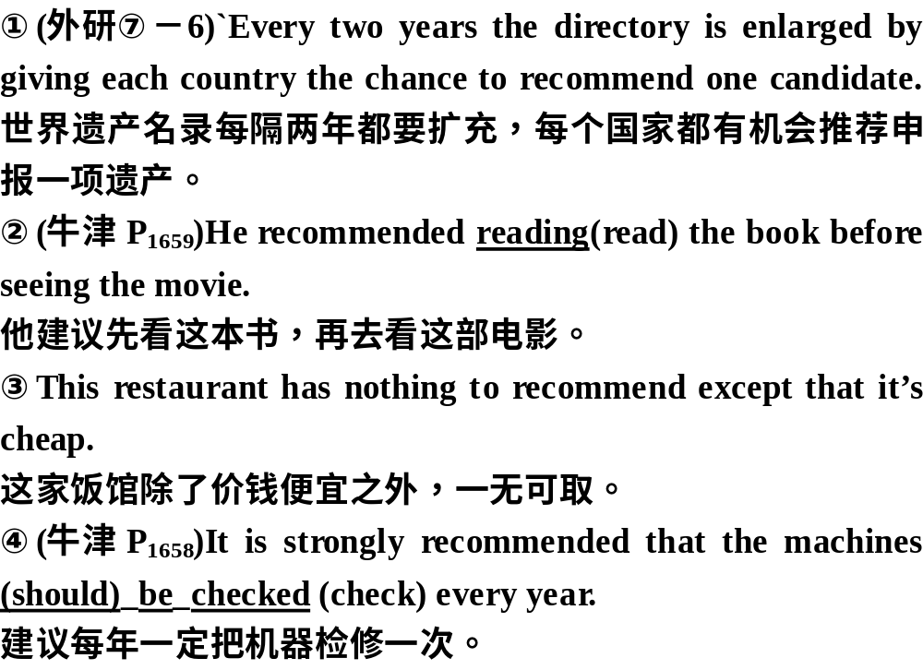

Slide 20
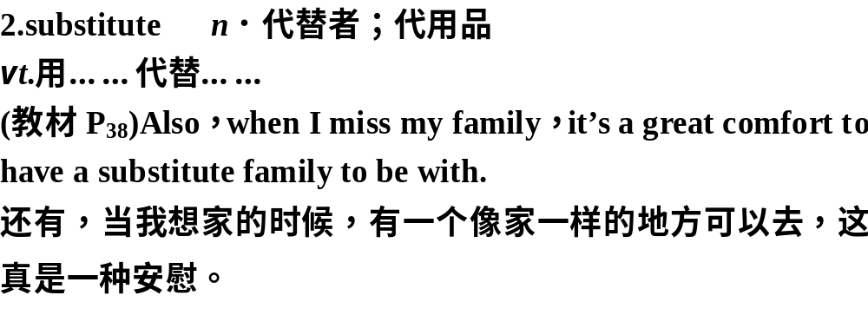
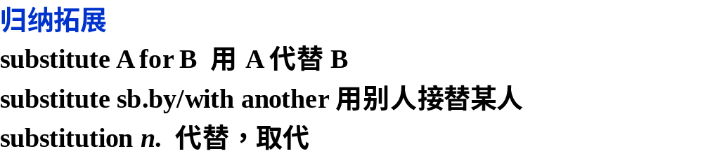

Slide 21
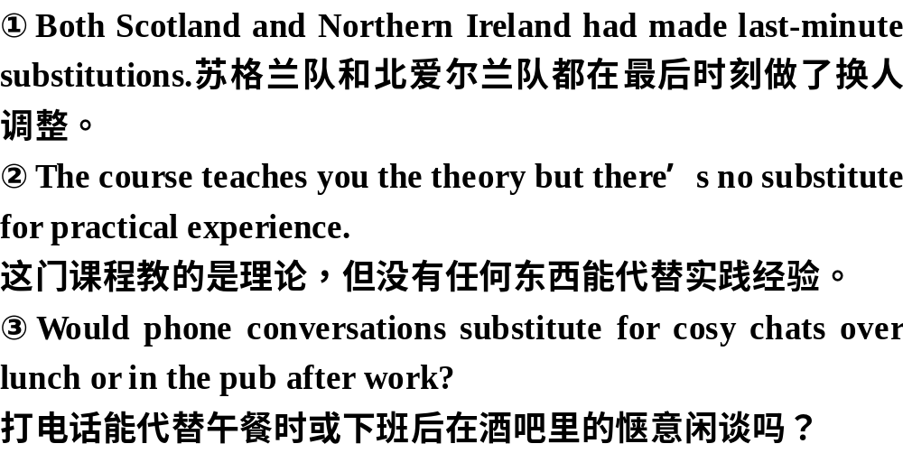

Slide 22
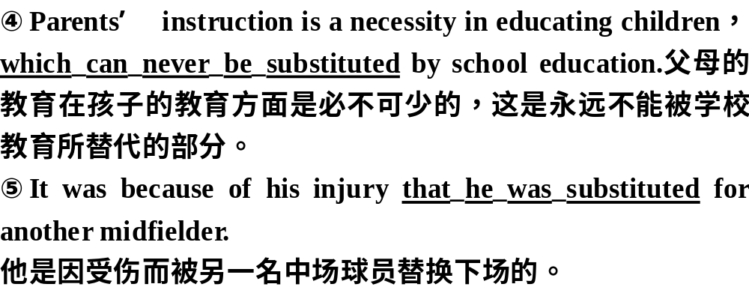

Slide 23
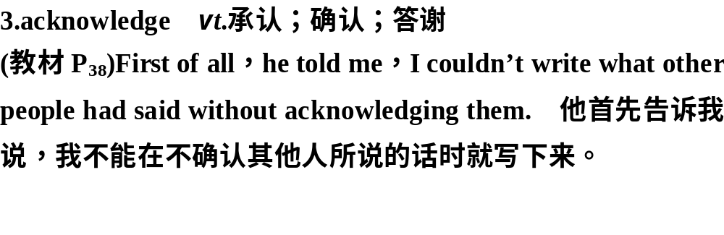
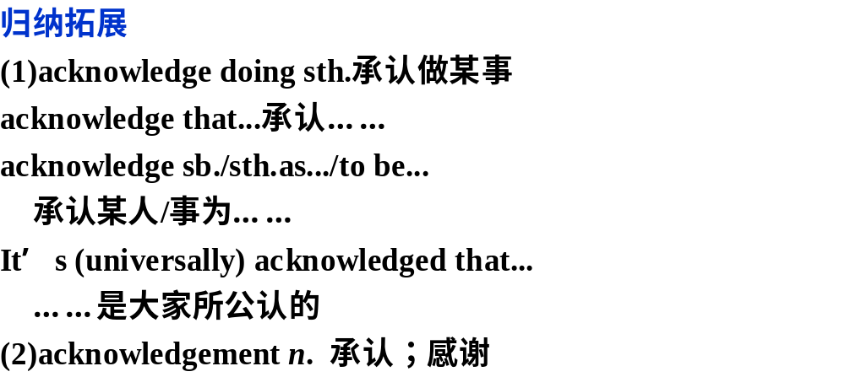

Slide 24
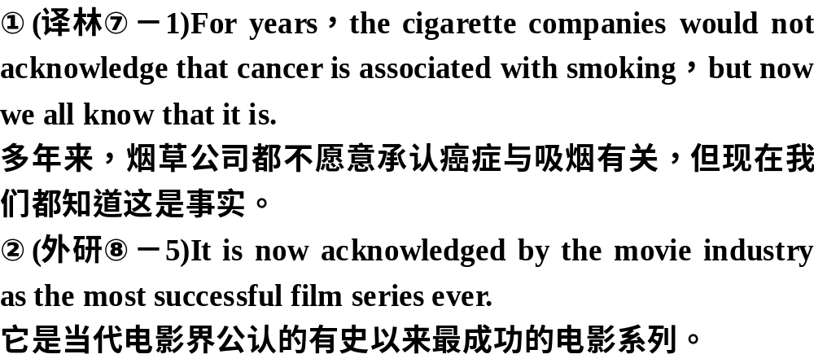

Slide 25
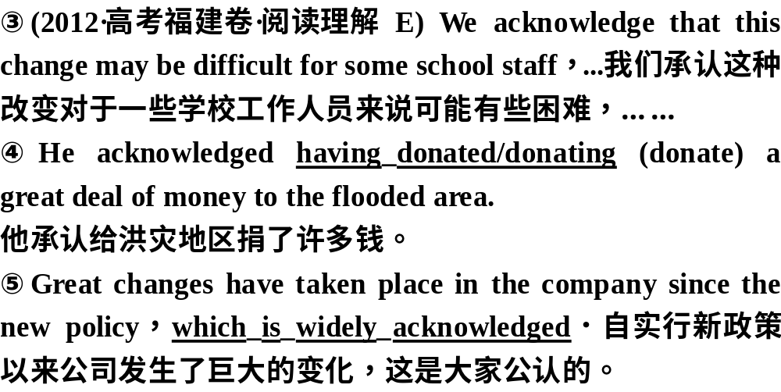

Slide 26
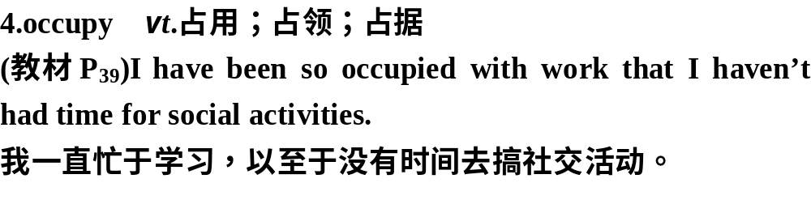

Slide 27
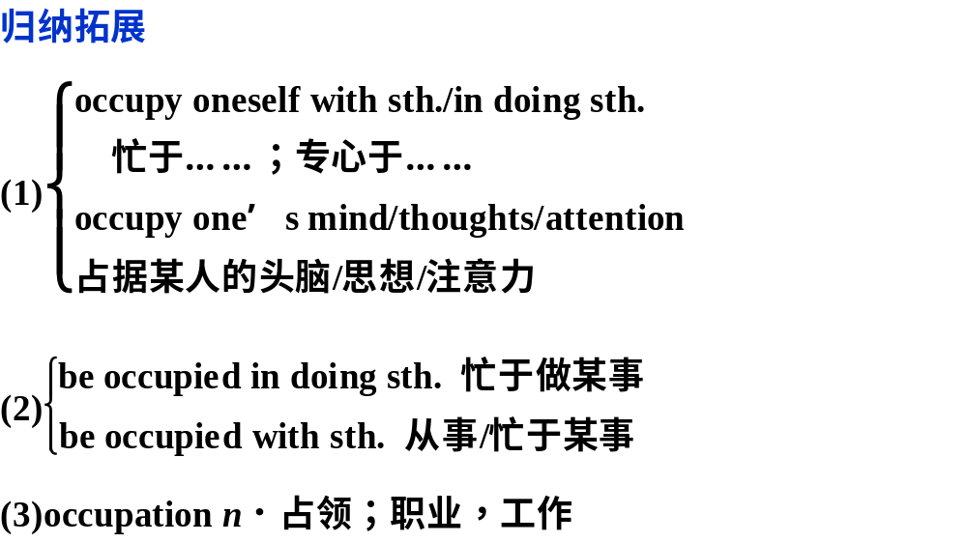

Slide 28
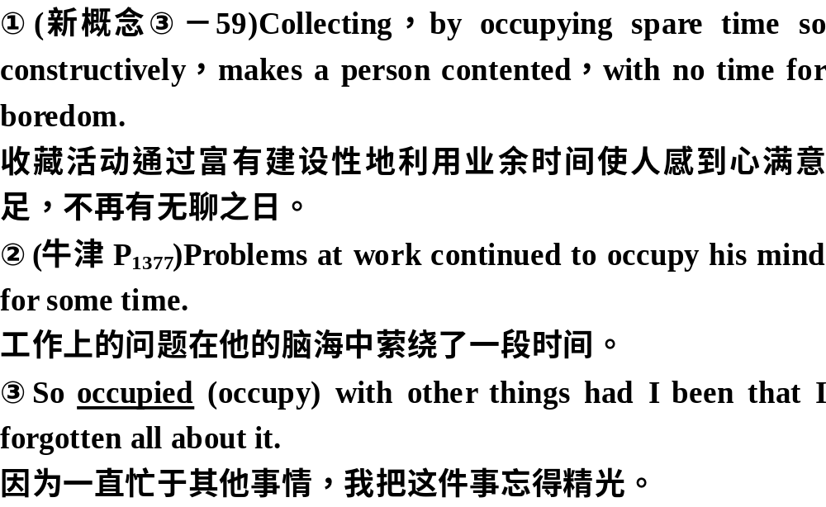

Slide 29
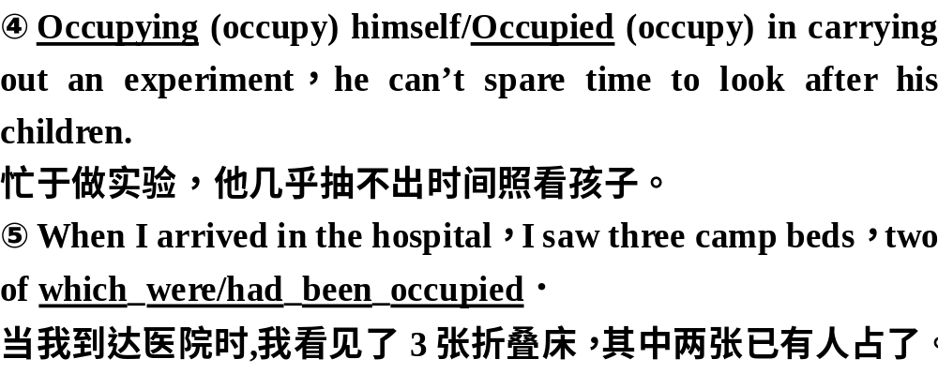

Slide 30
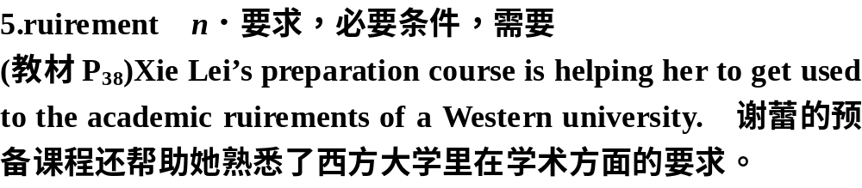
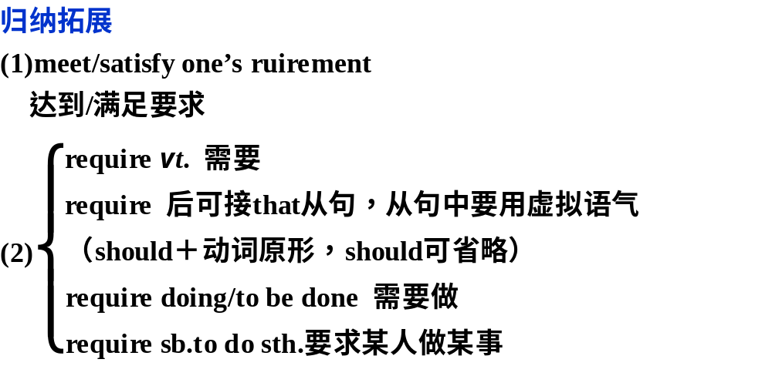

Slide 31
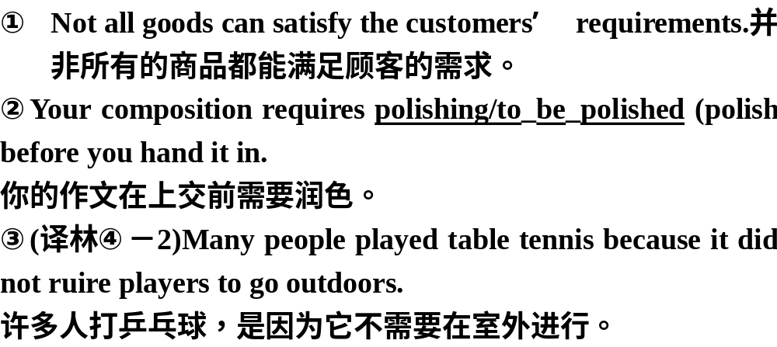

Slide 32
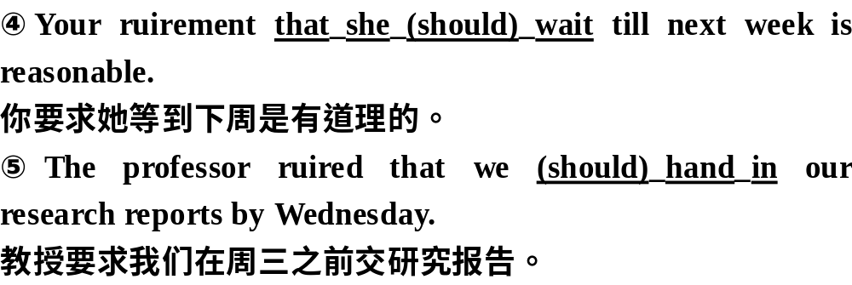

Slide 33
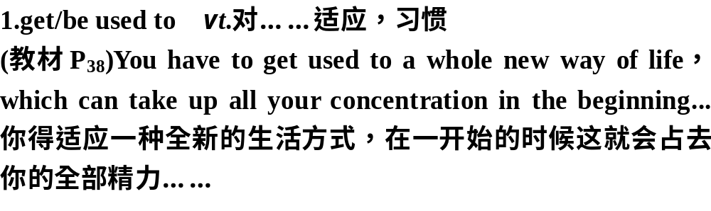
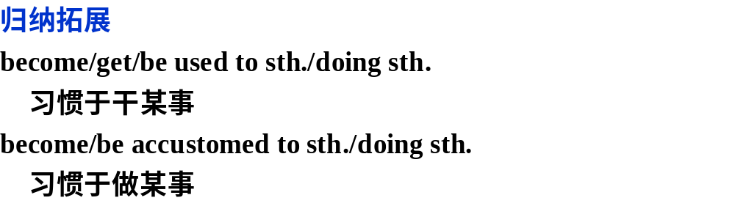
短语精释

Slide 34
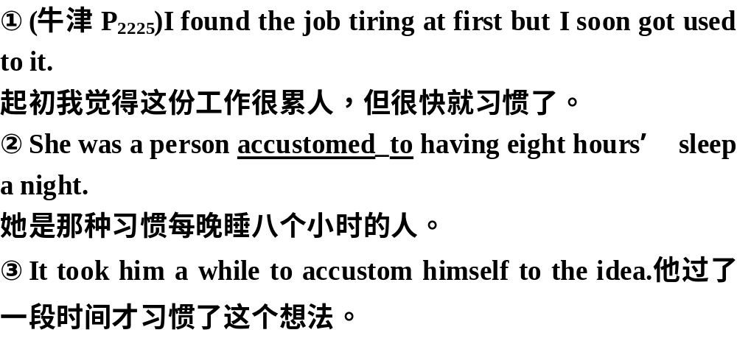

Slide 35
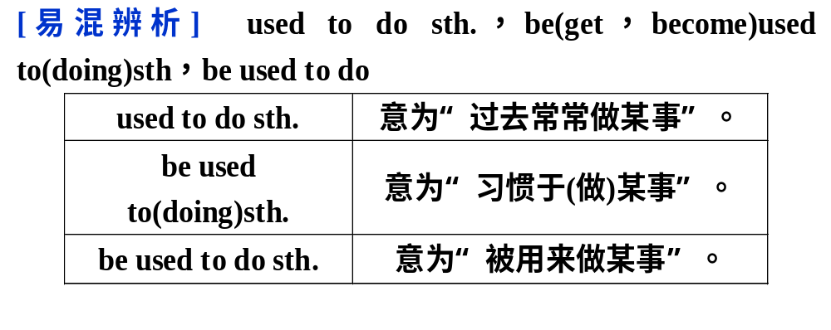

Slide 36
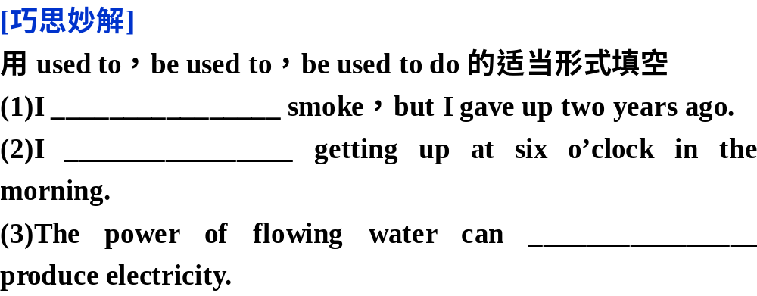
used to
am used to
be used to

Slide 37
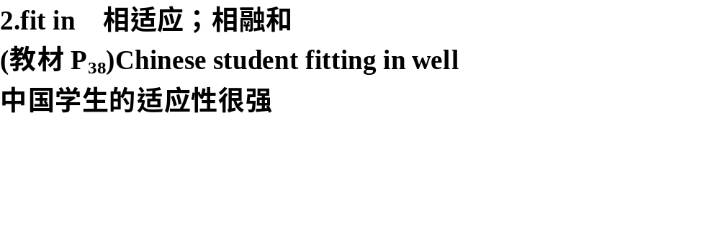
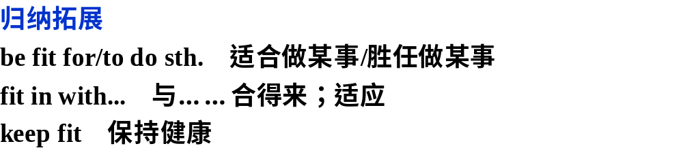

Slide 38
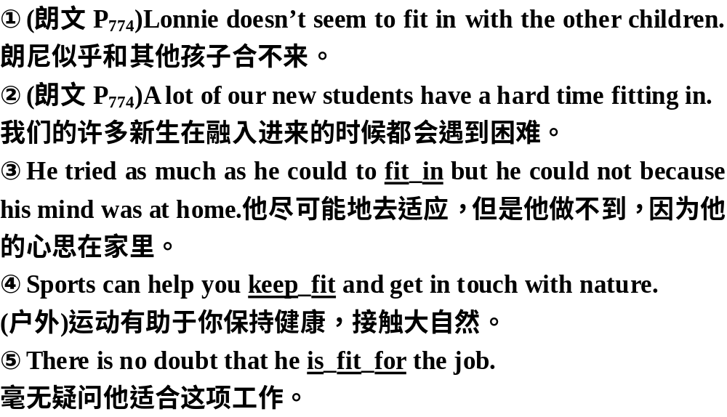

Slide 39
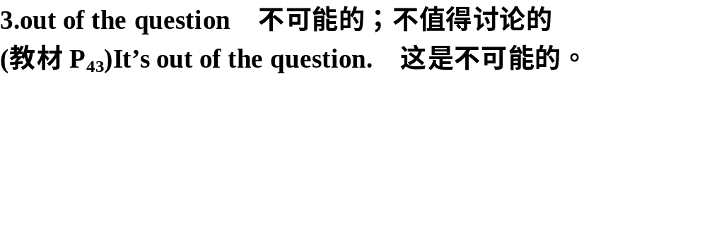
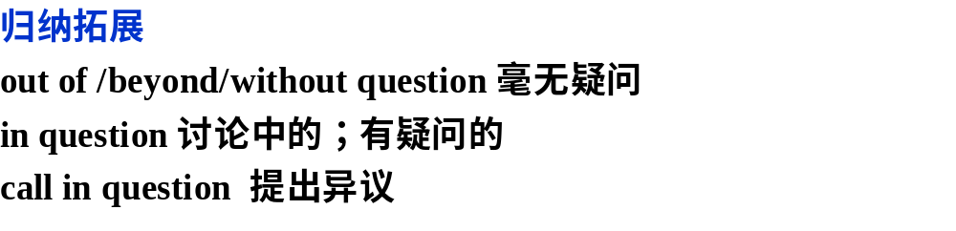

Slide 40
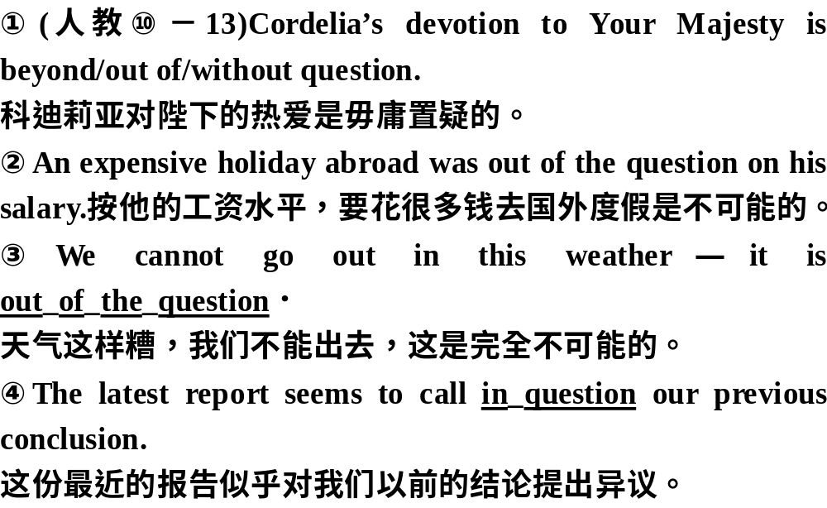

Slide 41

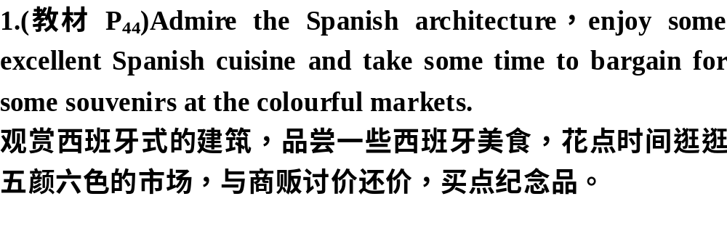

Slide 42
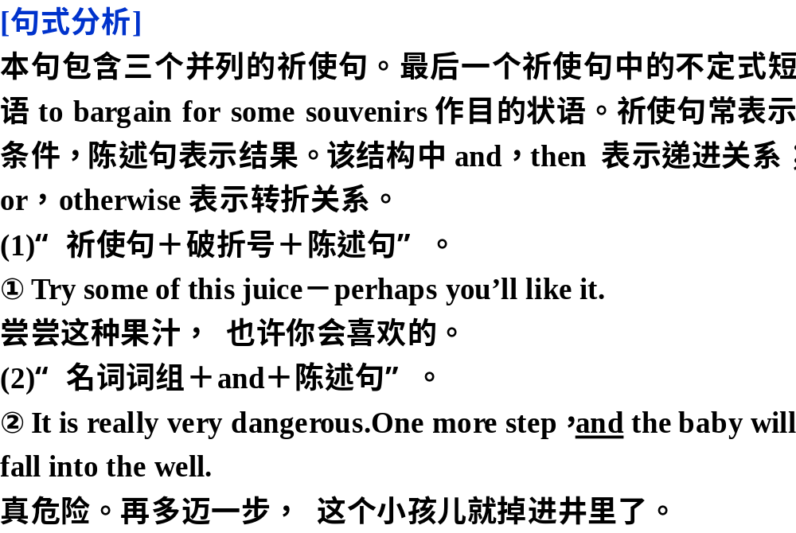

Slide 43
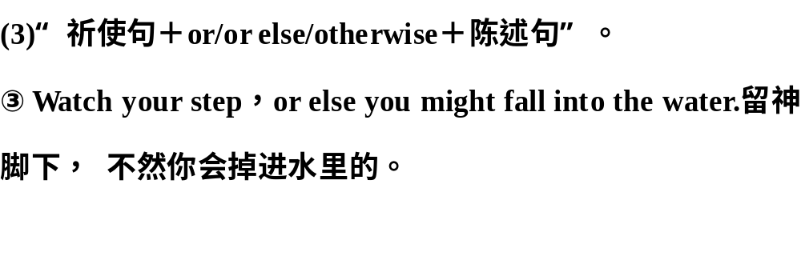

Slide 44
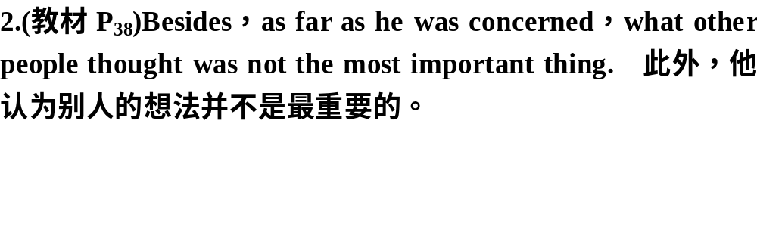

Slide 45
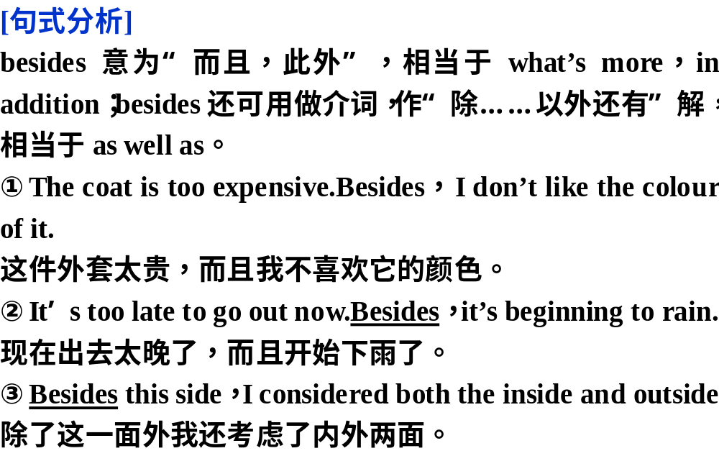

Slide 46

专题语法导练
专题语法导练（七）形容词和副词

Slide 47


Slide 48


Slide 49


Slide 50


Slide 51


Slide 52


