Slide 1
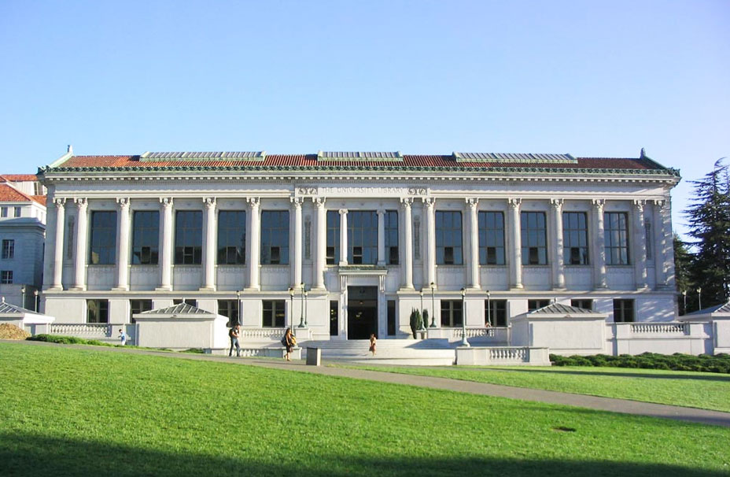

Unit 1 A land of diversity

Slide 2

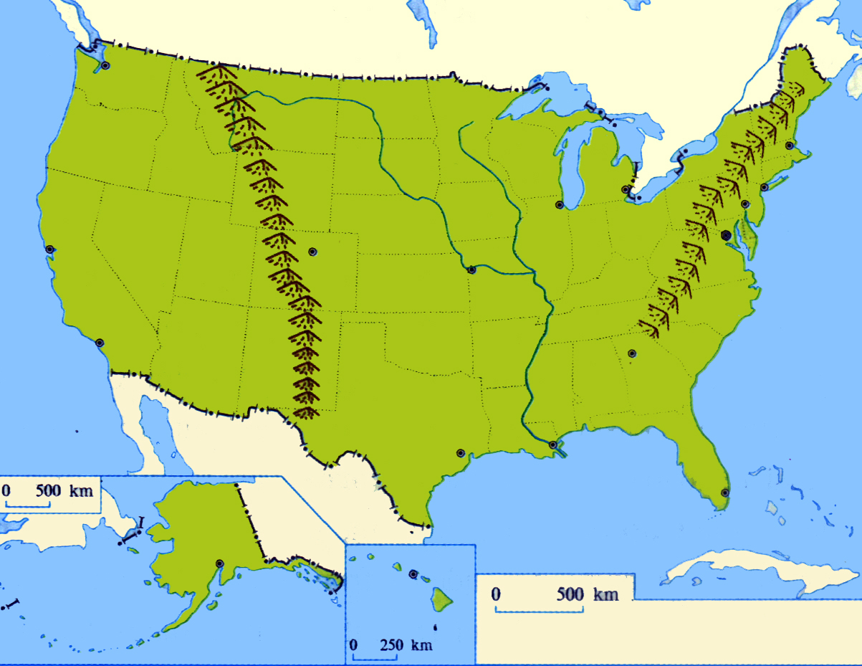
Canada
Boston
New York
Chicago
San Francisco
Washington, D.C
Rocky Mountains
the Mississippi
Los Angeles
Atlantic Ocean
Pacific Ocean
Mexico
Houston
It has an area of 411.ooo square kilometers. And it is one of the American states of the largest population, with the most developed economy.

Slide 3

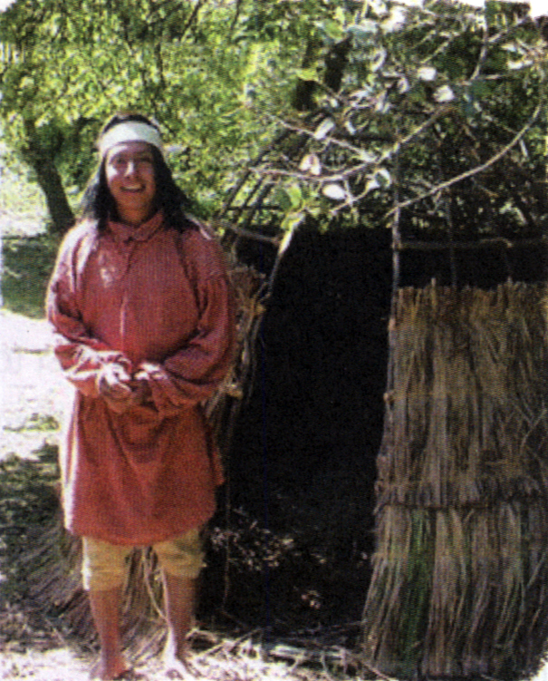


Careful-reading
Native American Indian—one of the first people to live in California.

Slide 4
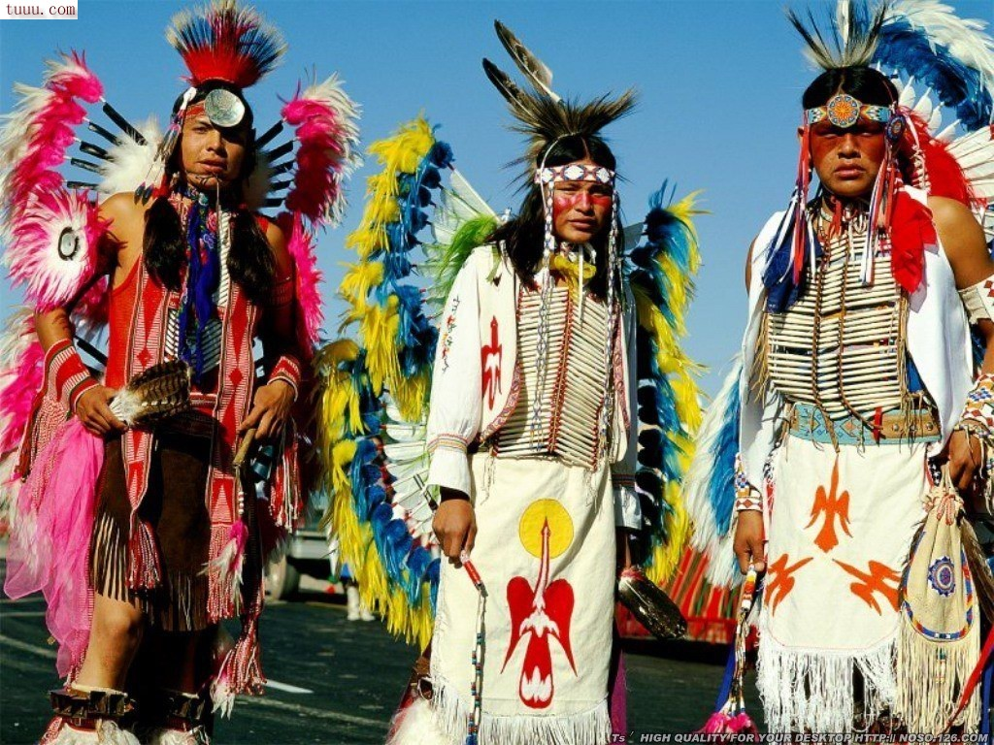
Native Americans

Slide 5
Native Americans
1.Time:
2.Where did they come from:
3.What happened in the sixteenth century?
suffered greatly
15000 years ago
crossed the Bering
Strait in the Arctic
to America
were killed by European
Native Americans
were forced into slavery
died from the disease
survived the terrible times

Slide 6
The Spanish
Fill in the form: (note down an important event)
16th century 18th century in 1821
in 1846
Spain soldiers arrived
and took their land
California was ruled
by Spain
California became part
of Mexico
Mexico gave California
to the USA

Slide 7

What is the influence?
Today over 40% of Californians speak Spanish as a first or second language.

Slide 8

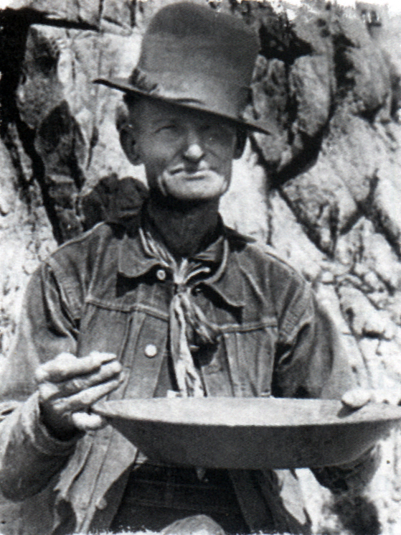
He was a gold miner.He looked not only thin and weak, but also thirsty and tired. The discovery of gold in California created a gold rush which brought people from all over the world to California.

Slide 9
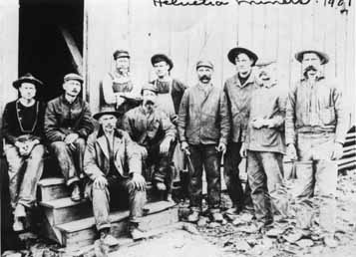
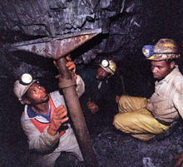

Slide 10
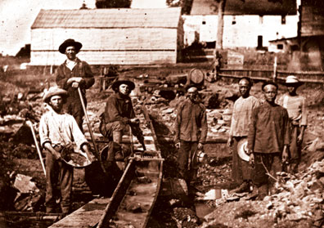

Slide 11
When and why did the large number of Chinese immigrate to California?
In the 1860s,a large number of Chinese went there to build the railway from the west to east coast During the Gold Rush Period, many Chinese immigrated to California to achieve their dream of becoming rich.

Slide 12
What was the result about Chinese immigrants during the Gold Rush period?
1. In the past, few achieved their dream of becoming rich. Some died or returned home, but most remained in California to make a life for themselves despite great hardship. They settled in the new town or on farms.
2. Today, Chinese-Americans live in all parts of California, although a large percentage have chosen to stay in the “Chinatowns” of Los Angeles and San Francisco.

Slide 13
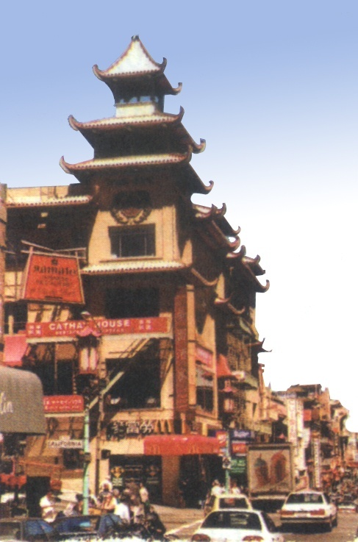
A building in Chinatown, San Francisco—Many Chinese have settled in California and many of them live in Chinatown in San Francisco.

Slide 14
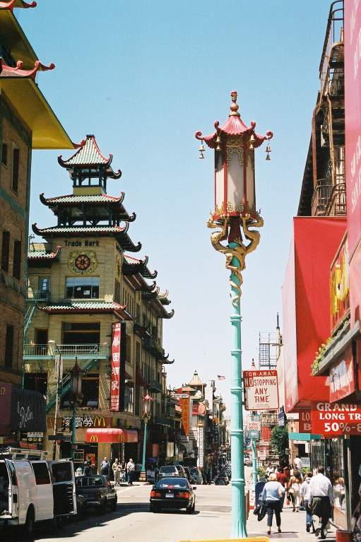
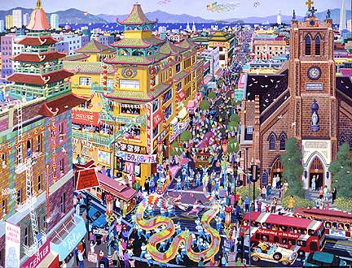
Chinatowns in California

Slide 15

Stage | People | Time | Event
Later arrivals | Africans | 1800s
 | Chinese | 1860s
 | Japanese | At the beginning of 20th century
 | Denmark | 1911
 | Jewish | By 1920s
 | Italians | Late 1900s
 | Africans | 1942~ 1945
Moved from Mexico
Built the railway
Farmed
Established a town
Developed industry
Fished and made wine
Worked in ship&
aircraft industry

Slide 16
Stage | People | Time | Event
Recent arrivals | Indians, Pakistanis |  | Worked in Computer industry
 | Cambodians Koreans Vietnamese Laotians |  | Immigrated
Future | Different parts | Future | Immigrated
1970s
Recent
decades

Slide 17
破解长难句并背诵
It also has the distinction of being
the most multicultural State in the
USA, having attracted people from
all over the world.
现在分词作原因状语
加州与众不同之处在于它也是美国最具多元文化特征的一个州，它吸引了来自世界各地的人们

Slide 18
2. Exactly when the first people arrived
in what we now know as California,
no one really knows.
宾语从句
最早一批人具体是在什么时候来到我们现在了解的加利福尼亚地区的，谁也说不清楚

Slide 19
3. Although Chinese immigrants began to
arrive during the Gold Rush Period, it was
the building of the rail network from the
west coast that brought even larger
numbers to California in the 1860s.
强调句
虽然中国移民在淘金热时期开始来到美国，但是更大批量的中国移民却是在19世纪60年代为了修建贯穿美国东西海岸的铁路而来。

Slide 20

Discussion
1. Why is California in the 21st century such a multicultural state ?
2. If you have a chance to go to the USA, would you like to visit California? Why?

Slide 21
1.If you have a chance to go to the USA,
would you like to visit California? Why?
1)California is a multicultural state, so you
can experience different cultures.
2) There are many Chinese-Americans,
and you will get along well with them.
3) There are many places of interest.
4) It is the centre of finance.
5) The good climate and lifestyle attract me.

Slide 22
2.Why is California in the 21st century such a multicultural ?
Because European, African and Asian people
have been immigrating to the state for the last
200 years. Before their arrival, Native American
people from all over the world are still coming
to settle in California because of its good
climate and the lifestyle it offers.

