Slide 1
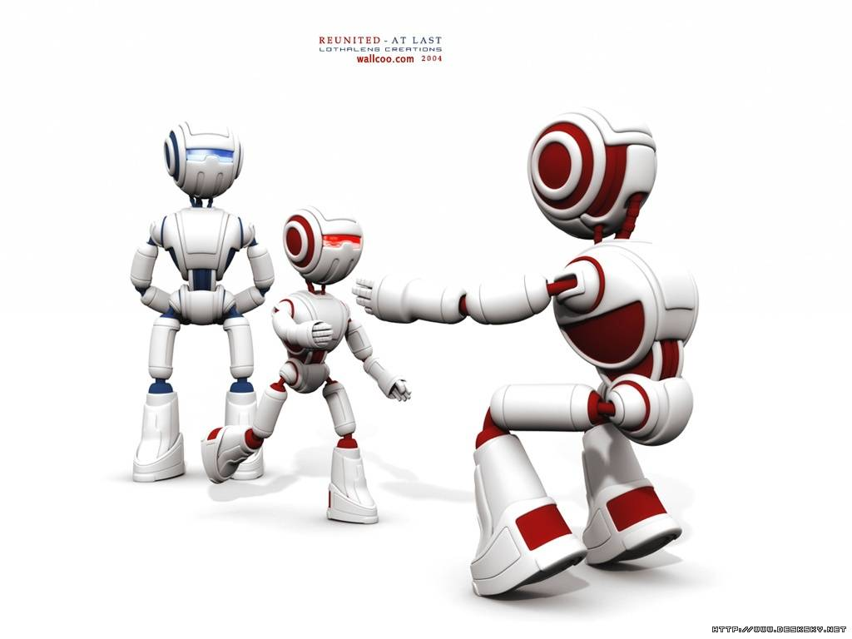

Unit 2 Robots

Slide 2


Reading
Satisfaction Guaranteed
包君满意
Writer: Isaac Asimov

Slide 3


Comprehending
1. Read the story, then fill in the occasions when Claire had these feelings.
Occasion | Claire…
1 | disliked him
2 When he arrived | was alarmed
3 | felt embarrassed
Before he arrived
When he offered to help her dress

Slide 4
4 | admired him
5 | Called him a dear
6 | Felt his warmth
When he offered to help her improve her house and herself
When he helped her with the salesman
When she fell off a ladder and caught by Tony

Slide 5
When she heard Gladys whispering to another woman that she had never seen anyone so handsome as Tony
7 | Felt being envied
8 | Cried all night
She remembered Tony was just a machine

Slide 6

4 List Tony’s characteristics that were similar to those of a human being and different from those of a human being.
Characteristics | Similar | Different
Physical
Tall, handsome, black hair, deep voice
Facial expressions never changed

Slide 7
Clever enough to solve all kinds of problems
Mental
Cannot think for itself

Slide 8


unit 2 robots
Language points

Slide 9

P1-2
Larry Belmont worked for a company that made robots. Recently it had begun experimenting with a household robot. It was going to be tested out by Larry's wife, Claire.
Claire didn't want the robot in her house, especially as her husband would be absent for three weeks, but Larry persuaded her that the robot wouldn't harm her or allow her to be harmed. It would be a bonus. However, when she first saw the robot, she felt alarmed. His name was Tony and he seemed more like a human than a machine. He was tall and handsome with smooth hair and a deep voice although his facial expression never changed.

Slide 10
为...工作
开始做某事
对..试验
一个家用机器人
进行试验
尤其
缺席离开
说服某人
伤害 某人.
允许某人做某事
感到吃惊
面部表情
work for
begin doing
experiment with
a household robot.
test... out
especially
be absent
persuade sb. that
harm sb.
allow sb.to do
feel alarmed
facial expression
1.he seemed more like a human than a machine
more...than...与其说……倒不如说……
She is more my friend than my teacher.
The boy is more lazy than stupid.

Slide 11

more than多于；超过；不仅仅
not more than不超过
no more than仅仅＝only
Mr.Zhang is more than our teacher and he is our friend.
Please don't be so angry. After all，she is no more than a child.
请不要如此生气，毕竟她还只是一个孩子。
1)The young lady is ____ a beauty; she is ______ than pretty.
A. more than; more smart B.more than; smarter
C. not only; smarter D.no more than; more clever
2)Ann acts quite unfriendly.I think she is ____ than unfriendly.
A. shyer B.shier C.more shy rather D.more shy

Slide 12
1. desire v.
desire to do sth.
1) 渴望;希望(做某事):__________________
desire sth.
2) 要求某事__________________
desire sb. to do sth.
3)要求(请求)某人做某事___________________
4)desire that…do/should do;
Exercise
我请您立即回信。
I desire ____________________ of yours.
我们希望有个好结果。
_____________________________
去请他进来。__________________________
an immediate answer
We desire to have a good result.
Please desire him to come in.

Slide 13
他们要求你马上回来。
They desire ______________________________.
that you should come at once
desire n. (1) 愿望; 欲望 (2) 要求
(3) 食欲 (4) 向往的东西
他有强烈的求知欲。
He has ____________________________________.
a strong desire for knowledge / to learn
meet one’s desire
have\feel a great desire for
at one’s desire
满足某人的欲望
强烈渴望得到
照某人希望

Slide 14
2. satisfaction n. ( opp. dissatisfaction)
1) 满足; 满意; 舒服 (at; with) 2)令人满意的事物
with satisfaction
满意地_______________
令某人满意的是_________________________________
to sb’s satisfaction/ to the satisfaction of sb.
express one’s satisfaction at/ with
对……表示满意_________________________
我听了这个消息非常满意。
I heard the news ____________________.
with great/ much satisfaction

Slide 15
satisfy vt.
satisfied adj.
satisfying adj.
satisfactory adj.
满足; 使满足
满意的; 满足的
令人满意的
令人满意的
1.It’s not easy to satisfy him.
2.I am satisfied with the result of the exam.
The result of the exam is satisfying.
3.It’s a satisfactory excuse for his absence.

Slide 16
4.As she turned around, there stood Gladys Claffern.
There stands...倒装句。
(1)there, here, now, then 等副词放在句首时,句子要完全倒装，
谓语动词常用 come, go, be, lie, run 等。
There goes the bell.
汽车来了
Here comes the bus
Out rushed Jack's wife,crying
Out she rused,crying
*主语如为人称代词，则应放在动词前面
—Look! There ______.
—Oh, there______.
A.comes the bus;comes it B.comes the bus; it comes
C.the bus comes; it comes D.the bus comes; comes it

Slide 17
3. alarm n. 警报; 惊慌; 恐慌
火灾引起很大恐慌。
____________________________
The fire caused much alarm.
give/raise/sound the alarm
take (the) alarm at
a fire alarm
a false alarm
air alarm
water level alarm
发警报; 敲警钟
对……感到吃惊;
火警
虚惊一场
空袭警报
水位警告

Slide 18
alarm vt. 使警觉; 惊动; 使惊慌
不要惊慌 Don’t alarm yourself.
be alarmed at (the news) 被(那消息) 吓了一跳.
be alarmed for (the safety of …)
放心不下; 担心(……的安全)
完成句子:
1) A small boy saw the smoke and
_________________ (发出警报).
2) ________________________ (人人都感到惊恐)
the news that war might break out.
raised the alarm
Everybody was alarmed at

Slide 19
4. smooth adj. 平坦的; 平滑的; 顺利的
路平坦了/困难扫除了。
______________________
vt. 使……光滑, 平坦或顺利
用熨斗把这件衣服熨平。
______________________________
smoothly adv. 平稳地; 顺利地
一切进展顺利。
_________________________
The way is now smooth.
Smooth this dress with a hot iron.
Everything went smoothly.

Slide 20

P3-4
On the second morning Tony, wearing an apron, brought her breakfast and then asked her whether she needed help dressing. She felt embarrassed and quickly told him to go. It was disturbing and frightening that he looked so human.
One day, Claire mentioned that she didn't think she was clever. Tony said that she must feel very unhappy to say that. Claire thought it was ridiculous to be offered sympathy by a robot. But she began to trust him. She told him how she was overweight and this made her feel unhappy. Also she felt her home wasn't elegant enough for someone like Larry who wanted to improve his social position. She wasn't like Gladys Claffern, one of the richest and most powerful women around.

Slide 21
第二天早晨,
感到不好意思
有一天
说起/提起
太胖/超重
提高社会地位
On the second morning
felt embarrassed
one day
mention that...
overweight
improve social position
2.On the second morning Tony, wearing an apron, brought her breakfast and then asked her whether she needed help dressing.
3.It was disturbing and frightening that he looked so human.
句子结构？
It’s amazing that he gave up the job.
It is clear that he will refuse the offer

Slide 22
5. embarrass vt. 使困惑; 使局促不安
销路下降使公司陷于财政困难.
The decline of sales _______________________.
在生人面前局促不安
embarrass sb. with sth./ by doing sth.
做……使某人尴尬/害羞/窘迫
不要问隐私, 会让他们觉得不好意思
Don’t _______________________ (by asking)
personal questions.
embarrassed the company
be/ feel embarrassed in the presence of strangers
embarrass them with

Slide 23
embarrassed adj. 尴尬的, 难堪的, 害羞的
他对我衣服的评论使我很尴尬。
_________________ by his comments about
my clothes.
embarrassing adj. 使人尴尬的; 令人难堪的
你什么时候最尴尬?
What has been your
_____________________________?
I was embarrassed
most embarrassing moment

Slide 24
6. sympathy n. 同情; 同感; 同情心
相关短语：
express sympathy for 慰问
feel sympathy for, have sympathy for 同情
in sympathy with 同情; 赞成; 跟着; 和……一致
out of sympathy for …
have no / some …sympathy with sb /sth
出于对…的同情
不支持 / 支持某人/ 某事

Slide 25
翻译:
我确信她一定赞成你的建议。(in sympathy with)
I’m sure she will be in sympathy with your
proposal.
我不同意他的意见。(have no sympathy with)
I have no sympathy with him.
我同情你。(sympathize)
I sympathize with you.

Slide 26
P5 As a favour Tony promised to help Claire make herself smarter and her home more elegant. So Claire borrowed a pile of books from the library for him to read, or rather, scan. She looked at his fingers with wonder as they turned each page and suddenly reached for his hand. She was amazed by his fingernails and the softness and warmth of his skin. How absurd, she thought. He was just a machine.
答应/承诺干 sth
从...借来
一堆书
更确切地说
浏览
惊奇地
翻动书页
伸出手去拿
对...感到大为惊异
多么可笑啊,
promise to do sth
borrow... from
a pile of books
or rather
scan
with wonder
turn each page
reach for sth
be amazed by
How absurd,

Slide 27
7. pile n. 堆; 摞; 叠 v. 堆起; 堆积
a pile of / piles of = lots of 成堆的/成批的
pile up 增多; 积累; (车辆) 相碰
There were a pile of magazines on the desk .
I’ve got piles of work to do this evening .
The fallen leaves piled up. 堆积

Slide 28
8. with wonder: 疑惑地
with + n 作状语
with surprise / embarrassment / fear
9. reach for / reach out one’s hand for
e.g.He reached out his hand for an apple.
n. reach
within one’s reach
out of one’s reach= beyond one’s reach

Slide 29
P6
Tony gave Claire a new haircut and changed the makeup she wore. As he was not allowed to accompany her to the shops, he wrote out a list of items for her. Claire went into the city and bought curtains, cushions, a carpet and bedding. Then she went into a jewellery shop to buy a necklace. When the clerk at the counter was rude to her, she rang Tony up and told the clerk to speak to him. The clerk immediately changed his attitude. Claire thanked Tony, telling him that he was a "dear". As she turned around, there stood Gladys Claffern. How awful to be discovered by her, Claire thought. By the amused and surprised look on her face, Claire knew that Gladys thought she was having an affair. After all, she knew Claire's husband's name was Larry, not Tony.

Slide 30
给sb换了个发型
化妆
sb被允许干sth
陪伴 sb.去sth
写出
一份...清单
一家珠宝店
柜台
对sb.粗鲁
给sb打电话
和sb.讲话
立即
通过
有趣而又惊奇的神色
有风流韵事
毕竟
give sb.a new haircut
wear makeup
be allowed to do sth.
accompany sb.to sp.
write out
a list of items
a jewellery shop
at the counter
be rude to sb
ring sb. up
speak to sb.
immediately
By (doing) sth
the amused and surprised look
have an affair.
After all,

Slide 31
10. accompany v.
1) to go / stay with
I’d like you to accompany me to the
supermarket.
What accompanies him is always a dog.
2) to exist at the same time 和……一起发生
Lightning usually accompanies thunder.

Slide 32
11. turn around 转身; 回转; 旋转;好转, 有起色
他突然转过身来, 看见了我。
___________________________________
______________
All of a sudden he turned around/about
and saw me.
turn about
turn against
turn away
turn on
turn off
turn out
转身; 转向; 调向
背叛; 反抗, 使对抗
把(脸)转过去; 抛弃
开(电灯, 收音机, 自来水)
解雇; 关掉; 使失去兴趣
结果是; 证明是; 生产(产品)

Slide 33
12. affair n. 事情/ 暧昧关系/ 私通
pl 业务/ 事务/ 事态
Affairs at present in that country are unsettled.
那个国家当前的局势动荡不安.
current/foreign/world affairs 时事/外交事务/
世界事务
affairs of state 国事/ 国务/ 政务

Slide 34
13. declare vt. 宣布; 声明; 表明; 说明; 宣称
1) declare +n. 宣告
他们将很快宣布选举的结果。
_______________________________
_____________
2) declare+n.+(to be) n./ adj. 宣布……为……
裁判宣布他为比赛的冠军。
______________________________
_______________________
They will declare the results of the
election soon.
The judge declared him (to be) the
winner of the competition.

Slide 35
我宣布这次会议开始.
__________________________________
3) declare +(that)从句 宣称; 声称
她宣称她是对的.
_______________________________
I declared this conference (to be) open.
She declared (that) she was right.
declare war on/ upon 对……宣战
declare against 声明反对
declare for (in favour of) 声明赞成

Slide 36
不仅仅是, 不止
14. more than + n _______________
+ adj._______________
+num.______________
很 / 非常
超过
more + adj / adv / n / v + than
与其说……, ，不如说……
e.g.What he wants is more than money.
He is more than scared of cats.
He is more scared than ill.
他与其说是病了, 倒不如说他是受了惊吓。

Slide 37
15. It was then that Claire realized that Tony
had opened the curtains… 强调句
It is / was + 强调部分 + that / who + 其他
It is not where you come from or what you are,
but the ability to do the job______ matters.
A. one B. that C. what D. it
It was after the invention of printing _____to
publish large numbers of books and pictures.
A. were people able B. that people were able
C. when were people able D. people were able
B
B

Slide 38
16. impress sb with sth
impress sth on / upon sb
make an impression on sb
这位姑娘既活泼又有幽默感, 给这位男孩留
下了深刻的印象。
The girl impressed the boy with her liveliness
and sense of humor.
他的话铭记在我心里。
His words was impressed on me.
他给我留下了深刻的印象。
He made a strong impression on me.

Slide 39
17. envy vt. & n. 忌妒; 羡慕
1) envy+sb.(for sth.)
2) envy sb. sth. 忌妒/羡慕某人某事
我真羡慕您！
_________________
他们羡慕我们的成功.
____________________________
envy sb. doing sth. 羡慕某人做某事
be in envy of one’s success 羡慕某人的成功
envy at / of sth. 对某事物的忌妒/羡慕
How I envy you!
They envied us for our success.

Slide 40
I don’t envy him his money problems.
我庆幸自己没有他那些金钱的麻烦。
Her many talents were the envy of all her friends.
她多才多艺, 所有的朋友都很羡慕她。
归纳拓展: envious adj.
be envious of = be jealous of
我羡慕Tom的成功。
I’m envious of / jealous of Tom’s success.
I envy Tom’s success.
I envy Tom his success.

Slide 41
18. leave…alone 不管; 不打扰; 让… …独自待着
不要动我的书.
_____________________
由我来做吧.
______________________
Leave my book alone.
Leave me alone to do it.
leave behind 留下; 忘带; 遗留
leave out 省去; 排除; 遗漏
leave off 停止
leave over 推迟某事; 剩下

Slide 42
19. have …doing = cause sb to do sth
1) 让……做
I won’t have him cleaning his bike in the kitchen.
She won’t have her children sitting down to
dinner with dirty hands.
2) 鼓励, 教会, 劝说
I’ll have them all talking in English in the
classroom.

Slide 43
Whom would you rather ____with your sister?
A. have gone B. have to go
C. have go D. have going
Who did the teacher have ____ an article for
the paper just now?
A. written B. writing C. write D. to write
C
C

