Slide 1
I. Warming up
Have you heard of Valentine’s Day?
Have you ever celebrated Valentine’s Day?
How do you usually celebrate it?

Slide 2
II. Reading
1. What did Hayden do on Feb 11?
2. Why did Hayden send flowers to each of his female schoolmates?
3. How did Hayden manage to pay for the flowers he bought?
4. What did the school Vice Principal think of his actions?

Slide 3
II. Reading
1. What did Hayden do on Feb 11?
He passed a carnation to each of the 834 female students at the school.
2. Why did Hayden send flowers to each of his female schoolmates?
He wanted every girl to feel joy.

Slide 4
II. Reading
3. How did Hayden manage to pay for the flowers he bought?
He worked part-time jobs at grocery stores and restaurants.
4. What did the school Vice Principal think of his actions?
He thought they were amazing.

Slide 5
III. Vocabulary
多亏，由于
thanks to
with the help of
be left out
be up to
hand out
be speechless at
在……的帮助下
被忽略
由……决定
分发
哑口无言的，无法用言语表达的

Slide 6
IV. Discussion
What do you think of his actions?
Would you do similar things for others?
Why or why not?

Slide 7
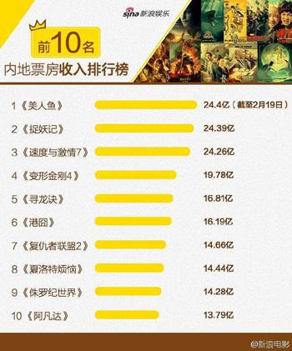

I. Warming up
1. What can you tell from the picture on the left?
2. Have you seen all the films in the picture on the left?
3. What’s your opinion of The Mermaid?
.

Slide 8
II. Skimming
Has the film The Mermaid been successful? Why can we say this?
2. Which information makes up this film review?
Yes, it has. The movie had a record-breaking first week, earning 1.79 billion yuan at the box office after it came out on Feb 8.
1)An introduction to the film including the title, director and actors.
2) The plot of the film.
3) The film techniques used in the film.
4) The themes of the film.
5) The reviews of the film.

Slide 9
III. Scanning
1. What is the message of Shanshan’s moving monologue?
When there is no longer a single drop of clean water, or a breath of unpolluted air, what is the point of having all the money in the world?
2. What does Chow urge us to do through the film?
To reflect upon how our selfish, material comforts and desires have led to the destruction of our environment as well as the habitats and lives of the many precious creatures we share our world with.

Slide 10
IV. Sentence structure
Read the sentences and pay attention to their structures.
1. In another scene, Shanshan tries to kill Liu with different weapons (武器) from the sea, hurting no one but herself.
hurting no one but herself 为现在分词短语做结果状语。现在分词作结果状语表示一种必然性（自然结果）。例如：
He dropped the glass, breaking it into pieces.
European football is played in more than 80 countries, making it one of the most popular games in the world. (全国卷)

Slide 11
IV. Sentence structure
2. Jokes aside, what makes The Mermaid stand out from the rest of this Lunar New Year’s films is that it also carries a message of social awareness.
aside 相当于 apart from “除了”。
句中what 引导的是主语从句，that引导的是表语从句。

Slide 12
Ⅴ. Vocabulary
1. The movie had a record-breaking first week, earning 1.79 billion yuan at the box office after it came out on Feb 8.
come out (书，电影，光盘等) 出版，发行
publish和come out
这两个词都有“出版、发行”的意思，但是用法上却不尽相同。publish是个及物动词，它的宾语是books，magazines等，可以有被动的结构。如：
Her second novel was published in July.
她的第二部小说于7月份出版了。
come out是个不及物动词词组，主语就是“书、唱片、杂志”等。如：
A second edition will come out next year.第二版将在明年出版。

Slide 13
Ⅴ. Vocabulary
2. Beautiful mermaid Shanshan is sent to stop Liu, but as fate would have it, they fall for each other.
fall for 爱上，迷恋
Dick fell for baseball when he was a little boy.
当迪克还是个小孩时，他就迷恋上了棒球运动。
Jim fell for Mary in a big way when they first met.
吉姆对玛丽一见钟情。

Slide 14
Ⅴ. Vocabulary
3. When there is no longer a single drop of clean water, or a breath of unpolluted air, what is the point of having all the money in the world?
What is the point of doing---: 做某事有什么意义？
What’s the point of doing this again and again?
这样反复做有什么意义?
I don’t understand your point. What’s the point
of doing this at this point?
我不理解你的想法, 这会儿这么做有什么意义?

Slide 15
Ⅴ. Vocabulary
come out
center on
fall for
stick to
be confused by
be dressed up as
stand out
carry a message
apart from
urge sb. to do
reflect upon

Slide 16
Ⅵ Discussion
What have you learned from reading about the film? (Your answer should be related to protecting the environment.)

Slide 17

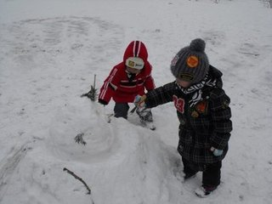
Does it often snow in winter where you live?
If so, have you ever built a snowman? What is usually the reason why a snowman disappears or is destroyed one day?
I. Warming up

Slide 18
Read the passage again and answer the following questions.
II. Skimming
1. Who was the snowman destroyed by?
2. How did the author punish the snowman bullies?

Slide 19
II. Skimming
1. Who was the snowman destroyed by?
It was destroyed by a group of fifth-grade bullies.
2. How did the author and his little sister punish the snowman bullies?
They filled a bucket with water and left the water to freeze. Then they packed snow all around the ice block for the snowman’s base. And the hard ice block hurt the bullies’ feet.

Slide 20
III. Sentence structure
Read the sentences and pay attention to the v-ing form.
1. The next morning, when looking outside, we smiled lovingly at him over our meal.
2. Monday morning, looking out the window, we soon saw what we were waiting for.
3. Taking their places on all sides, they pulled back their legs to deliver strong kicks.
4. We came close to feeling sorry for them, but they were too funny as they jumped away holding their damaged feet.
V-in形式为现在分词作状语，其逻辑主语与句子主语一致。

Slide 21
III. Sentence structure
5. The next day we came home to find another mess on the front lawn (草坪).
不定式作结果状语，表示未曾料到的不愉快的结果，有时为了强调，前面加only。 例如：
Tom got to the station only to find the train had gone.
汤姆到达车站，却发现火车已经开走了。
Marry hurried back only to find that her mother had been taken to the hospital.
玛丽匆忙赶了回来，结果却发现她母亲在医院里奄奄一息。

Slide 22
IV. Discussion
If you happened to come across the type of bullies the author wrote about, what would you do to deal with them?
Do you agree with the author’s way of dealing with the problem?

