Slide 1

英语国际音标

Slide 2
元音和辅音的定义：
发音时声带振 动，呼出的气流通过口腔时不受阻碍，这样形成的语音称为元音。
不论声带振动与否，发音时呼出的气流通过口腔或鼻腔时受到一定的阻碍，这样形成的语音称为辅音。
发音时声带不振动的辅音称为清辅音。
发音声带振动的辅音称为浊辅音。

Slide 3
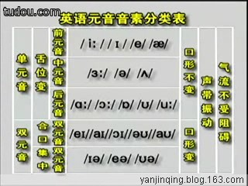
元音音标学习

Slide 4
元音音标
---长元音

Slide 5
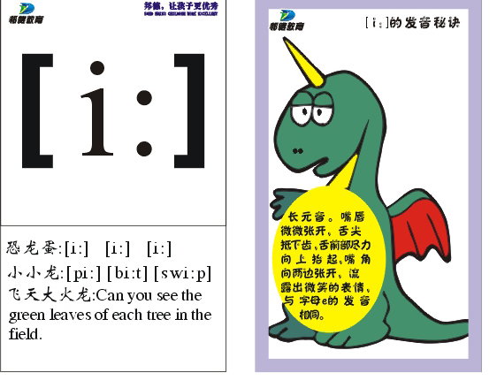

Slide 6
[i:] 发这个音的字母和字母组合e ea ee
e: me be she he we evening
ee:sweet bee sweep sheep see sleep three green
ea:meat leaf sea pea teach eat clean

Slide 7
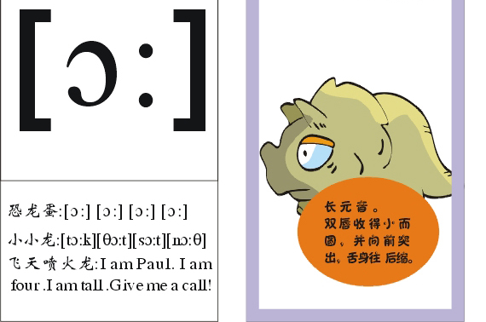

Slide 8
[ɔ:]
发这个音的字母和字母组合a aw al or oor
a: water
aw:draw strawberry
al:ball wall
or:horse corn fork or short
oor:floor door

Slide 9
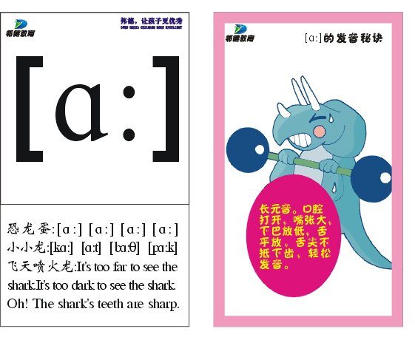

Slide 10
[a:]
发这个音的字母和字母组合a ar au ear
a: grass glass class plant dance fast
father last
ar: car star arm March garden dark scarf
au: laugh aunt
ear: heart

Slide 11
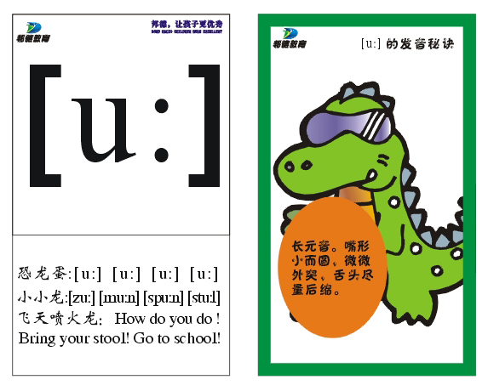

Slide 12
[u:] 发这个音的字母和字母组合o oo ui
o: do who whose
oo: food moon too
ui: fruit juice
u: ruler rude

Slide 13
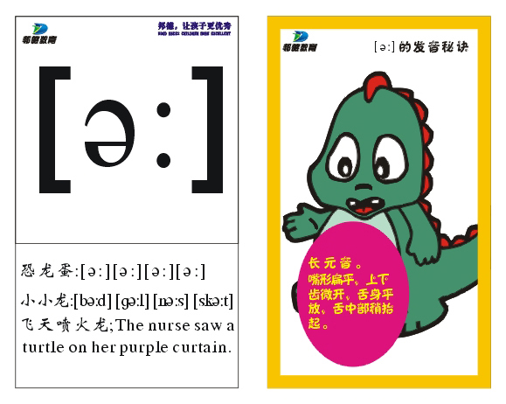
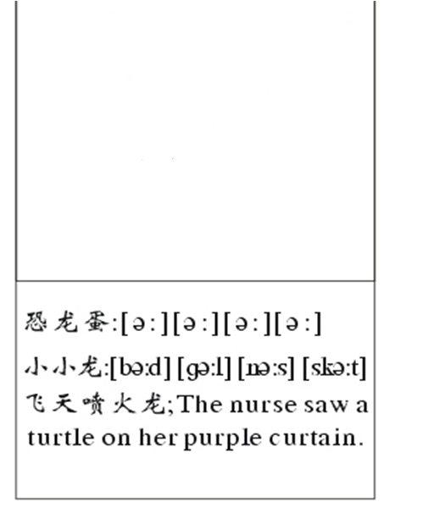

[3:]

Slide 14
[ә:]
发这个音的字母和字母组合er ir ur ear or
er: her serve term
ir:bird girl skirt first dirty skirt shirt
ur:nurse Thursday turtle purple curtain
ear:early learn
or: word work world

Slide 15
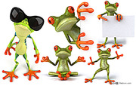
[ i:]
[ɔ:]
[a:]
[u:]
[3:]

Slide 16
短元音

Slide 17
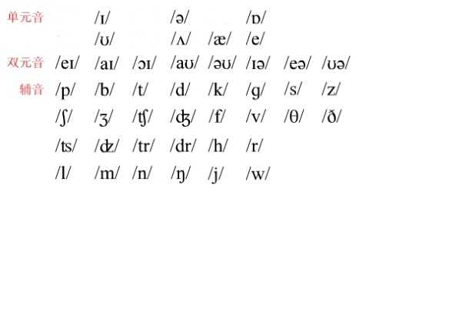
/æ/
/ e /
/ I /
/Λ/
/ ә /

Slide 18
[Λ] 发这个音的字母和字母组合o u oo ou
o: son come colour love money
u: sun nut jump gum bus brush
supper us
ou: touch cousin country

Slide 19
[i] 发这个音的字母和字母组合i e y ey ay
i: pig fish in fifteen six ship thin
e: begin behind jacket basketball
y: happy heavy busy lorry carry sunny
lovely study thirsty twenty thirty windy rainy
ey: monkey money
ay:Sunday Saturday Friday

Slide 20
[ә] 发这个音的字母和字母组合ure er ar or a e
ure: picture
er:teacher brother dinner father sister
ar: sugar
or:doctor
a:panda about above camera sofa China

Slide 21
[ɔ] 发这个音的字母和字母组合o a
o: fox coffee dog shop dog
doctor long
a: watch

Slide 22
[u]
发这个音的字母和字母组合o oo u
o:woman wolf
oo:look good book foot wood
u:bull bullet

Slide 23
[æ] 发这个音的字母和字母组合a
a: dad cap cat bad apple bag flag
hand rabbit ant black fat has
stand rat map

Slide 24
[e] 发这个音的字母和字母组合e ea
e: egg bell desk leg pet ten pen
ea: bread head breakfast

Slide 25
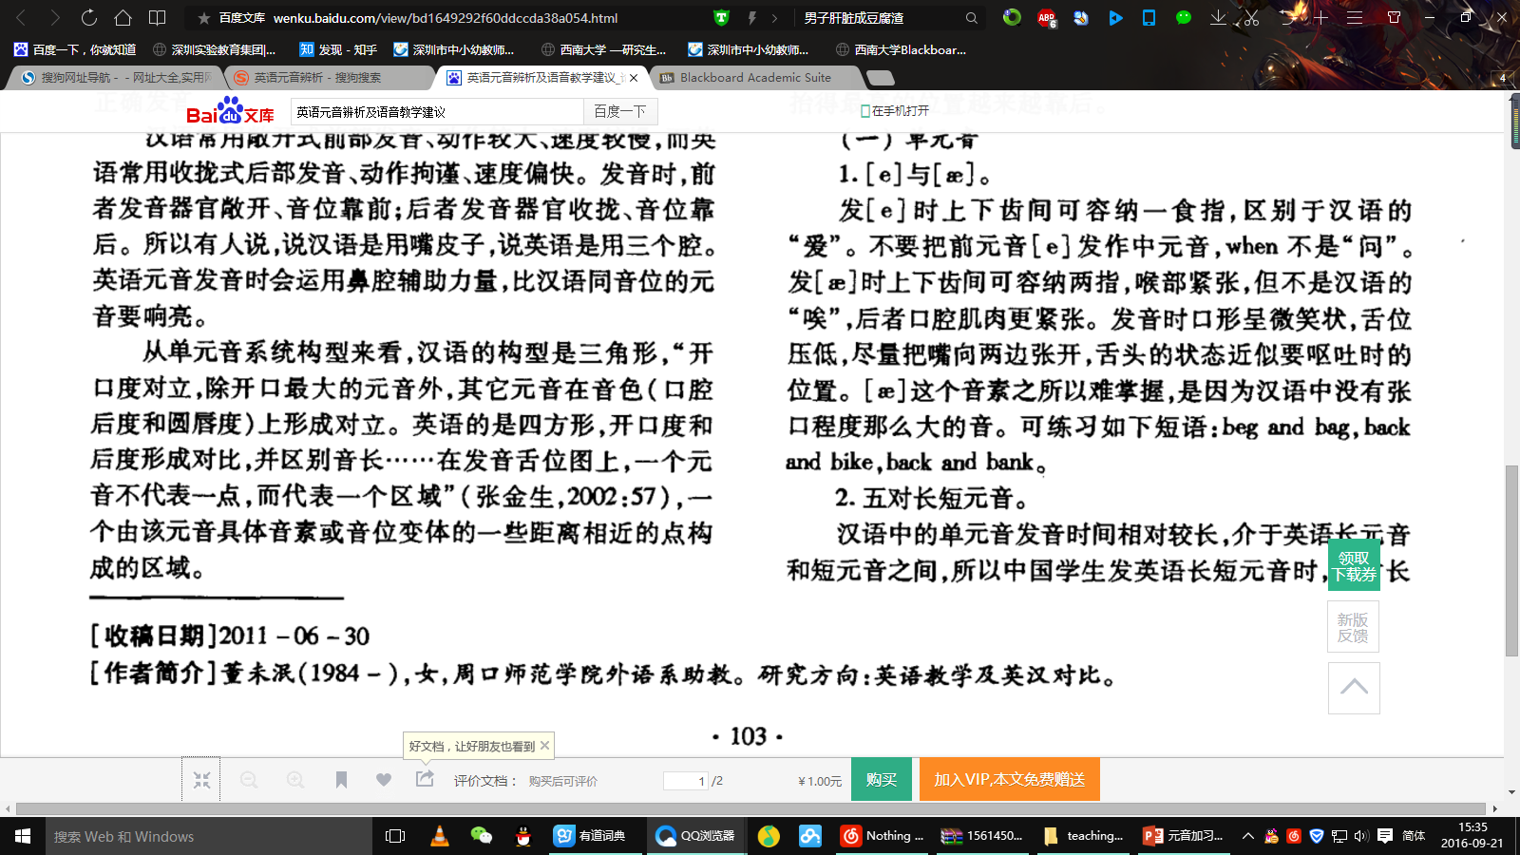

Slide 26
双元音

Slide 27
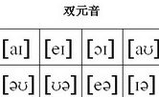


Slide 28
[au]
发这个音的字母和字母组合ou ow
ou: house mouse mouth trousers
ow: flower cow how now down

Slide 29
[ei]
发这个音的字母和字母组合a ai ay
a: cake make name game snake gate lazy
ai: rain train wait
ay:day May play taday way

Slide 30
[ai] 发这个音的字母和字母组合i y ie uy
i: kite bike nice tiger write knife
y: by cry fly my sky try why
ie:tie pie
uy:buy

Slide 31
[ɔi] 发这个音的字母和字母组合oi oy
oi: oil boil coin
oy: boy toy

Slide 32
[iә] 发这个音的字母和字母组合ear eer
ear: ear hear tear
eer: deer beer

Slide 33
[eә] 发这个音的字母和字母组合air ear
air: hair chair pair
ear:pear bear wear

Slide 34
[әu] 发这个音的字母和字母组合o oa ow
o: nose rose poen over
oa: boat coat soap goat
ow:show window snow bowl

Slide 35
[uә] 发这个音的字母和字母组合oor our ure
oor: poor
our: tour
ure: sure pure

Slide 36

一. 读音标,将下列单词补充完整或写出字母，单 词的音标。
[klaud] [set] [kɔin] [krɔ:s]
c__ __ __d s__ __ c__ __n cr__ __s
[flæg] [trein] [desk] [smail]
f__ __g tr__ __n d__ __ __ s__ __le
［nәuz］ [said] [iә] [kau] [peә]
[puә] [bæt] [wu:d]
[pleisiz] [tuә] ['θiәtә] ［rәuz］ [skweә]

Slide 37
读音标写单词。
[bi:] [bә:d] [si:] [swi:t] [′bizi] [hә:]
[′dɔktә] [′sistә] [li:f] [hi:]
[bru:m] [dɔ:] [sit] [bә:d]
[fut] [wi:] [dɔg] [′sistә]
［pa:st］ [ru:m] [swet] [sit]
[fæt] [gɔt] [cΛp] [shә:t]

