Slide 1
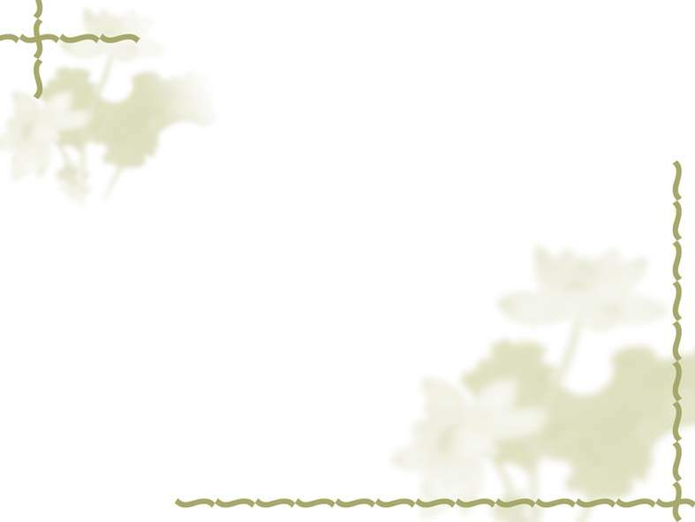
1. Someone is ringing the doorbell. Go and see ________ .
A. who is he B. who he is C. who are they D. who it is
2. ________ she couldn't understand was ________ fewer and fewer students were interested in her lessons.
A. What; why B. That; what C. What; because D. Why; that
3. -We haven't heard from Jane for a long time.
- ________ has happened to her?
A. Do you suppose that B. What do you suppose
C. Do you think that D. What you think
4. I don't care ________ she has no money. I care ________ she is honest or not.
if; when B. whether; that C. if; whether D. what; if

Slide 2
5. Word came ________ the PLA man approached the child slowly and helped him to safety.
A. since B. so that C. that D. why
6. The child is always lying, so none of us will believe ________ he says.
A. whatever B. no matter what C. how D. which
7. The fact troubles me so much ________ I have been unable to pass the driving test up to now.
A. which B. because C. why D. that
8. See to ________ the children don't catch cold.

Slide 3
A. it what B. it that C. what D. that
9. He, ________ is playing an important part, is well-known to us all.
A. that who B. those who C. who that D. who
10. It matters little ________ a man dies, but ________ matters so much more is ________ he lives.
A. how; what; how B. how; it; how
C. why; it; why D. which; what; that
11. Pointing to the house, he said, "This is ________ I used to live when I was young."
A. when B. what C. that D. where
12. After ten years, he had changed a lot and looked different from ________ he used to be.
why B. which C. what D. who

Slide 4
13. Father made a promise ________ I passed the examination, he would buy me a bicycle.
A. that B. if that C. whether D. that if
14. -What about the speech he made this afternoon?
- ________ he said so must be quite encouraging, I think.
A. What B. That C. / D. All
15. There are signs ________ restaurants are becoming more popular with families.
in which B. which C. that D. whose

Slide 5
16. Because they usually receive the same score on standardized exams, there is
often disagreement as to ________ is the better student, Bob or Helen.
A. who B. where C. when D. whose
17. Scientists believe native Americans arrived by crossing the land bridge that connected Siberia and ________ more than 10,000 years ago.
A. this is Alaska B. Alaska is now
C. is now Alaska D. what is now Alaska
18. The boy dived into the water and, after ________ seemed to be a long time, he
came up again.
what B. that C. it D. which

Slide 6
19. ________ we can pass the coming examination will mainly depend on ________ we learn and ________ we learn it.
A. Whether; what; how B. That; whether; why
C. If; how; that D. Why; that; how
20. Although most of them have no doubt ________ he will pass the exam, I still wonder ________ he has really got everything ready.
A. whether; that B. that; whether
C. that; that D. whether; whether
key: 1-5 DABCC 6-10 ADBDA 11-15 DCDBC 16-20 ADAAB

Slide 7
名词性从句自测题
He asked _____ for the violin.
A. did I pay how much B. I paid how much
C. how much did I pay D. how much I paid
2.They want to know _____do to help us.
A. what can they B. what they can
C. how they can D. how can they
3. _____ you have done might do harm to other people.
A. That B. What
C. Which D. This
4.These photographs will show you _____.
A. what does our village look like
B. what our village looks like
C. how does our village looks like
D. how our village looks like
5. _____ leaves the room last ought to turn off the lights.
A. Anyone B. The person
C. Whoever D. Who

Slide 8
7.It is not _____that this situation will continue very long.
A. alike B. like
C. likely D. the like
8.Computers can only give out _____ has been stored in them by man.
A. that B. which
C. what D. everything
9.We all heard the news _____ the Chinese Women Volleyball Team had won the match.
A. which B. that
C. in which D. when
10.There is a police car in front of our neighbour’s house. What do you suppose_____?
A. is happen B. has happened
C. would happen D. did ha

Slide 9
11.Energy is _____ makes things work.
A. what B. something
C. anything D. that
12.This is just _____they are mistaken.
A. when B. what
C. where D. which
13.Why he fell ill suddenly was _____ he was caught in the rain yesterday.
A. because B. since
C. that D. only because
14.I don’t think the question of _____ they are old or young is important.
A. which B. whether
C. how D. why

Slide 10
15.I’ll make _____ to all that you were once a sailor.
A. known B. knowing
C. then known D. it known
16. _____ was not our concern.
A. No matter he might pass the examination
B. Whether he passed the examination or not
C. Though he might pass the examination
D. He passed the examination
17.Do you believe _____ he will win?
A. that B. whether
C. if D. what
18.I have no doubt _____ it is true.
A. that B. whether
C. if D. what

Slide 11
19.I don’t think _____.
A. that is true he’ll go there himself
B. it true that he’ll go there himself
C. that he will true go there himself
D. this is true he’ll go there himself
20.Do you know _____ get three gold medals?
A. how Tim could B. how Tim was able to
C. how was Tim able to D. how could Tim
21.They expressed the hope _____ they would come over to visit China again.
A. which B. that
C. whether D. for which
22.The reason why I didn’t finish my homework was _____ my schoolbag with all my textbooks in it.
A. because I lost B. because of losing
C. for I lost D. that I lost

Slide 12
.Why he fell ill suddenly was _____ he was caught in the rain yesterday.
A. because B. since
C. that D. only because
从句自测题答案：
1-5 DBBBC 6-10 CCCBB 11-15 ACCBD
16-20 BAABB 21-25 BDBDC

