Slide 1

宾语补足语的10种表示法：
His father named him Daming.
They painted their house white.
You mustn’t force him to lend his
money to you.
4. Nobody noticed him enter the room.
5. We saw her entering the room.
(名词)
  (形容词)
(不定式短语)
(不定式)
(现在分词或其短语)

Slide 2
6. We must get the work finished by 10
o’clock.
7. We take English as a useful tool for
research work.
8. Whenever you may go, you will find
him at work.
9. Let the fresh air in.
10. What has made China what she is
today?
(过去分词)
(用as引出)
(介词短语)
(副词)
(从句)

Slide 3
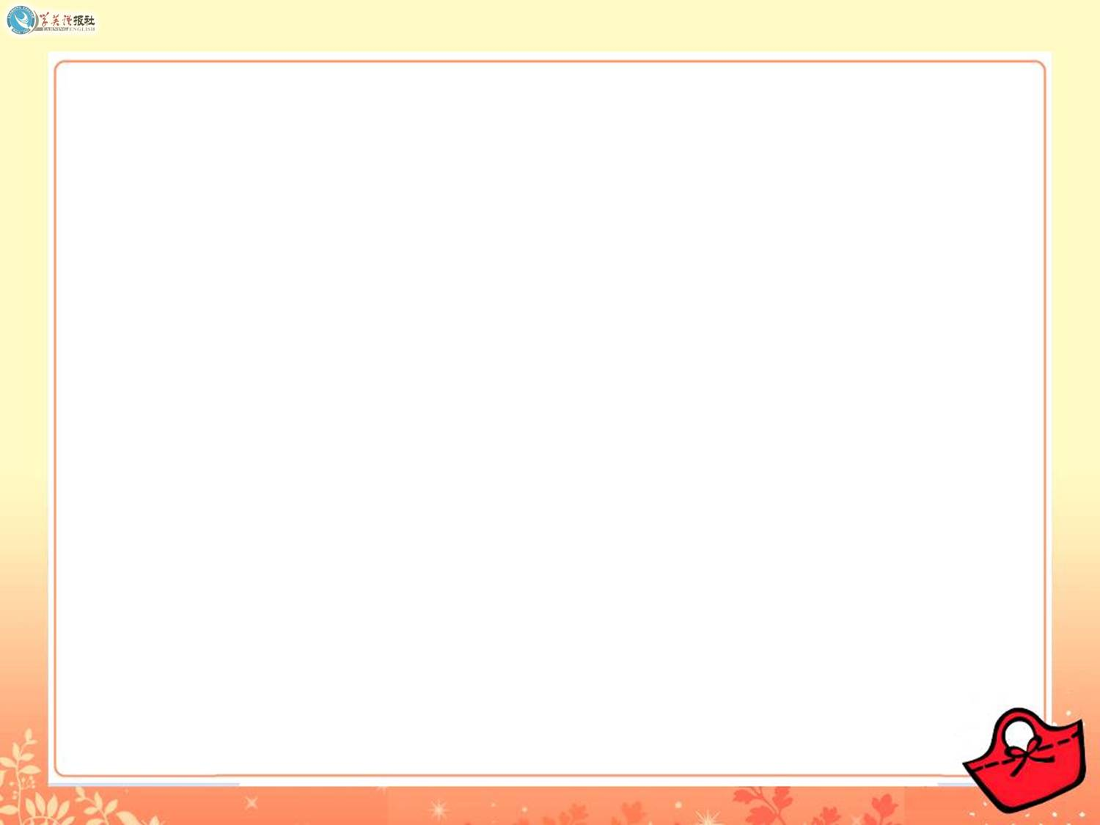

Quiz I: Multiple choice
1. Lucy has a great sense of humour
and always keeps her colleagues
____ with her stories. (2010上海)
A. amused B. amusing
C. to amuse D. to be amused

Slide 4
2. Alexander tried to get his work _____
in the medical circles. (2010辽宁)
A. to recognize B. recognizing
C. recognize D. recognized
3. Even the best writers sometimes find
themselves ______ for words.
(2011浙江)
A. lose B. lost
C. to lose D. having lost

Slide 5
4. Michael put up a picture of Yao
Ming beside the bed to keep himself
______ of his own dreams.
(2011重庆)
A. reminding B. to remind
C. reminded D. remind
5. Claire had luggage _____ an hour
before her plane left. (2011陕西)
A. check B. checking
C. to check D. checked

Slide 6
6. Before driving into the city, you are
required to get your car ______.
(2012四川)
A. washed B. wash
C. washing D. to wash
7. When we saw the road ______ with
snow, we decided to spend the
holiday at home. (2013北京)
A. block B. to block
C. blocking D. blocked

Slide 7
8. The manager was satisfied to see many new products ______ after great effort.(2014四川)
A. having developed B. to develop C. developed D. develop

Slide 8
Quiz II: 用所给单词的正确形式填空。
surprised
1 What he had said made me _________.
(surprise)
2 My glasses are broken. I’ll have to get
them ________. (repair)
3 I heard the song ______ in English.
(sing)
repaired
sung

Slide 9
4 I don’t want any bad words ____ (say) about him behind his back.
5 Please get the work ______ (do) as soon as possible.
6 I’ll have the materials ____ (send) to you next Monday morning.
7 She won’t have her long and beautiful hair ____ (cut) short.
said
done
sent
cut

Slide 10
8 You should make your voice ______ (hear).
9 I want you to keep me _________ (inform) of how things are going with you.
10 The price is fine with me. How would
you like it _____ (pay)?
11 At last I succeeded in making myself
__________ (understand).
heard
informed
paid
understood

Slide 11
Quiz V. 阅读下面的短文，在空白处填
入适当内容（不多于3个单词）
或括号内单词的正确形式。
When you visit London, one of the first things you will see is Big Ben, the famous clock ______ can be heard all over the world on the B.B.C. If the Houses of Parliament ____________ burned down in 1834, the great clock would never have been erected.
which
had not been

Slide 12
Big Ben takes its name from Sir Benjamin Hall ____ was responsible for the making of the clock when the new Houses of Parliament were being built. It is not only of immense size, but is _________ (extreme) accurate as well. Officials from Greenwich Observatory have the clock ________ (check) twice a day.
who
extremely
checked

Slide 13
On the B.B.C. you can hear the clock when it is actually striking _________ microphones are connected to the clock tower. Big Ben has ______ (rare) gone wrong. Once, however, it failed ________ (give) the correct time. A painter _____ had been working on the tower hung a pot of paint on one of the hands and slowed it ______!
because
rarely
to give
who
down

