Slide 1

For Senior 1
15-16学年第15期总第617期
Wake and work (P3)
烟台经济技术开发区高级中学 唐福珍

Slide 2
Have you ever taken part in military training? What did you think of the experience?
I. Warming up

Slide 3
II. Skimming
What event did Scott take part in?
He took part in the “Wake Up and Work Out” event held in Fort Lauderdale, Florida.
2. Did Scott think highly of the event?
Yes, he did.

Slide 4
III. Scanning
What was the meaning of the event, according to Major Nadrian McGill?
What’s causing trouble with young people’s health? What’s a cause of the increasing obesity rate?
What was Destiny’s opinion of the event?

Slide 5
III. Scanning
What was the meaning of the event according to Major Nadrian McGill?
It was a wake-up call, not only physically, but mentally, to let these kids know that their health is important.
2. What’s causing trouble with young people’s health? What’s a cause of the increasing obesity rate?
The increasing obesity rate among children and teenagers is already having an effect on their health.
A lack of exercise in today’s world is a cause.

Slide 6
III. Scanning
3. What was Destiny’s opinion of the event?
He thought it was a really cool experience. He has been keeping in touch with many people he met there since the event happened last year.

Slide 7
IV. Vocabulary
1. It was hosted by the US Marine Corps and the 2015 National Urban League Conference.
host: v. 主办; 主持
Which country is going to host the next World Cup? 哪个国家将要主办下一届的世界杯？
Next week’s show will be hosted by Sarah Cox.
下个周的节目将由莎拉·考克斯主持。

Slide 8
IV. Vocabulary
2. According to the US Centers for Disease Control and Prevention, the increasing obesity rate among children and teenagers is already having an effect on their health..
increasing： becoming greater or larger
have an effect on: 对---有影响
Eg. The trees themselves also have an effect on the climate.
树木本身也对气候产生影响.

Slide 9
IV. Vocabulary
3. Even if you’re not trying to make friends, it’s fine, because you end up doing it anyway.
end up: 最终，到头来
Most slimmers end up putting weight back on.
大多数减肥的人最后又发胖了。
Every time they went dancing they ended up in a
bad mood.
每次他们去跳舞，都会不欢而散。

Slide 10
IV. Vocabulary
4. ---the program was also part of a larger effort to reach out to young people.
reach out to: 伸出援手
Reach out to someone who needs comfort.
对需要安慰的人伸出援助之手。
5. The marines cared enough to take the time to come out and inspire us.
care to do：愿意做
Experts reveal only as much as they care to.
专家们只透露了他们想透露的那些。

Slide 11
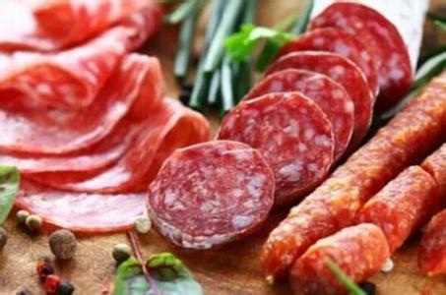
For Senior 1
15-16学年第15期总第617期
New meat cancer link found (P5)
烟台经济技术开发区高级中学 唐福珍

Slide 12
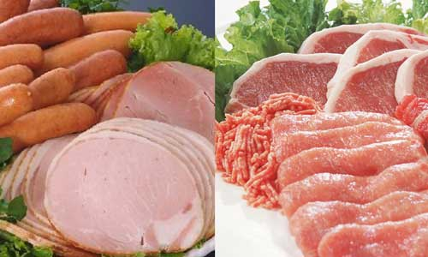
Which kinds of meat do you like best: processed meat, lean cuts (精瘦肉)，beef, pork or lamb? Do you know whether they are healthy?
I. Warming up

Slide 13
II. Skimming
What did WHO report about processed meat?
Processed meat, like sausages, hams and bacon, is a “Group 1” carcinogen.
Red meat, including beef, pork and lamb, are “probably” cancer-causing.

Slide 14
III. Scanning
1. Is processed meat really as dangerous as cigarettes according to the WHO?
2. Must we give up meat to stay healthy?
3. Is diet the only factor we can control to reduce our cancer risk?
4. Besides cutting down on meat, what should people do?

Slide 15
III. Scanning
1. Is processed meat really as dangerous as cigarettes according to the WHO?
No. The evidence linking meats to cancer is as strong as that between smoking and cancer.
2. Do we have to give up meat to stay healthy?
No. Scientists suggest that we cut down the amount of meat we eat instead of giving meat up altogether.

Slide 16
III. Scanning
3. Is diet the only factor we can control to reduce our cancer risk?
No.
4. Besides cutting down on meat, what should people do?
People should also have a diet rich in fiber from fruit and vegetables, keep a healthy body weight throughout their lives and be physically active.

Slide 17
IV. Sentence structure
Read the sentences and pay attention to the structure.
1. This is why scientists suggest that you cut down the amount of meat you eat instead of giving meat up altogether.
Experts suggest taking the same broad, overall approach to balancing your lifestyle choices.
Why引导的是表语从句。

Slide 18
suggest表“建议”的用法：
1)可接名词、动名词做宾语
We suggested a visit to the museum the next day.
I suggested putting off the sports meeting.
They suggested waiting until the proper time.
2)可接that宾语从句，从句用should+动词原形，should可以省略。
She suggested that the class meeting (should) not be held on Saturday.
We suggested that he (should) go and make an
apology to his teacher.

Slide 19
IV. Sentence structure
2. But diet isn’t the only factor (因素) you can control to reduce your cancer risk.
本句中，you can control是定语从句，关系代词是that，在从句中做宾语，可以省略。

Slide 20
Ⅴ. Vocabulary
Use the following words and expressions to complete the sentences.
set off; kiss … goodbye; cut down on; essential; fit into; link … to; apart from; be rich in
cut down on
He ___________ coffee and cigarettes, and ate a balanced diet.
It is _______ that our pilots are given the best possible training.
Some of the patients we see do not ______ any of the existing categories.
___________money, people choose jobs for other reasons.
essential
fit into
Apart from

Slide 21
Ⅴ. Vocabulary
Use the following words and expressions to complete the sentences.
set off; kiss --- goodbye; cut down on; essential; fit into; link ---to; apart from; be rich in
5. Many fruits __________ Vitamin C.
6. Our economy ___ closely __________ America's.
7. News that the claims might be true ________ widespread panic.
are rich in
is linked with
set off

Slide 22
Ⅵ Discussion
Do want to change your diet after reading the passage? What do you plan to do?

Slide 23
For Senior 1
15-16学年第15期总第617期
Making me smile (P6)
烟台经济技术开发区高级中学 唐福珍

Slide 24
I. Warming up
1. Do you often go to restaurants or cafes?
2. Have you ever met any waiters who said or did something kind to you? If so, have you ever thought of writing a thank-you note to them?

Slide 25
II. Skimming
What is the purpose of the letter?
To thank the barista for his writing the simple word “smile” on her order that changed her day for the better.
2. Tell the writer’s story including the answers to the following questions:
1) What happened to the writer?
2) What did the writer feel?
3) What did the barista do?
4) How did the “smile” change the writer’s life?

Slide 26
III. Sentence structure
1. You wouldn’t know that behind this smile is a girl who has broken and gone to pieces.
that 引导的宾语从句中，主语是a girl, who 引导的是定语从句，behind this smile放在句首，句子用了倒装语序。
here, there, out, in, up, down, now, then, away等副词以及表方位的介词短语放在句首，句子需要完全倒装。
In front of the house there was a police car.
Nearby were two canoes in which they had come to the island.
Under the tree was a boy.

Slide 27
III. Sentence structure
2. You could have treated me like another annoying customer. But you took that extra second to add something positive to a life that’s been filled with so much negativity lately.
could have done 意为“过去本可以做，但事实上并没做”。
Eg. He could have passed the exam, but he didn’t take it seriously enough.本来他能够通过考试,但是他太粗心.

Slide 28
III. Sentence structure
3. If I hadn’t seen that cup, I could have done more damage to myself that night.
本if条件状语从句中使用了虚拟语气。通常有三种情况：①与过去事实相反。②与现在事实相反。③与将来事实可能相反。
⑴、If I had come here yesterday, I would have seen him.
⑵、If I were a teacher, I would be strict with my students.
⑶、If it snowed tomorrow, they wouldn’t be able to go out.

Slide 29
与现在事实相反
If＋主语＋动词的一般过去时（ be动词一般用were）， 主语＋would /could/might＋动词原形
与过去事实相反
If＋主语＋had＋过去分词, 主语＋would /could/ might＋have＋过去分词
与将来事实相反
If＋主语＋一般过去时
If＋主语＋were to
If＋主语＋should＋动词原形,
主语＋would /should / could / might ＋动词原形

Slide 30
IV. Beautiful sentences
1. Most importantly, you probably didn’t know that writing the simple word “smile” on my order would change my day for the better.
2. But you took that extra second to add something positive to a life that’s been filled with so much negativity lately.
3. When I read that word, I couldn’t help but smile.
4. A simple act of kindness can mean the world to someone. It can provide hope for the hopeless.
5. Now I plan to pass this hope along. Thank you for turning my day around.

Slide 31
Ⅴ. Discussion
After reading the passage, what do you want to say to the writer?

