Slide 1
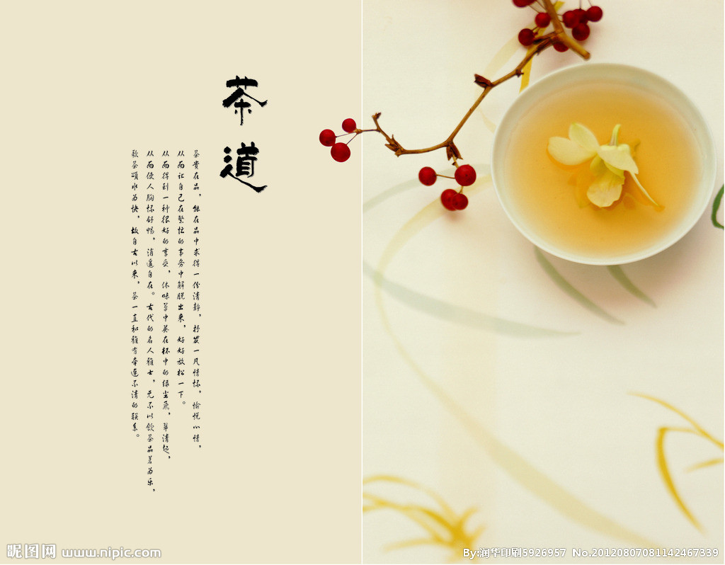
Chinese Tea Culture

Slide 2
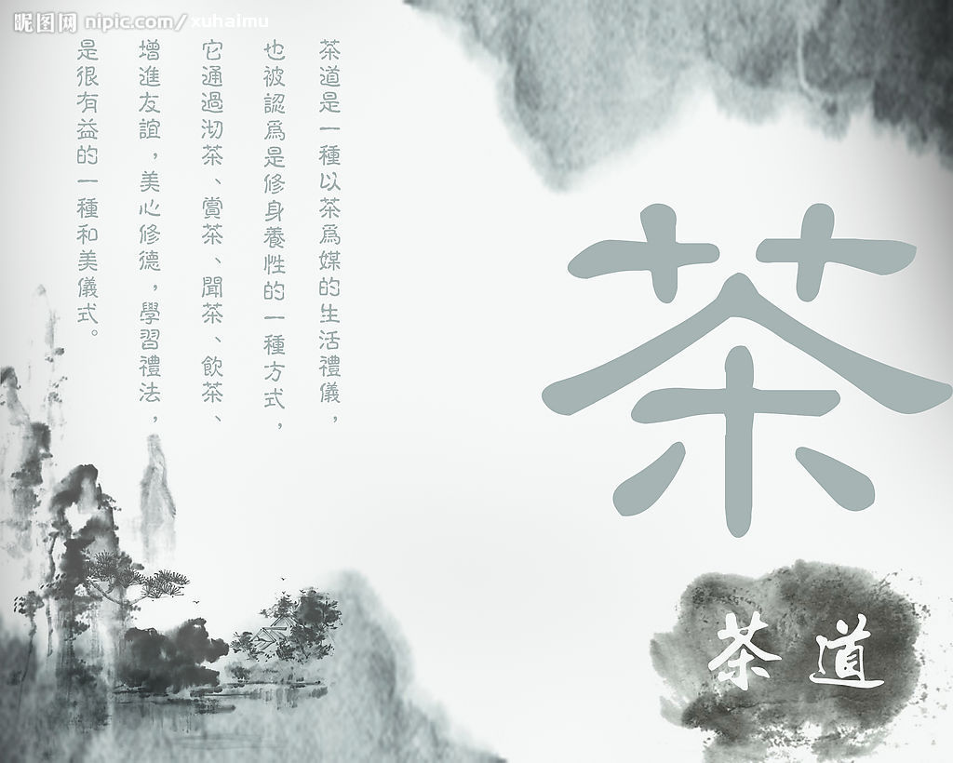
The origin(起源) of Chinese tea
Referring Chinese tea,it can be traced back to the ancient times,and it was flourished in Tang dynasty and Song dynasty

Slide 3
We can say,the event of tea in other countries in the world,directly or indirectly,are bascially spread out from China.China is the homeland of tea,and tea have become the national drink.

Slide 4
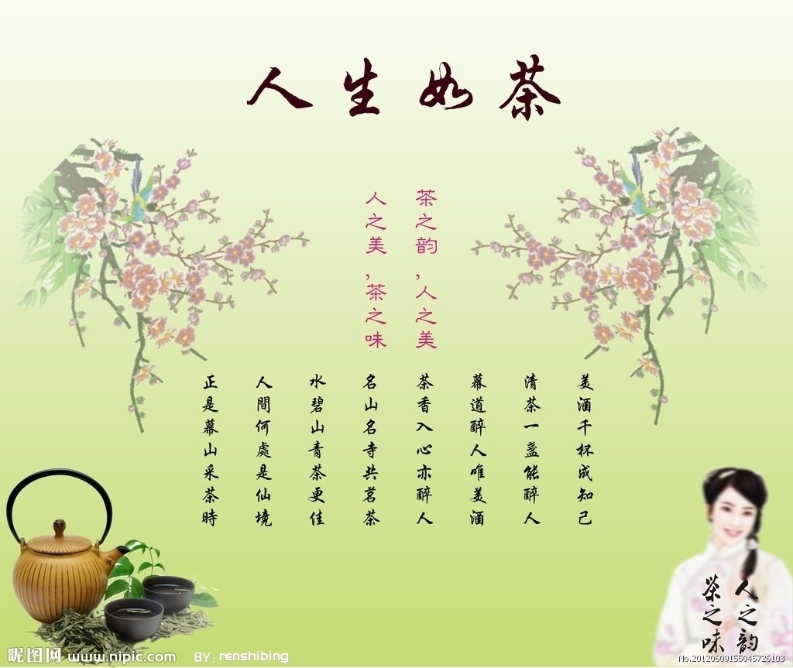
The spirit of Chinese tea culture
The Chinese tea ceremony thoughts is the fusion of Confucianism,Taoism and Buddhism.The core of chinese tea ceremony spirit is”harmonious”.

Slide 5
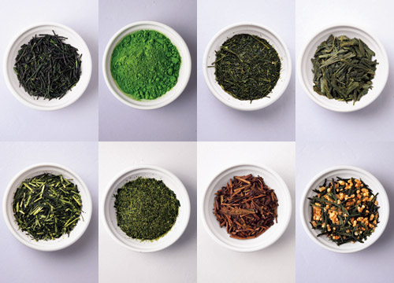
Tea classification
There are many kinds of tea in china.
They are mainly growen in the south of China

Slide 6
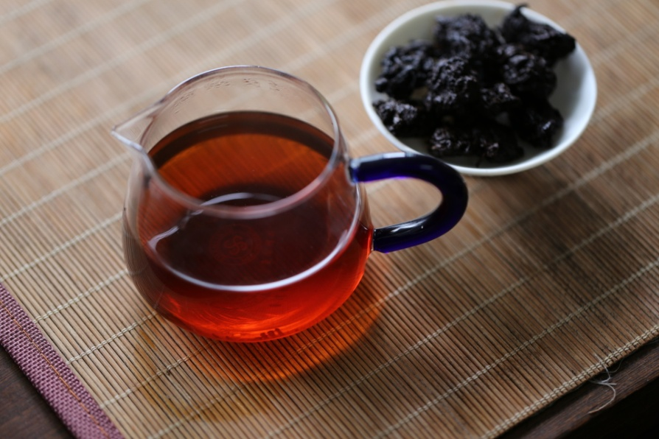
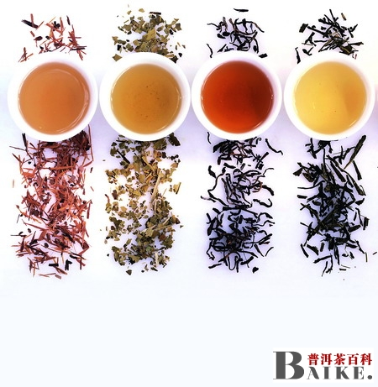
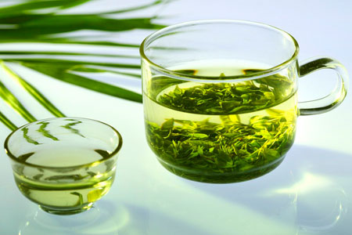
Some kinds of tea

Slide 7
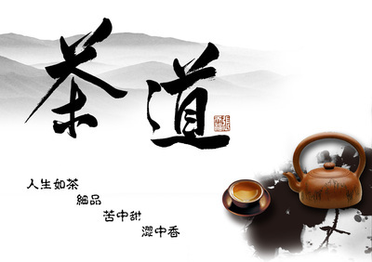
The benefits of tea
Make people in hign spirits,enhance thinking and memory.
Can eliminate fatigue(疲劳),promote metabolism(新陈代谢),prevent many kinds of disease.
Edify sentiment,cultivating interest(陶冶情操，培养情趣）

Slide 8
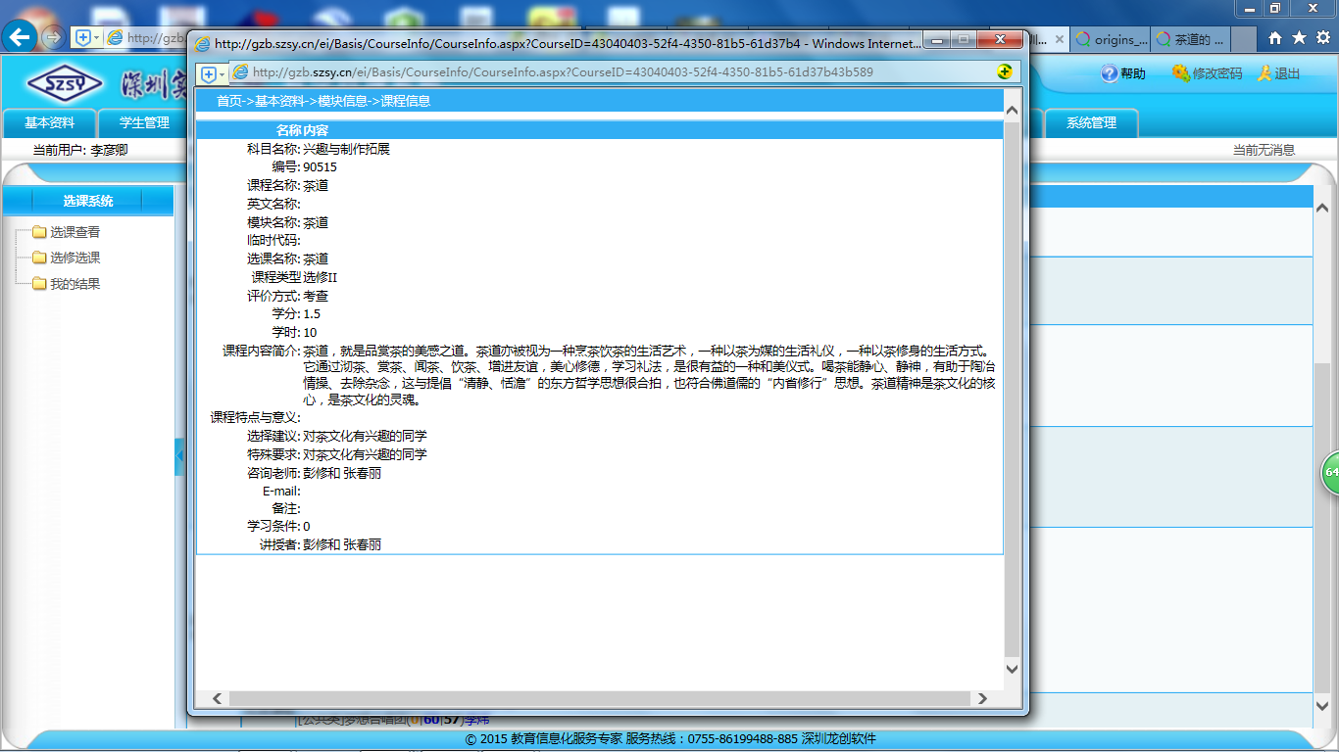

Slide 9
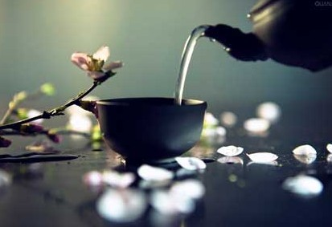
Thanks for watching

