Slide 1

pixar
By zhao yao

Slide 2
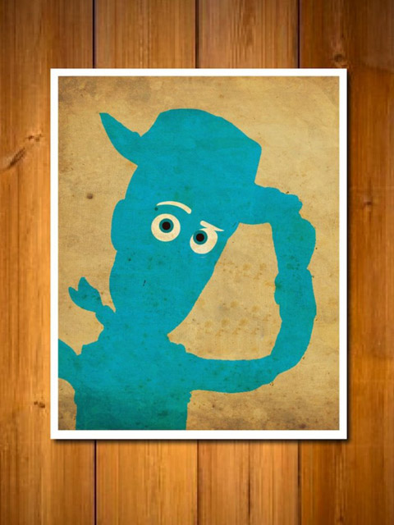
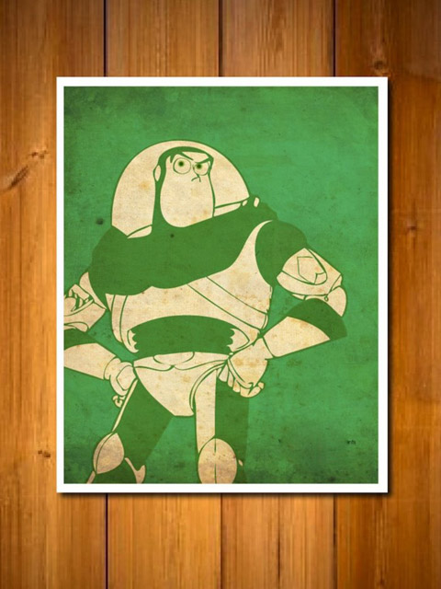
Toy story--1995

Slide 3

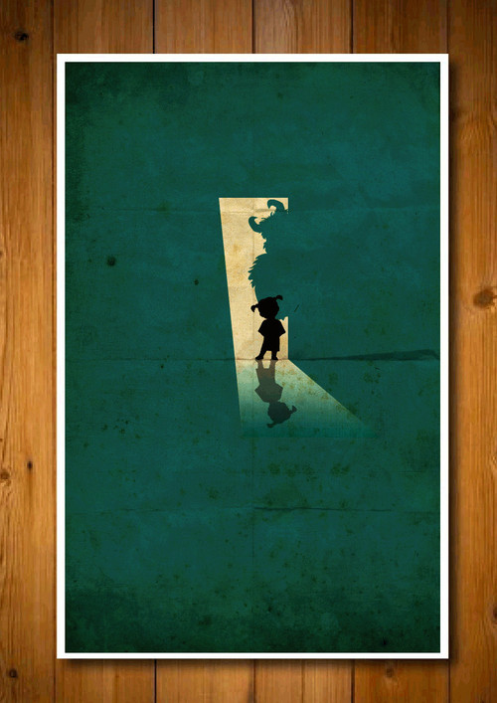
Monsters,INC--2001

Slide 4
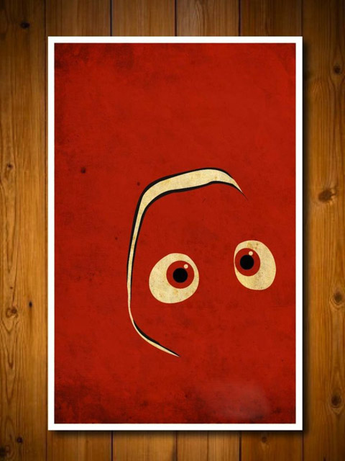
Finding Nemo--2003

Slide 5
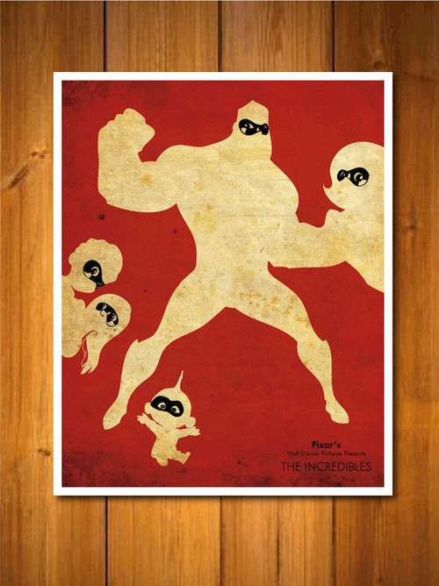
The incredibles--2004

Slide 6
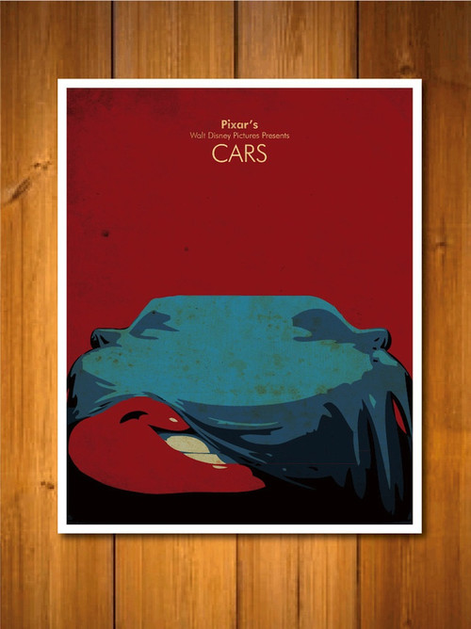
Cars--2006

Slide 7
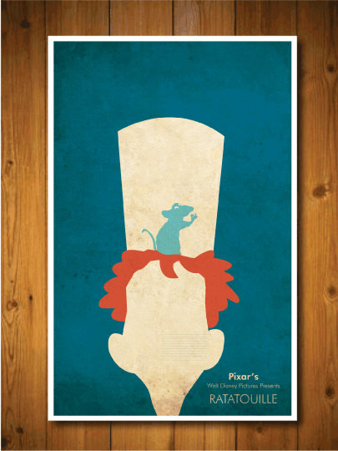
Ratatouille --2007

Slide 8

Wall E--2008

Slide 9

Up --2009

Slide 10
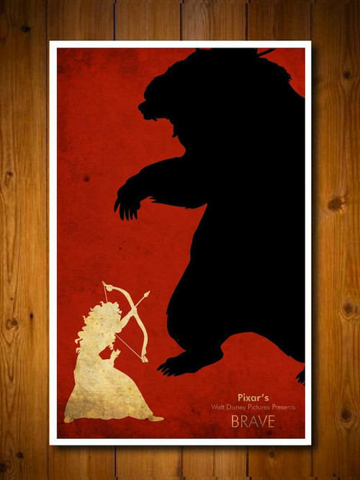
Brave --2012

Slide 11
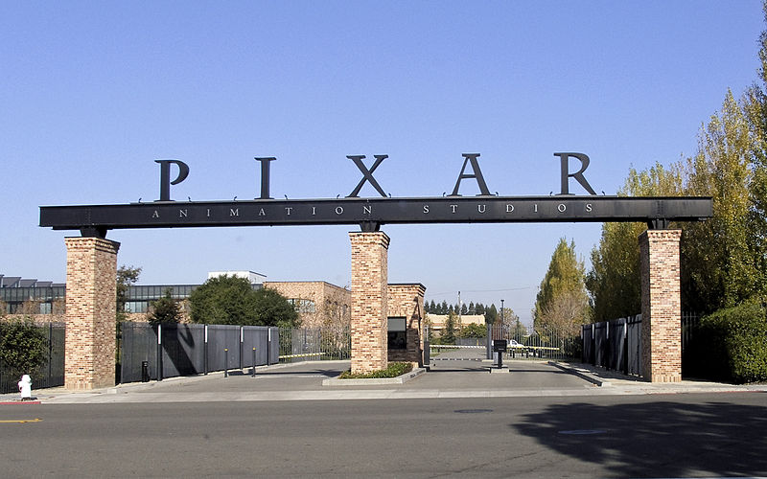
It has made 15 feature films!

Slide 12
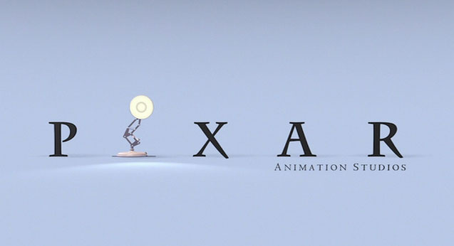
Pixar history

Slide 13
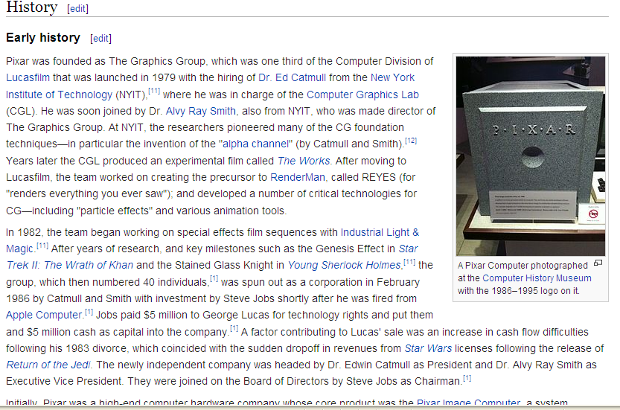

Slide 14
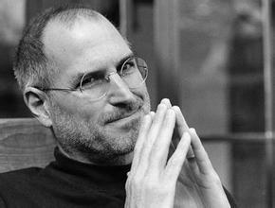
The most important thing!
In 1986,Steve jobs established the pixar animation studio.

Slide 15

Let `s watch a small film

Slide 16

Conclusion

Slide 17
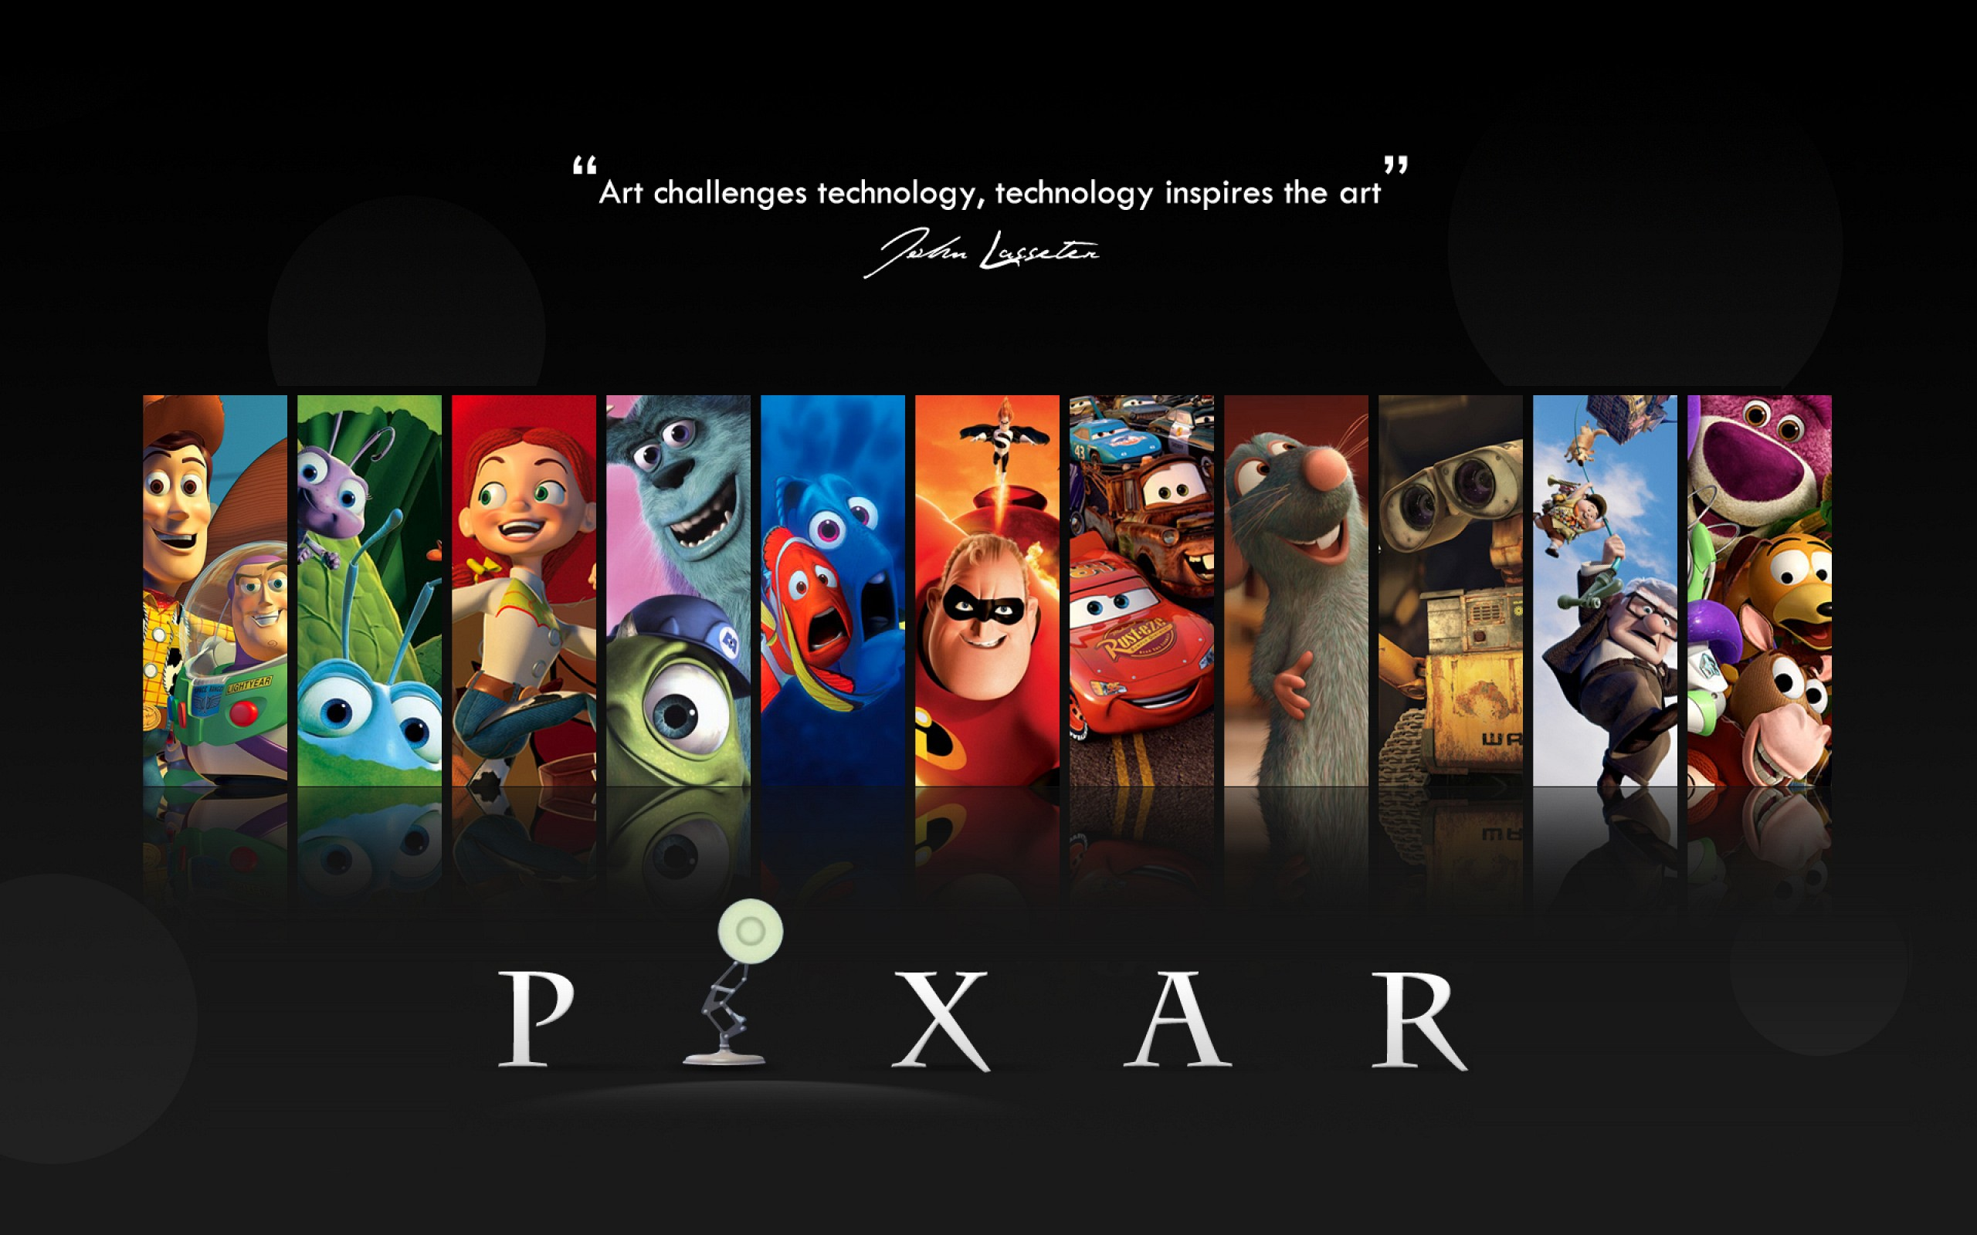
thanks for watching

