Slide 1


The Olympic Games

Slide 2



Choose the best answer.
1. Where do all the competitors live?
A. A hotel.
B. A place hired by competitors.
C. A restaurant.
D. A special village.

Slide 3

2. Which of the following is included in
the Winter Olympic Games?
A. Skiing and ice skating.
B. Running and races.
C. Horse riding.
D. Swimming.

Slide 4
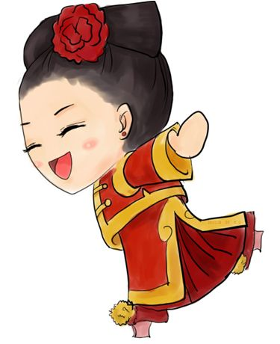
3. Why do so many countries want to
host the Olympic Games?
A. To run faster, jump higher and
throw further.
B. To get a great honor.
C. To make the country famous.
D. To make money.

Slide 5

4. How does Pausanias feel when he
hears the Olympic Games are also
about being able to run faster, jump
higher and throw further?
A. Surprised.
B. Happy.
C. Sad.
D. Astonished.

Slide 6
Differences | Ancient | Modern
Any Winter Olympics?
competitors from?
Men/Women athletes
Prizes
Any Olympic villages?
(more/fewer) events
No
Yes
all over the world
only in Greece
only men
both
olive wreath
medals
No
Yes
Fewer events
More events

Slide 7
Similarities
1 have running races
2 held every 4 years
3 no prize money for winners
4 seen as most important competition
Why does he raise the question, “Do you compete for prize money too?” nowadays?
So many things have changed in the Olympic Games that he fears that the spirit of the Olympics may have changed too.

Slide 8
Focus on
Words:
volunteer, regular, admit, nowadays, host, responsibility, replace, motto, swift
Expressions:
find out, as well, as a matter of fact
Patterns:
That’s why …
It’s a great responsibility …

Slide 9

Careful reading
重难点句式分析

Slide 10

what引导的名词性从句做介词in的宾语
I live in what you call “Ancient Greece” and I used to write about the Olympic Games a long time ago.
used to do sth. 过去常常做某事
我生活在你们所说的“古希腊”。我曾经写过很久以前奥林匹克运动会的情况。

Slide 11

Translation
1. 你不像过去那样经常来看我了。
You don't come and see me like you used to.
2. 她过去很喜欢猫，但自从被一只猫袭击过后，就再也不喜欢猫了。
She used to love cats but one attacked her and she doesn't like them anymore.
3. 我决定不下来下一步该做什么。
I can't decide what to do next.

Slide 12

定语从句
Pausanias, who was a Greek writer about 2,000 ago, has come on a magical journey on March 18th, 2007 to find out about the present-day Olympic Games.
（
）
进行一次
魔幻旅行
动词不定式短语作目的状语
帕萨尼亚斯是大约2,000年前的一位希腊作家，在2007年3月18日他进行了一次魔幻旅行，来了解关于当今奥林匹克运动会的情况。

Slide 13

定语从句
Only athletes who have reached the agreed standard for their event will be admitted as competitors.
一般将来时的被动语态
一般将来时的被动语态:
will (shall)/am/is /are going to+ be+ done
只有达到他们各自项目统一标准的运动员才会被接受参加奥运会。

Slide 14
Translation
1. 这些书将在什么时候出版？
When will these books be published?
2. 运动会将于四月十日举行。
The sports meet is going to be held on April 10.
3. 这个问题将在明天的会上讨论。
The problem is to be discussed at the meeting tomorrow.

Slide 16
I. Complete the passage with proper words, which will help you retell the text.
There are two sets of the Olympic Games — the Summer Olympics and the Winter Olympics, both of ________are held every four years. Athletes who have reached the ________(agree) standard
will be admitted as competitors. In Winter
Olympics, there are ___________(compete) like skiing and ice skating _______snow and ice are needed.
which
agreed
competitions
where

Slide 17
And that is _______they are called the Winter Olympic Games. While in Summer Olympic Games, athletes compete ______ the running races, swimming, sailing and all the team sports. For each Olympics, a
special village _________(build) for athletes to live _____. Every country wants the opportunity to host the Olympics, because ______is thought to be a great honor ___________(choose). The motto of the Olympic Games is “Swifter, Higher and Stronger.”
why
in
is built
in
it
to be chosen

