Slide 1



Slide 2











Slide 3


Slide 4
[题目要求]
下午数学考试，你成绩不好，心情郁闷。晚上几个好朋友邀你去歌厅(KTV)唱歌，你们一晚上唱得很尽兴。你用日记的形式记录下你今天的活动及感受。
日记须包括以下几个要点：

Slide 5
(1)你因数学成绩不佳，心情一直不好。
(2)晚上朋友们邀请你去KTV唱歌，这是你第一次去KTV。
(3)大家唱得很高兴，而你一直当听众，你觉得你的歌唱得不好，不敢去唱。
(4)在大家的鼓励下，你终于拿起麦克风(microphone), 唱了一首英文歌曲I Believe I Can Fly。

Slide 6
(5)现在你心情舒畅了，更重要的是你找回了自信。
(6)你在日记中对自己说了这样一句话：“……”
注意：1.词数：100左右。开头已写好，不计入总词数。

Slide 7
2．日记必须包括所有要点，但可以用不同的句式表达。
  Friday, Nov.18, 2011Sunny
  This evening I went to the KTV with some of my good friends.
  _________________________________________________
  _________________________________________________
  _________________________________________________

Slide 8
[技法指导]
日记是把自己在当天生活中经历的有意义的事以及见闻感受记录下来的书面形式。写英文日记时应注意以下三点：
1．注意格式。
(1)日期、星期一般顶格写在正文之前。可以先写星期，后
  写年月日，也可以先写年月日，后写星期几。

Slide 9
(2)天气情况应写在日期和星期的同一行稍靠右之处。表示
  天气情况常用fine, cloudy, rainy, snowy, windy, stormy等形容词来表示。
(3)正文。正文的内容应该思想健康，积极向上。文章可长
  可短，开头语应简洁，结尾可适当发表感想。

Slide 10
2．注意人称选择。
  由于日记的内容多是记叙自己的亲身经历或抒发自己的感想，所以多用第一人称I或we。

Slide 11
3．确定正确的时态。
  日记一般写当天发生的事情，因此通常使用一般过去时。当然，即使发生在过去的事情，为了描写生动，也可以使用现在时，以表现当时的情况。发表感想或议论时则可用现在时或将来时。

Slide 13
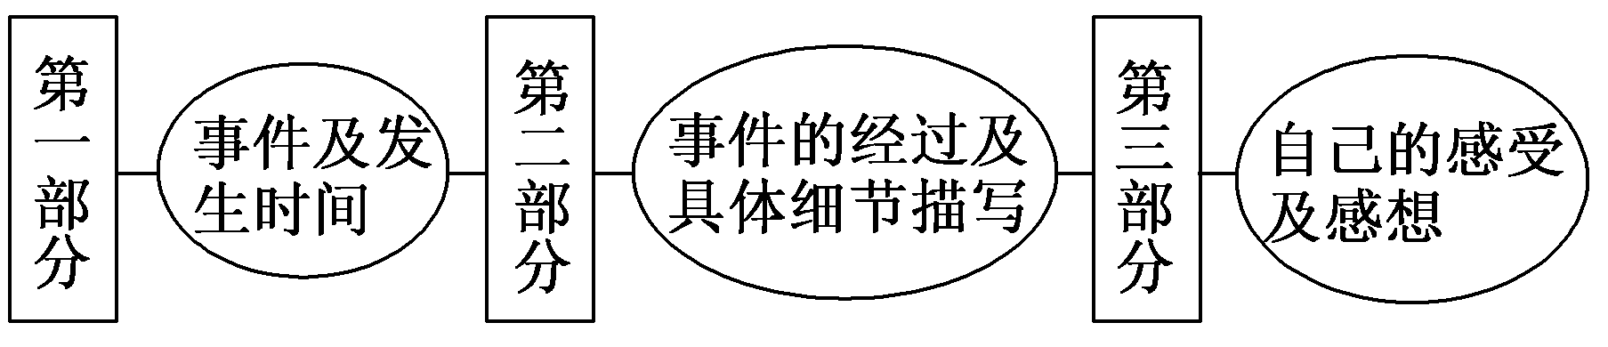
第一步 构建框架，清晰行文
[谋篇布局]

Slide 14
[黄金模板]
________(月，日，年，星期)________(天气)
________________________(标题)
Today/Yesterday, I/we did ________________(事件)．

Slide 15
In the morning, we ... then, ...after that ... By the time ... We had a good time. Finally ________________(具体叙述事情经过). I'll never forget the memorable day!
From this activity, I have learned that/I think _____(事件意义，自己的感想)．

Slide 16
第二步 打造亮句，增色文章
1．因为我数学考试成绩不佳，我整个下午情绪低落。
►I was in a bad mood the whole afternoon because I didn't do well in the math exam.
►I got bad grades in the math exam, so I was in low spirits the whole afternoon.

Slide 17
2．在同学们的鼓励下，我拿起麦克风唱了一首英文歌曲
  I Believe I Can Fly。
►Encouraged by my classmates, I picked up the microphone and sang an English song entitled I Believe I Can Fly.
►Because I was encouraged by my classmates, I picked up the microphone and sang an English song which is entitled I Believe I Can Fly.

Slide 18
第三步 串句成文，保证流畅
Friday, Nov. 18, 2011Sunny
This evening I went to the KTV with some of my good friends.
This was the first time that I had been to a KTV and at first I didn't want to go. I was (had been) in a bad mood the whole afternoon because I didn't do well in the math exam.

Slide 19
At the KTV, everybody sang his favorite songs very happily except me — I was only one of the audiences. I dare not have a try because I was afraid that I couldn't sing well. Encouraged by my classmates, I picked up the microphone and sang an English song entitled I Believe I Can Fly.

Slide 20
I have become cheerful now and above all I've regained self­confidence. I believe that, the worst enemy in one's life is oneself. I shouldn't lose heart just because of one or two failures because I still have chances to try.

Slide 22
(2012·北京模拟)假设你是某所中学的学生，3月22日(世界水日)你参加了你班开展的一系列节水宣传活动。请根据以下四幅图的先后顺序，以日记的形式记录当天的活动内容。
注意：词数不少于60。
提示词：宣传材料leaflets；危机crisis

Slide 23
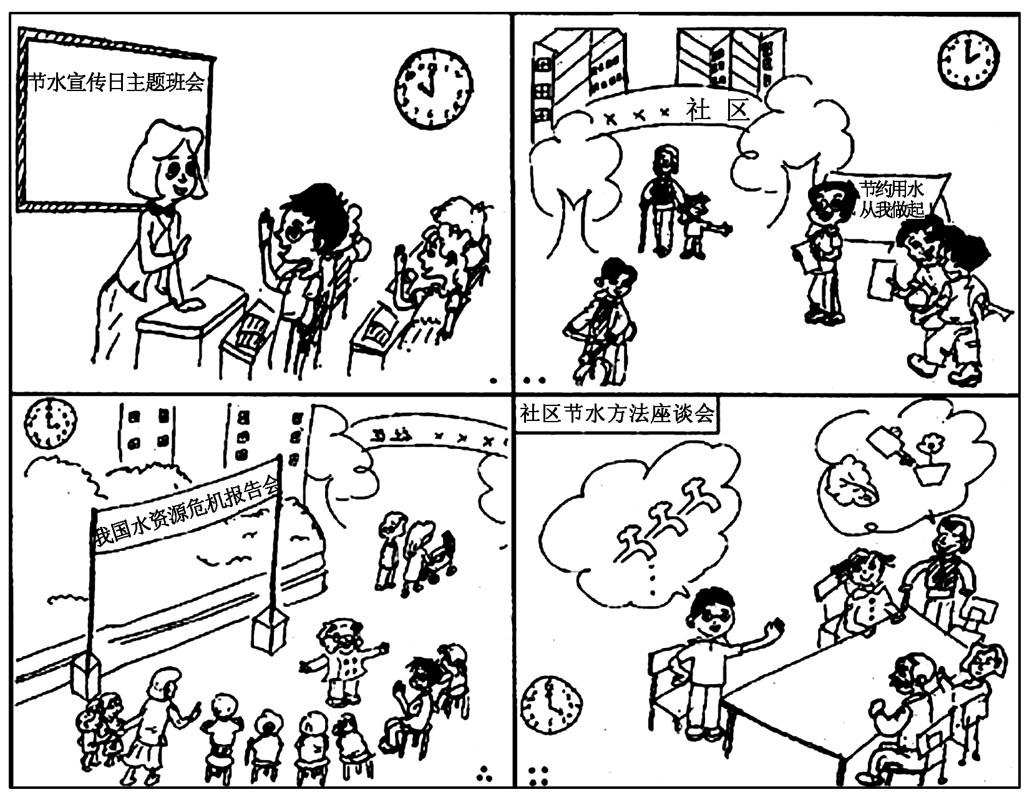

Slide 24
March 22, 2012 Thursday Sunny
Today is World Water Day. __________________________________________________
____________________________________________________
___________________________________________________
____________________________________________________
___________________________________________________

Slide 25
参考范文：
March 22, 2012 ThursdaySunny
Today is World Water Day. In the morning, we had a class meeting talking about what to do on this special day. Finally, we reached an agreement and immediately began to make preparations for the afternoon's activities.

Slide 26
At 2：00 pm, we went to the neighboring community to hand out leaflets, calling on people to save water. Around 3 o'clock, the expert we invited made an excellent speech on the current water crisis in China. He talked about the draught in the Southeast and the severe shortage of water in our city. The speech had a strong appeal to all the people present, including me.

Slide 27
After the speech, we had a discussion with our neighbors about various ways of saving water in our daily life. I suggested turning off the tap water immediately after use, and a granny came up with the ideas of reusing the water from kitchen, for example, the water after washing fruits and vegetables can be used to water flowers and so on.

Slide 28
Today, I have had a better understanding of the importance of saving water and really learned a lot about saving water.

