Slide 1



Slide 2











Slide 3


Slide 4
[题目要求]
(2012·黑龙江名校联考)为了提高同学们处理突发事件的能力和自救的能力，你校决定举办一场地震知识讲座，并观看相关录像。假设你是校学生会主席，请你以学生会名义用英语写一则书面通知(写通知时间为2012年10月2日)。

Slide 5
时间：2012年10月16日，星期二，上午8：00
地点：学校礼堂
内容：学习有关地震中逃生的知识，并观看相关录像
演讲人：地质学家王教授
要求：全体学生按时参加；认真听讲，记好笔记；讲座后进行讨论。

Slide 6
注意：
1．内容完整，不要逐字翻译以上提示；
2．词数100左右。
参考词汇：地质学家 geologist

Slide 7
NOTICE
In order to help us deal with emergencies and save ourselves, ___________________________________________________
___________________________________________________
____________________________________________________
____________________________________________________
____________________________________________________
Students' Union
October 2, 2012

Slide 8
[技法指导]
通知是一种安排活动或布置工作时使用的文体，可分为两类，即口头通知(Announcement)和书面通知(Notice)。口头通知是当面向有关人员口授有关活动的信息，而书面通知是以布告的形式把事情通知给有关人员。通知的要素是时间、地点、对象、事件具体内容、注意事项等。通知的语言应该简洁明了、直截了当。除此之外，还应该注意要有一定的逻辑顺序。

Slide 9
口头通知的开头往往有称呼语(被通知的对象)，以及提醒听众注意倾听的开场白。常见的开场白有：
·Ladies and gentlemen/Boys and girls, may I have your attention, please?
·Attention, please! There will be ...

Slide 10
·Excuse me, everyone! I'd like to tell you that ...
·Now everybody! Excuse me if I interrupt you. But I have an announcement to make.
·Boys and girls, I have an announcement to make.
·Please excuse my interrupting you, but I have something important to tell you.

Slide 11
常见的结束语有：
·That's all. Thank you.
·Thank you for listening.
·OK. That's all. Wish you a pleasant journey.

Slide 12
书面通知在正文之前的正中位置写Notice字样，结尾要写明时间及发出通知的单位。被通知的对象用第一人称或第二人称(口头通知用第一人称)，要写明所做事情的具体时间、地点、概括性内容、出席对象及有关注意事项。通知是要告诉大家即将进行的活动，因此时态要以一般将来时为主。如：

Slide 13
·The match will be put off to next week.
·We are going to hold a meeting to discuss the problem. There will be a lecture on American culture .../A lecture will be given on American culture ...
·The Students' Union has decided to hold a meeting ...
·Those who are interested in it, please ...

Slide 14
·All the students are expected to attend it.
·All the students are welcome.
·Make sure that you .../Be sure to ...
·Please remember to .../Don't forget to ...
·Please attend it on time.
·Don't be late./Do be present on time.
·Don't miss the chance!

Slide 16
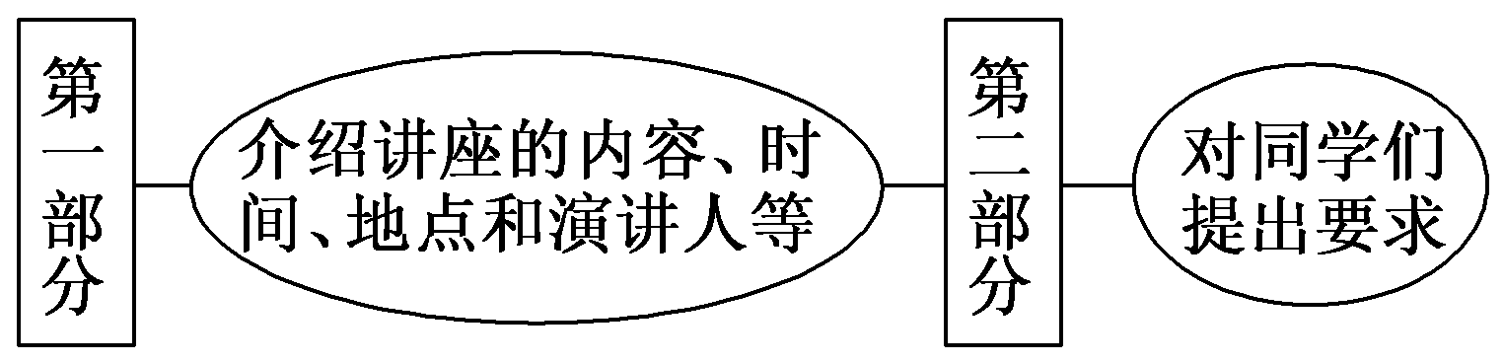
第一步 构建框架，清晰行文
[谋篇布局]

Slide 17
[黄金模板]
NOTICE
In order to help us deal with emergencies and save ourselves, a lecture will be held ________________________(时间、地点). The lecture is mainly about ________________________(具体内容). It will be given by ________________________(谁做讲座).

Slide 18
After the lecture, ________________________(其他活动内容). Everybody is required to ________________________(注意事项等).
Students' Union
October 2, 2012

Slide 19
第二步 打造亮句，增色文章
1. 中国著名地质学家王教授将为我们做讲座。
►Professor Wang, a famous geologist in China, will give us the lecture.
►The lecture will be given by Professor Wang, a famous geologist in China.

Slide 20
2．讲座过后，我们将以小组的形式展开讨论。
►A discussion in groups will be held among us after the lecture.
►After the lecture, we'll have a discussion in groups.

Slide 21
第三步 串句成文，保证流畅
NOTICE
In order to help us deal with emergencies and save ourselves, a lecture will be held in the lecture hall of our school at 8：00 am on October 16, 2012, Tuesday. The lecture is mainly about surviving in an earthquake, including the signs of a coming earthquake and the dos and don'ts during and after an earthquake. The lecture will be given by Professor Wang, a famous geologist in China.

Slide 22
After the lecture, there will be a video about earthquakes. Everybody is required to be present on time. Please listen attentively and take notes. After the lecture, we'll have a discussion in groups.
Students' Union
October 2, 2012

Slide 24
请按下列要求，用英语为学生会写一个举行英语演讲比赛的通知，词数100左右。通知必须包括以下几点：
1．目的：提高学生的英语口语水平
2．组织者：校学生会
3．参加者：高三学生

Slide 25
4．报名时间与地点：2012年9月20 日以前，学生会办公室
  参考词汇：学生会 Students' Union；报名 sign up；
  英语演讲比赛 English speaking contest
  _________________________________________________
  _________________________________________________
  _________________________________________________
  _________________________________________________

Slide 26
参考范文：
Notice
In order to improve the students' spoken English, an English speaking contest (among the students of Senior 3) will be held in the school auditorium at seven o'clock p．m. on October 5th, 2012. The contest is organized by the Students' Union. Those who would like to take part in the contest may sign up in the office of the Students' Union before September 20th. Five English teachers will be invited to work as judges. The first ten winners will be given rewards.

Slide 27
All students of Senior 3 are welcome to join in the contest.
Students' Union
September 15th, 2012

