Slide 1



Slide 2











Slide 3


Slide 4
[题目要求]
(2012·湖北名校模拟) 请根据下表提供的信息写一篇文章向外宾介绍国家体育馆“鸟巢”。
地点 | 北京北部
建筑面积 | 25.8万平方米，可容纳9万多名观众
开/竣工时间 | 2003年12月～2008年
外观 | 犹如树枝搭成的鸟巢
用途 | 奥运会期间可举办田径、足球比赛奥运会后可用于举办各种大型活动
专家评价 | 奥运史上一个难以置信的标志性建筑

Slide 5
注意：词数120左右。
参考词汇：标志 symbol; 鸟巢 Bird's Nest
__________________________________________________
__________________________________________________
__________________________________________________
__________________________________________________

Slide 6
[技法指导]
说明文是阐述事物的特征、本质、性能、结构、用途或科学原理的一种文体。高考英语说明文内容集中在反映社会现象、介绍方位地点和指导如何做事情这些方面，要求考生能够按照一定的说明顺序进行介绍和说明，以达到实际应用和交际的目的。

Slide 7
写说明文宜采用三段式：第一段主要介绍要说明的对象及说明的目的；第二段说明事物的主要特征或做事情的方法步骤；第三段进行总结概括。时态通常用一般现在时。写作时应注意以下几个方面：

Slide 8
1．仔细审题：明确说明对象，抓住要说明的事物或事理的
  主要特征。
2．选择合理的说明顺序：比如时间顺序、空间顺序或逻辑
  顺序，分层次进行说明，注意条理清晰。

Slide 9
3．选择恰当的说明方法：比如定义法、举例法、比较法和
  细节描述法等，来增加文章的色彩。
4．语言：既要确切无误，又要通俗浅显。适当使用一些结
  构比较复杂的句式，如定语从句、名词性从句、倒装句、强调句及非谓语动词等，以增加语言表达效果。

Slide 11
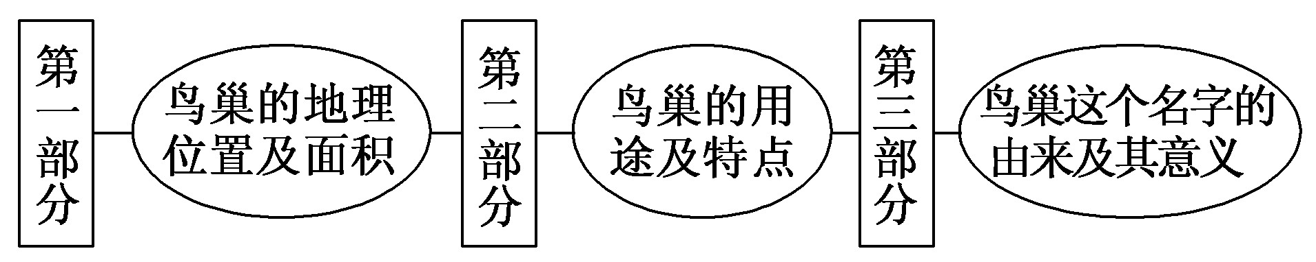
第一步 构建框架，清晰行文
[谋篇布局]

Slide 12
[黄金模板]
模板一：地理介绍型
________ is located in ________(位置), covering an area of ________(面积). It has a population of ________(人口). It grows ________， and it is rich in ________(特点)．
In a word, ________ is a fascinating place with fascinating people.Welcome to ________.

Slide 13
模板二：路线描绘型
We are going to ________________(举行活动) at/in/on ________(时间) at/in ________(地点). It is not very difficult to find your way to this place./Now let me tell you the way to this place.

Slide 14
When you get out of ________(某地一), you can take Bus ________(几路公交车) to ________(某地二), and get off at the second/third crossing.Walk across the crossing to the east/west/south/north until you see ________(某地三) on your left/right.Turn left/right there (at the corner) and go straight on/ahead.Then you can see/find ________(某地四)

Slide 15
is on your left/right.The place is next to/opposite to ________(某地点). The place is ________(多远) yards/kilometers down the street on the left/right.Find Room ________(几号房间) and we will be meeting you there.

Slide 16
模板三：说明原因型
Nowadays, more and more ________(阐述现象). Why ________(提出问题)? The reasons for it are as follows.

Slide 17
First of all, ________(原因一). Besides, ________(原因二). What's more, ________(原因三)．

Slide 18
As a matter of fact, the main cause of it is due to ________(最主要原因)．In my opinion, it is high time that we did something to ________(解决措施)．Only in this way will we ________(要实现的目标)．

Slide 19
第二步 打造亮句，增色文章
1．鸟巢，也就是国家体育馆，位于北京北部，占地面积25.8万平方米，可容纳9万多名观众。
►The Bird's Nest, the national stadium, is located in the north of Beijing, with an area of 258,000 square meters, able to hold more than 90,000 audience members.

Slide 20
►The Bird's Nest — the national stadium located in the north of Beijing, covering an area of 258,000 square meters, is able to hold more than 90,000 audience members.

Slide 21
2．从外观看，它犹如树枝搭建的鸟巢，这就解释了这个名字的由来。
►Seen from the outside, it resembles a real bird nest made of branches, which explains where its name came from.
►When it is seen from the outside, it resembles a real bird nest made of branches, which explains where its name came from.

Slide 22
第三步 串句成文，保证流畅
The Bird's Nest, the national stadium, is located in the north of Beijing, with an area of 258,000 square meters, able to hold more than 90,000 audience members.

Slide 23
Started in December 2003 and completed in 2008, it was used for track and field events and football matches during the Beijing Olympic Games. After that it will be used to hold all kinds of grand activities.

Slide 24
Seen from the outside, it resembles a real bird nest made of branches, which explains where its name came from. No wonder experts regard it as an incredible symbol for Olympic history.

Slide 26
最近某教科院对15000名高中生的课外阅读情况作了一次调查。请根据下图提示的信息，用英语写一篇100～120词的短文，介绍调查情况。
注意：1.短文必须包括调查对象、调查问题及调查结果。

Slide 27
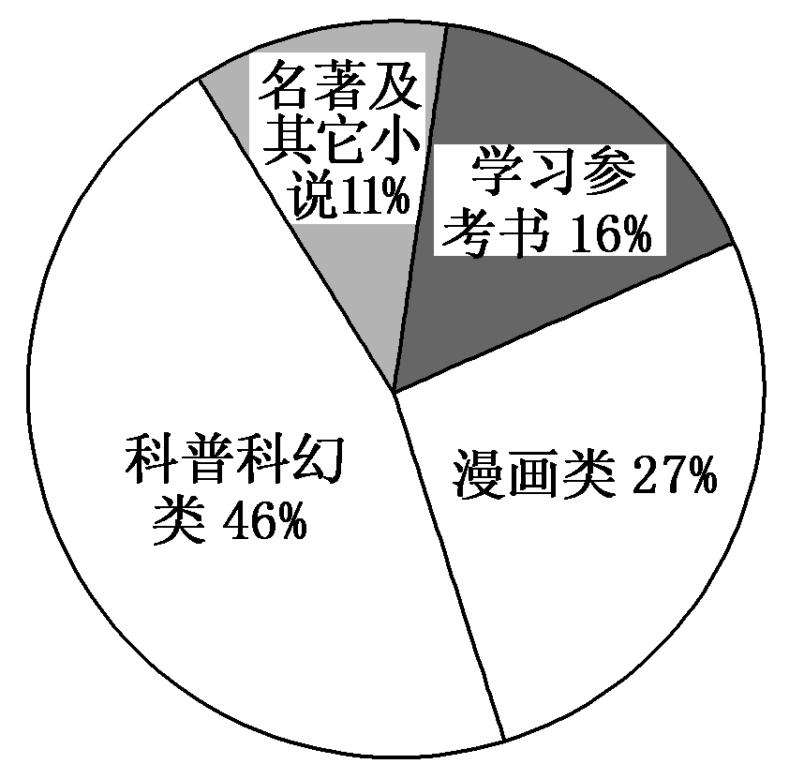
2．参考词汇：课外读物 collateral reading 漫画书 comic
  学习参考书learning reference book

Slide 28
________________________________________________
________________________________________________
________________________________________________
________________________________________________

Slide 29
参考范文：
As the saying goes “Reading makes one full; writing makes one accurate”， reading good books is one of the greatest pleasures in life, for it can make people knowledgeable and smart.

Slide 30
Recently a survey has been done to find out what books are senior middle school students' favorite collateral readings. 15,000 middle school students took part in the survey. According to the survey, forty­six percent of the students who took part, like reading popular science books

Slide 31
and science fiction best. Twenty­seven percent of the students say that comic books are their favorite and sixteen percent of the students say they read learning reference books in their spare time. Only eleven percent of them are more interested in famous works and other novels.

