Slide 1



Slide 2











Slide 3


Slide 4
[题目要求]
(2011·四川高考)最近，某中学生英文报开设了“After­class Activities”的栏目。请你根据以下提示，为该栏目写一篇英文稿件，并鼓励同学们积极参加课外活动。

Slide 5
1．你校开展课外活动的情况；
2．你参加过的课外活动及给你带来的益处；
3．为同学选择课外活动提出建议；
4．为学校开展课外活动提出建议。

Slide 6
注意：
1．词数100左右；
2．文中不得提及人名、校名及地名；
3．稿件的开头已为你写好(不计入总词数)。

Slide 7
After­class Activities
Nowadays, after­class activities are becoming more and more popular in high schools.___________________________
____________________________________________________
____________________________________________________
____________________________________________________
____________________________________________________

Slide 8
[技法指导]
提纲作文要求考生根据给出的提示性文字，首先确定文章的中心思想，然后紧紧围绕中心思想展开论述，表达主旨。它的特点是提纲既体现了文章的层次，又规定了各段大体的内容，为考生提供了一条写作思路。考生稍加思索、计划、整理即可成文。另外，它的限定性较大。考生如果不理解提纲所提示的内容，就会感到难以下笔。因此考生要掌握提纲作文的以下写作技巧：

Slide 9
1．认真审题和分析所给出的提纲，认清题目和提纲之间的
  关系，然后确定文章的主题、大致内容以及文体。
2．每一个要点可以作为文章的一个段落层次。段落的展开
  应围绕提纲的中心和内容，不能偏离，也不能任意增减。
3．提纲只是对文章的提示和概括，不是主题句。考生需要
  根据提纲的性质，写出完整的、体现提纲主旨的句子，使之成为主题句，然后围绕主题句进行扩展。

Slide 10
4．收集材料支持主题句。材料可以是例证、亲身经历、名
  人名言、谚语警句等。应当注意的是，所选材料要与文章的主题相符，即要“扣题”，同时要具有典型性，能充分说明问题。在有多个例证的段落中，还要注意各个例证之间的连贯性。

Slide 12
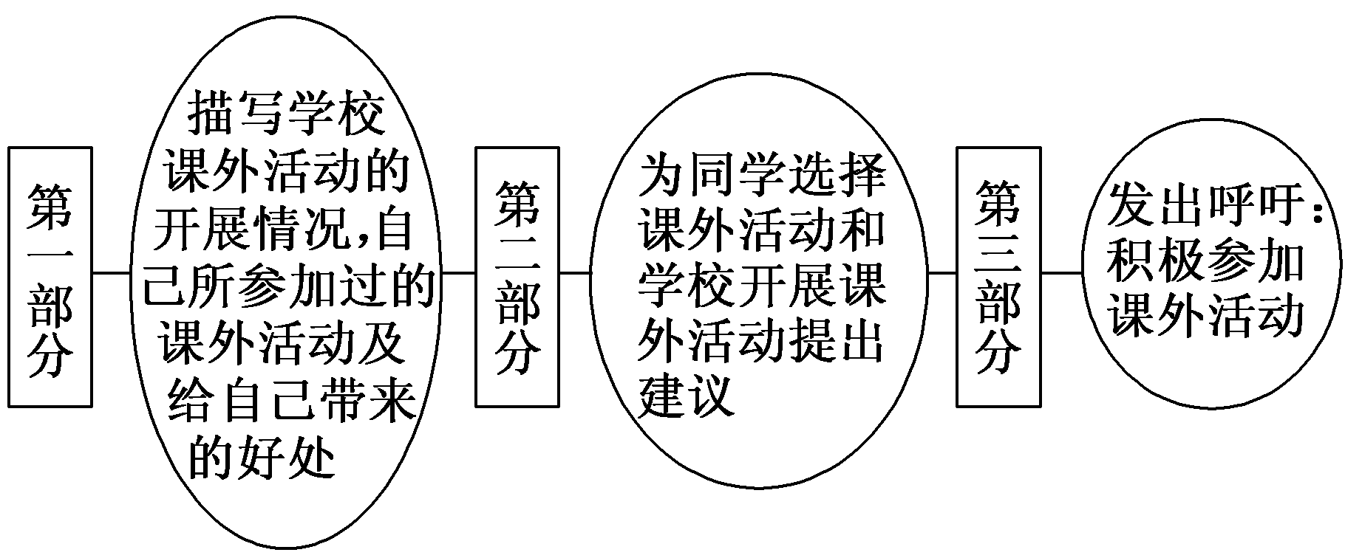
第一步 构建框架，清晰行文
[谋篇布局]

Slide 13
[黄金模板]
After­class Activities
Nowadays, after­class activities are becoming more and more popular in high schools. In our school, there are various kinds of activities, for example, ________________________ (列举具体活动名称). We enjoy them very much.

Slide 14
________________________ (具体活动名称) are my favorites which do me lots of good. Besides ________________________ (益处一), they also ________________________ (益处二)．

Slide 15
Here I have some suggestions. To students, ________________________ (具体建议一); to schools, ________________________ (具体建议二)．
Dear friends, please ________________________ (发出呼吁), which will not only make your school life colourful, but also improve your learning.

Slide 16
第二步 打造亮句，增色文章
1．在我们学校，拥有各种各样的课外活动，例如艺术和体育。
►We can take various kinds of activities in our school, such as arts and sports.
►In our school, there are various kinds of activities, for example, arts and sports.

Slide 17
2．踢足球和阅读故事都是我的最爱，因为它们给我带来很多好处。
►Playing football and reading stories are my favorites which do me lots of good.
►I like both playing football and reading stories very much, for they do a lot of good to me.

Slide 18
第三步 串句成文，保证流畅
After­class Activities
Nowadays, after­class activities are becoming more and more popular in high schools. In our school, there are various kinds of activities, for example, arts and sports. We enjoy them very much. Playing football and reading stories are my favorites which do me lots of good. Besides building my body and enriching my knowledge, they also free me from the heavy work of study.

Slide 19
Here I have some suggestions. To students, you'd better choose the activities which interest you and suit you; to schools, they should organize more activities for students and leave students more time for activities by giving them less homework.

Slide 20
Dear friends, please actively take part in after­class activities, which will not only make your school life colourful, but also improve your learning.

Slide 22
(2012·济南模拟) 假设你是光明中学的李华，你想参加美国某大学在你校举行的“赴美交换生”的选拔赛。请你根据以下要点，用英语写一篇120—150词的自我陈述。要包含以下内容：

Slide 23
1．参加目的；
2．兴趣特长；
3．未来打算。
参考词汇：交换生 exchange student
___________________________________________________
___________________________________________________
___________________________________________________

Slide 24
参考范文：
Dear Sir/ Madam,
My name is Li Hua and I am now in Grade Three, Class Two from Guangming Senior High School. I want to be an exchange student of your school. I would like to apply to join the program. Firstly, my listening and speaking skills on English are good. In class, ourEnglish teacher often

Slide 25
praises me for my excellent English capabilities. Secondly, I am very interested in American culture. My parents and I once went to America on a trip and it left me a very good impression and I fell in love with this country. Lastly, as to my personality, I am an open­minded young boy who is good at interpersonal relationship.

Slide 26
Therefore, as what I have stated above, I'll be thankful if you accept me as an exchange student. I'm looking forward to your early reply.
Yours sincerely,
Li Hua

