Slide 1

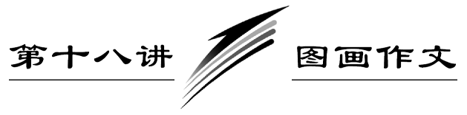

Slide 2











Slide 3


Slide 4
[题目要求]
(2011·湖南高考)假设你参加所在年级的英文写作比赛，请按如下要求完成一篇短文：
1．简要描述下图内容，并点明主题；
2．联系实际，表达该图带给你的启示。

Slide 5
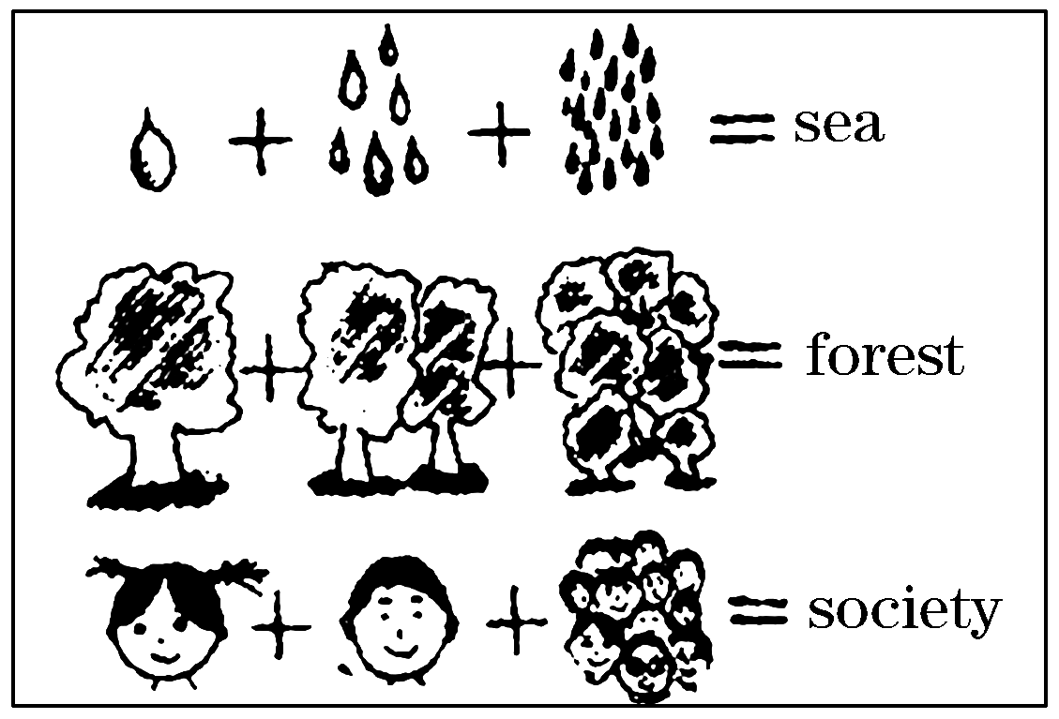

Slide 6
注意：
1．词数不少于120个；
2．不能使用真实姓名和学校名称。
____________________________________________________
____________________________________________________
____________________________________________________

Slide 7
[技法指导]
图画作文所提供的材料是一幅或几幅图，所写内容要求有日记、故事、简介等，有的还提供一定的参考词汇，因此有一定的发挥空间，但它并不是允许考生随意发挥，这是图画作文的特点，图画作文的一般写作步骤如下：

Slide 8
1．审题。主要是看清楚题目要求，读懂画面内容和所表达
  的含义，抓住要点，注意文体是什么，准备写作的人称和时态。如果是日记和故事，宜采用过去时态；如是简介之类的，宜采用现在时态。

Slide 9
2．逐图列纲。主要是就每幅图的内容列个提纲，考虑所要
  选用的单词、词组、句型，要能根据自己的英语水平，尽量扬长避短，避难就易。遇到想不起的词、句时，就用同(近)义词或同义句代替，不要使用没有把握的词句，并且要综合考虑所涉及的情景、场合，语言要地道。

Slide 10
3．连句成文。主要是把第二步所写的句子，在规定的范围
  内稍加发挥，运用适当的连词把它们串联起来组成一篇短文。但要注意句式的灵活运用，长、短句，简单句、复合句要搭配运用，不要“I”到底，句号完文。

Slide 11
4．修改润色。主要是看全文符不符合题目要求和图画
  含义，行文是否流畅，有没有遗漏要点；语法是不是正确，包括单词的拼写、大小写、标点符号、时态、语态、单复数、主谓一致、冠词等。

Slide 13
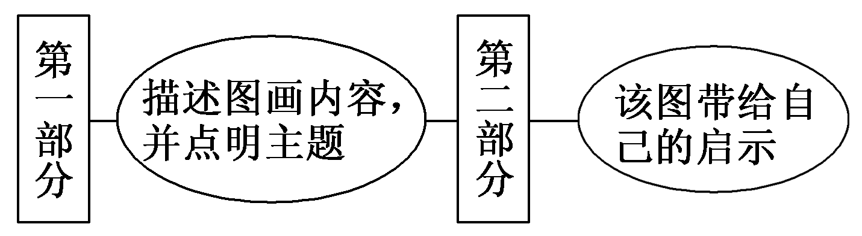
第一步 构建框架，清晰行文
[谋篇布局]

Slide 14
[黄金模板]
From the picture/In the picture/Looking at the picture, we can see it's about a person who ________(人物). It's ________(时间或地点). He/She is/They are doing ________(事件)．

Slide 15
Something occurs to me. ________(漫画中人物) should ________ and shouldn't ________(个人观点). As we all know, at present/in the society most people ________(联系生活实际). Besides/Worse still, some people ________(继续议论)．

Slide 16
In my opinion, the government/the school/we should take measures to/something must be done to ________(采取措施)．Only in this way can the problem be really solved./Only when everybody can do so will our world become more and more beautiful.

Slide 17
第二步 打造亮句，增色文章
1．这幅图引起我们的深刻思考：我们的社会是由许多拥有不同个性和性格的人组成的。
►We can't help thinking deeply when seeing the picture: our society is made up of many people who have different personality and characters.
►The picture sets us thinking deeply: our society is made up of many people who have different personality and characters.

Slide 18
2．既然我们每个人都与其他人相联系，我们就应该为我们所说所做的事情负责任。
►Now that everyone is related to others, we should take responsibility for what we say and what we do.
►Since everybody is related to others, we should be responsible for what we say and what we do.

Slide 19
第三步 串句成文，保证流畅
The picture shows us a simple truth: If too many drops of water are put together, they will become a sea. Many trees standing together form a forest and many people make up a society. It conveys a message to us: A whole is made up of many small parts that are closely related. Nothing or no one could exist alone.

Slide 20
The picture sets us thinking deeply: our society is made up of many people who have different personality and characters. If we want to create a harmonious society, we must live in harmony with others. On the other hand, since everybody is related to others, we should be responsible for what we say and what we do so that we can develop a pleasant relationship with others, which makes it possible for us to enjoy our life to the fullest.

Slide 22
(2012·南京模拟) 请你根据所给漫画用英语写一篇短文。短文内容应该包括以下三个方面：
1．描述这幅漫画的内容；
2．是否同意他们的教育方式，并陈述理由；
3．对家庭教育提出建议。

Slide 23
注意：
1．词数150左右；
2．作文中不得提及考生所在学校和本人姓名。
参考词汇：溺爱spoil v.

Slide 24
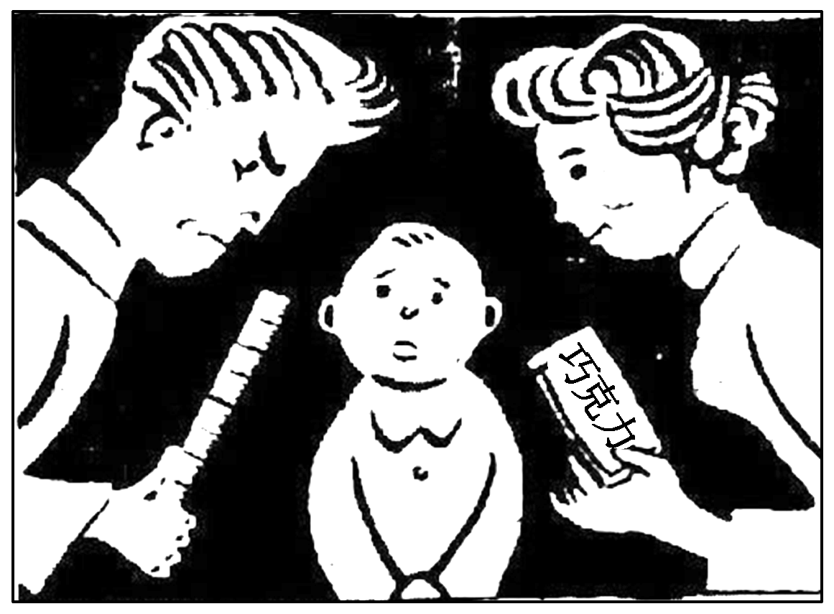

Slide 25
As can be seen in the cartoon, the young couple educate their child in different ways. __________________
___________________________________________________
___________________________________________________
___________________________________________________

Slide 26
参考范文：
As can be seen in the cartoon, the young couple educate their child in different ways. Father educates their child with a ruler but Mother with a bar of chocolate. What is illustrated in the picture is that Father is too hard on their child while Mother spoils him. They adopt strikingly inconsistent methods, which makes their child confused.

Slide 27
I subscribe to neither of their education methods. If we always give children severe punishment, they will become nervous and lack self­confidence or become violent and aggressive, following in the father's footsteps. If we always love children too much, they will turn out to be self­centered and dependent, tending to do whatever they want to.

Slide 28
So far as I am concerned, it is better to use appropriate methods based on children's individual personalities. Since praise and criticism both play vital roles in children's education, it is essential that parents should try to maintain the balance between love and strictness. Only in this way can children benefit from proper family education and achieve all­round development.

