Slide 1



Slide 2











Slide 3


Slide 4
[题目要求]
(2012·温州模拟) 据一项调查显示，有85.8%的中学生说自己的字不好看，而他们又不想改善它，其理由有很大差别。请根据下图内容用英语写一篇短文，说明该现象并发表看法。

Slide 5
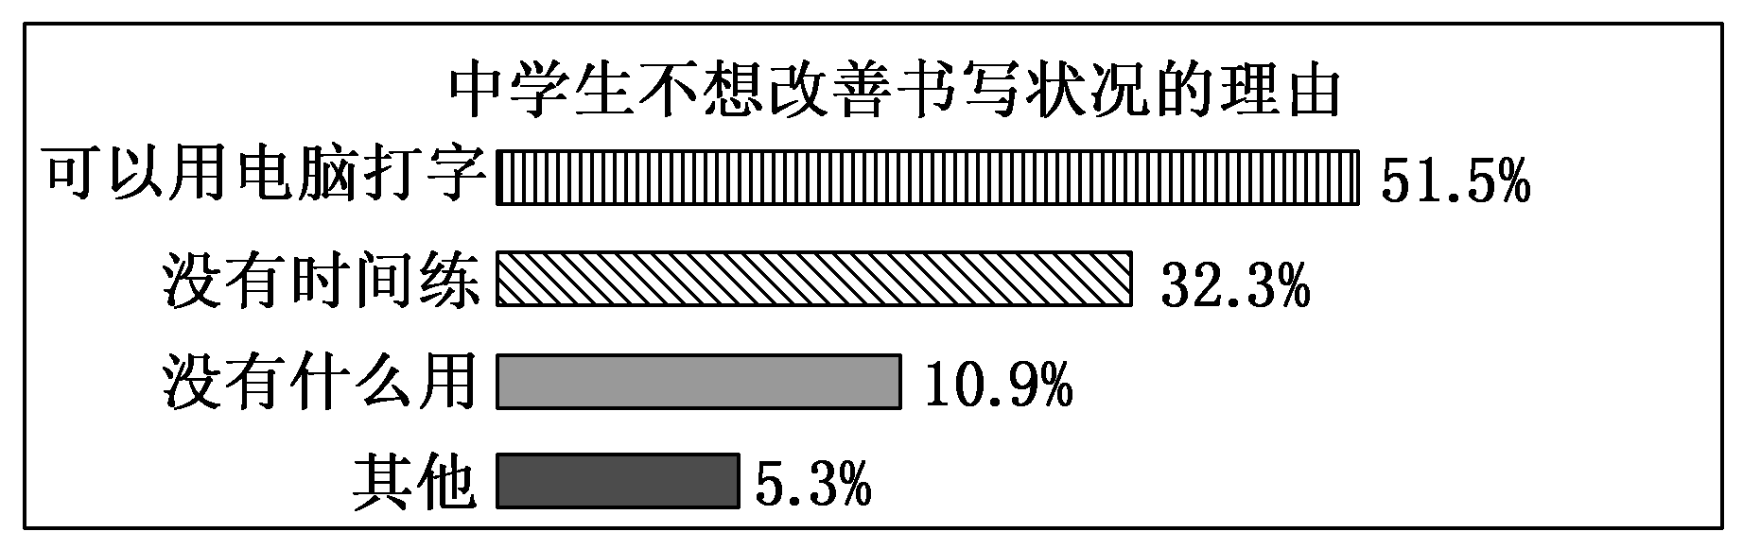

Slide 6
注意：词数100—120(开头已给出，不计入总词数)。
Nowadays, with the growing popularity of computers, more and more people are paying less and less attention to their handwriting. ____________________________________
____________________________________________________
____________________________________________________

Slide 7
[技法指导]
图表作文要求学生首先看懂图表旨在展示的内容，然后准确清晰地进行分析、描述和概括，最后得出合乎情理的结论。写图表作文的一般步骤如下：

Slide 8
1．开头部分：图表作文的首段必须描写图表，这里应该包
  括趋势描写和数据支持。
2．主题段落：在这一部分，考生应该根据图表所提供的信
  息进行分析，阐述自己的观点和理由。

Slide 9
3．结尾部分：考生可以总结全文，加深读者的印象；也可
  以发出号召，唤起读者的共鸣；还可以表示作者的信念，增强文章的感染力；有时，也可以提出问题，启发读者思考。
  无论怎样，考生都应该注意既要做到与开头呼应又要概括全文，使读者有一个统一完整的概念。

Slide 10
写图表作文时，考生还应注意以下几个方面：
1．图表往往提供大量数据，应仔细观察分析，从中选择有
  效信息进行描述。
2．充分利用图表中提供的文字或说明。同样，图表中没有
  的信息不能凭主观想象任意捏造。

Slide 11
3．说明、描述图表时应该注意动词时态，属于过去发生的
  应该用一般过去时，属于经常发生的应该用一般现在时。
4．句子结构要力求有变化，不要总是一个句型。

Slide 13
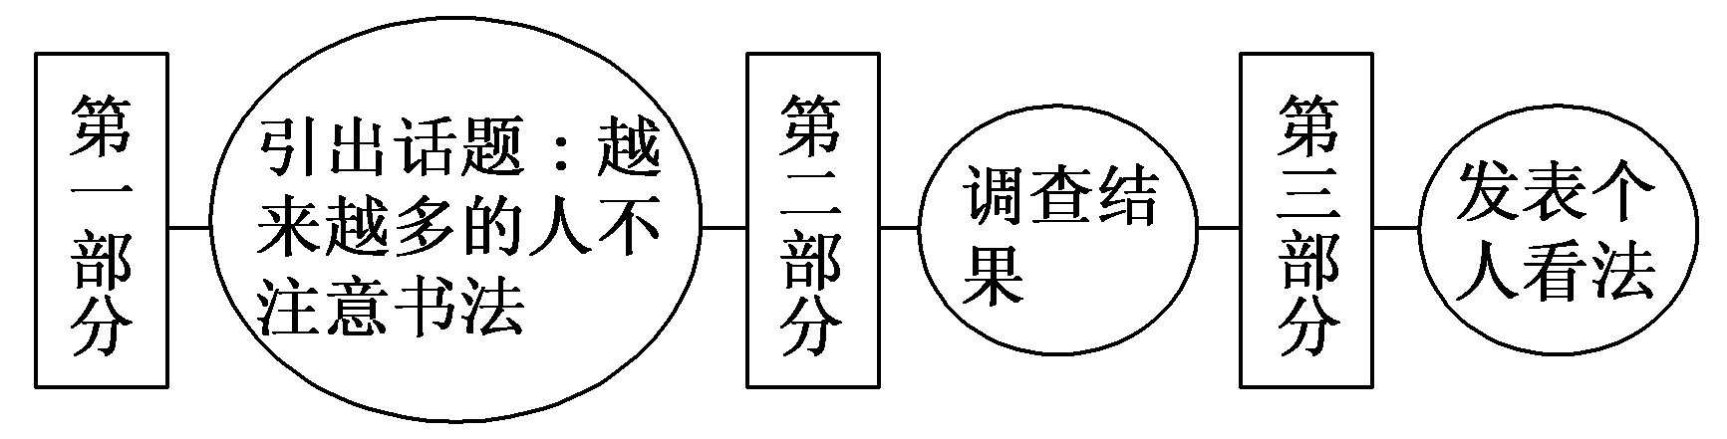
第一步 构建框架，清晰行文
[谋篇布局]

Slide 14
[黄金模板]
The chart gives us an overall picture of the ________________(图表主题). The first thing we notice is that ________________(图表最大特点). This means that as ________， ________(进一步说明)．

Slide 15
We can see from the statistics given that ________(图表细节一). After ________(细节一中的第一变化), the ________(紧跟着的变化). The figures also tell us that ________(图表细节二). ________(数据位置，如In the second column), we can see that ________ accounts for ________(进一步描述)．

Slide 16
Judging from these figures, we can draw the conclusion that ________(结论). The reason for this, as far as I am concerned, is that ________(给出原因). /It is high time that we ________(发出倡议)．

Slide 17
第二步 打造亮句，增色文章
1．根据最近的一项调查，大约85.8%的中学生认为他们的字不好看。
►A recent survey shows that about 85.8 percent of middle school students hold the idea that their handwriting is poor.
►According to a recent survey, about 85.8 percent of middle school students think that their handwriting is poor.

Slide 18
2．漂亮整洁的书法是有益的，尤其对中学生来说。
►It's beneficial for students, especially for middle school students, to have beautiful and neat handwriting.
►Beautiful and neat handwriting is beneficial, especially for middle school students.

Slide 19
第三步 串句成文，保证流畅
Nowadays, with the growing popularity of computers, more and more people are paying less and less attention to their handwriting.

Slide 20
According to a recent survey, about 85.8 percent of middle school students think that their handwriting is poor. Yet for various reasons, many students don't want to improve their handwriting. 51.5 percent of them think that they can just use a computer, so there is no need to waste time improving their handwriting, and 32.3 percent believe that they are so busy with the study that they do not have time to practice. 10.9 percent think that practicing handwriting is useless. The rest have other reasons.

Slide 21
As the saying goes, writing style shows the man. Beautiful and neat handwriting is beneficial, especially for middle school students. Therefore, in my opinion, more emphasis should be placed on this aspect in future.

Slide 23
(2011·北京东城区模拟)近日，某报对我市几所小学的学生展开了一项关于“什么样的人可以当班长”的调查。请根据下面的图表写一篇英语短文，介绍调查结果并谈谈你认为什么样的人可以当班长。

Slide 24
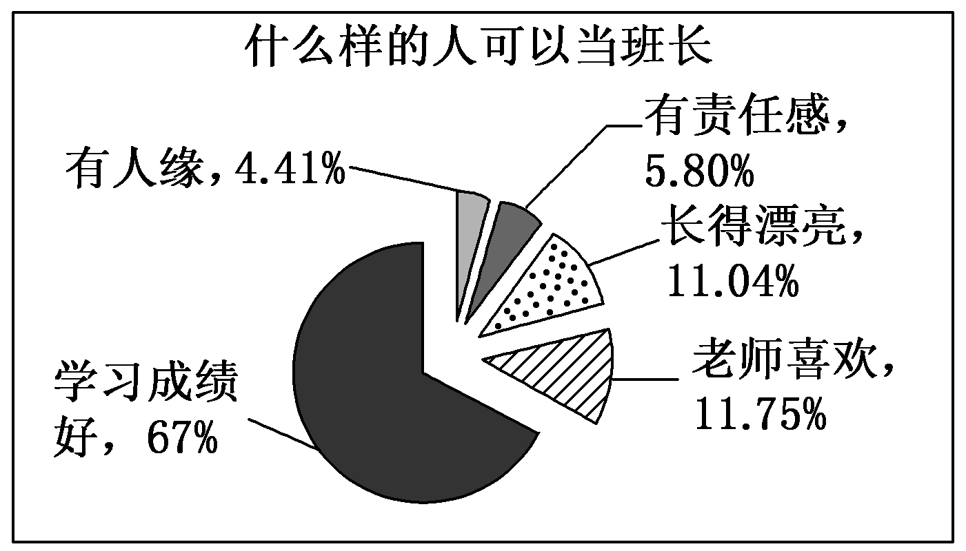

Slide 25
注意：
1．开头已为你写好，不计入总词数。
2．词数不少于60。
The primary school students have different opinions on what kind of person can become a monitor. ______________________________________________________________________________________________________
___________________________________________________

Slide 26
参考范文：
The primary school students have different opinions on what kind of person can become a monitor.
We can see from the pie chart that about 4.41% of the students believe that those who have good relationship with others are likely to become a monitor. More students around 6%, however, think that the most important character of a monitor is having responsibility. Interestingly, there are

Slide 27
about 11.04% considering that a monitor should have a good look while 11.75% of them suppose that teachers usually appoint their favourite students as monitors. The majority of students, about 67% believe that only when they do well in their studies can they have the chance to become a monitor.

Slide 28
On the one hand, I think, being a monitor requires high grades in study so that you can set a good example to the fellow students. On the other hand, being responsible is of equal importance to studying well. You need to be a good assistant to your teacher to help deal with some daily affairs in class, and sometimes when the headteacher is away, you are to be in charge of the class.

