Slide 1



Slide 2











Slide 3


Slide 4
[题目要求]
(2011·安徽高考)某校英文报开辟了一个专栏：Experience。本期话题是如何解决学习中遇到的困难。请你以“My Approach to Difficulties in Learning”为题，用英语写一篇短文，谈谈自己的一些做法。

Slide 5
要求：1.词数100左右；
2．短文中不能出现本人的相关信息。
____________________________________________________
____________________________________________________
____________________________________________________
____________________________________________________

Slide 6
[技法指导]
针对开放类作文的灵活性与开放性，考生可以按以下几个步骤写作：
一、认真审题，把握要求，找准提示语中的关键句。
开放作文需要考生根据试题提示的要求进行立意，确定文章的中心思想。立意的基础是审题。因此，考生在着手写作之前，要认真审题，把握命题要求，找准提示语中的关键句。

Slide 7
二、依据关键句，草拟提纲，梳理文章脉络。
  通过认真审题，找准关键句以后，下一步的任务就是如何安排已选定的这些材料，要为自己心中所设想的材料草拟一个提纲，梳理清楚先后顺序。这样写起来就会有条不紊、条理清楚、详略得当，使得所写的文章中心突出。

Slide 8
三、准确定位人称、时态。遣词造句要扬长避短。
1．开放作文通常以提供一个故事材料片段为主。大部分情
  况下，文中所使用的动词时态以一般过去时为主，但人
  称的使用较为灵活，考生应该依据文章提示准确定位人称。

Slide 9
2．在人称、时态准确定位以后，考生应将重点放在文章的
  遣词造句上。考生应尽可能运用自己熟悉的单词、短语或
  句型来灵活表达，但要避免单词、短语或句型的重复使用。
  简而言之，开放作文的写作思路和汉语作文非常相似。首先要明确主题，然后根据主题构建文章的主体结构，即写作提纲，最后在写作过程中要突出主题、层次分明。

Slide 11
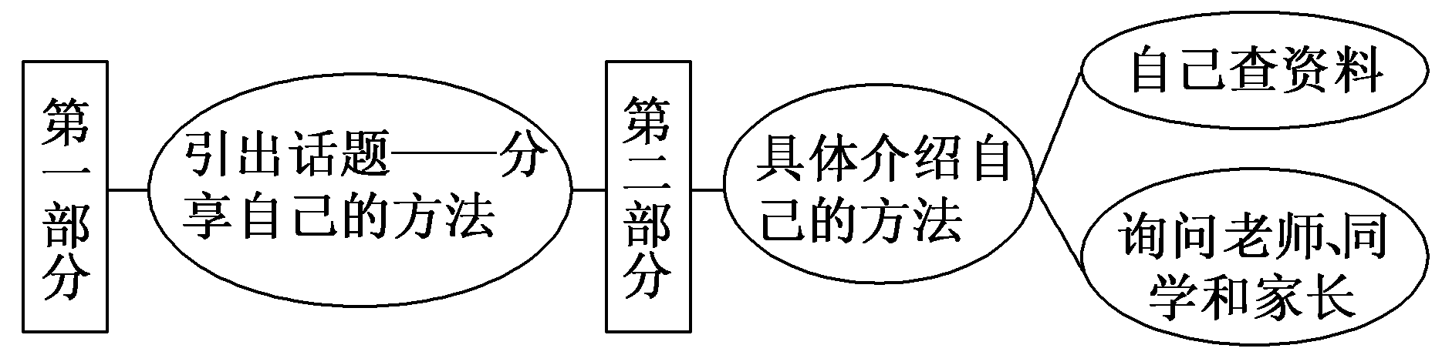
第一步 构建框架，清晰行文
[谋篇布局]

Slide 12
第二步 打造亮句，增色文章
1．面对一个难题，我通常选择参考有关的学习资料或网页。
►Faced with a difficulty, I usually choose to refer to relevant learning materials or Web pages.
►When I am faced with a difficulty, I usually choose to refer to relevant learning materials or Web pages.

Slide 13
2．用这种方法，我不仅可以把难题做出来，而且还能提高自己克服难题的能力。
►With this method, not only can I work it out but also improve my ability to overcome problems all by myself.
►In this way, I can not only work it out but also improve my ability to overcome problems all by myself.

Slide 14
第三步 串句成文，保证流畅
My Approach to Difficulties in Learning
As high school students, we run into one difficulty after another in the process of learning. Everyone has their own way to deal with them. Here I would like to share mine.

Slide 15
When I am faced with a difficulty, I usually choose to refer to relevant learning materials or Web pages. In this way, I can not only work it out but also improve my ability to overcome problems all by myself.

Slide 16
However, when it is something beyond my competence, I turn to my classmates or teachers for help. Sometimes I also ask my parents for advice. As a result, I have made steady progress in my studies.

Slide 18
(2011·湖北高考)请根据以下提示，结合你校园生活中的一个事例，就与人合作这一话题，用英语写一篇短文。
Working in groups at school is an opportunity to learn more about teamwork. Teamwork shows us how other people's roles fit the purpose of the group, and it teaches us to be patient and how to respond to different people.

Slide 19
注意：①无须写标题，不得照抄英语提示语；
②除诗歌外，文体不限；
③内容必须结合校园生活中的一个事例；
④文中不得透露个人姓名和学校名称；
⑤词数为100左右。

Slide 20
___________________________________________________
___________________________________________________
___________________________________________________
___________________________________________________

Slide 21
参考范文：
Years of school life has taught me a lot of things, of which teamwork is the most important for me.
In fact, I didn't realize its importance until I was chosen monitor of my class in my senior middle school. At first, I did most of the duties myself while other students cared little

Slide 22
about class activities. As a result, I was tired out and depressed. Then I turned to my teacher and he advised me to cooperate with others. Thus I began to recognize the strengths of my classmates and have everyone do their part in class.
It is working in teams instead of on my own that has freed me of trouble and made my work more efficient.

