Slide 1

定语从句
在复合句中，如作定语的是一个从句，该从句被称为定语从句。
Attributive Clauses
修饰the boy
主语
定语从句
The boy who is wearing a black coat bought an iPod yesterday.

Slide 2
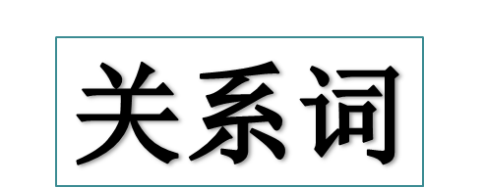
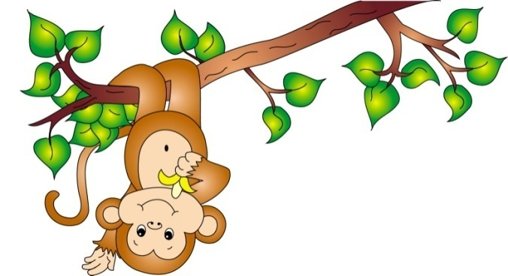
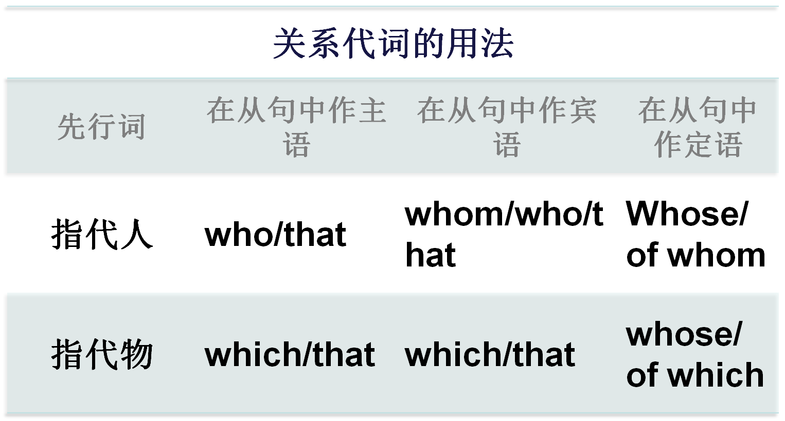

Slide 3
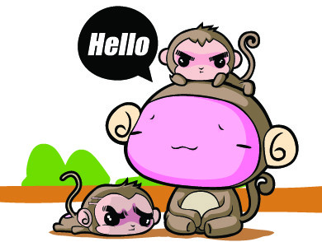
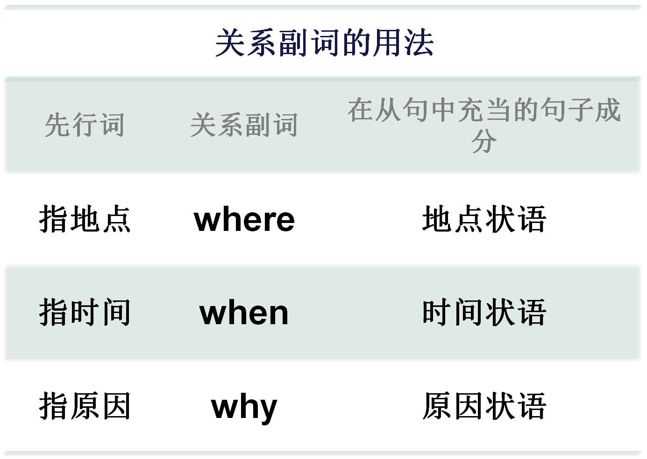

Slide 4
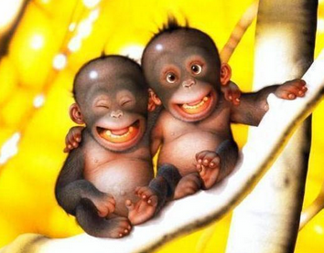
who和whom
who和whom都用于指代人，who往往可以代替在从句中担任宾格的whom，但who的前面不能有介词，如果带介词必须用whom，即“介词+whom”。

Slide 5
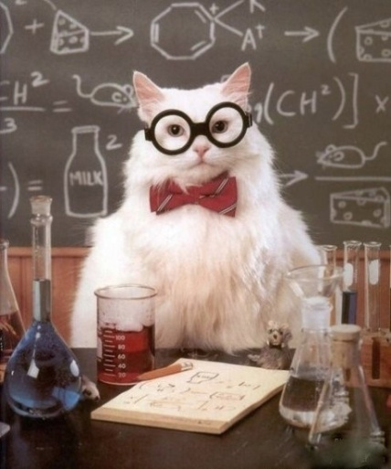
只用who不用that的情况
Anyone who laughs last laughs best.
No words are strong enough to express our thanks to those who worked hard to rescue survivors in the earthquake.
I met a girl in blue yesterday who grew up in western Yunnan province.
先行词是one, ones和anyone时
先行词是those时
当先行词有较长后置定语时

Slide 6

只用who不用that的情况
The boy that you met last night is the group leader who studies very hard.
There is a young man who wants to see your father.
一个句子中带有两个定语从句时，其中一个定语从句的关系代词是that，另一个用who。
在there be开头的句子中

Slide 7
whose的用法
Do you know Peter whose father happens to be working in your company?
你认识彼得吗？他的父亲恰巧在你们公司工作。
Xi’an, whose walls remain as good as before, is one of the few cities with city walls.
西安是少数几座有城墙的城市之一，它的城墙保持得和以前一样好。
whose是who的所有格形式，可以指代人或物。当指代物时，相当于of which，whose可以引导限制性定语从句和非限制性定语从句。

Slide 8

关系代词which和that
只用that的情况
Which of the cars that are in front of the hotel belongs to you?
He talked about the schools and teachers that he had visited.
主句已有疑问词who或which时
先行词既有人又有物时

Slide 9

We haven’t got much that we can offer you.
This is the best way that has been used against pollution.
This is the third time that they have met.
先行词为all, much, few, little, any, no, something, nothing, none等不定代词时
先行词有形容词最高级修饰时
先行词有序数词修饰时

Slide 10

This is the very room that I slept in that evening.
Edison built up a factory which produced things that had never been seen before.
先行词有the very, the only, the same, one of等修饰时
有两个定语从句，其中一个关系代词已用which，另一个宜用that

Slide 11

关系代词which和that
只用which的情况
Jim passed the driving test, which surprised everybody in the office.
This is the hotel in which you will stay.
引导非限制性定语从句
在限制性定语从句中，关系代词前有介词

Slide 12
Correct mistakes
them →whom
1. Under the big tree are 34 students, many of them come from class two.
2. This is the best TV which is made in china.
3. The famous writer and his works which the radio broadcast have aroused great interest among the students.
4. My mother has a good book, which cover looks terrible.
which → that
which → that
which → whose
Notes:
第一个答案超链接到第10张幻灯片 可查看解释

Slide 13
非限制性定语从句应注意以下几点：
1.非限制性定语从句通常不能用that引导。
2.非限制性定语从句不能用why引导, 要用for which代替why。
3. 在非限制性定语从句中，指人的关系代词作宾语时，只能用宾格whom; 不能用who替换，也不能省略。
I had told them the reason, for which I didn't attend the meeting.
Do you know Tom, whom we talked about?

Slide 14
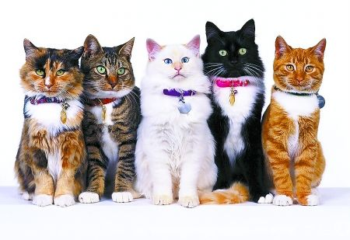
as和which 引导非限制性定语从句的区别
He didn’t tell me any news, as/which upset me.
As is reported in the newspapers, talks between the two countries are making progress.
在非限制性定语从句中，as和which都可以代替整个句子，as引导的定语从句，代表整个主句时可以放在主句之前或之后，which引导的定语从句，代表整个句子时不能放在主句之前。

Slide 15
限制性定语从句和非限制性定语从句的区别
 | 限制性 定语从句 | 非限制性 定语从句
形式上 | 不用逗号与主句隔开。 | 用逗号与主句隔开。
意义上 | 是先行词不可缺少的定语，如删除，主句则失去意义或意思表达不完整。 | 只是对先行词的补充说明，如删除，主句仍能表达完整的意思。

Slide 16
限制性定语从句和非限制性定语从句的区别
 | 限制性 定语从句 | 非限制性 定语从句
译法上 | 译成先行词的定语：“……的” | 通常译成主句的并列句
关系词的使用上 | 1.作宾语时可省略 | 1.不可省略
 | 2.可用that | 2.不用that
 | 3.可用who代替whom | 3.不可用who 代替whom

Slide 17

【例1】
Carol said the work would be done by October, ____ personally I doubt very much.
A. it B. that C. when D. which
“我个人所怀疑的”是“到十月份这工作能否被完成”，而不是“十月份”，由此判定非限制性定语从句所修饰的不是October，而是前面整个主句。答案：D。
Notes:
“碰壁点拨式”教学法是素质教育的一种方式，这种教学法的基本模式是：编拟题组—练中碰壁—讲评点拨—巩固消化。该教学法以问题为载体，以训练为主线，目标导控，问题教学，先练后讲，碰壁点拨，反馈矫正。增强了学习的方向性、选择性及目标性，使学生在克服困难消除障碍的过程中发展自己的观察力、想象力和思维能力，使他们的智慧升华，创造思维得以开发。

Slide 18
【例2】
Alice received an invitation from her boss, _____ came as a surprise.
A. it B. that C. which D. he
此为非限制性定语从句，不能用that修饰，而用which。it和he都使后句成为句子，两个独立的句子不能单以逗号连接。况且选he句意不通。答案：C。

Slide 19
【例3】
The old town has narrow streets and small houses ______ are built close to each other.
A. they B. where
C. what D. that
that 引导的定语从句，修饰先行词 streets and houses ，在定语从句中作主语；答案： D。

Slide 20

为下列句子填上合适的关系词。
This is the college __________ I visited.
that/which
This is the college _________ I studied three years ago.
where
that/which
I’ll never forget the day __________ we spent together.
I’ll never forget the day __________ I got married.
when

Slide 21
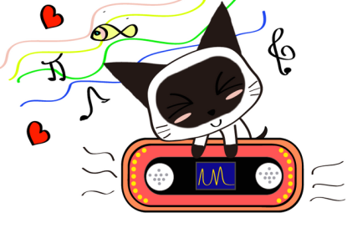
Quiz I: Fill in the blanks with proper
relative words.
1. The famous basketball star, ____ is an American, came to China yesterday.
2. They are always smoking, _____, of course, will do harm to their health.
3. I bought a car yesterday, _____ cost me a lot.
who
which
which

Slide 22
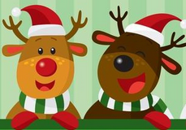
4. Xi’an, ______ I visited last year, is a nice old city.
5. He will come to see me next July, _____ he won’t be so busy.
6. The school, ______ I once studied, was built thirty years ago.
7. ____ we all know, he is good at English.
which
when
where
As

Slide 23


Quiz II: Multiple Choice
1. The book has helped me greatly in my daily communication, especially at work ________ a good impression is a must.
(2014 江苏 )
A. which B. when
C. as D. where
1.An ecosystem consists of the living and nonliving things in an area ________ interact with one another. (2013上海)
A. that B. where C. who D. what

Slide 24
3.John invited about 40 people to his wedding, most of ________ are family members. (2013重庆)
A. them B. that C. which D. whom
4.There is no simple answer, ______ is often the case in science. (2013山东)
A. as B. that C. when D. where

