Slide 1
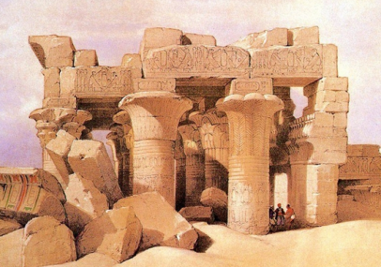
Words and
Expressions
in search of
amaze
amazing
select
honey
design
fancy
寻找
vt. 使吃惊；惊讶
adj. 令人吃惊的
vt. 挑选；选择
n. 蜜；蜂蜜
n. 设计；图案；构思
vt. 设计；计划；构思
adj. 奇特的；异样的
vt. 想象；设想；爱好

Slide 2
Words and
Expressions
style
decorate
jewel
artist
belong
belong to
in return
troop
n. 风格；风度；类型
v. 装饰；装修
n. 珠宝；宝石
n. 艺术家
vi. 属于；为……的一员
属于
作为报答；回报
n. 群；组；军队

Slide 3
Words and
Expressions
reception
at war
remove
less than
wooden
doubt
former
n. 接待；招待会；接收
处于交战状态
vt. 移动；搬开
少于
adj. 木制的
n. 怀疑；疑惑
vt. 怀疑；不信
adj. 以前的；从前的

Slide 4
Words and
Expressions
worth
local
apart
take apart
painting
castle
trial
prep. 值得的；相当于……的价值
n. 价值；作用
adj. [古] 值钱的
adj. 本地的；当地的
adv. 分离地；分别地
拆开
n. 绘画；画
n. 城堡
n. 审判；审讯；试验

Slide 5
Words and
Expressions
explode
entrance
sailor
sink
maid
think highly of
informal
debate
vi. 爆炸
n. 入口
n. 水手；海员；船员
vi. 下沉；沉下
n. 少女；女仆
看重；器重
adj. 非正式的
n. 争论；辩论
vi.争论；辩论

Slide 6

Match
in search of belong to
in return
at war
less than
处于交战状态
少于
寻找
属于
作为报答; 回报

Slide 7

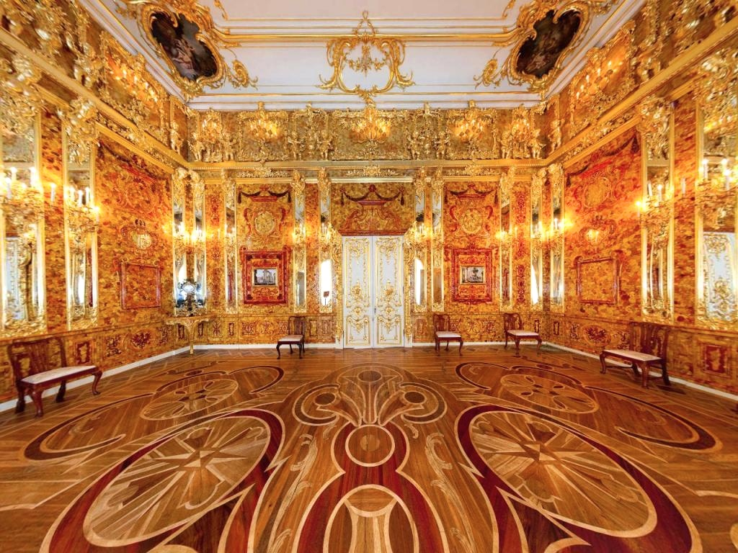

Slide 8

(1) Choose the best answer.
The passage is mainly developed in the order of _____.
A. place B. people C. time

Slide 9
(2)Match the main ideas and the paragraphs.
Para 1
How did the Amber Room become
one of the wonders of the world?
Para 2
How was a new Amber Room built?
Para 3
How did the Amber Room get lost?
Para 4
How was the Amber Room made?
Para 5
Why did the King of Prussia give
the Amber Room to the Czar of
Russia as a gift?

Slide 10
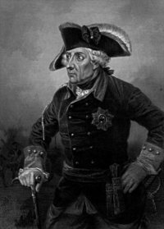
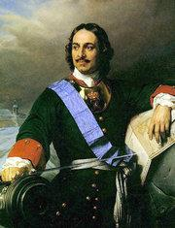

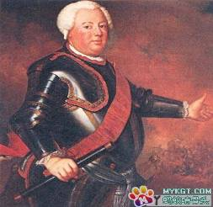

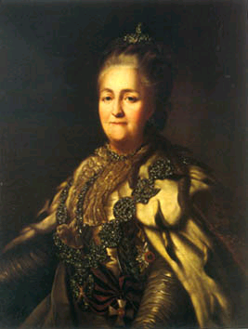
The clue of the story
Nazi
Frederick I
Peter the Great
pass down
stolen
given as a gift
pass down
Frederick William I
Catherine II

Slide 11
(3) Fill in the form below.
Year | Person | What happened to the Amber Room
 |  | built the Amber Room
 | Frederick William I | gave the Amber Room to ______________ as a gift
1770 | Catherine II | __________________________________________________
 |  | _____ the Amber Room
 | The Russians and Germans | _______ the Amber Room
Frederick I
1716
Peter the Great
had the Amber Room moved outside St Petersburg
The Nazis
stole
2003
rebuilt

Slide 12
(1) Join the correct parts of the sentences together.
A stole the Amber Room.
B sent a troop of his best
soldiers to the King of
Prussia.
C had the Amber Room made.
D had it moved outside St
Petersburg.
E gave it to the Czar as a gift.
F built a new Amber Room
after studying pictures of
the old one.
1 Frederick I
2 Frederick
William I
3 Peter the Great
4 Catherine II
5 The Nazi army
6 The Russians and
Germans
P2

Slide 13

(2) Choose the best answer.
1. How long did it take Prussian artists to
finish the Amber Room?
A. 5 years. B. 8 years.
C. 10 years. D. 12 years.
2. Why did Frederick William I give the
Amber Room to Peter the Great?
A. To stop the war between the two countries.
B. To get the best Russian soldiers.
C. To get the land of Russia.
D. To get weapons from Peter the Great.
Notes:
为方便教学，教师可提前将word页打印并在课前分发，给出scanning指令后，让学生带着任务阅读，最后看PPT对答案。节约时间，提高效率。

Slide 14
3. Who added more details to the Amber
Room?
A. Catherine II. B. Peter the Great.
C. Frederick William I. D. Frederick III.
4. What happened to the Amber Room
during World War II?
A. It was saved by the brave Russians.
B. It was burned by the German Nazis.
C. Pieces of the Room were buried in a
place in German.
D. Pieces of the Room were sent to
Königsberg by train.

Slide 15
同位语
Frederick William I, , could never have imagined
the King of Prussia
that his greatest gift to the Russian people would have such an amazing history.
宾语从句
普鲁士国王威廉一世绝不可能想到他送给俄罗斯人民的厚礼会有这样一段令人惊讶的历史。

Slide 16
同位语
However, the next King of Prussia, Frederick William I, to whom the amber room belonged, decided not to keep it.
whom引导的非限制性定语从句
当先行词在定语从句中充当介词宾语时，可使用介词+which/whom的结构引导从句。
然而，下一位普鲁士国王，腓特烈▪ 威廉一世, 这个琥珀屋的主人却决定不要它了。

Slide 17
主语
谓语
宾语
Later, Catherine II had the Amber Room moved to a palace outside St Petersburg where she spent her summers.
定语(修饰palace)
宾补
定语从句(修饰palace)
have sth. done
让/使别人做某事
I had my watch repaired yesterday.
后来，叶卡捷琳娜二世派人把琥珀屋搬到圣彼得堡郊外她避暑的宫殿中。

Slide 18
I. Complete the passage with proper words, which will help you retell the text.
The Amber Room, the best and biggest work of amber art that ever ______________(make), was first built for the palace of Frederick I. In 1716, Frederick William I gave it to Peter the Great ______a gift and in _______he got some of the Czar’s best soldiers. ______ the Amber Room became part of the Czar’s winter palace in St. Petersburg and _______(serve) as a small reception hall for important visitors. Later, Catherine II told her artists to add more details to it.
has been made
as
return
So
served

Slide 19
Unfortunately, in September, 1941, When Russia and Nazi Germany were ______war, the Amber Room was __________(secret) stolen by the Nazis. 100,000 pieces of the room were put inside twenty-seven wooden boxes. There is no doubt ___________the boxes were then put on a train for Konigsberg. __________ (recent), the Russians and Germans have built a new Amber Room which was ready for the people of St. Petersburg to celebrate the __________(300) birthday of their city in 2003.
at
secretly
that
Recently
300th

