Slide 1

P3 2
Answer the following questions.
1. How did Anne feel about nature before she and her family hid away?
2. Why do you think her feelings of nature changed?
3. Why did Anne no longer just like looking at nature out of the window?

Slide 2
How did Anne feel about nature before she and her family hid away?
Before she and her family hid away, she took nature for granted, but now she appreciates its beauty and majesty.

Slide 3
2. Why do you think her feelings of nature changed?
Her feelings have changed because she
was no longer able to go out as she pleased.
Losing freedom made her feel more
excited about good and beautiful things
around her.

Slide 4
3. Why did Anne no longer just like looking at nature out of the window?
She did not want to be a “prisoner” in the hiding place any longer. She wanted to live a normal life again.

Slide 5
Guess the implied meaning of those words and phrases according to the context.
words/phrases | what it implied
nature
outdoors
crazy
thundering clouds, entirely power
relaxed, peaceful, freedom
freedom
anxious, eager, thirsty
helpless, depressed, lonely, the worship and love for nature

Slide 6
Complete the passage with proper words, which will help you retell the text.
Anne lived in Amsterdam in the Netherlands during World War II. ______ (be) Jewish, she and her family had to hide away, or they would _________ (catch) by the German Nazis. During that time she wasn’t able to go outdoors for ___ long ____ she had ____________ about everything ________________. One evening, she stayed awake on purpose __________ have a look at the moon by herself.
Being
be caught
so
that
grown crazy
to do with nature
in order to

Slide 7
Another time she ___________ be upstairs at dusk _____ the window was open. The dark, rainy evening, the wind, the thundering clouds held her ________ in their power. It was the first time in a year and a half that she ________ (see) the night face to face. It was sad that she could only look at nature through dirty curtains _________ (hang) before windows, because nature was one thing _______ must be experienced.
happened to
when
entirely
had seen
hanging
that

Slide 8

Careful reading
重难点句式分析

Slide 9

1. I wonder if it’s because I haven’t been able to be outdoors for so long that I’ve grown so crazy about everything to do with nature.
to do短语作后置定语
if所连接的宾语从句使用了it’s ... that ...强调句型，强调状语because I haven’t been able to be outdoors for so long（原因状语从句）。
我不知道这是不是因为我长久无法出门的缘故，我变得对一切与大自然有关的事物都无比狂热。

Slide 10
Translation
1. It is because he wants to keep up with his classmates that he has decided to work hard at his English.
正是因为他想跟上其他同学，所以决定努力学习英语。
2. Tom不知道我是否因为生病的缘故，昨天才没有去参加他的生日聚会。
Tom wondered if it was because I was ill/sick that I didn’t go to his birthday party yesterday.

Slide 11
well adv.很好地;充分地;
完全地
宾语从句
2. I can well remember that there was a time when a deep blue sky, the song of the birds, moonlight and flowers could never have kept me spellbound.
定语从句，修饰time
keep后接v-ed作宾语补足语
我记得非常清楚， 以前，湛蓝的天空、鸟儿的歌唱、月光和鲜花，从未令我心迷神往过。

Slide 12
Translation
我仍能记得和我的好朋友第一天见面的时候。
I can still remember the first day 【when I met my best friend】.

Slide 13
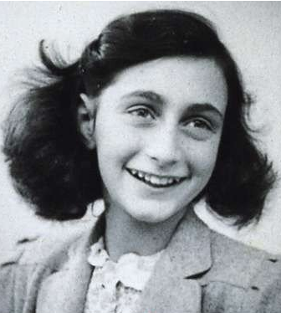
Discussion
1. If you were Anne, what would you do and how would you live such a tragic age?
2. how to deal with these things
a. that you don’t have
b. that you lost
c. that you already have

