Slide 1

同步教学辅助课件
必修5

Slide 2

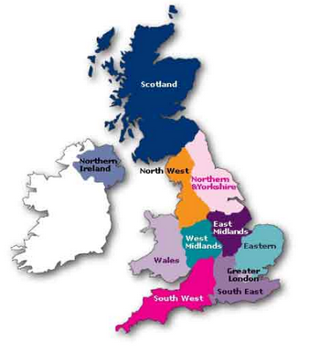
Unit 2 Reading
PUZZLES IN GEOGRAPHY

Slide 3

Words review
clarify
accomplish
conflict
unwilling
break away (from)
union
The Union Jack
credit
to one’s credit
currency
vt. 澄清；阐明
vt. 完成；达到；实现
n. 矛盾；冲突
adj. 不愿意(的)；不乐意(的)
挣脱(束缚); 脱离
n. 联合；联盟；结合；协会
英国国旗
n. 信任；学分；赞扬；信贷
为……带来荣誉;值得赞扬;
在……名下
n. 货币；通货

Slide 4
Words review
institution
educational
convenience
rough
roughly
midlands
nationwide
attract
n. 制度；机制；公共机构
adj. 教育的
n. 便利；方便
adj. 粗糙的；粗暴的
adv. 粗略地；粗糙地
英格兰中部地区
adj. 全国性的；全国范围的
vt. 吸引；引起注意

Slide 5
Words review
historical
architecture
Roman
collection
administration
port
adj. 历史（上）的；
有关历史的
n. 建筑学；建筑艺术
n. (古)罗马人
adj. (古)罗马的
n. 收藏品；珍藏；收集
n. 管理；行政部门
n. 港口（城市）

Slide 6
Words review
Anglo-Saxon
Norman
Viking
countryside
enjoyable
leave out
n. 盎格鲁-撒克逊人
adj. 盎格鲁-撒克逊人的
n. 诺曼人；诺曼语
adj. 诺曼的；诺曼人(语)的
n. 北欧海盗；斯堪的纳维亚人
n. 乡下；农村
adj. 令人愉快的；
使人高兴的
省去；遗漏；不考虑

Slide 7

1. To summarize the main idea and
retell the passage
2. To learn how the UK was formed
geographically and historically
3. To know more about England, Wales,
Scotland and Northern Ireland

Slide 8


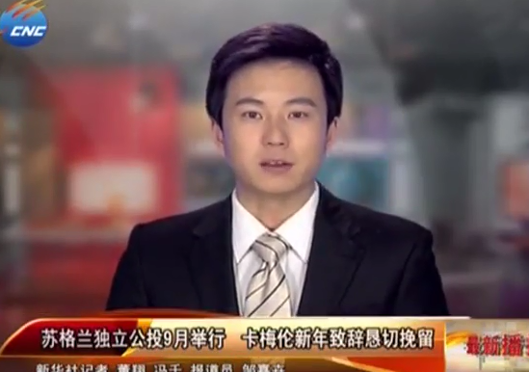



A referendum on Scottish independence took place on 18 September 2014.
or

Slide 9

What was the result of the Scottish independence referendum?
The "No" side won, with 2,001,926 (55.3%) voting against independence and 1,617,989 (44.7%) voting in favour. Scotland will remain as part of the United Kingdom, with its own Parliament.
Why did it happen? Why did Scotland want to be an independent country?

Slide 10

The Scottish National Party, whose central aim is independence, won the 2011 Scottish Parliament election by a landslide (以绝对优势).
The relationship between the four countries and the UK is complicated, let’s read the text and get more information about it.
The Scottish government believes that an independent Scotland, aided by its oil wealth, would be one of the world's richest countries.
The continued existence of legal, educational and religious institutions distinct from those in the remainder of the UK has all contributed to the continuation of Scottish culture and national identity since the 1707 union.
some reasons

Slide 11

Skimming for general idea

Slide 12


Check your answer.
Skim the passage and find the main idea of the passage.
The passage is mainly about a brief introduction of the United Kingdom, including its foundation and development based on geography, history and culture, etc.

Slide 13


the structure of the passage
Para. 1
the introduction of the topic
How the UK came into being
Para. 2
How the four countries work together
Para. 3
Part 1 about the UK
Para. 4
The geographical division of England, the similarities and differences
Part 2
about England
Para. 5-6
The cultural importance of London
Part 3
about London

Slide 14
Scanning for specific information

Slide 15



1. Which countries make up the UK?
Check your answer.
England, Wales, Scotland, Northern Ireland.
2. Which countries form Great Britain?
England, Wales, Scotland.
3. When was Wales linked to England?
How did the UK come into being?
In the thirteenth century.
4. When were England and Wales joined to Scotland?
In the seventeenth century.
5. When did Southern Ireland break away and Northern Ireland join with England, Scotland and Wales to form the UK?
In the early twentieth century.

Slide 16
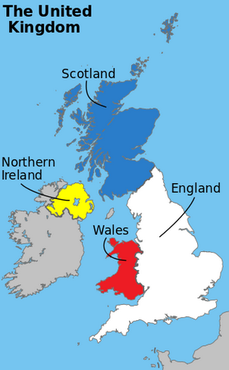
Great Britain
Do the four countries always work together? Give some examples. Do they have different institutions? Give some examples.
★
  Northern Ireland joined with England, Wales and Scotland to become the UK in the early 20th century.
the name was changed to
England and Wales were joined to Scotland in the 17th century.
★
First there was England.
Wales was linked to England in the 13th century.
★
★
Notes:
通过几幅地图可以演示联合王国的形成过程.

Slide 17

★
The four countries do work together in some aspects
(e.g. the currency and international relations)
★
They still have different institutions.
e.g. Northern Ireland, England and Scotland have different educational and legal systems as well as different football teams for competitions like the World Cup!

Slide 18

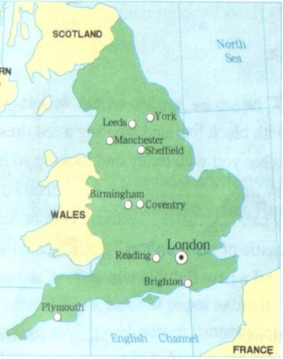
most of industrial cities
p11 3
North
Midlands
South of England
Look at the map of England and Wales. Divide it into three parts. Draw lines across to show the zones of the South, Midlands and North of England. Then put each town or city into its correct zone.
York ,Leeds,
Manchester, Sheffield
Birmingham,
Coventry
Reading, London,
Brighton, Plymouth
most of the population

Slide 19


Which city is the cultural centre of the UK? Give some examples.
It’s London. London has a lot of historical treasures. For example, it has the oldest port built by the Romans in the first century, the oldest building begun by the Anglo-Saxons in the 1060s and the oldest castle constructed by later Norman rulers in 1066.

Slide 20


The invaders’ influence on England
The Romans—
Anglo-Saxons—
Vikings—
Normans—
towns and roads
language and government
vocabulary and place-names of the North of England
castles and new words for food

Slide 21



Read the passage and answer the questions.
First Wales was linked to England. Then in the 17th century England and Wales were joined to Scotland, thus forming Great Britain. In the 20th century the UK was formed with Northern Ireland joining.
1. What do you think of the formation of the United Kingdom?
2. What three countries does British Airways represent?
England, Scotland and Wales.
3. Which group of invaders did not influence London?
The Vikings did not influence London.

Slide 22

Read the passage and complete the sentences using the words in the box.
p11 1
The countries that make up Great Britain are ___________________________.
2. If we speak of England we mean ________________.
3. The United Kingdom includes _________________
_____________________________.
4. The part of Ireland that separated from England is
called __________________________.
5. London is the capital city of ________________
____________________.
England, Wales and Scotland
England and Wales
England, Wales,
Scotland and Northern Ireland
Republic of Southern Ireland
England /
Great Britain / the UK

Slide 23
Careful reading
重难点句式分析

Slide 24
that引导主语从句
1. It is a pity that the industrial cities built in
the nineteenth century do not attract visitors.
v-ed短语作后置定语
It is a pity that ... 令人遗憾的是......，it为形式主语，that引导的为真正的主语。
很遗憾，这些建于19世纪的工业城市对游客并没有吸引力。

Slide 25

1. 真可惜你今晚不能和我们一起去看戏。
It’s a pity that you can't come to the theatre with us tonight.
2. 大部分被邀请到聚会的人是著名的科学家。
Most of the people invited to the party were famous scientists.

Slide 26
=look about / round
浏览，四下查看
if引导条件状语从句
2. If you look around the British countryside
you will find evidence of all these invaders.
if 条件句
真实条件句，遵循主将从现原则
I'll pay you double if you get the work finished by Friday.
如果你在英国的乡村四处走走的话，就会发现这些入侵者的痕迹。

Slide 27

Translate the following sentences.
1. 如果明天下雨，我们将呆在家里。
If it rains tomorrow, we’ll stay at home.
You have 15 minutes to look around.
2. 你有15分钟的时间到周围看看。

Slide 28


Discussion
1. Can you work out why London is the capital of England, Great Britain and the UK?
2. What geographical factors make it difficult to invade England successfully?

Slide 29

The full name of the UK is the United Kingdom of Great Britain and Northern Ireland. It _________ four parts. They are ________, ________, __________ and _______________. People always think Wales is part of England. The flag of the UK is called the ____________. The four countries have different educational and legal systems _________ different football teams. England is the _______ of the four countries and it is ___________ three zones. Most of the people _________ the south, but most of the industrial cities are in the _________ and the ______. The capital of the UK is London, ______ has many great _______________.
consists of
England
Wales
Scotland
Northern Ireland
Fill in the blanks to finish the Summary of the text and then try to retell it.
Union Jack
as well as
largest
divided into
settled in
Midlands
North
which
places of interest

Slide 30

Do you know the song’s name?
God Save the Queen

Slide 31

Spelling Bee
Now two minutes to test your spelling.
1. English-Chinese
conflict, union, credit, currency, institution,
convenience, architecture, collection,
administration, port, countryside
2. Chinese-English
澄清，粗糙的，完成，不愿意（的），
吸引，粗略地，全国范围的，令人愉快的
When finishing, exchange your papers to see who does the best.

Slide 32

Homework
1. Find more information about the UK.
2. 发挥想象，连词成文(50-100字).
unwilling, break away (from), union, currency, institution, nationwide, attract, architecture, collection, administration.
3. Go over “Learning about Language” 1, 2 and 3 on pages 12.
5. Do “Discovering useful structures” 1 and 2 on pages 13.

