Slide 1
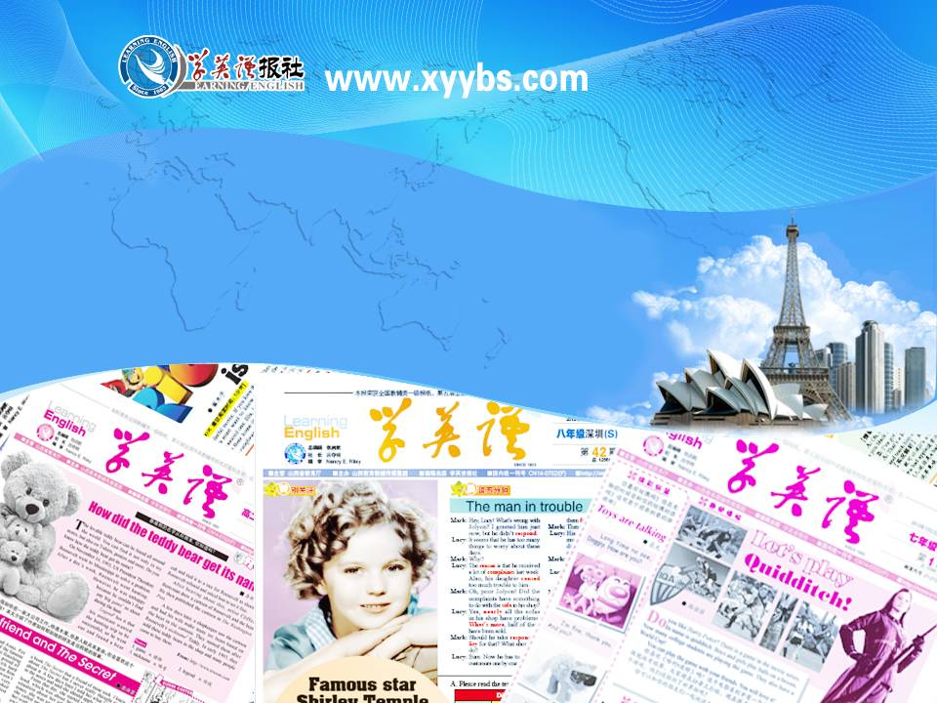
同步教学辅助课件
必修5

Slide 2

Unit 2
Words Review

Slide 3
to make sth. clear or easier to understand by giving more details or a simpler explanation
vt. 澄清; 阐明
clarify
to finish sth. successfully or to achieve sth.
vt. 完成; 达到; 实现
accomplish
an active disagreement between people with opposing opinions or principles; fighting between two or more groups of people or countries
n. 矛盾; 冲突
conflict

Slide 4
not willing
adj. 不愿意(的); 不乐意(的)
unwilling
the act or the state of being joined together
n. 联合; 联盟; 结合; 协会
union
a unit which represents a successfully finished part of an educational course; praise, approval or honour; a method of paying for goods or services at a later time, usually paying interest as well as the original money
n. 信任; 学分; 赞扬; 信贷
credit

Slide 5
the money that is used in a particular country at a particular time
n. 货币; 通货
currency
a custom or tradition that has existed for a long time and is accepted as an important part of a particular society; when a law, system, etc. begins or is introduced; a large and important organization, such as a university or bank
n. 制度; 机制; 公共机构
institution
when sth. is convenient
n. 便利; 方便
convenience

Slide 6
not even or smooth, often because of being in bad condition; dangerous or violent; not calm or gentle
adj. 粗糙的; 粗暴的
rough
without taking a lot of care to make sth. perfect; in a way that does not leave a smooth surface
adv. 粗略地; 粗糙地
roughly
existing or happening in all parts of a particular country
nationwide
adj. 全国性的; 全国范围的

Slide 7
(of people, things, places, etc.) to pull or draw someone or sth. towards them, by the qualities they have, esp. good ones
vt. 吸引; 引起注意
attract
the art and science of designing and making buildings; the style in which buildings are made
n. 建筑学; 建筑艺术
architecture

Slide 8
a group of objects of one type that have been collected by one person or in one place
n. 收藏品; 珍藏; 收集
collection
the arrangements and tasks needed to control the operation of a plan or organization
n. 管理; 行政部门
administration

Slide 9
a town by the sea or by a river which has a harbour, or the harbour itself
n. 港口(城市)
port
land not in towns, cities or industrial areas, which is either used for farming or left in its natural condition
n. 乡下; 农村
countryside
an enjoyable event or experience gives you pleasure
enjoyable
adj. 令人愉快的; 使人高兴的

