Slide 1
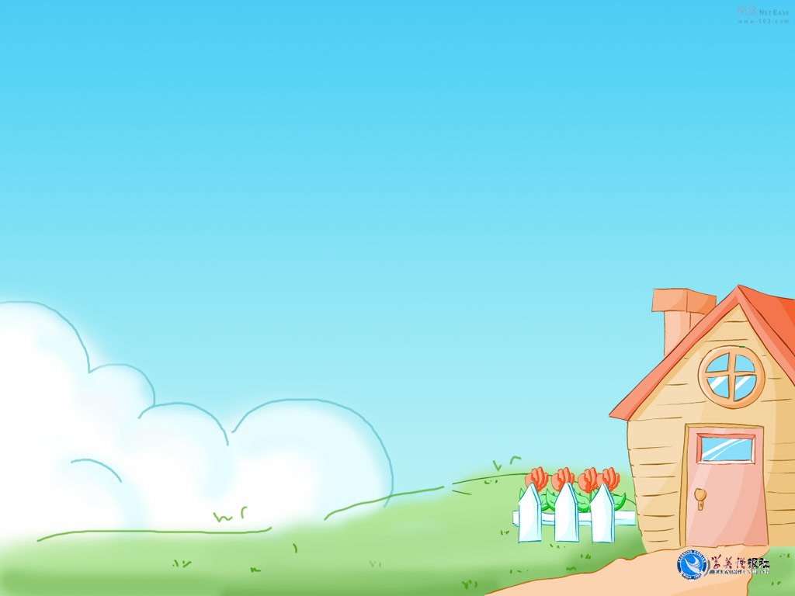

Writing

Slide 2

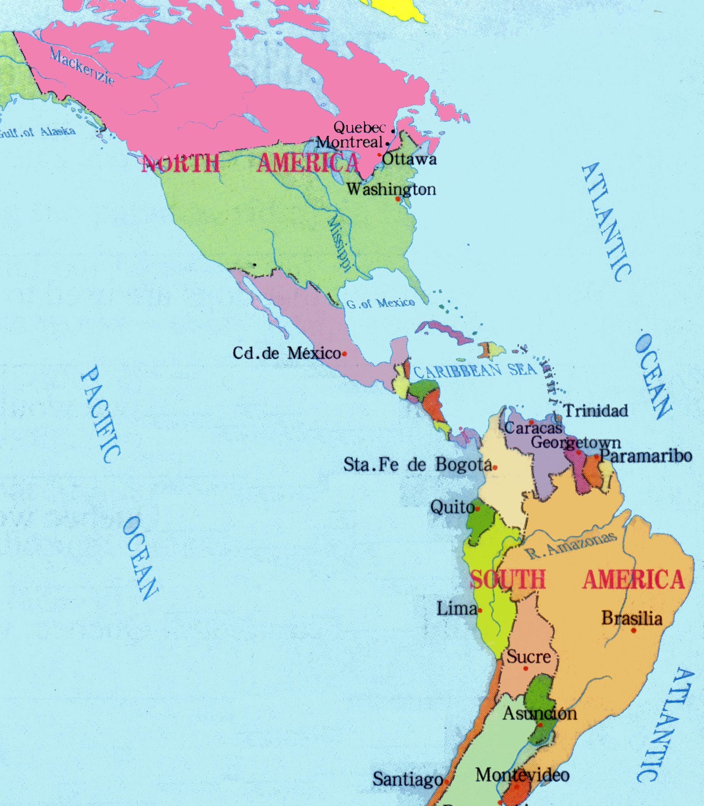
Why is the temperature so different in these two countries at the same time?
Because they lie in different places.

Slide 3
2. Suppose you are going to travel to the Carnival in Quebec, what ideas should you think about?

Slide 4

Useful expression
I must... I would...
I should... I could...
I can... I might...
I would have to...

Slide 5
Sample writing
If I could go to the carnival in Quebec, I would have to take a plan from Beijing to Montreal, I would then take a train east to Quebec City. I might spend all night on the train. It’s so cold there that I must take warm clothes with me, especially my gloves,

Slide 6
boots, hats and fur overcoats. From now on I would have to learn some French, which is the official language in Quebec, then I can talk with people there or ask for help. Even so I still need a travel companion to share my happiness or help each other. So I can invite Bob to go with me. I must

Slide 7
book the plane tickets and the hotel in advance. In order to enjoy myself there I could learn to how to skate, snowboard and ski since now.
At the thought of traveling there, I am so excited that I’d like to make preparations right now.

Slide 8
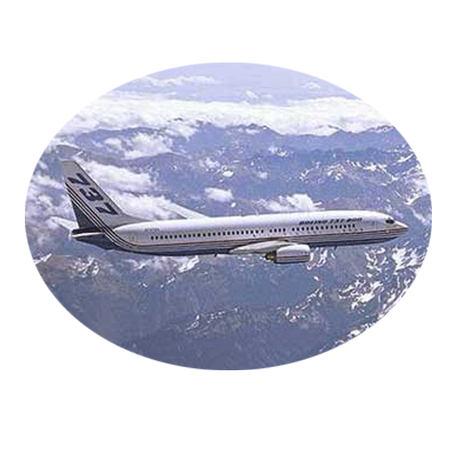
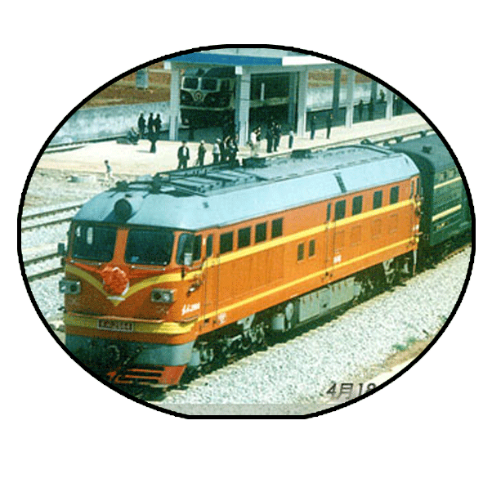
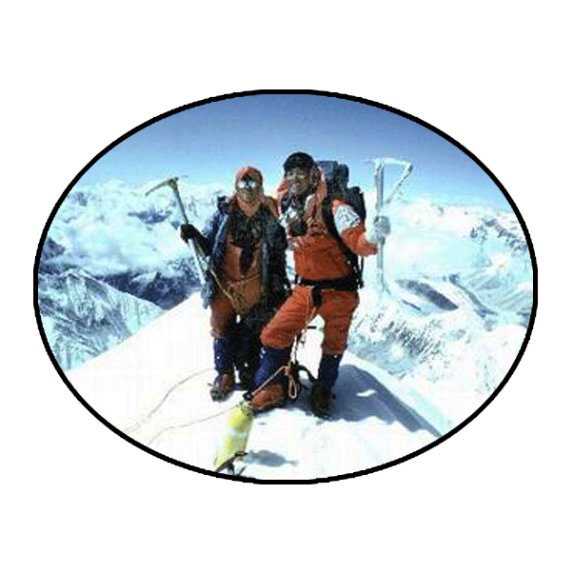
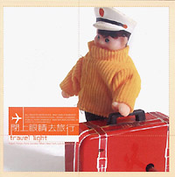

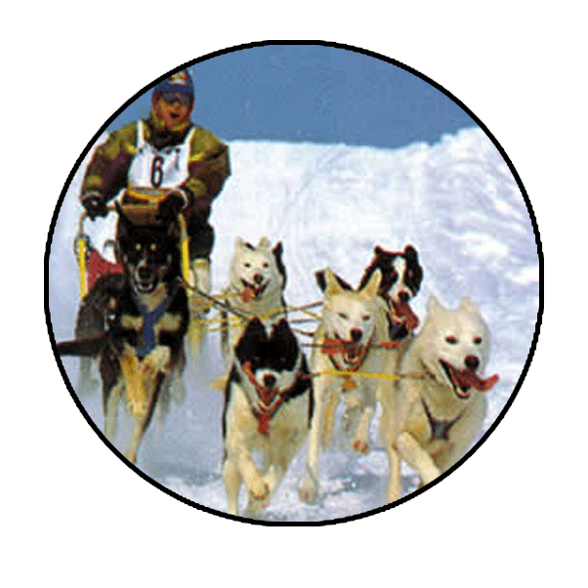


Slide 9

Project
You have learned about several festivals. Choose one of them and develop a travel brochure advertising it. You must include the following items:

Slide 10
Where it takes place;
How to get there;
What clothes to bring;
Three things that the visitor will see;
At least one thing that the visitor can do;
How much it will cost.

Slide 11
WINTER CARNIVAL IN QUEBEC
Come here by air or by train in February
It’s cold, cold, cold so bring your warmest clothes
Take part in the most well known North American winter event!

Slide 12
See the most exciting canoe race in the world!
See the very popular ice sculpture competitions in the world!
See examples of the various sports such as snowmobiling, snowboarding, ice-skating and skiing.

Slide 13
Enjoying favorite Carnival food like pea soup with bacon, crepes or pancakes with maple syrup and sugar pie.
A week experience including hotel and two meals a day
ONLY
1200 dollars per person
(children under five free)

Slide 14

Homework
Make a self-assessment after class by completing Summing-Up of Page 8 and Checking yourself on Page 47.

Slide 15

Thank you.

