Slide 1
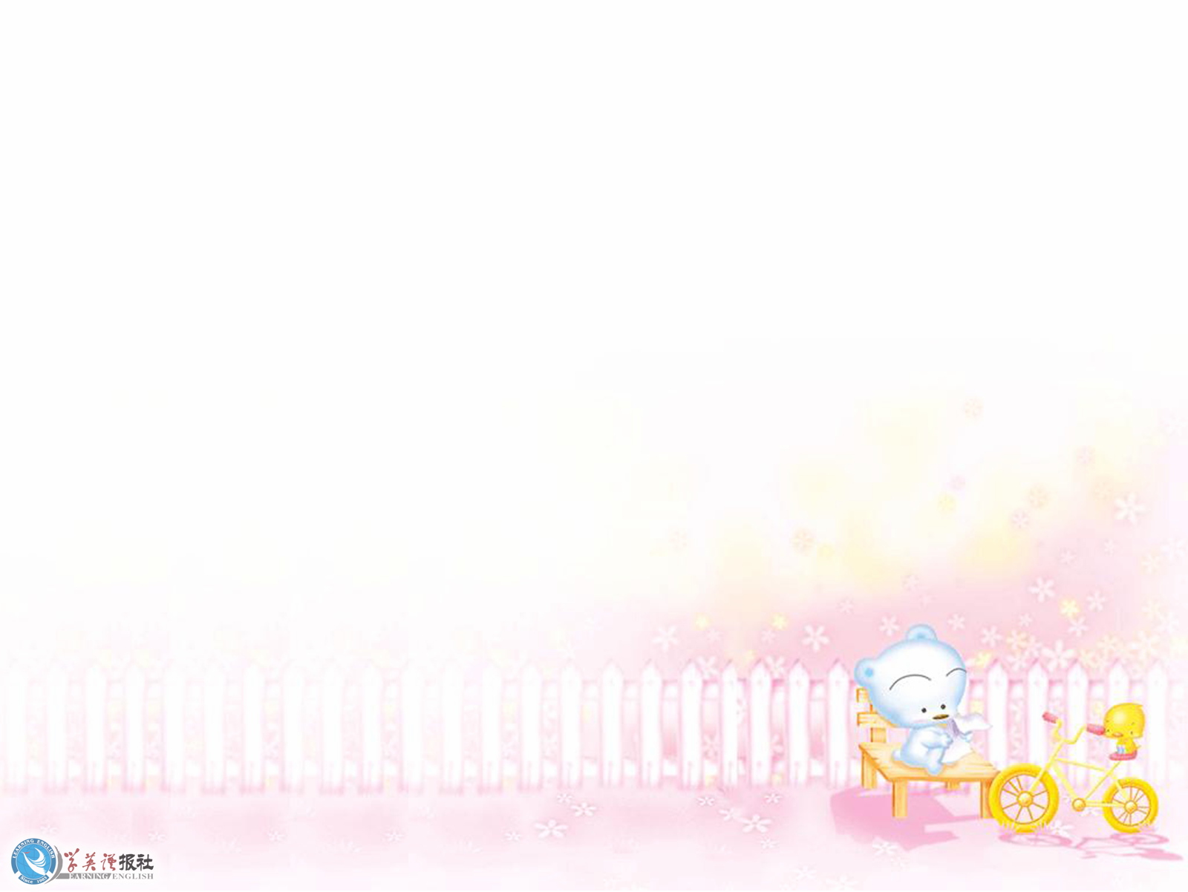
A Sad Love Story

Slide 2

Happy Valentine’s Day

Slide 3
1.What do people do on Valentine’s Day?
2. Have you ever received any gifts on Valentine’s Day?
3. Do you think only lovers send gifts to each other on that day?

Slide 4
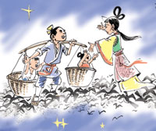
Do we have our own Valentine’s Day in China?
Qiqiaojie (乞巧节)
The seventh day of the seventh lunar month（七夕）

Slide 5
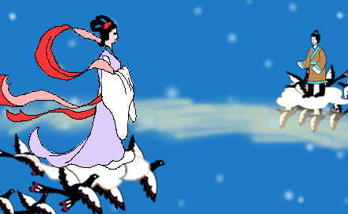

Slide 6



Well-known poem
两情若是久长时,
又岂在朝朝暮暮。
Eternal love between us two,
Shall withstand the time apart.

Slide 7



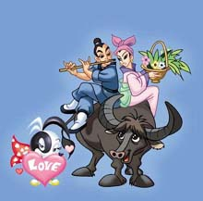
乞 巧 节
Feb. 14th
Chinese Valentine’s Day
the Double Seventh Day
the seventh day of the seventh lunar month

Slide 8
Introduction | Zhinu, the _______ girl, the most l_____ of the daughters, visited the earth and met Niulang, the _______ boy.
Development | They f___ ___ _____ , married secretly and were very happy.
Climax （高潮） | The Goddess of Heaven got so angry that she forced Zhinu back to ________ . Niulang tried to f_________ her but was stopped by the Milky Way. Thus, the c_______ were separated.
Ending | The Goddess of Heaven allowed the couple to meet once a year on the ______ day of the s_______ l_______ month when magpies made a _________ of their wings.
weaving
ovely
herd
ell in love
Heaven
ollow
ouple
seventh
eventh unar
bridge

Slide 9
Structure of a narrative (叙述文) story
Introduction | Zhinu, the weaving girl, the most lovely of the daughters, visited the earth and met Niulang, the herd boy.
Development | They fell in love , married secretly and were very happy.
Climax （高潮） | The Goddess of Heaven got so angry that she forced Zhinu back to heaven . Niulang tried to follow her but was stopped by the Milky Way. Thus, the couple were separated.
Ending | The Goddess of Heaven allowed the couple to meet once a year on the seventh day of the seventh lunar month when magpies make a bridge of their wings.
Introduction Development
Climax 高潮
Ending
The Goddess of Heaven allowed the couple
to meet once a year on the seventh day of
the seventh lunar month when magpies
made a bridge of their wings.

Slide 10
another narrative story
about Li Fang and Hu Jin
on Valentine’s Day

Slide 11
coffee
Introduction | Li Fang was waiting alone at the ________ shop with his roses and chocolates, but Hu Jin didn’t ______ ______ . He thought she would keep her w_______. Feeling like a ______, he would _________ his sadness in coffee.
Development | Li Fang watched a TV program about “Qiqiaojie”. Thinking Hu Jin played a __________________ on him, he t________ away the gifts and s_____ off for home.
Climax （高潮） / Ending | As Li Fang passed the _____ shop on the corner, he heard Hu Jin calling and waving at him, “I’ve been waiting long. I have a ______ for you! Why are you so late?” What would he do? Would she f________ him?
turn up
ord
fool
drown
trick / joke
threw
et
tea
gift
forgive

Slide 12
Structure of a narrative (叙述文) story
Introduction | Li Fang was waiting alone at the coffee shop with his roses and chocolates, but Hu Jin didn’t turn up. He thought she would keep her word. Feeling like a fool, he would drown his sadness in coffee.
Development | Li Fang watched a TV program about “Qiqiaojie”. Thinking Hu Jin played a trick on him, he threw away the gifts and set off for home.
Climax （高潮） / Ending | As Li Fang passed the tea shop on the corner, he heard Hu Jin calling and waving at him, “I’ve been waiting long. I have a gift for you! Why are you so late?” What would he do? Would she forgive him?
Introduction
Development
Climax 高潮 / Ending
As Li Fang passed the tea shop on the corner, he heard Hu Jin calling and waving at him, “I’ve been waiting long. I have a gift for you! Why are you so late?”
What would he do? Would she forgive him?

Slide 13
A sad love story
1. He was sad that Hu Jin didn’t turn up.
2. The story of Qiqiaojie made him sad.
3. Sadly, he threw away his love gifts.
4. He was sad to have thrown away his love gifts
when he heard Hu Jin calling him.
5. He was sad that this Valentine’s Day wouldn’t
be a happy Valentine’s Day.

Slide 14
Group Writing
Discuss with your group members and write a different ending to the story, beginning with:
As he sadly passed the tea shop
on the corner on his way, …
Content / Idea
Organization
Grammar
Vocabulary

Slide 15
As he sadly passed the tea shop on the corner on his way, Li Fang heard his name called. It was Hujin. He didn’t think Hujin would love him any longer. He was so sad. But to his surprise, Hujin went to him with a beautiful flower. Li Fang didn’t know what to say. Would he tell her the truth?
Finally he was honest with her. Hujin know she has made a mistake about the place to meet. Hujin forgive him, they look each other, and laugh.
since then, they know each other more better.

Slide 16
Evaluate (评价) writing :
Group evaluation (评价)
Writing & Evaluating
Content
Organization
Grammar
Vocabulary

Slide 17
HOMEWORK
1. Go over new words and expressions
of the reading passage.
2. Write a narrative story
with “Hu Jin” as the main character.

Slide 18

Thank you!

