Slide 1

Language points

Slide 2
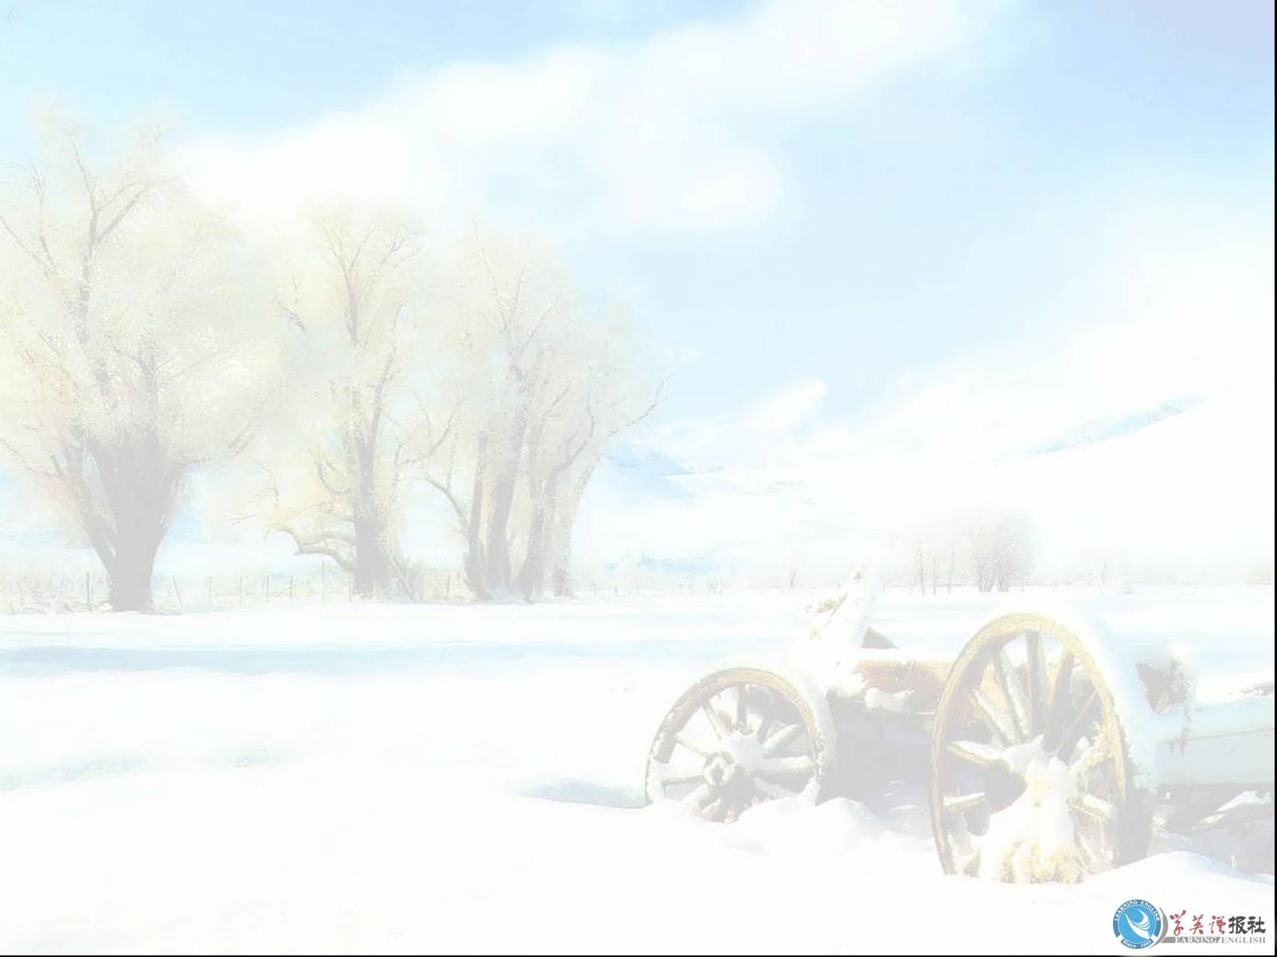
starve:
die from hunger 使饥饿， 饿死
starve to death 饿死
starve of/ for 渴望，急需，迫切需要
Eg: 1. They lost in the desert and starved to death.
2. The patients are starving of/for medicine.
3. She is lonely and starving for friendship.

Slide 3
Plenty
1. plenty of: a large number of 许多，大量
+可数名词复数+复数谓语
+ 不可数名词+单数谓语
Eg: There is plenty of time.
There are plenty of apples in the home.
2. day/ year/life … of plenty 富裕的日子/年月/生活等
Eg: 1) You have a life of plenty, what would you be
worried?
2) Everyone has enough to eat in years of plenty.

Slide 4
Honor
vt “尊敬，使感到荣幸”
Eg. He felt honored to be invited there.
可数名词，常与不定冠词连用，“光荣的人或事”.
不可数名词，“荣誉，尊敬”
Eg. 1. Liu Xiang is an honor to our country.
2. All of us should show honor to our parents.
3. The athletes competed for the honor of their
countries.
do honor to sb. 向…表示敬意
in honor of…. 为庆祝/纪念…；向…表敬意
We celebrate Teachers’ Day in honor
of our teachers.

Slide 5
satisfy 满足，使满意
be satisfied with sb/sth 对……感到满意
be satisfied to do sth 乐意做……
Eg: 1. My English teacher was satisfied with my
English study
2. we were satisfied to get a timely answer.
注意： satisfied （人）满足的，满意的
satisfying (事物)令人满意的

Slide 6
lead to (to 为介词，接动词要接doing的形式)
通向，引领
Eg. This bridge leads to the island.
All roads lead to Rome. 条条大路通罗马。
b. 导致，招致
Eg. Careless driving led to this accident.
Hard work leads to success, while laziness leads to
failure.

Slide 7
offer
1.提供
offer sb. sth.= offer sth. to sb.
Eg: He offered me a job in his company.
He offered me his pen.
2. 出价；拿…出售
Eg: I offered him $1000 for the house.
= provide sth. for sb.
= provide sb. with sth.
Eg: The parents supply food and education
to the children.
supply sth. to sb.

Slide 8
dress up 盛装，打扮，装饰
Eg: We dressed up for the wedding
He dressed up as Father Christmas.
dress up 只能接人做宾语，
如果要接衣服等要接介词 in
Eg: The bride was standing on the left side,
dressed up in a white silk dress.

Slide 9
The poor dog starved ____ death.
B. in C. from D. at
2. Washington, a state in the United States,
was named ____ one of the greatest American
presidents.
instead of B. in favor of
D. by means of
3. ____ young should respect ____ old.
A. The; / B. A; a
D. / ;/
4. Don’t worry, he won’t ____ to you.
A. does harm
C. does harms D. do harms
A. to
C. in honor of
C. The; The
B. do harm

Slide 10
5. His answer led me ____ make further inquires.
A. of B. in D. on
6. They have ____ us $1500,000 for the house.
shall we take it?
A. provided B. supplied
C. shown
7. sir, I beg you will ____him my sincere apologies.
A. supply B. provided
D. explain
8. The poor children are looking forward
to ___ a Christmas present that day.
A. give B. be given
C. giving
C. to
D. offered
C. offer
D. being given

Slide 11
gather
gather in crops 收割庄稼
gather up 集拢，集中
gather oneself 使振作起来
Eg: Gather your toys up.
The farmer are gathering in the crops.

Slide 12
awards
v. 授予，判定
Eg: 1) He was awarded the prize for being the
fastest runner.
他因跑得最快而被授予奖品
2) The judges awarded both finalist equal points.
裁判员判定决赛双方分数相同。
n. 奖品
She showed us the award she had won.

Slide 13
admire
v. 夸奖， 赞美
Don’t forget to admire the baby.
钦佩，羡慕
admire sb./ sth. for….
Eg: I admire him for his courage
I admire for her beauty.

Slide 14
Clothing
衣服的总称，包括衣服、鞋帽、被褥
集体名词，不可数。
可用 a piece of clothing, an article of clothing
Eg: Our clothing protects us form the cold.
This shop sells women’s clothing.
Clothes 具体的衣服，只有复数，做主语时谓语
动词用复数。

Slide 15
As though/ if 好象
eg. It looks as though Tom is not coming today.
The man talks as though he knows everything.
As though 引导的从句谓语动词也可用虚拟语气。
若谓语动词与现在事实相反，用一般过去时
(be 动词用were)。
若与过去事实相反，则用过去完成时
Eg: She looks as if she had been ill.
She looks as if she were ill.
Eg: 1)He behaved as though nothing had happened.
2) Susan is walking slowly as though she were tired
但as if/ though引导的句子如果表示很可能的
事实就用陈述语气.
It looks as if it is going to rain.

Slide 16
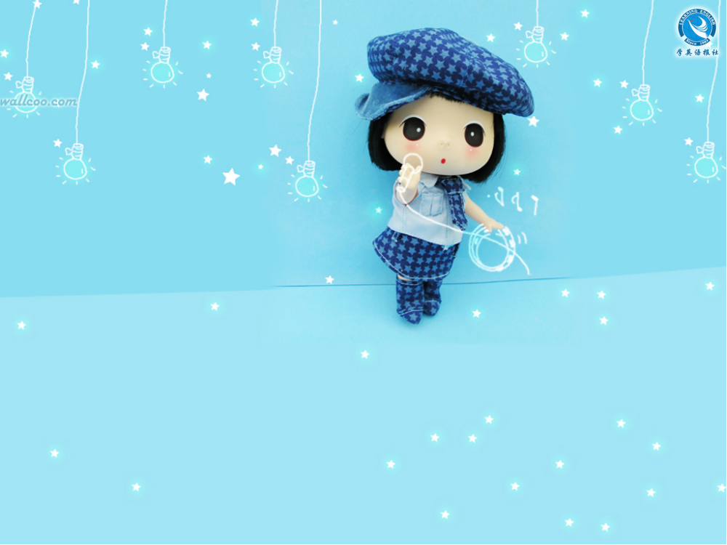
Thank you.

