Slide 1
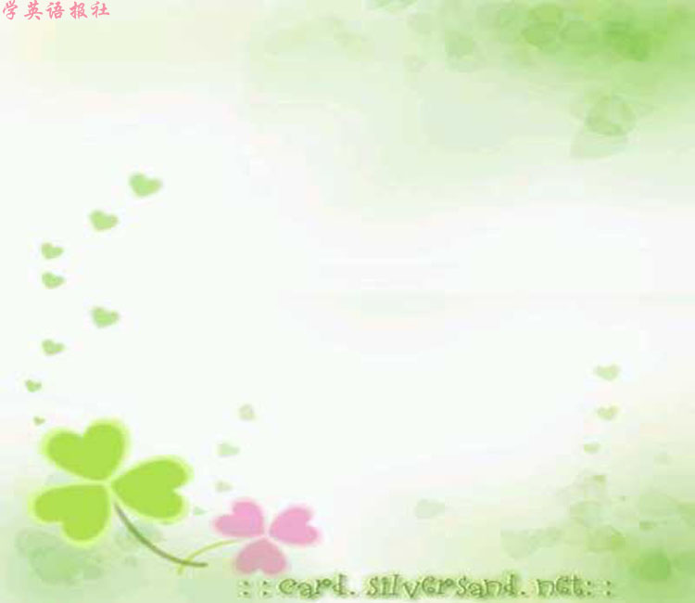
Listening

Slide 2

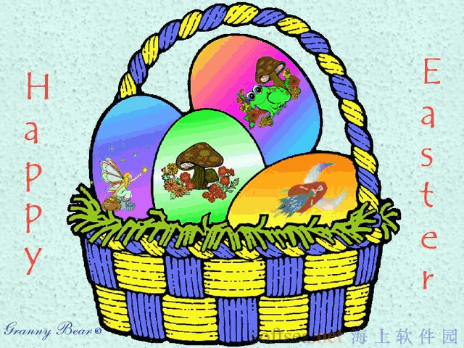
Listening (Page 41)

Slide 3

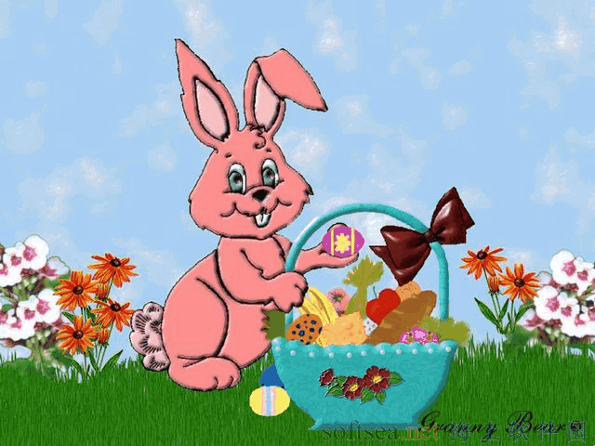
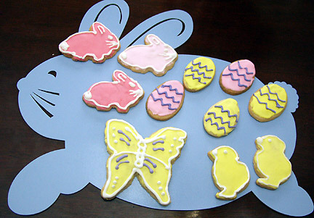
Pre-listening

Slide 4
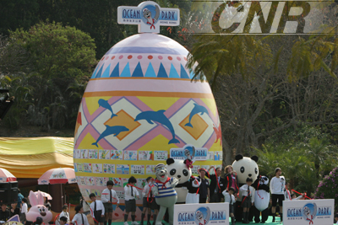
香港百名小学生为熊猫保育装饰巨型复活蛋

Slide 5
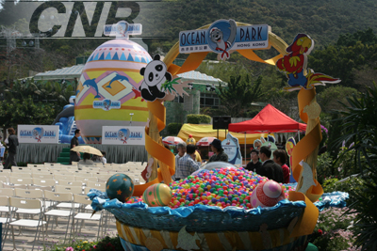
多彩的蛋

Slide 6
寻找复活节彩蛋的习俗，据民间传说，是由一位德国公爵夫人兴起的。据说，五彩缤纷的彩蛋是复活节兔子为乡村的孩子们留下的。孩子们把找蛋作为一种游戏。
最精心制作的复活节彩蛋甚至不是真蛋。一个叫卡尔·费伯奇的俄国珠宝商曾用金、银和珠宝做成彩蛋。打开蛋还可以看到小小的人、动物、植物和房子。俄国皇帝以此作为礼物送人。

Slide 7
复活节兔子是非常古老的复活节象征的现代说法。野兔是兔子的大个子亲戚，它是专供厄俄斯特女神用的圣物。
在复活节穿新衣服的习俗是在公元后300年左右开始的，大约在第一个基督徒皇帝康斯坦丁的时代。他下令在复活节那天朝臣们都得穿最好的衣服。

Slide 8
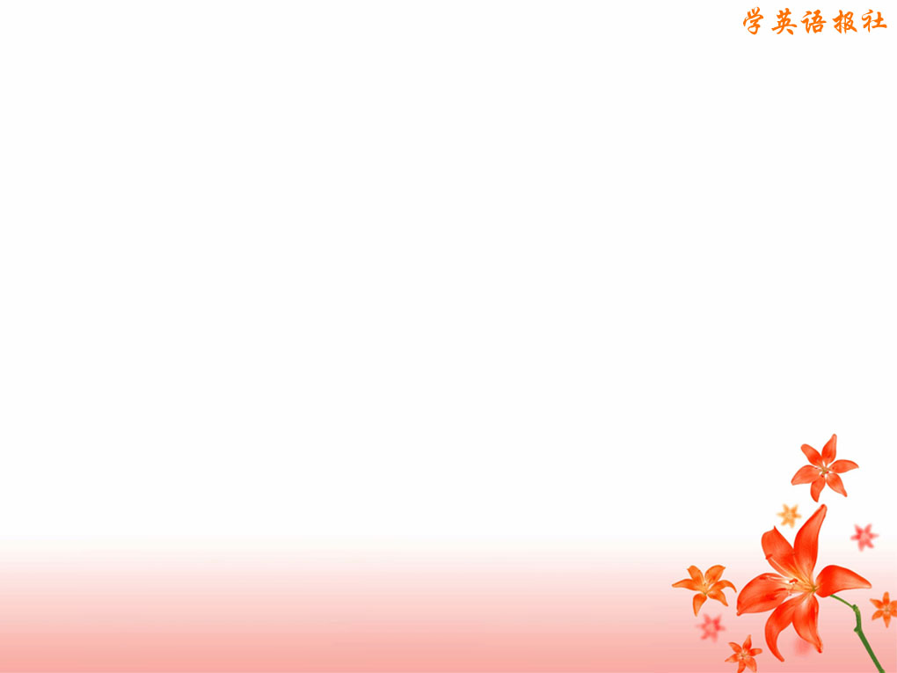
Listen to this conversation between Chen Bin and his American friend, Joey. What is the main topic of their conversation.
The main topic of the conversation is about the meaning of Easter and some of its traditional customs. Easter is the Christian festival that celebrates Jesus' coming back to life from the dead.

Slide 9
Easter customs include making and eating hot cross buns, colouring and searching for eggs supposedly hidden by the Easter Bunny and decorating with lilies.

Slide 10

Listen to the conversation again and take
notes to fill in the following chart.
In which season?
Who celebrates?
The reason for the festival?
On which day of the week?
What things represent Easter?

Slide 11
In which season? | spring
Who celebrates? | Christian around the world
The reason for the festival? | story about Jesus coming back to life
On which day of the week? | Sunday
What things represent Easter? | hot cross buns, eggs, bunnies, lilies

Slide 12

Listening text
Easter
CHEN BIN：Hey，Joey! I was watching a movie last night that showed some
people celebrating Easter. What is Easter？
JOEY: Oh, Easter is the holiday every spring when Christians around the world celebrate Jesus coming back to life from the dead.

Slide 13
CHEN BIN: Coming back to life?
JOEY: Yes, it’s a famous story in the
Bible about Jesus. Easter is always
celebrated on a Sunday. It’s said that
Jesus rose from the dead on a Sunday.
People will often go to church on Easter
Sunday to sing songs and hear about
Jesus.

Slide 14
CHEN BIN: I saw in the movie that a
mother was making little cakes with Xs on them.
JOEY: Oh Yes. Those are “hot cross
buns”. The cross on the bun is to remind people how Jesus died.

Slide 15
CHEN BIN:I remember last year on
Easter you gave me an egg that was painted
many different colours. Why do you colour eggs on Eater?
JOEY: That’s mostly an American tradition. Children will colour the eggs before Easter. Early on Easter morning, parents will hide the eggs inside the house or outside in the garden.

Slide 16
Then when the children wake up, they try to find the eggs. The parents often say that the eggs were left by the Easter bunny.
CHEN BIN: The Easter bunny? What do eggs and bunnies have to do with Jesus?

Slide 17
JOEY:I guess it is because people think they represent life. We also often have lilies at Easter to represent life that is new and clean.
CHEN BIN: So Easter is about Jesus, hot cross buns, eggs, bunnies and lilies?

Slide 18
JOEY: Well, it’s supposed to be about Jesus. But today many people forget the story and just remember the hot cross buns or the eggs and bunnies!

Slide 19

Speaking

Slide 20
Now you have the chance to create a new festival. Talk with your partner and make a name for your festival. Prepare a short report about your new festival and present it to the class.

Slide 21
Point to discuss:
when the festival takes place
what the festival is for
what people do at the festival
what people eat at the festival

Slide 22
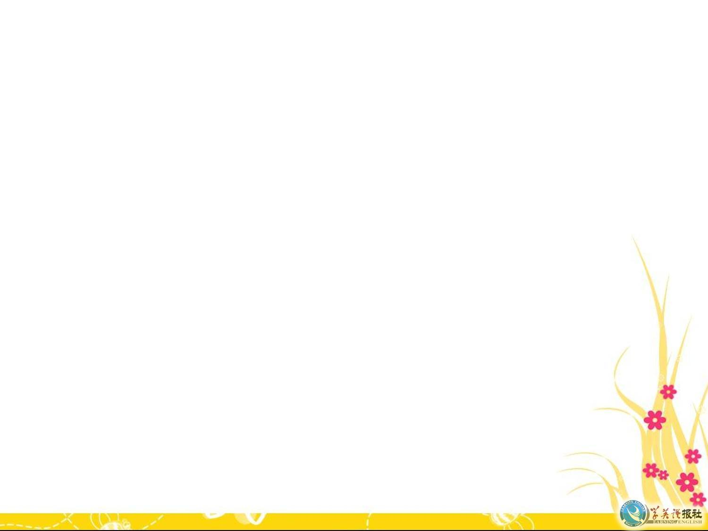


Slide 23
Write a brochure for the new festival that you have created, including it and giving advice to those who want to come. Be sure to include：

Slide 24
where it will take place
how people can get there
what kind of weather people should expect
what things people should bring
three things that visitors should see
how much it will cost

Slide 25
Use the following expressions to help you.
You must... You should...
You could… You can...
You might… You would…
You would have to... You need…

Slide 26

Sample writing
The End-of-School Festival takes place every year at schools around the nation on the two days after the last day of school. This year, the End-of-School Festival at Harbin’s No 12 Middle School is going to take place on June 28th.

Slide 27
People can get to the school by taking the No__ bus from__ stop. The weather school be fine and clear, but you might want to bring an umbrella in case of rain or to protect you from the sun! Students must bring a special dish prepared by their parents, but teachers can buy something from the street , such as grilled fish, hamburgers or fired potatoes, to bring to their class party.

Slide 28
Visitors to our End-of-school Festival can expert to see some great performances and shows by different classes and small group. Ms Tian’s class 12 will perform an
English play written by themselves. A group of boy students from class 7 and 8 will give a kungfu show. Also, we hear that
a group of the maths and science teachers have prepared a funny comedy show.

Slide 29
We all look forward to that! In addition to these performances and others, there will be a big dance on the first evening and a big parade on the second day. Visitors can see a lot of painted faces and funny clothing!
There is no cost to attend the festival, so come and enjoy the fun!

Slide 30
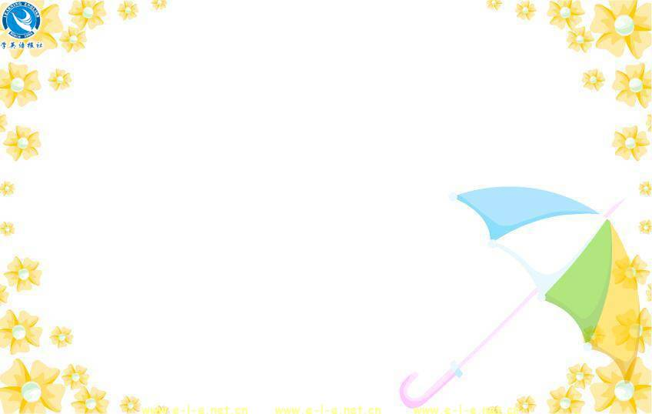
Project
Look up the information about different minority festival in China. Choose one, research it, and then write a short report about it for the class. Use the list in the Writing Task to help you.

Slide 31
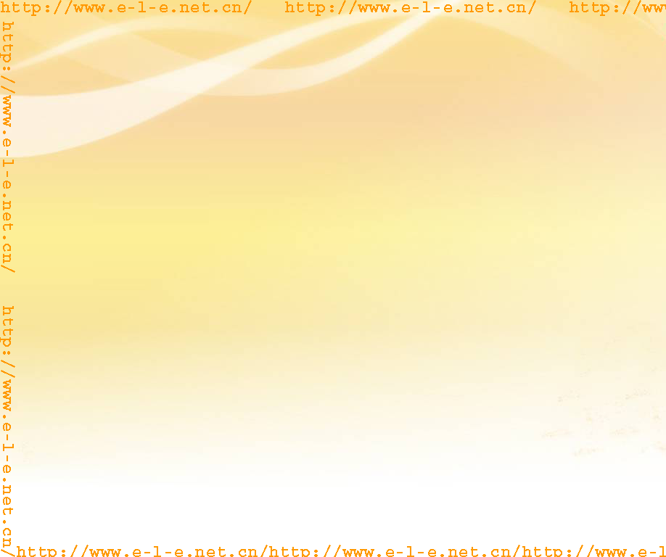
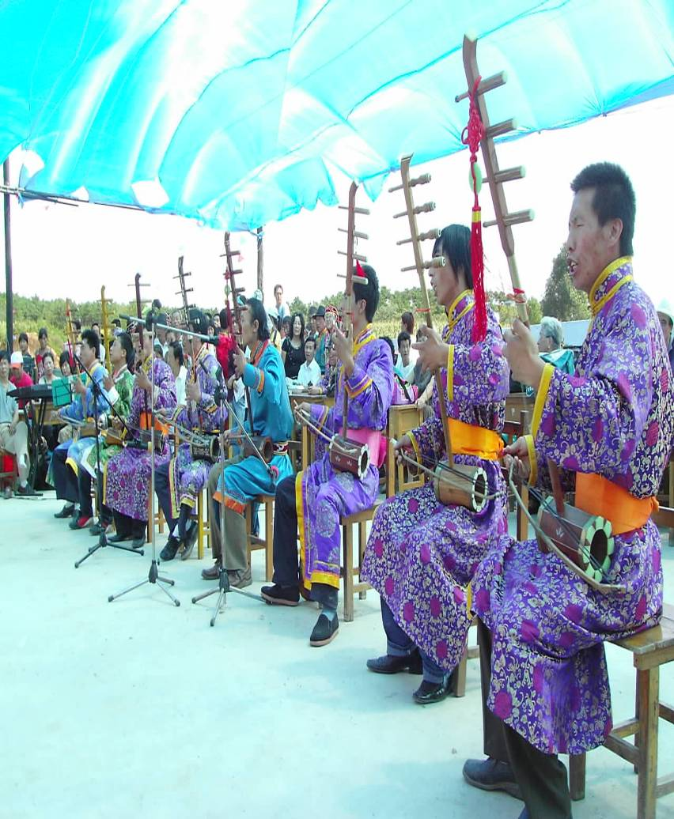
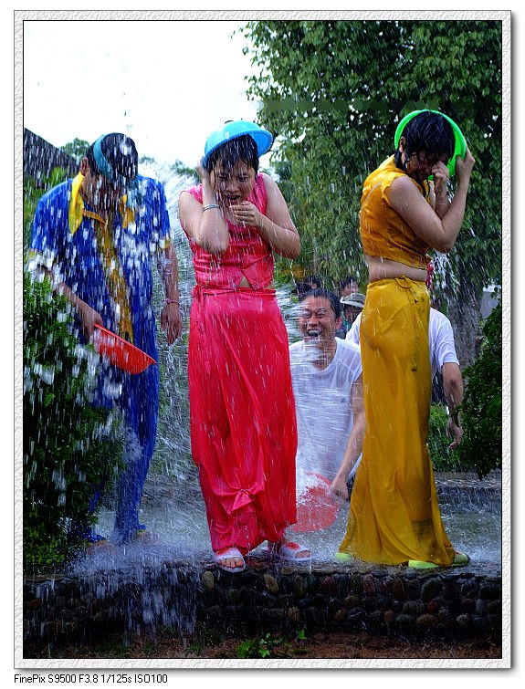
Aobao Festival
(Mongolian)
Water-Splashing Festival
(Dai)

Slide 32
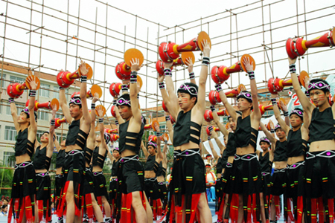
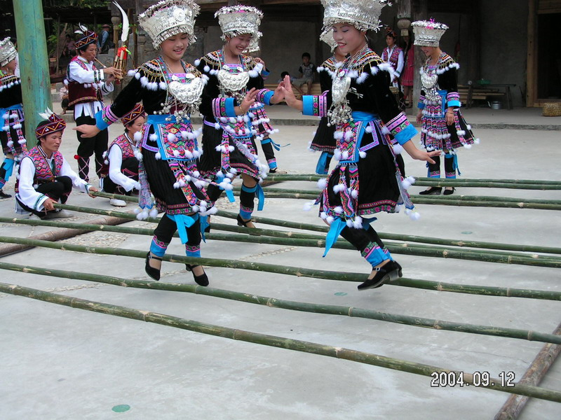
San Yue San Festival
(Zhuang)
Tiaohua Festival (Miao)

Slide 33

Sample writing
The Knife-Pole Festival of
the Lisu Minority
The Lisu minority celebrates the Knife- Pole Festival on the second day of the second month, according to the Lunar calendar. On the evening before the festival, a large bonfire is lit, and people dance around it. After a while,

Slide 34
some of the braver men will jump into the fire and try to put it out with their feet. On the day the Knife-Pole Festival, several poles are put up, each 20 metres high. On each pole there are either 36 or 72 steps to help men climb to the top. The steps, however, are made of sharp knives. Man who plan to climb the pole first drink a cup of wine and then begin

Slide 35
their climb to show their bravery and strength. When they reach the top, they light firedrakes and throw red flags down on the crowds to give them good luck. On the rest of the day, the young people throw pouches to each other to show love. There is a phrase in Chinese that comes from this festival. Bravery is described as “climbing the Knife Mountain and diving into the Fire Sea.”

