Slide 1

Using Language

Slide 2

Words preview
parking
apologize
drown
sadness
obvious
wipe
n. （汽车等）停放
vi. 道歉；辨白
vi. & vt. 淹没；溺死
n. 悲哀；悲伤
adj. 明显的；显而易见的
vt. 擦；揩; 擦去

Slide 3
Words preview
woven
weep
remind
forgive
n. 编制；（使）迂回前进
vi. 哭泣；流泪
n. 哭；哭泣
vt. 提醒；使想起
vt. 原谅；饶恕

Slide 4
Expressions preview
parking lot
turn up
keep one’s word
hold one’s breath
set…off
remind… of…
停车场
出现；到场
守信用；履行诺言
屏息；屏气
出发；动身；使爆炸
使…想起…

Slide 5

Listening

Slide 6

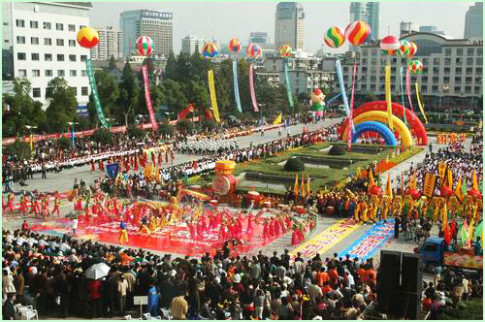
Listening on Page 6
中国西湖狂欢节

Slide 7
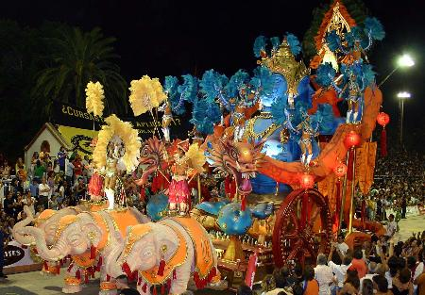
阿根廷的狂欢节上的花车游行

Slide 8
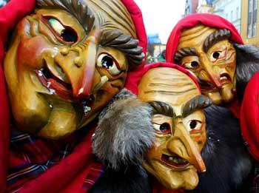
德国科特布斯狂欢节

Slide 9
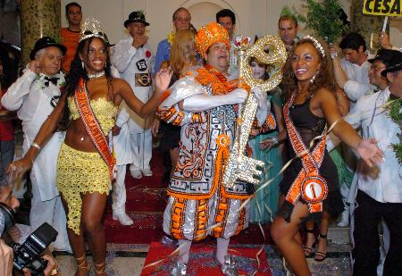
巴西里约热内卢市政宫狂欢节

Slide 10

Listening
Li Mei and Wu Ping are going with their friends Carla and Hari to the Carnival parade. Listen to the conversation and answer the questions.

Slide 11
Part 1:
1. What is wrong with Li Mei’ clothing and shoes?
2. What advice does Carla give Li Mei?

Slide 12
Part 2:
3. Why is it important for them to have water?
4. Why is it difficult for them to hear each other?
5. Why do they plan to meet at the parking lot at 8 o’clock?

Slide 13
1. What is wrong with Li Mei’ clothing and shoes?
Li Mei’s clothing is too thick and
her shoes are not comfortable
enough to walk in for a long time.

Slide 14
2. What advice does Carla give Li
Mei?
Carla suggests that Li Mei change her shoes to something more comfortable, wear some lighter and cooler clothing and also take a hat.

Slide 15
3. Why is it important for them to have water?
It is important for them to have water because it is very hot and they will be doing a lot of walking.

Slide 16
4. Why is it difficult for them to hear each other?
It is different for them to hear each other because the music is very loud.

Slide 17
5. Why do they plan to meet at the parking lot at 8 o’clock?
They plan to meet at the parking lot at 8 o’clock because they might get separated in the crowd.

Slide 18
Listening text
CHRNIVAL IN TRINIDAD
Part1
Carla and Hari are students in Trinidad. Their Chinese friends, Li Mei and Wu Ping, are visiting for the Carnival holiday in February.

Slide 19
CARLA: Li Mei, why are you wearing those shoes? You can’t be serious! Your feet will hurt so much by the end of the parade that you won’t be able to stand. Would you like these comfortable shoes?

Slide 20
LI MEI: Thanks, Carla, but I wanted something to go with this dress. Those are the wrong colour.
CARLA: You must be joking! That dress is too thick. Do you realize that it’ll be thirty-five degrees out there and that you’re going to walking and dancing until midnight?

Slide 21
You have to have something light and cool ─ and a hat!
Part2
The boys are already there when the girls arrive. The music over the loudspeakers makes it difficult to hear each other. One after another, big bands arrive, along with thousands of dancers and musicians. The Carnival is beginning!

Slide 22
C=Carla WP=Wu Ping H=Hari
C: Sorry we’re late. I had to get Li Mei
some comfortable shoes!
WP: No problem. We’ve just got here. But
I forget my water - can I have some of
yours?
LM: Me too! We just came, and I’m
already tired and thirsty!

Slide 23
C: We’re each going to need a lot of water tonight! Shall I run over to the stand there and get something to drink for everybody?
H: Hurry up, Carla! The bands are moving!
C: OK, I’ll hurry! But remember… We’re
going to go slowly at first, so Wu Ping
and Li Mei can get used to the music and
the heat!

Slide 24
H: Yeah, OK! Remember, you two, if we
get separated in the crowd, We’ll
meet at the north end of the parking
lot by 8 o’clock. Then we can go
together to see the winners of
year’s awards for best band and best
costumes.

Slide 25
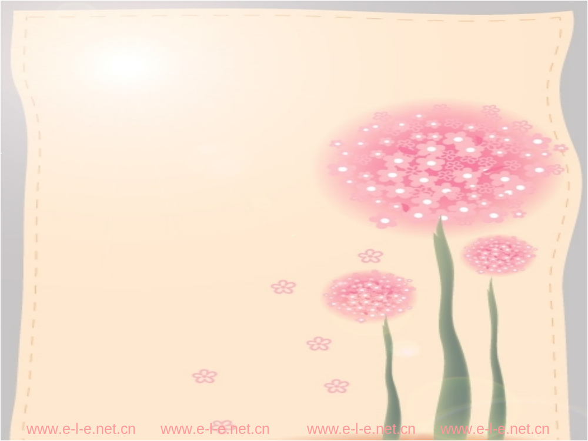
Reading
A SAD LOVE STORY

Slide 26

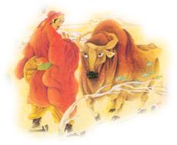
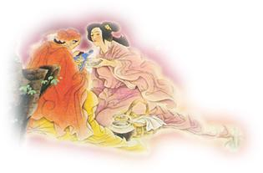
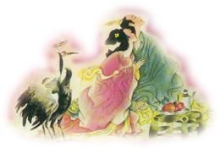
牛郎白天放牛
牛郎织女喜结良缘
王母娘娘把他们分开
牛郎织女终于
在鹊桥上相会了

Slide 27
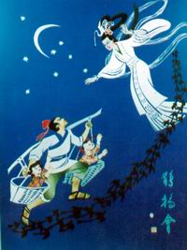
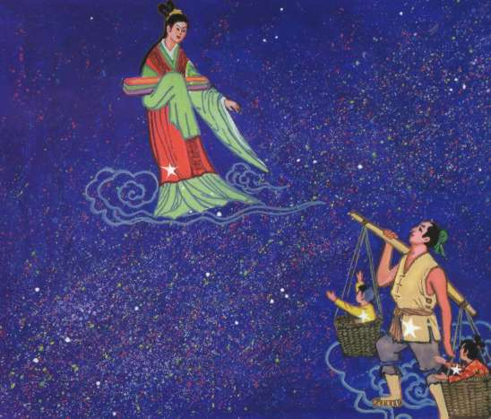

Slide 28
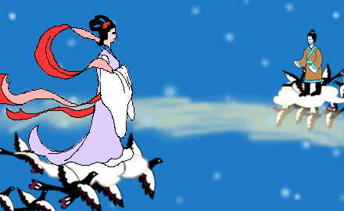

Slide 29
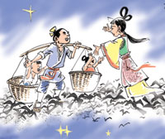

The Chinese people believe that the star Vega（织女星）, east of the Milky Way, is Zhi Nu and, at the constellation of Aquila（天鹰座）,
on the western side
of the Milky Way,
Niu Lang waits for
his wife.

Slide 30




well-known poem
两情若是久长时,
又岂在朝朝暮暮。
Eternal love between us two,
Shall withstand the time apart.

Slide 31

Answer these questions
1. Why was the TV story what Li Fang
needed?
2. Why do people want the weather to be
fine on Qiqiao Festival?
3. What more do you know about Qiqiao
Festival?

Slide 32
Why was the TV story what Li Fang
needed?
2.Why do people want the weather to be
fine on Qiqiao Festival?
The TV story was a sad story about lost love-the same situation as Li Fang.
People want the weather to be fine so
they can meet the one they love.

Slide 33

Read the story about Li Fang again.
What do you think is going to happen to
Li Fang and Hu Jin? Write your own
ending to the story. Use the following
hints to help you prepare for writing.

Slide 34

Think of how Li Fang explain that
the flowers and chocolates are gone.
Think of what HU Jin will say when
she hears that news.
Think of an ending to the story that
will solve the problem. Will Li Fang
be happy or sad?

Slide 35


Language points
1. But she didn’t turn up.
1) 来, 出席(某活动)
I’m very happy you turned up
so early.
2) 把(收音机等)音量开大一些,其反
义短语是turn down.

Slide 36
Turn up the radio a little, I can scarcely hear the program.
相关短语:
turn down 拒绝
turn off 关掉
turn on 打开
turn out 结果是..
turn to sb. for help 向某人求助

Slide 37
2. She said she would be there at seven o’clock, and he thought she would keep her word.
keep one’s word 意为“守信用”,其反义词是break one’s word, 即“失信”。
He is a man who always keeps his word.

Slide 38
Don’t break your word, otherwise, no one will trust you.
注意：keep one’s word和break one’s word中的名词word不能用复数形式。
相关短语：
in a word/in short/to be short
简言之；总之

Slide 39
have a word with sb.
与某人谈话
have words with sb.
与某人发生口角
in other words
换句话说

Slide 40
A gentleman should always __ his __.
A. keeps; word
B. keep; word
C. keeps; words
D. keep; words
B

Slide 41
3. Well, he was not going to hold his breath for her to apologize.
hold one’s breath: 屏息；屏气
I can hold my breath for about one minute.
我可憋差不多一分钟的气。
apologize vi.道歉; 辨白
I must apologize for calling you so late.
实在抱歉, 这么晚给您打电话。

Slide 42
  apologize to sb. 向某人道歉
  apologize to sb. for sth.
  向某人为某事(为做了某事)道歉
  apologize to sb. for doing sth.
  向某人为某事(为做了某事)道歉
  apologize for oneself
  为自已解辩或辩护

Slide 43
4. It was obvious that the manager of the coffee shop was waiting for Li Fang to leave...
obvious adj.
1) obvious
+ to + 表示人的名词或代词
Her disappointment was obvious to her friend.
明显的， 清楚的

Slide 44
2) It + be + obvious +that-clause
It was obvious that she was in danger.
辨析：
obvious/apparent/clear
1）obvious 是三者中程度最强的，含有“一目了然” 之意。
It is obvious that you are wrong.

Slide 45
2) apparent 指具有某些明显的迹象的，侧重与经历推理才能看出结果。
It was apparent from his face that he was lying.
3) clear 作“明白的，清楚的”讲。指不模糊含混，易于观察，了解和识别。
He seems clear about his plans.

Slide 46
5. As Li Fang set off for home, he thought...
set off:
Tom and his father set off for America yesterday.
The bomb set off among the crowd.
动身, 出发; 使（地雷、炸弹）爆炸; 使某物更有吸引力

Slide 47
A woman’ beauty is set off by her clothes and jewellery.
相关短语：
set about doing sth. 着手（做某事）
set in 开始
set up 建立，创立
set down 写下，记下

Slide 48
set somebody to do something.
使某人开始工作
set somebody doing something
使某人处于某种动的状态

Slide 49
6. I don’t want them to remind me of her.
remind vi.
remind sb. of sth.
You remind me of your father.
你使我想起你爸爸。
There photos remind me of my childhood.
这些照片使我想起了我的童年。
提醒，使想起

Slide 50
remind sb. to do sth.
remind sb. that
What you said just now ____ me of that American professor.
A. mentioned
B. informed
C. reminded
D. memorized
C

Slide 51

Homework
Go over the texts after class and try to preview Speaking Task and Writing Task on Page 46.

