Slide 1
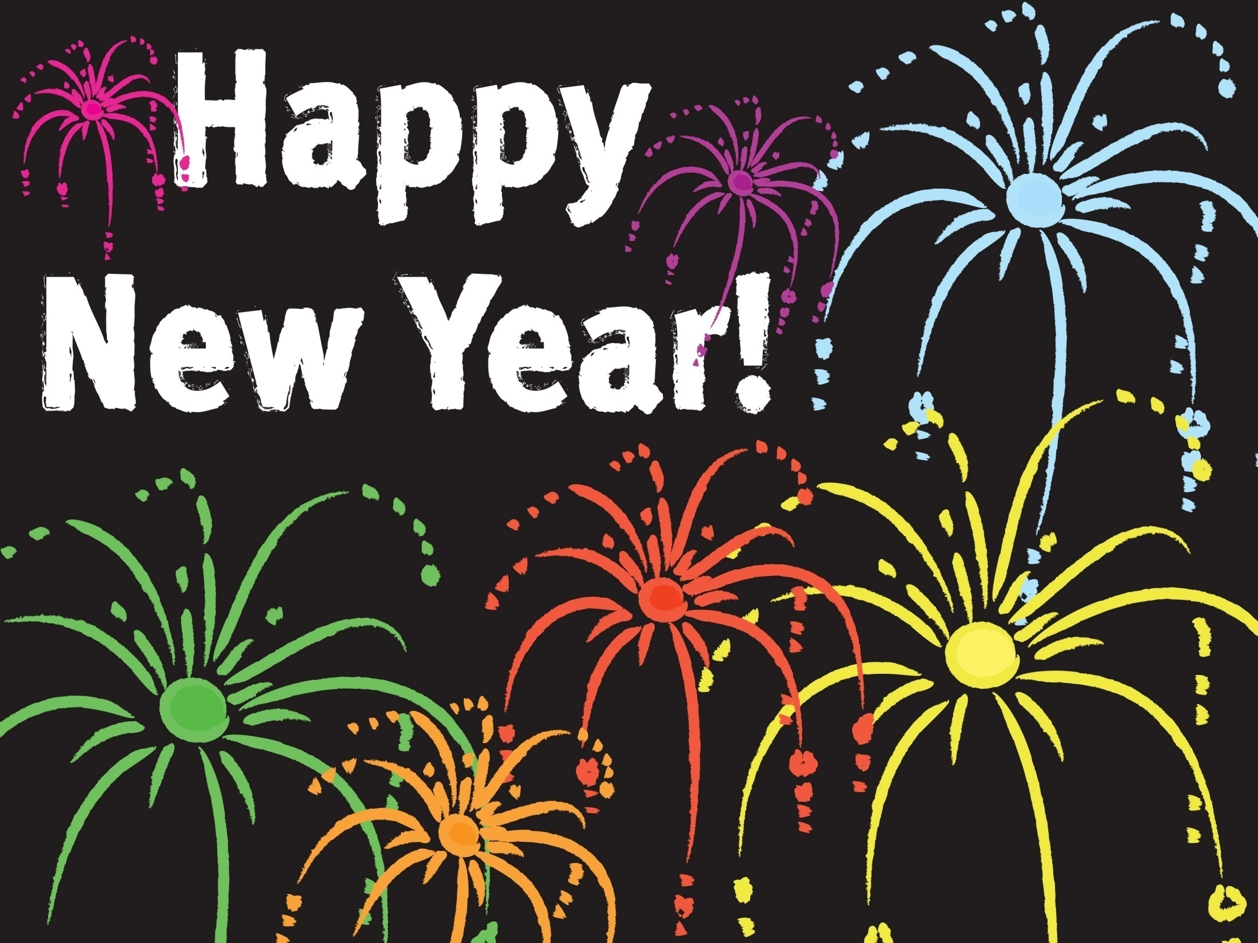

Slide 2
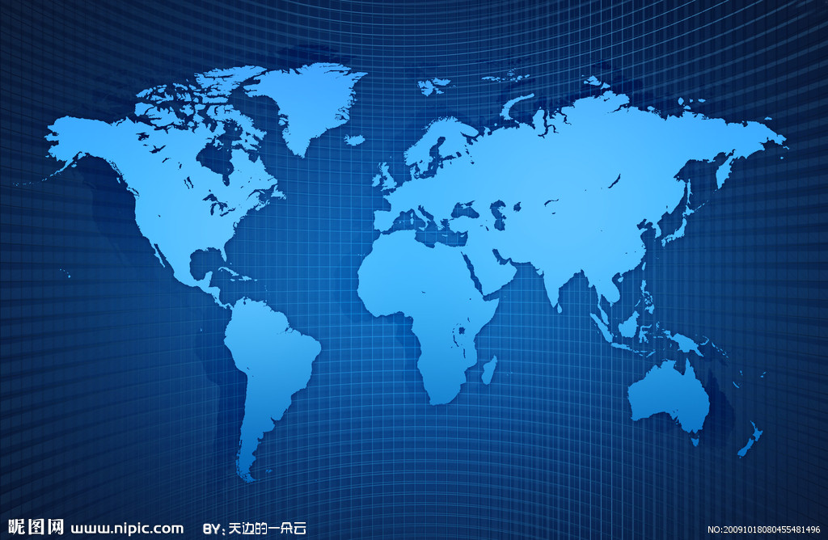

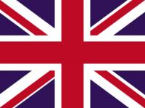
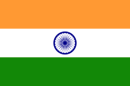


Slide 3
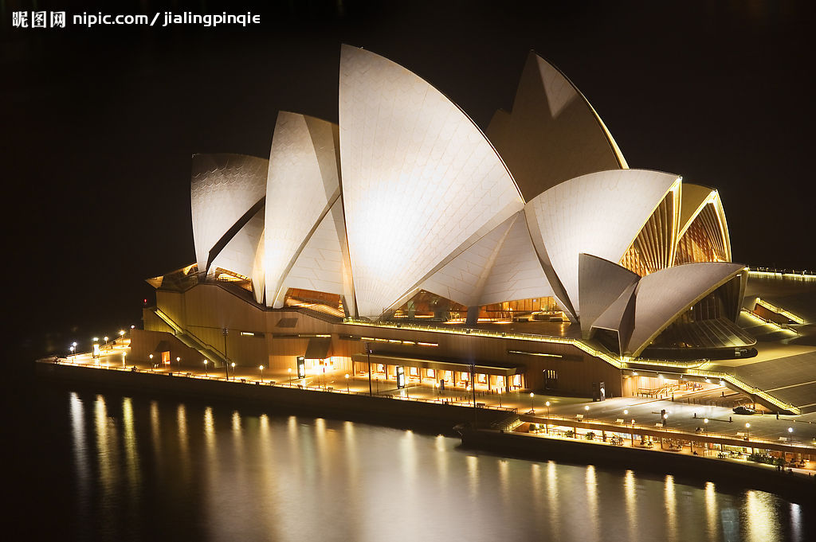

Slide 4
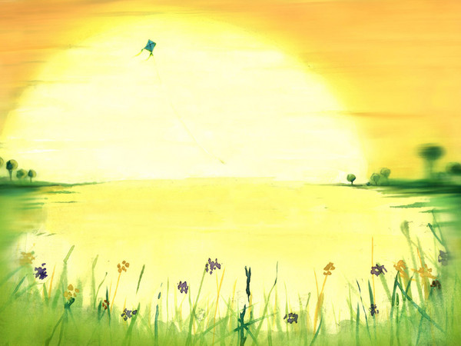
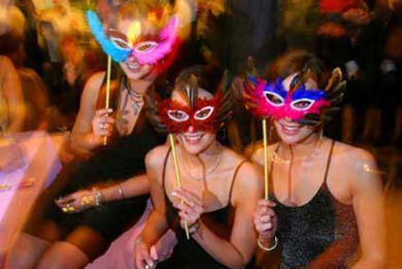
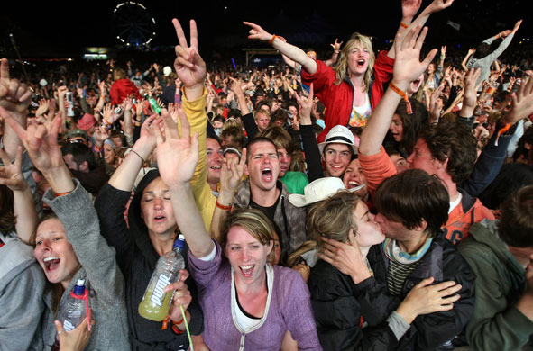
. New Year Eve Celebration
All pubs, clubs, hotels, party halls and even beaches are crowded with party people. Australians celebrate the day with high spirits and excitement. Even if they are at homes, levels of energy are very high. As soon as church bells ring at midnight, everyone start producing loud noises with trumpets, drums, horns etc and wish each other Happy New Year.

Slide 5
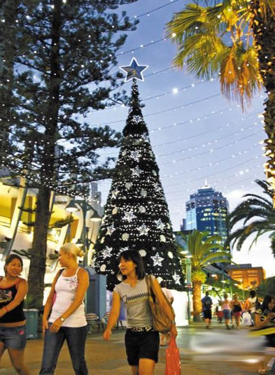
New Year's Celebration in Australia
New Year is a public holiday and many people love to spend this day with their family and friends. It's most often an outdoor activity which includes picnics, camping, surfing, water sports etc. Australia becomes the largest tourist hub at the time of New Year. More than 300,000 tourists celebrate their New Year in Australia.

Slide 6
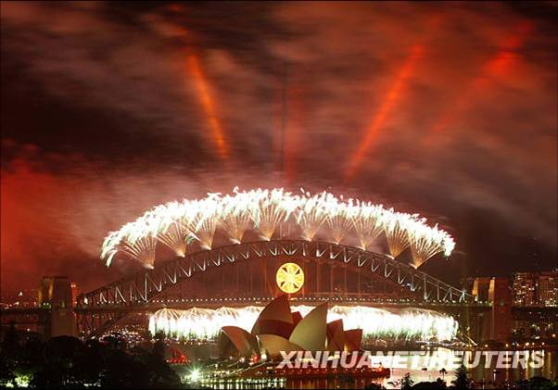
The main attraction of Australian New Year are its magnificent fireworks.

Slide 7
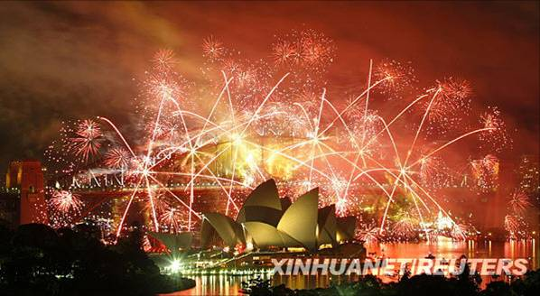

Slide 8
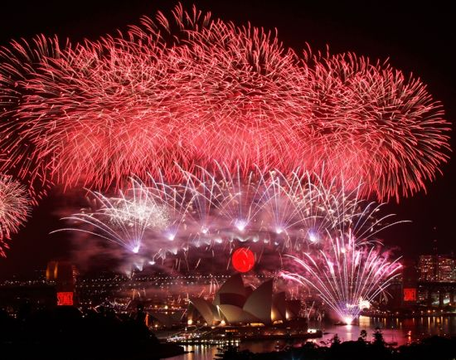

Slide 9
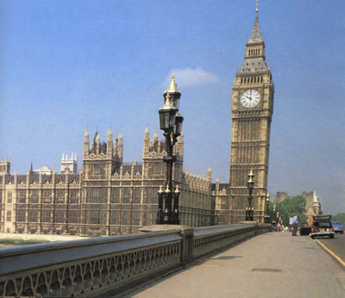

Slide 10
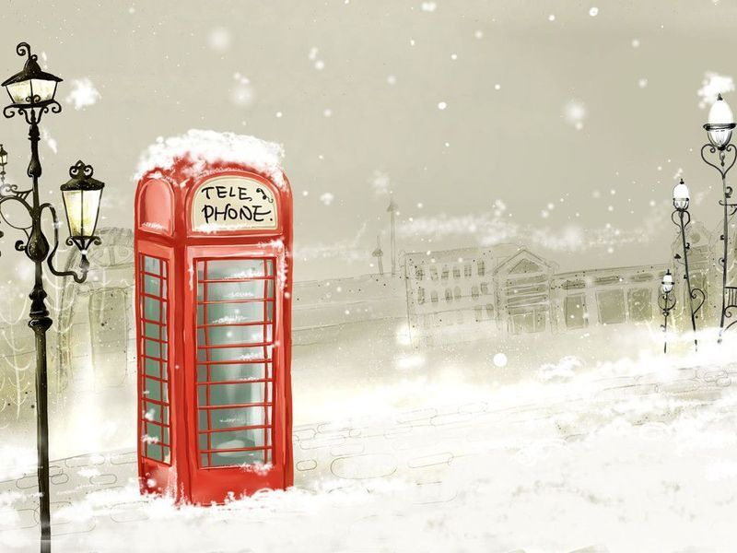
The beginning of the New Year is signified by the chiming of Big Ben, the famous London clock, at midnight, which is also shown on TV for those who are staying in.

Slide 11
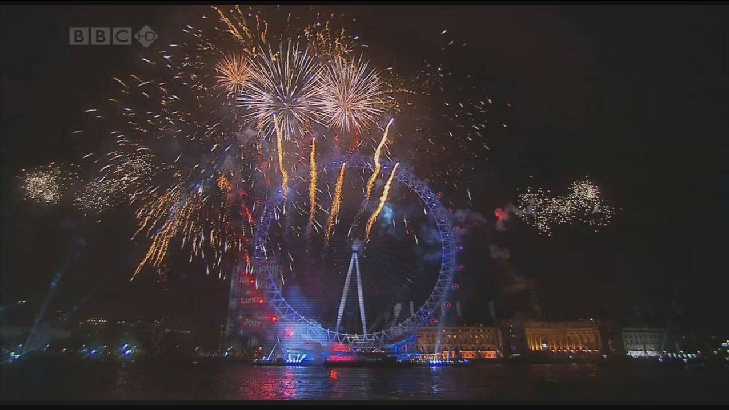

Slide 12
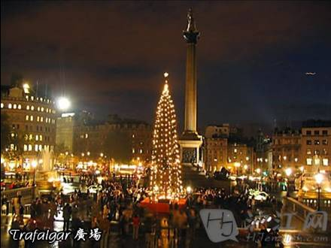
Others go to a pub to celebrate, or spend the evening in a large public space, for example Trafalgar Square in London.

Slide 13
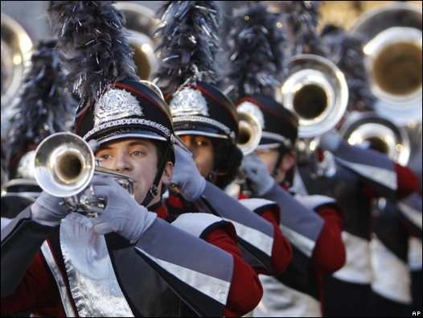
parade

Slide 14
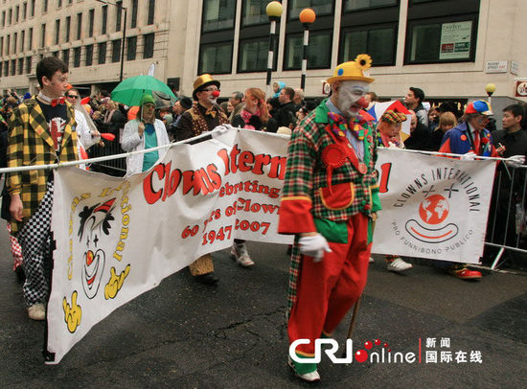
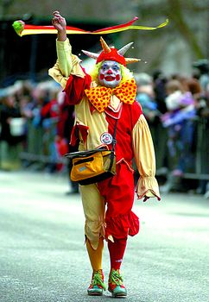
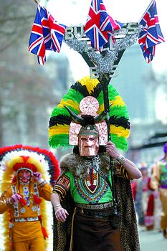
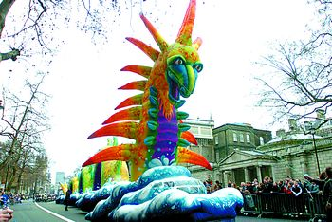

Slide 15
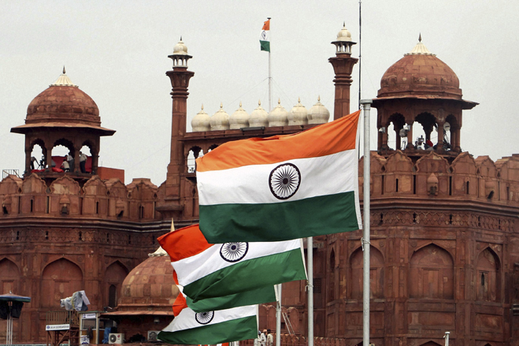

Slide 16
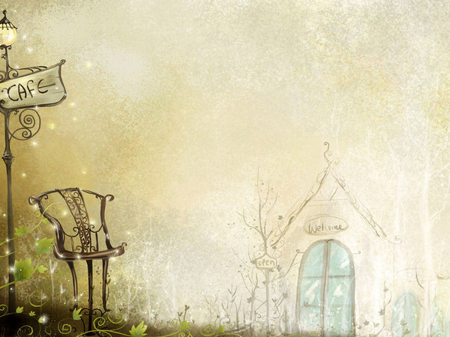
Deepawali is celebrated for five days as it marks the beginning of the Indian New Year. Deepawali signifies the end of the previous year and the start of a New Year. Deepawali is one of the most cheerful festivals of India that is enjoyed by people to the fullest.

Slide 17
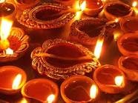
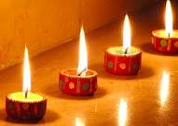
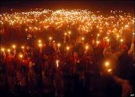
Deepawali is also known as festival of lights and these oil lamps and candles spread light all around, welcoming the Indian new year. The light of lamps further symbolizes the victory of good over the evil. People by lighting these oil lamps and candles, thank God for all the good things in their life

Slide 18
People make a lot of preparations for this Indian New Year, like they decorate their houses with fresh flowers, exchange gifts with relatives and friends, buy new clothes, enjoy get-togethers with their near and dear ones, and a lot of other activities are a part of this colorful Indian New Year festival.

Slide 19
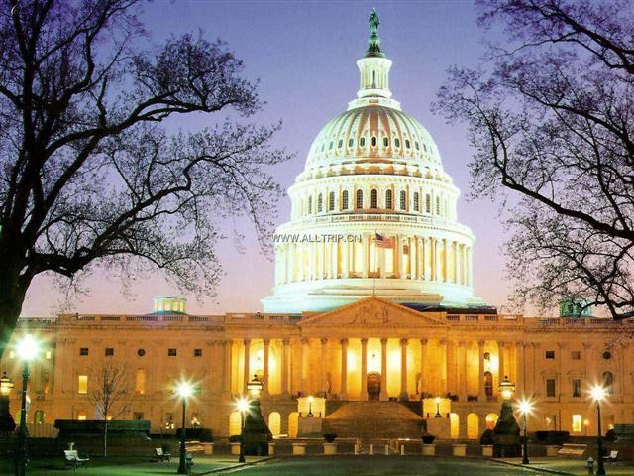

Slide 20
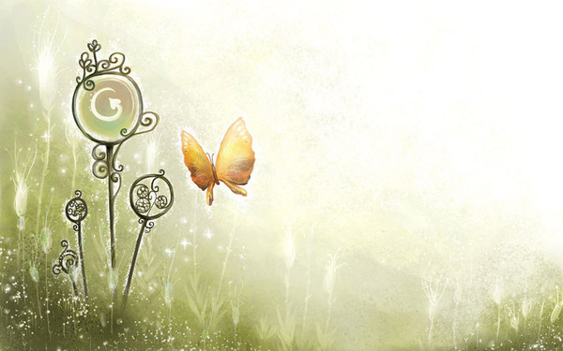
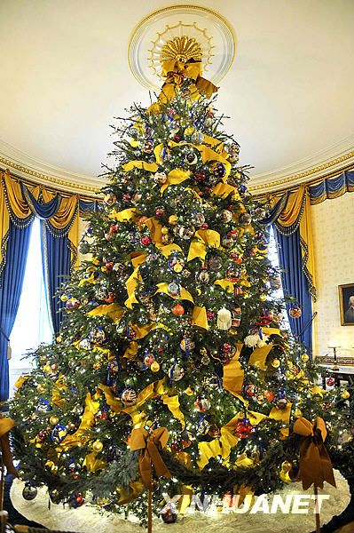
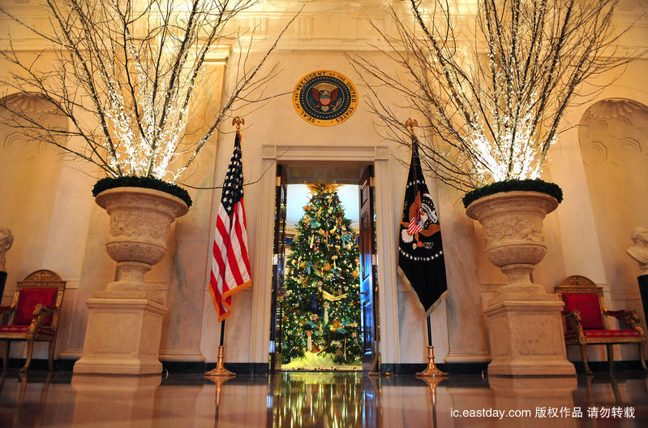
In Washington, people celebrate the new year by decorating the White House.

Slide 21
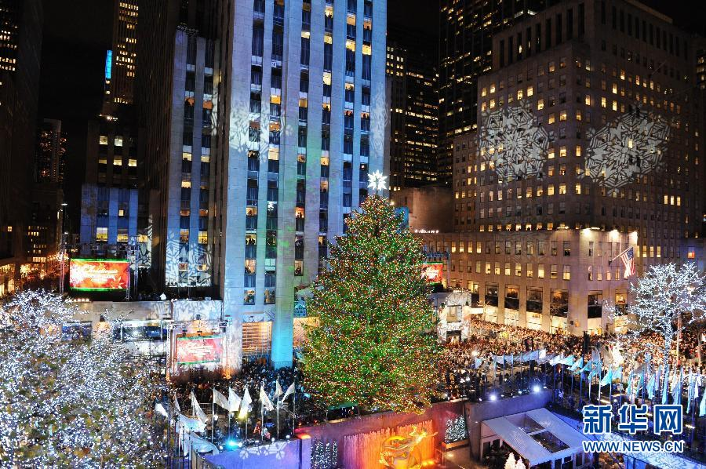
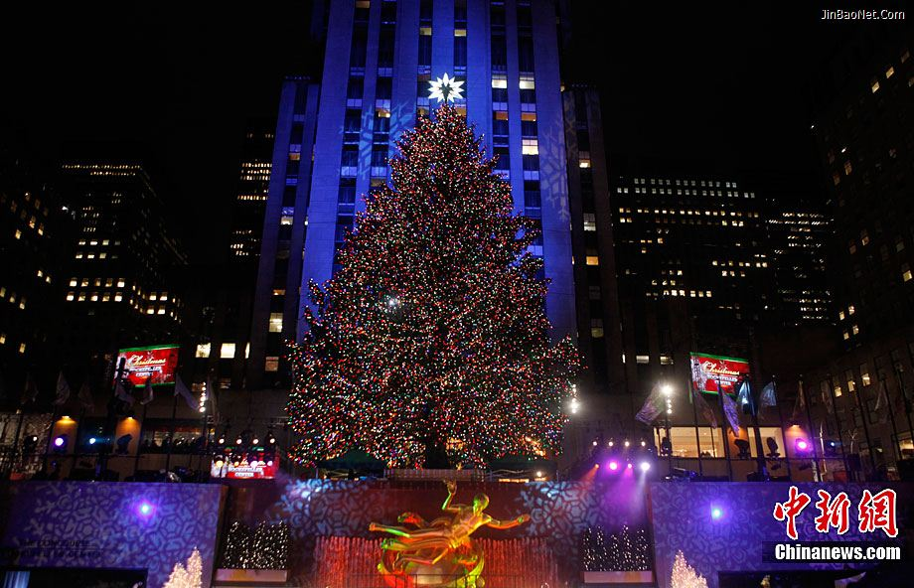
In the United States of New York Rockefeller Center, people will place a Christmas tree in the center and hold a ice skating activities in the skating rink to celebrate the new year.

Slide 22
Turkey is the American specialty. And North America have many turkeys, so eating it becomes a traditional custom in the United States. That custom has a history of more than 3oo years.

Slide 23
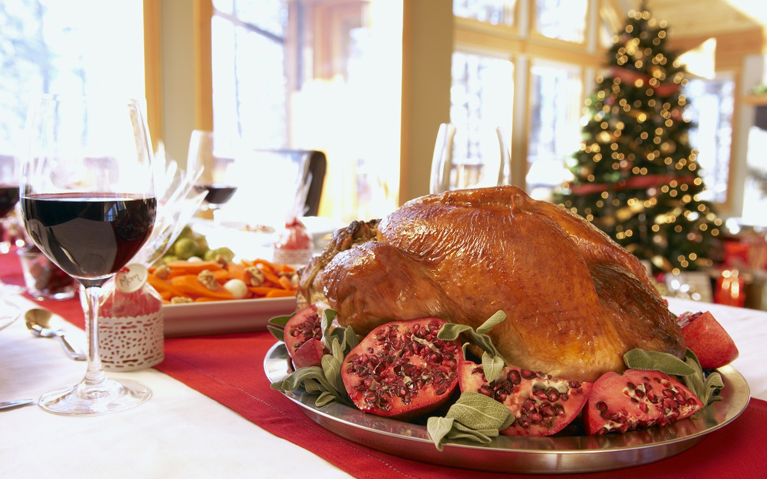

Slide 24
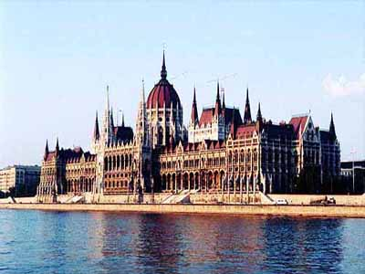

Slide 25
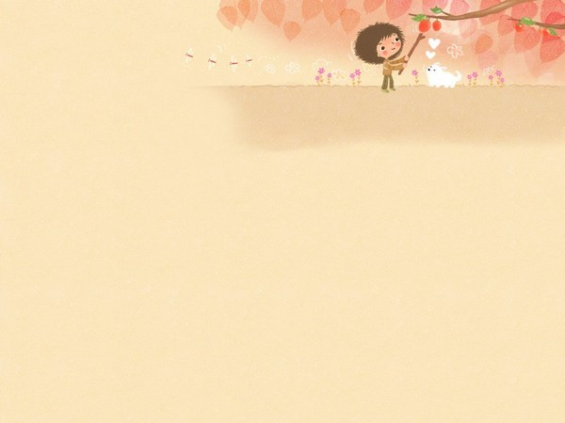
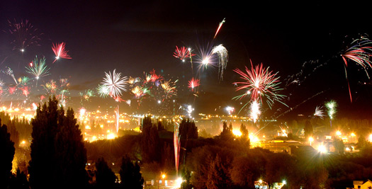
Usually the entire family on the New Year Eve, gathers for late Dinner. Around 11 in the night Dinner is served and just before midnight people are out in the streets to enjoy fireworks.

Slide 26
