Slide 1

How to defeat Burnout and stay Motivated.
gzx Class7
Jessie:)

Slide 2
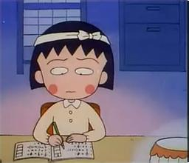

Burnout

Slide 3

1. Achieve in increment
>get a journal,
notebook,
or calendar.
Writing down the important things.

Slide 4

2."WORK LESS"
Eliminate unnecessary tasks.
Stop multitasking.
Seek help from other people.

Slide 5

3.Get more sleep

Slide 6

4.Get a second opinion

Slide 7


Thank you for your listening!

