Slide 1
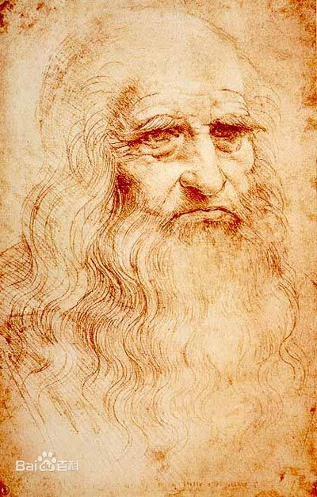

Slide 2
Leonardo di ser Piero da Vinci(1452-1519), the most perfect representative of the Renaissance(文艺复兴).He was born in Florence(佛罗伦萨), the seminary of the Renaissance.
He was known as one of the most famous artists in the world. Some people think he was the best painter that has ever lived.

Slide 3
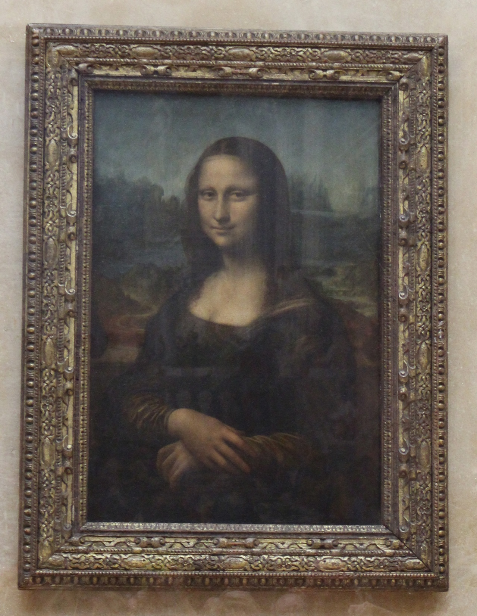

Slide 4
Mona Lisa
Maybe this is the most famous painting in the world. Somebody says it is the picture of an Italian lady called Lisa Gherardini.
You can see a faint smile on her face. Leonardo made her look real because he understood how to use dark and light correctly. This is still an important skill in drawing and painting nowadays.

Slide 5
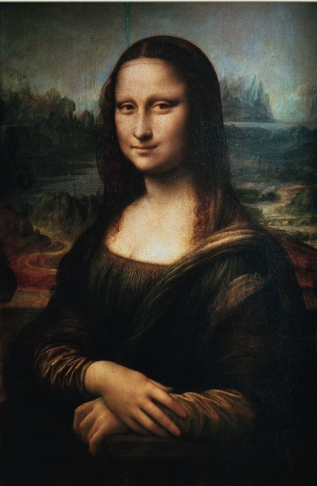
Notice the background of the lady. That is a beautiful landscape with a stream and some hills. When we look at the landscape, we will find out we cannot see things as clearly as things close to us. This is called perspective drawing, another important skill in painting. This kind of skill was first invented during the Renaissance.

Slide 6
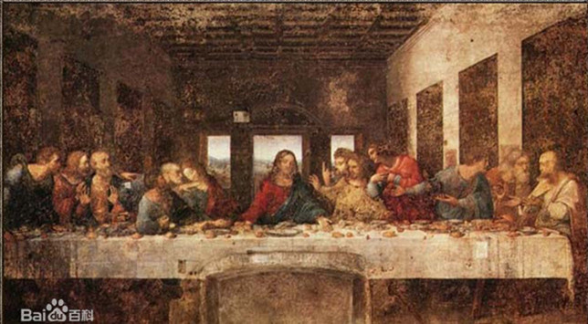

Slide 7
The Last Supper
This is a wall painting. It shows Christ and the twelve Apostles(使徒) seated at a long table. This is the moment when Christ has just said, “One of you will betray me.”
Leonardo was interested in trying new ways of painting. Not many years after it was finished, the paint began to come off the wall. That was because he did not use the traditional skill of fresco(湿壁画).

Slide 8
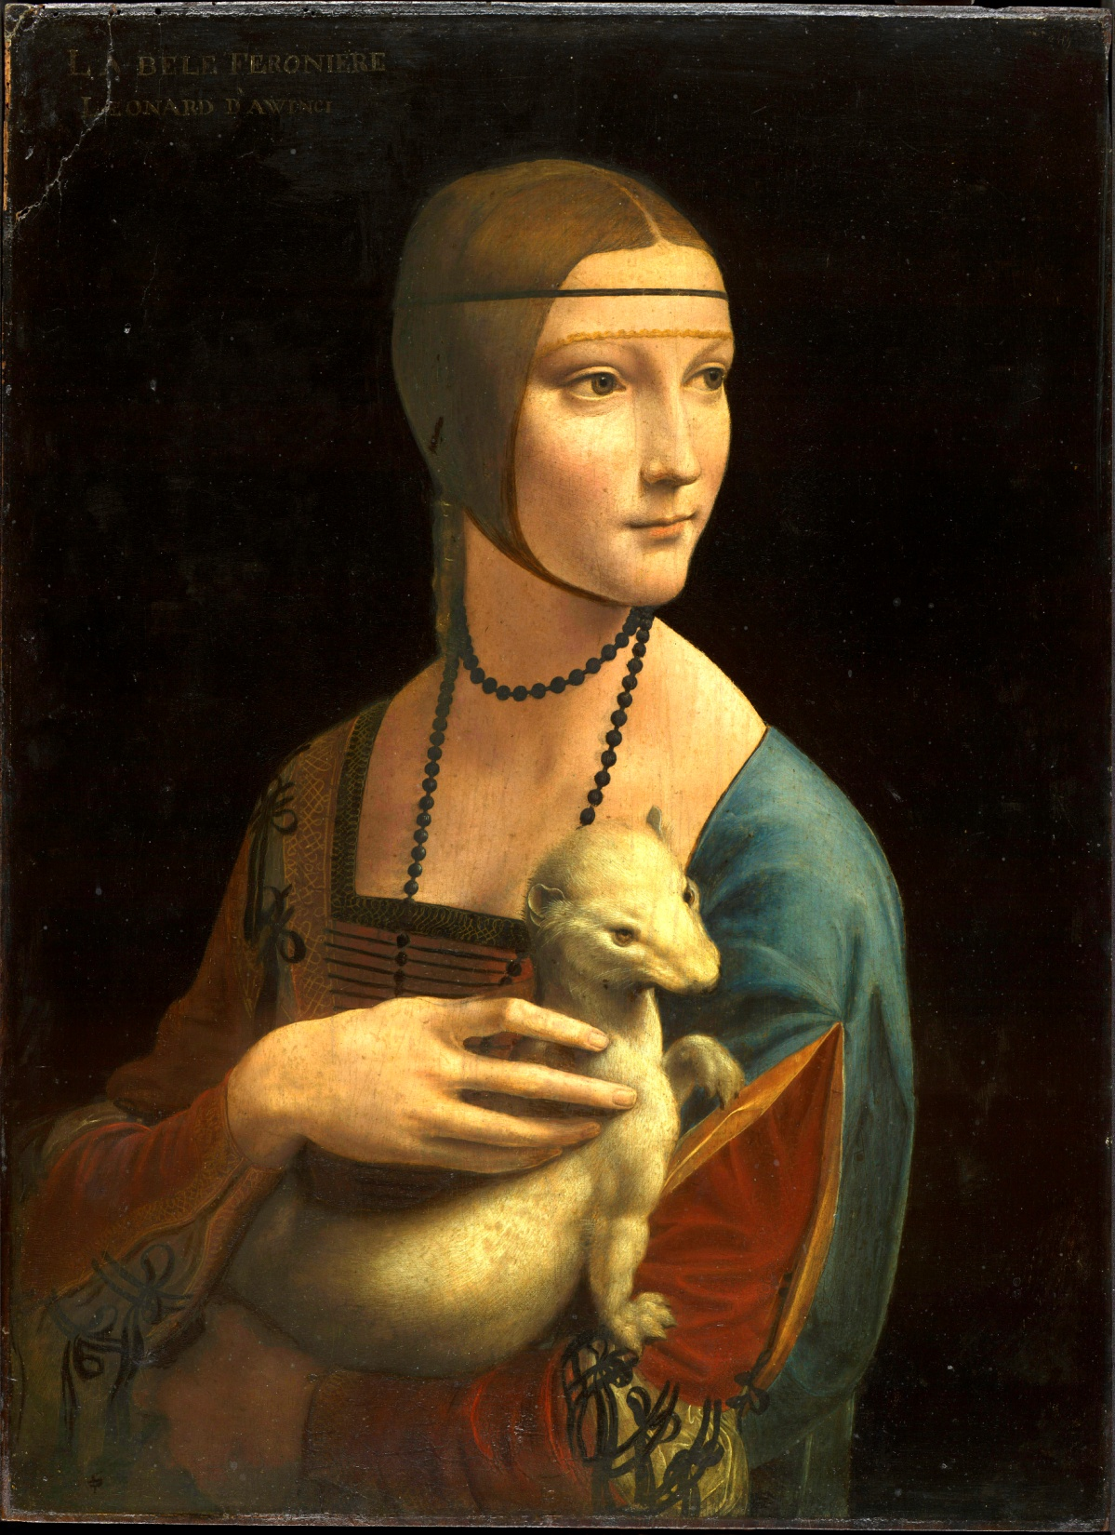
Lady with an Ermine(白貂)
(Cecilia Gallerani)

Slide 9
Leonardo was also a scientist, mathematician, engineer, musician…
He did well in many other subjects besides art.
He was left-handed, so he wrote from right to left. People can read his notes after put them in front of a mirror.

Slide 10
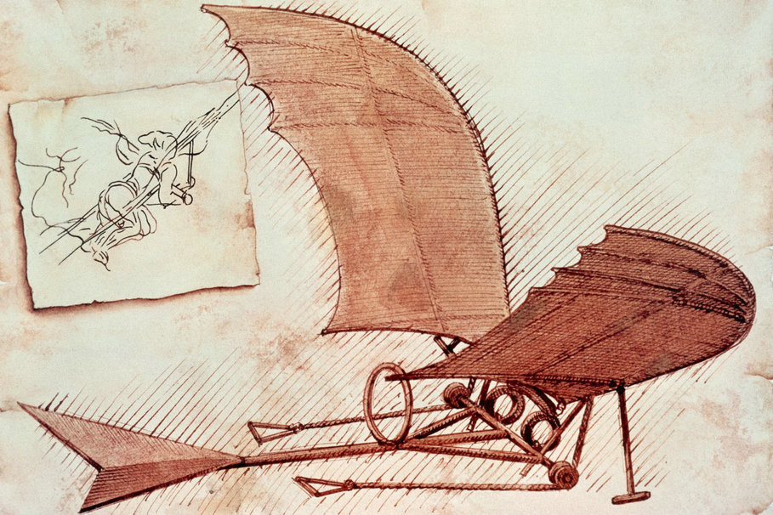
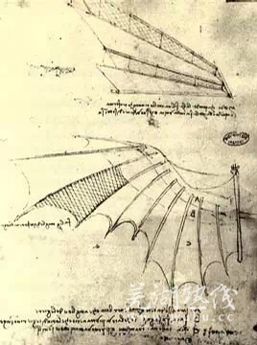
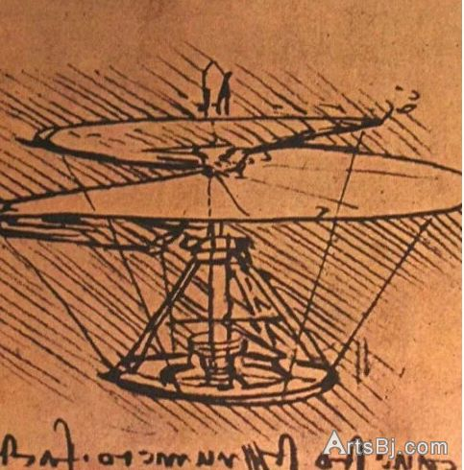
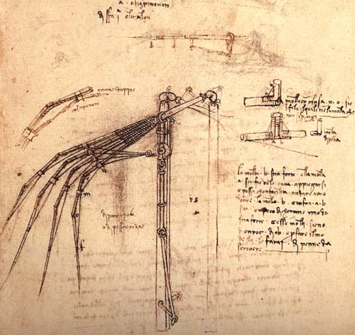

Slide 11
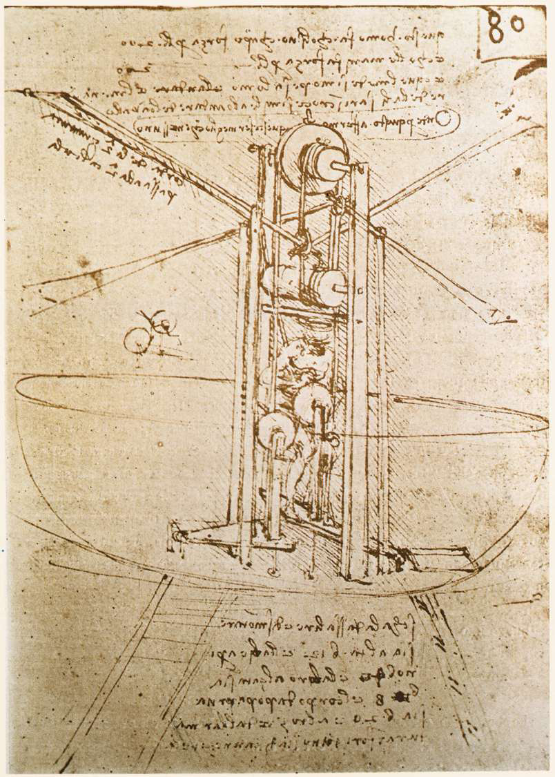
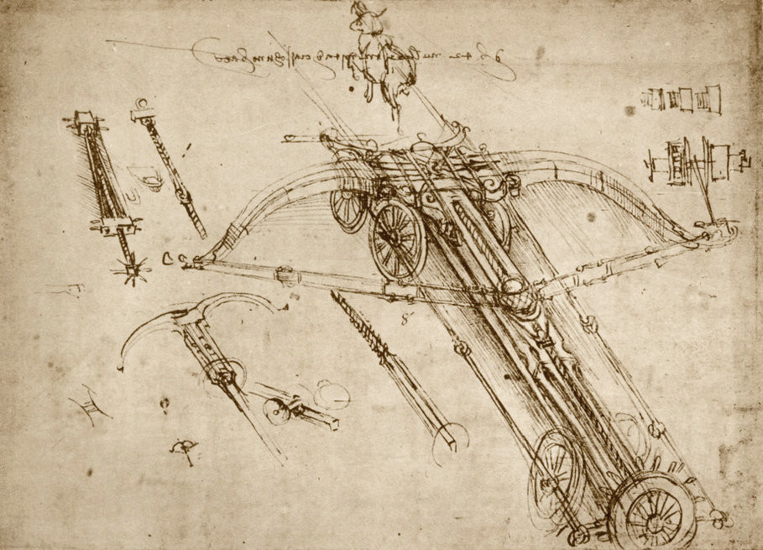
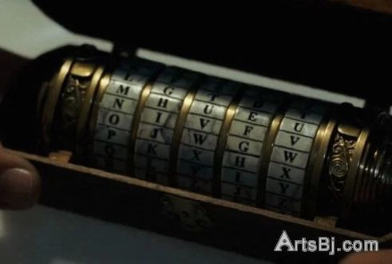

Slide 12
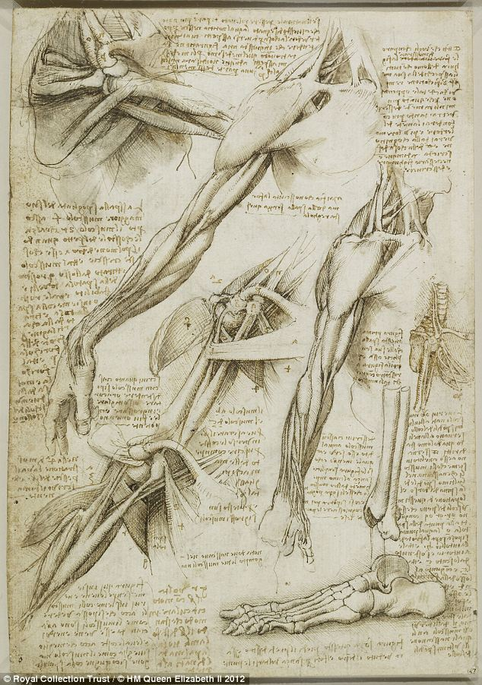
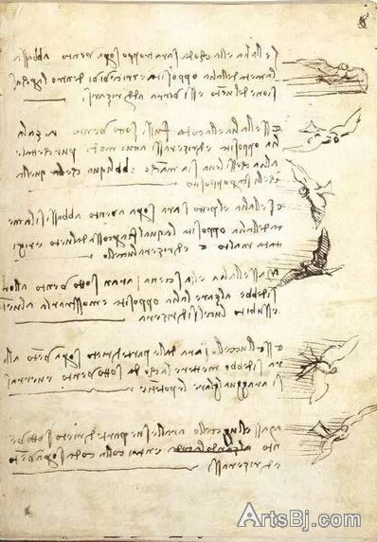
anatomy

Slide 13
As an artist, Leonardo da Vinci is my idol. His painting skill was really great. Although he died about 500 years ago, we can still learn something from him: hard-working, braveness of innovating, pursuit of excellence and so on.

