Slide 1
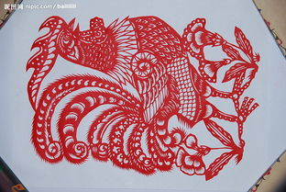
READY FOR ROOSERS

Slide 2
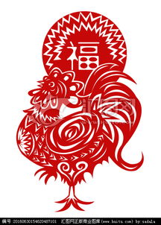
Roosters in China
Ancient story
Despite（竟然） its hardworking nature,the animal is traditionally considered as bird that can get rid of (消除）evil spirits.

Slide 3
The information about roosters in ancient times
In ancient times,when there were no clocks,it was the roosters that told people it was the time to get up and start work.
So,hardworking ancient
Chinese people were therefore
big fans of the rooster.

Slide 4
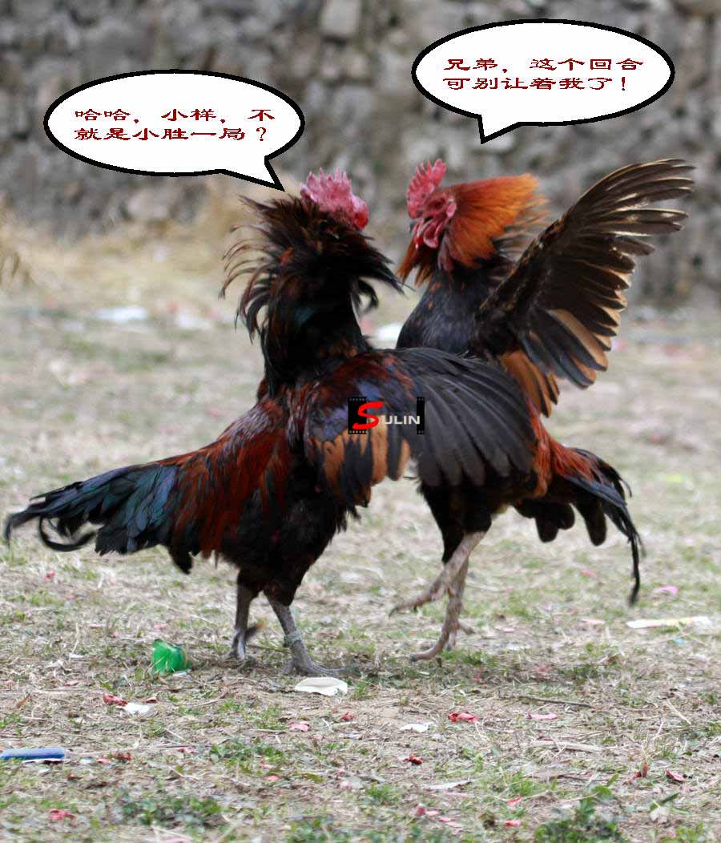
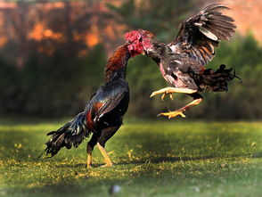
Cockfighting
In ancient China,cockingfighting always attracted large crowds due to its exciting atmosphere.

Slide 5
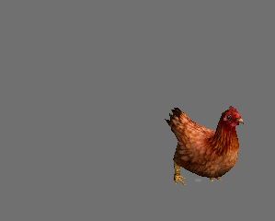

Slide 6
pronunciation
It’s not just the animal’s personality that appeals to(吸引）public.In Chinese culture,the pronunciation of “roosters” in Mandarin(普通话）is the same as that of “opportunity”. This coincidence(巧合）means that many different customs and connected with rooster.

Slide 7
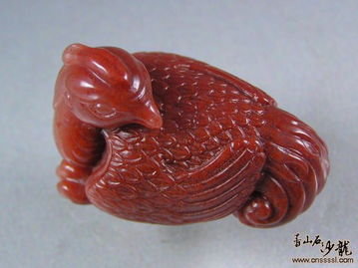
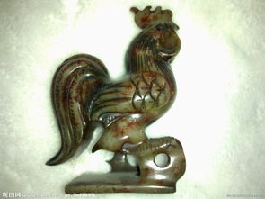
Accessory(配饰）
The Han people had a tradition of wearing a rooster-shaped accessory,a symbol of good beginnings.
The symbol of the phoenix was designed based on the rooster.

Slide 8
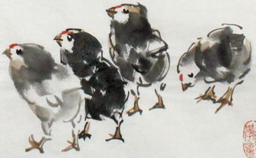
Roosters in other cultures
Ancient Greeks--------the rooster rose to the attention and saluted the sun.
In Christianity--------the rooster is a symbol of Jesus Christ’s final days.

Slide 9
This year is The Year of Roosters
Good luck ahead the year

Slide 10
Thank you

