Slide 1
British Museum
—— One of the biggest and most famous museums in the world

Slide 2
Have you gone to some museums?
Do you still remember any collection which makes a deep impression on you?

Slide 3
Can you recognize?

Slide 4
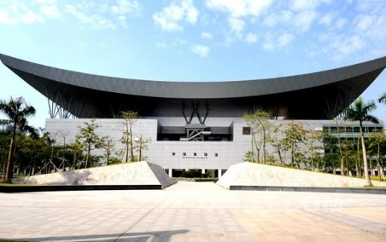

Slide 5
Shenzhen Museum

Slide 6
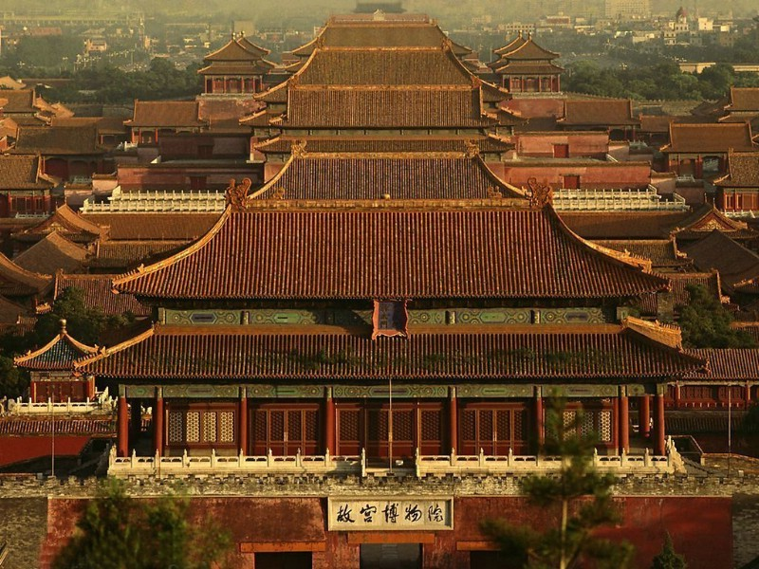
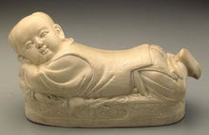

Slide 7
National Palace Museum(in Fomosa)

Slide 8
Today I want to talk about
British Museum

Slide 9
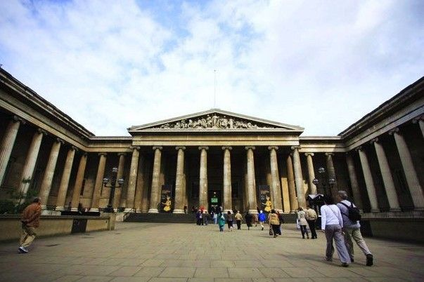
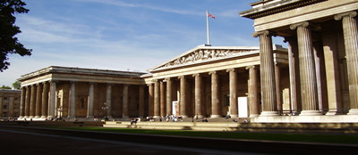
Simple introduction
British Museum,which also is called England national museum,lies on Russell Square which is in the north of England New Oxford Street.
It was set up on January 15 ,1753.
It has a collection of more than 800 pieces.

Slide 10
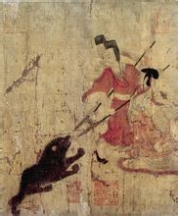
Admonitions Scroll
A collection from China in British Museum

Slide 11
Admonitions Scroll was robbed by the Eight-Power Allied Forces during the War of Invading China by the Eight-Power Allied Forces.
During the World War II,British government in order to thank China for helping Japan,decided to give China a present.They gave China two choices,one is Admonitions Scroll,another one is a submarine.Finally,we chose a submarine.

Slide 12
Five parts
Egypt cultural relics hall
Greek and Roman cultural relics hall
West Asia cultural relics hall
Medieval Europe cultural relics hall
Oriental art cultural relis hall

Slide 13
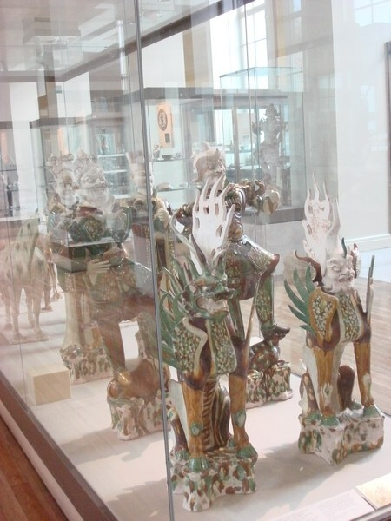
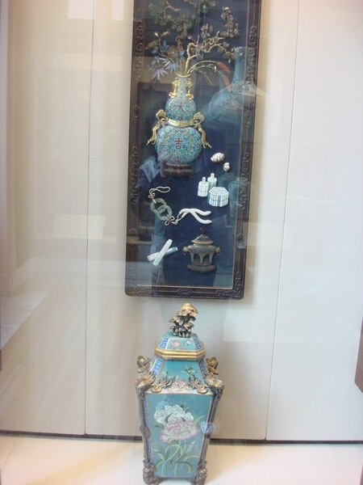
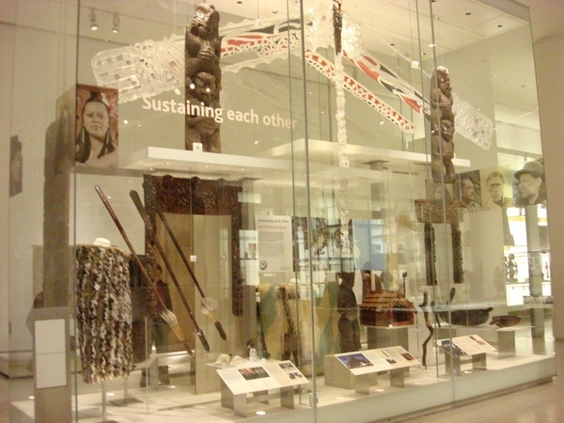
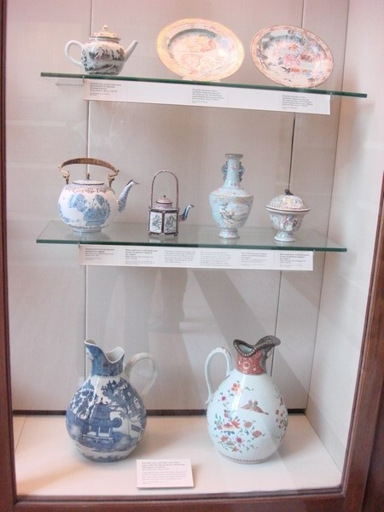
Oriental art cultural relics hall

Slide 14
Thank you!

