Slide 1

Listening

Slide 2
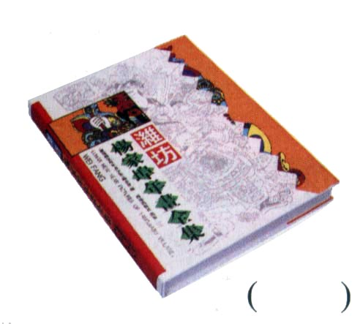
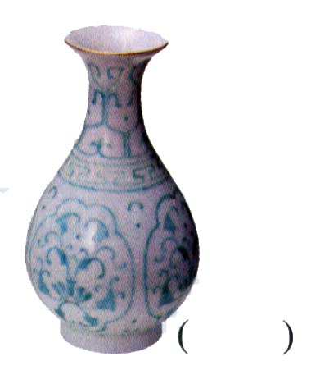
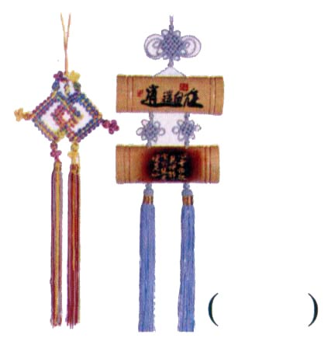
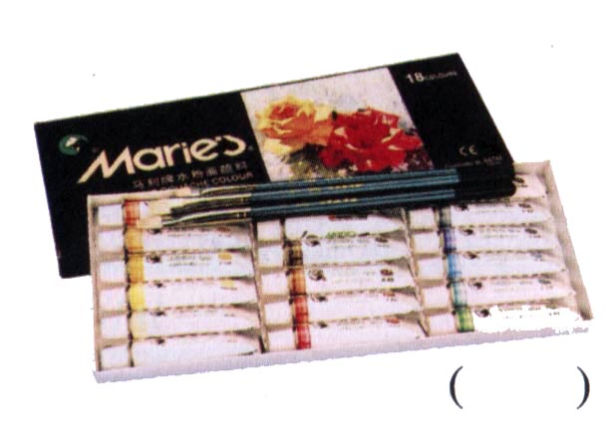
Listening on P41
Show the order in which you hear them discussed.
3
1
4
2

Slide 3
Listen again and put a tick in the chart every time you hear the person speak. Who speaks most often? Who speaks least often?
Name | Number of times each spoke
Steve lee
Wang pei
Xiao wei
4 times
7 times
7 times

Slide 4
Listen again and answer the
questions.
Who arrived late?
Xiao Wei.
Why did they decide not to get the vase for Mr Hang?
It was too expensive.

Slide 5
Why did Steve Lee wish they had talked to Mrs Hang before they went shopping?
Mrs Hang would probably have known what to get Mr Hang.

Slide 6
Which present did Wang Pei prefer?
At first he liked the book but later
he thought the wall hanging would be best.

Slide 7
Which present do you think the students will get? Give a reason.
I think they will probably get the wall hanging because the others seem to respect Wang Pei’s opinion. Also, they know Mr Hang likes that type of wall hanging.

Slide 8
Listening text
Mr Hang, the art teacher is leaving the school. Steve Lee, Wang Pei and Xiao Wei have decided to get him a going-away present. Listen to them talking about what to get him.

Slide 9
STEVE: Where’s Xiao Wei? She ought to be here by now.
WANG: There she is, just coming in the door.
XIAO: Hi Steve, Wang Pei. Sorry I’m
late.

Slide 10
WANG: Never mind, you’re here now. Look, We’ve picked out these four things. So now we just have to choose between them.
STEVE: I like the vase best of all. Do you think he’d like that?

Slide 11
XIAO: Yes, I’m sure he would, Steve. It’s beautiful. But look at the price! It’s too expensive. If we had more money it would be the perfect gift.
WANG: Yeah, I suppose so. Well what about the paints and brushes?

Slide 12
XIAO: Don’t you think he’d prefer to choose his own paints and brushes?
WANG: You’re probably right. So that leaves just the wall hanging and the art book.

Slide 13
STEVE: We should’ve talked to his wife before we came shopping. If we had, we would have a better idea about what he likes.
XIAO: Well, we didn’t, so we’ll just
have to do the best we can.
WANG: I think I’d rather get him the book. Everyone likes books.

Slide 14
XIAO: Yes but what if he’s already got it? He’s probably got lots of art books.
WANG: If he’s already got this one, he can change it for another one. What do you think Steve?

Slide 15
STEVE: This is too hard. I wish we knew more about Mr Hang. He might hate what we get him.
XIAO: No, he wouldn’t. He’d like
anything his students give him.
WANG: Do you remember those wall hangings he talked about in class? He said he loved that kind

Slide 16
of art. I think if he were here, he’d choose the wall hanging.
XIAO: OK, so what’s it to be? Which would he prefer — the wall hanging or the book?
(fade with them saying He’d prefer…, I think…I wish…)

Slide 17
Listening task on P44
Number them and then write the name of the historical period when it was painted.

Slide 18
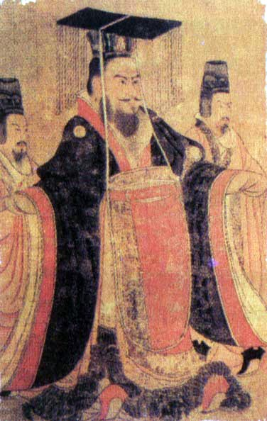
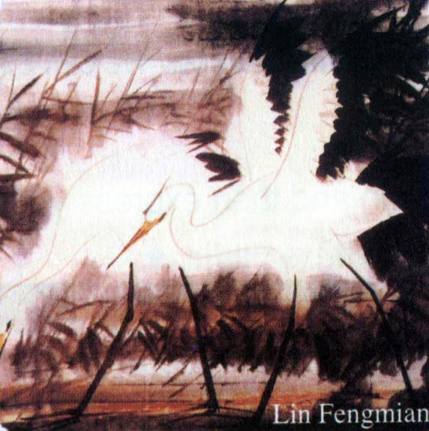
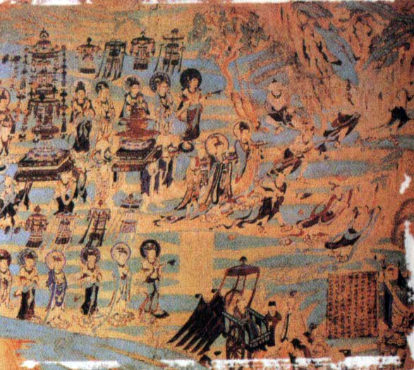
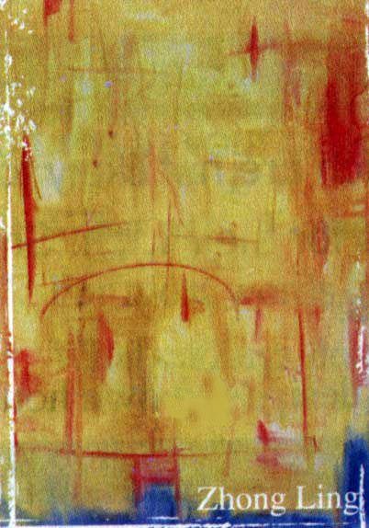
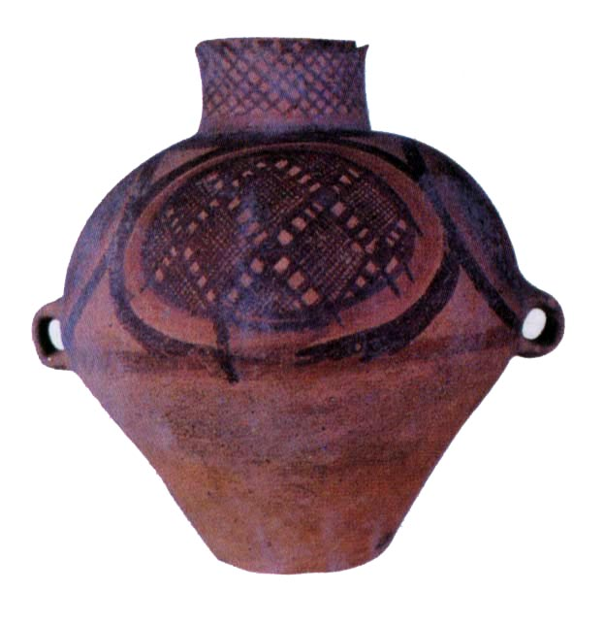
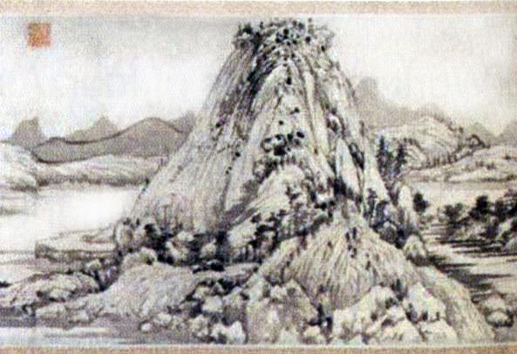
Tang Dynasty
20th century
First century AD
3
5
2
20th century
5000-3000 BC
Yuan Dynasty
6
1
4

Slide 19
Listening text
Good morning class. Today I’d like to show you some of my favourite paintings and pottery by Chinese artists.

Slide 20
You may not know that Chinese artists have been creating art for over 7,000 years. In this picture you can see a piece of painted pottery that was made between 5,000 and 3,000 BC.
When Buddhism came to China in the first century AD, architecture,

Slide 21
sculpture and painting began to have a religious theme. This cave painting is from the Caves of the Thousand Buddhas near Dunhuang, Gansu. As you can see, artists at this time had developed a very organized system of drawing, which focused on the use of brush strokes.

Slide 22
By the time of the Tang Dynasty, from about 960 to 1279 AD, the traditional style of painting we recognize today was well developed. Humans animals and scenes of palace life were popular for painting at this time, as you can see in this picture painted about 650 AD by Yan Liben.

Slide 23
During the Yuan Dynasty, human figures and pictures of still life became popular. This painting by Zhao Mengfu is typical of that period. As you can see, these artists did not try to paint nature realistically. Instead, they changed the real scenery to stress one

Slide 24
part of the scenery. They did this to show their feelings, thoughts and hopes in their paintings.
Even today, Chinese artists continue the traditions of old Chinese artists. However, many artists also experiment with Western techniques and styles in

Slide 25
their work. You can see the western influence in these two modern paintings. This one was painted by Lin Fengmian in 1974, while this abstract painting by Zhong Ling was done in the 1980s.

Slide 26
I’m afraid that’s all I have time to talk about today. But if you’re interested, I can give you more information after class and show you many examples of Chinese art from ancient to modern times. Thank you for listening to my talk.

