Slide 1

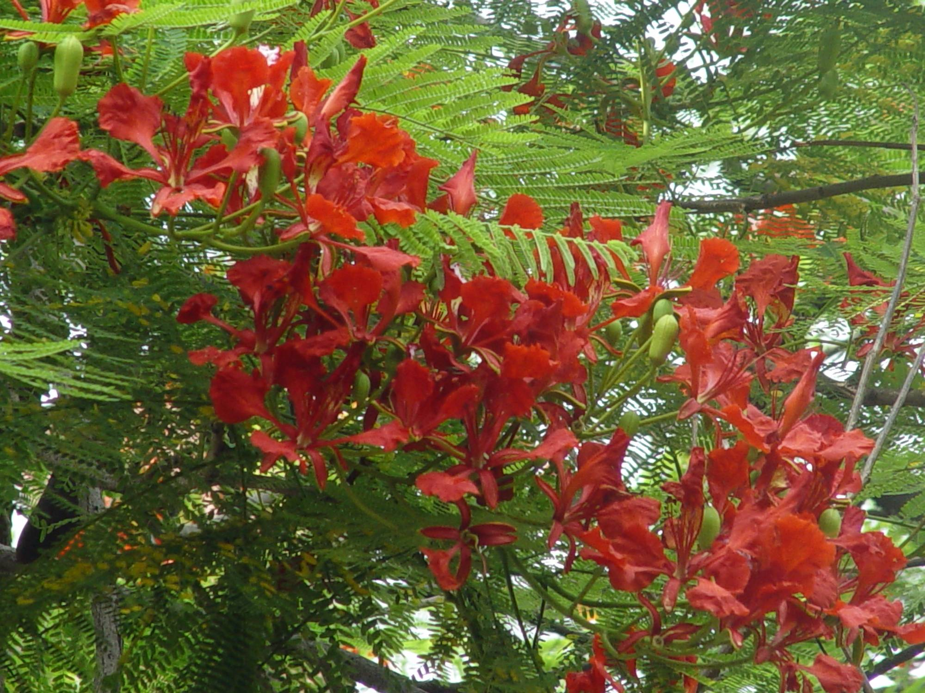


Red flowers

Slide 2
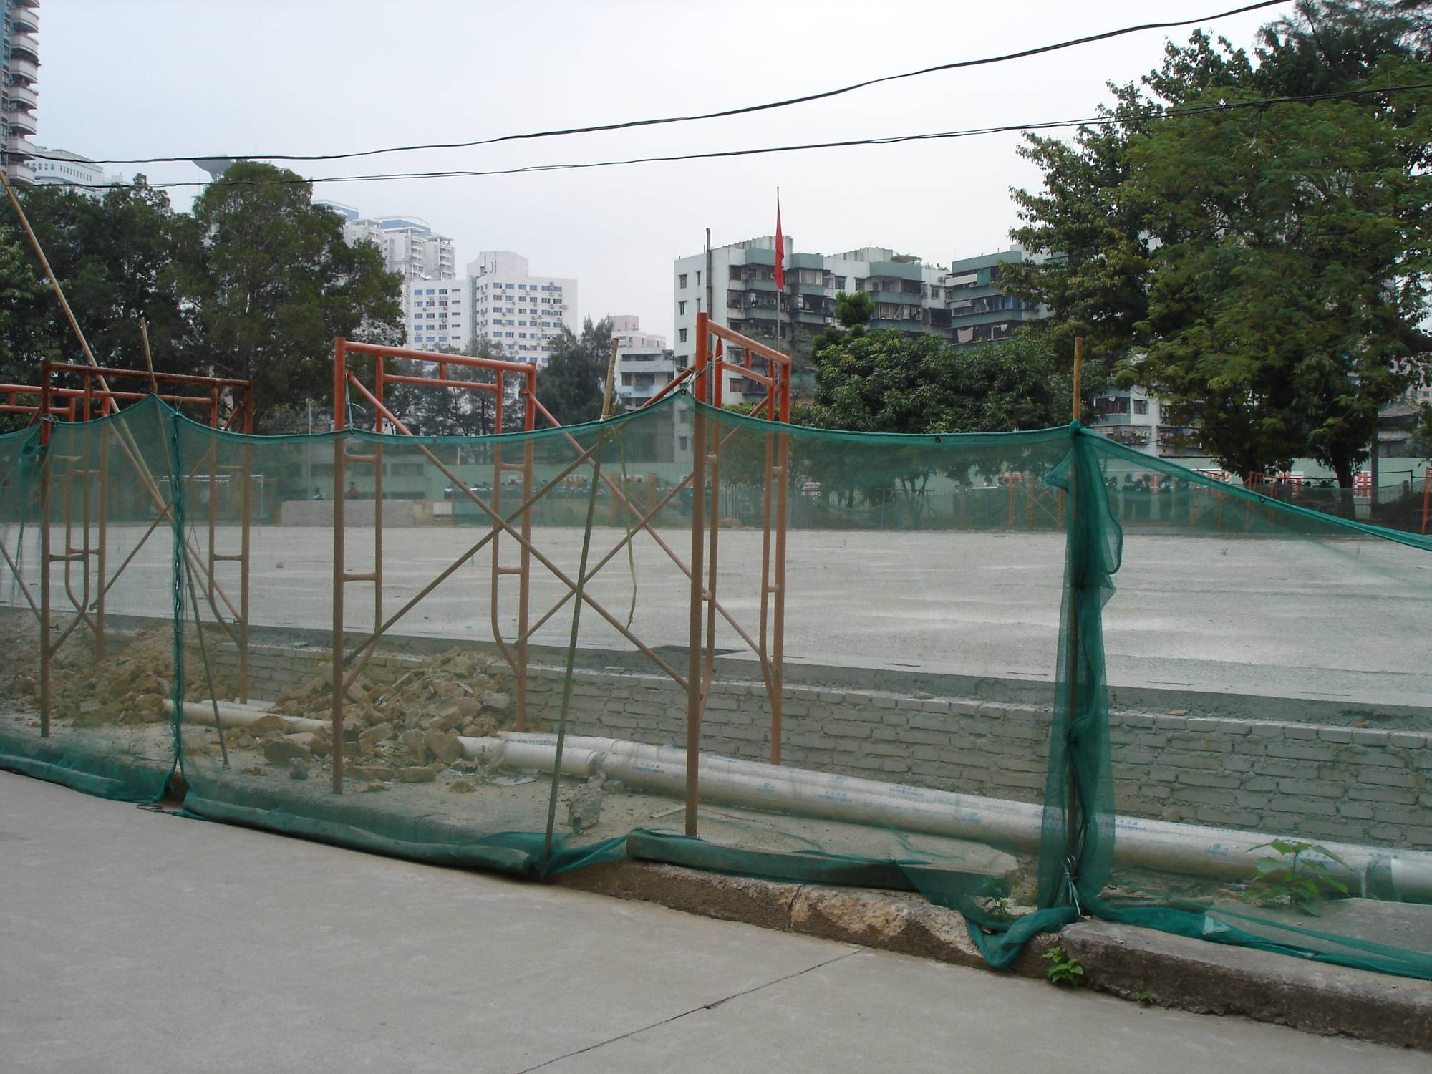
Unfinished basketball court

Slide 3
Presentation
What did you find about the environment?

Slide 4

Speaking
Discussion
What should be improved?
How to improve?

Slide 5

Writing
Writing task 1
Draw up an outline for the letter to our headmaster.

Slide 6
How to write
Start your letter with an introductory paragraph.
Describe your plan and how you will achieve it.
End with a summary.

Slide 7
How to write
on one hand, on the other hand; above all; firstly, secondly, thirdly; what’s more; for example; in a word; in conclusion
1. We suggest doing… /that …(should) do… 2. I think we should… 3. Maybe we should… 4. How about…? 5. Why not…?

Slide 8
Writing task 2
Write your own letter according
to the outline.

Slide 9
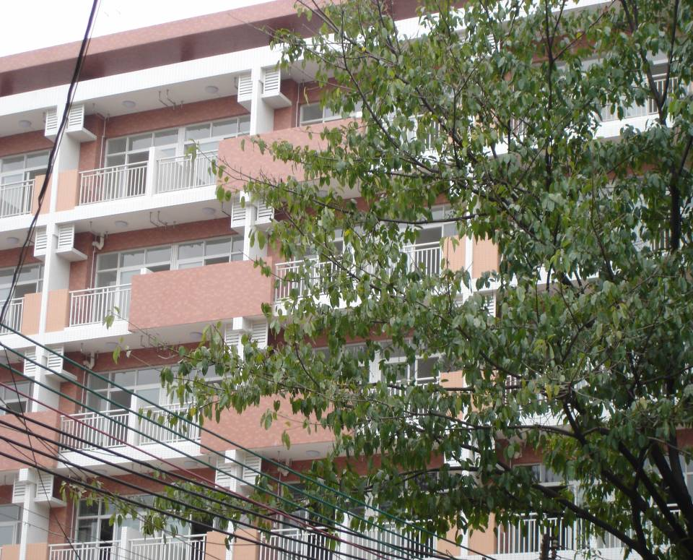
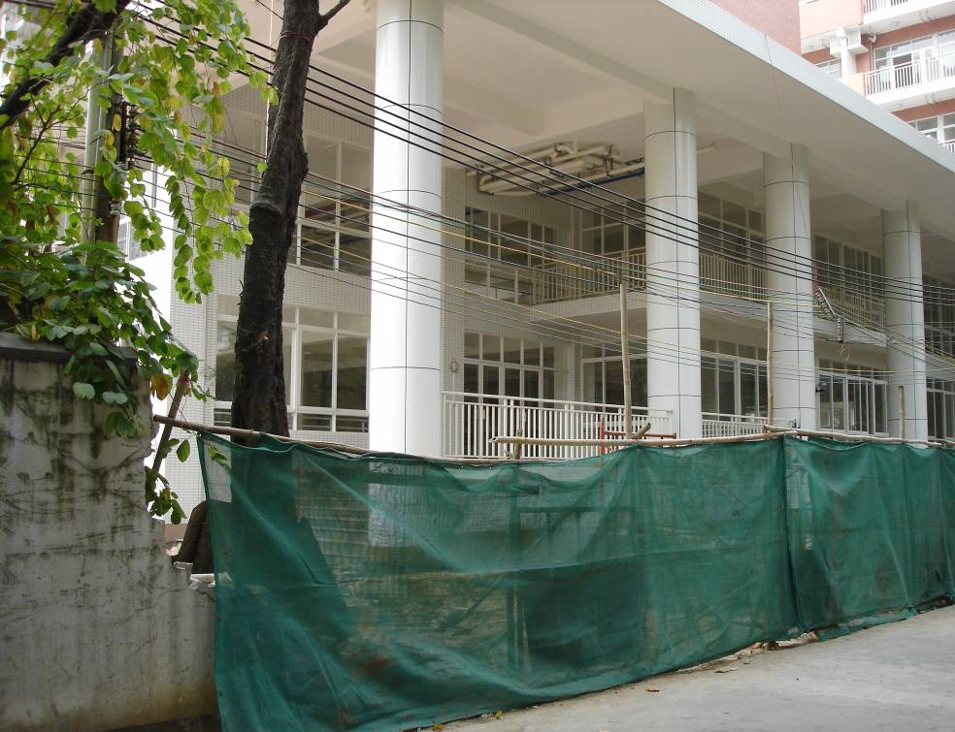
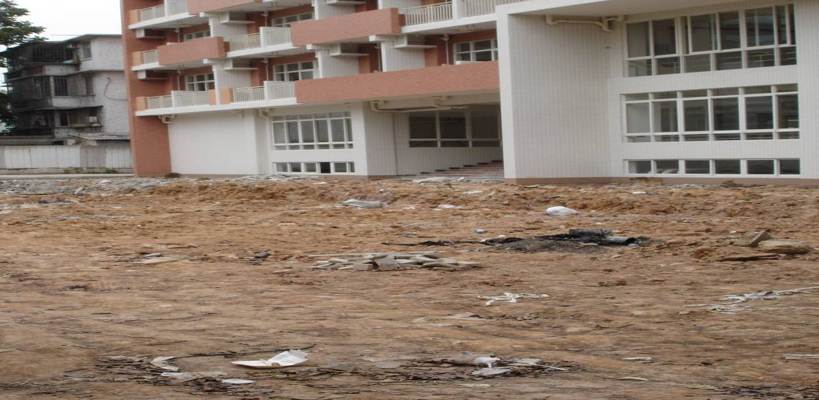

Dormitory: beautiful roof, but rough ground

Slide 10
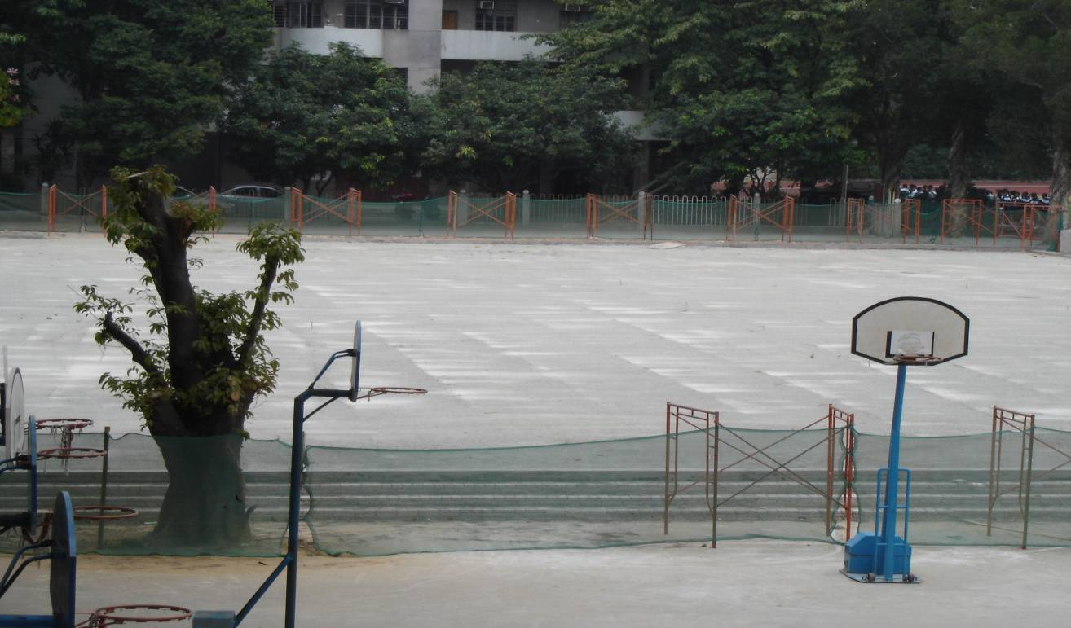
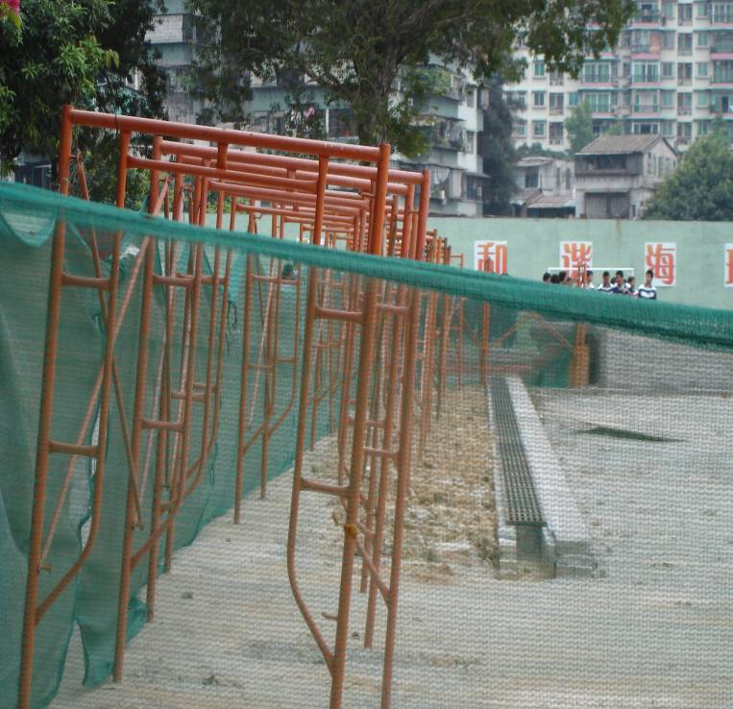
The unfinished
basketball court

Slide 11
A good writing
Share your letter
A purpose Some ideas
A summary Some structures
Clear steps Some conjunctions
High-level sentences
Good handwriting

Slide 12
Post-class task
Task 1
Write a letter to your parents---what to be improved in your house and how.
Task 2
Write a letter to the mayor--- how to improve the environment of Guangzhou.

Slide 13
Task 3
Write an E-mail to your head teacher---how to improve your class management.

