Slide 1



Unit 1 Workbook
Listening

Slide 2
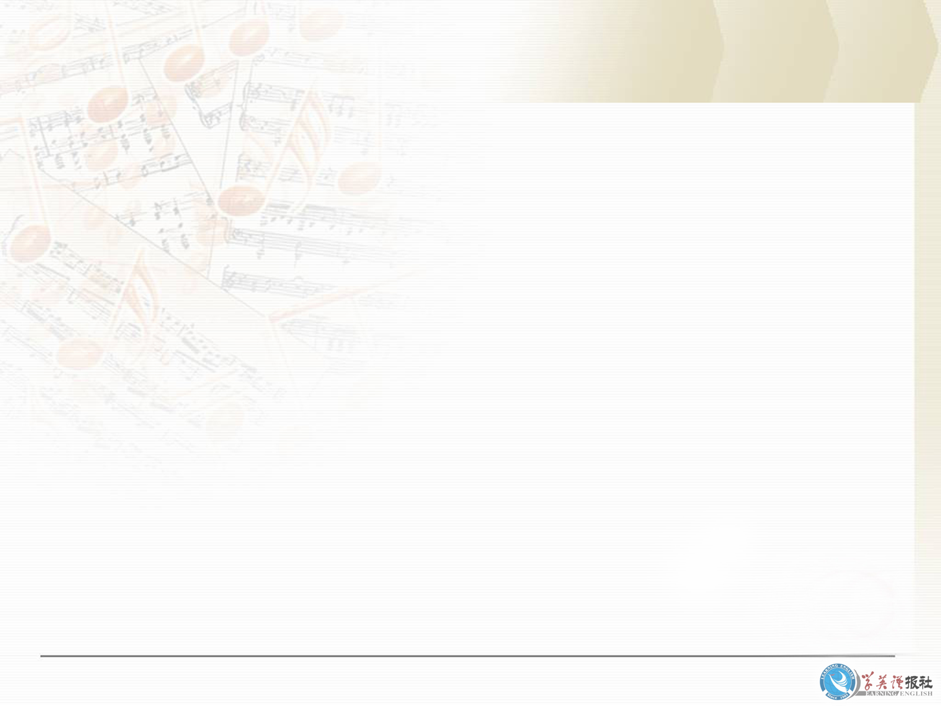
Mr Hang, the art teacher, is leaving the school. Steve Lee, Wang Pei and Xiao Wei have decide to get him a present. Listen to them talking about what to get him. Number the presents 1-4 to show the order in which you hear them discussed.

Slide 3
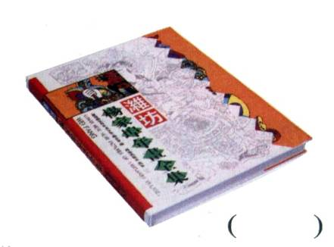
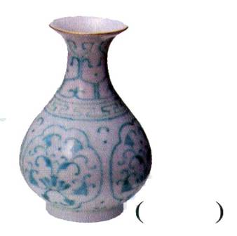
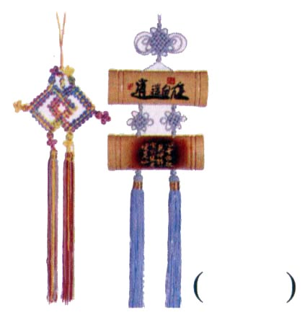
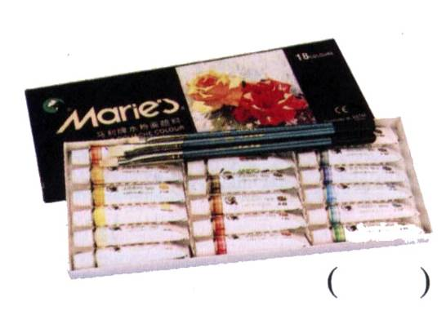
Show the order in which you hear them discussed.
3
1
4
2

Slide 4
Listen again and answer the questions.
Who arrived late?
Why did they decide not to get the vase for Mr Hang?
Xiao Wei.
It was too expensive.

Slide 5
Why did Steve Lee wish they had talked to Mr Hang’s wife before they went shopping?
Mrs Hang would probably have known
what to get Mr Hang.
4. Which present did Wang Pei prefer?
At first he liked the book but later he
thought the wall hanging would be best.

Slide 6
Which present do you think the students will get? Give a reason.
I think they will probably get the wall
hanging because the others seem to
respect Wang Pei’s opinion. Also,
they know Mr Hang likes that type
of wall hanging.

Slide 7
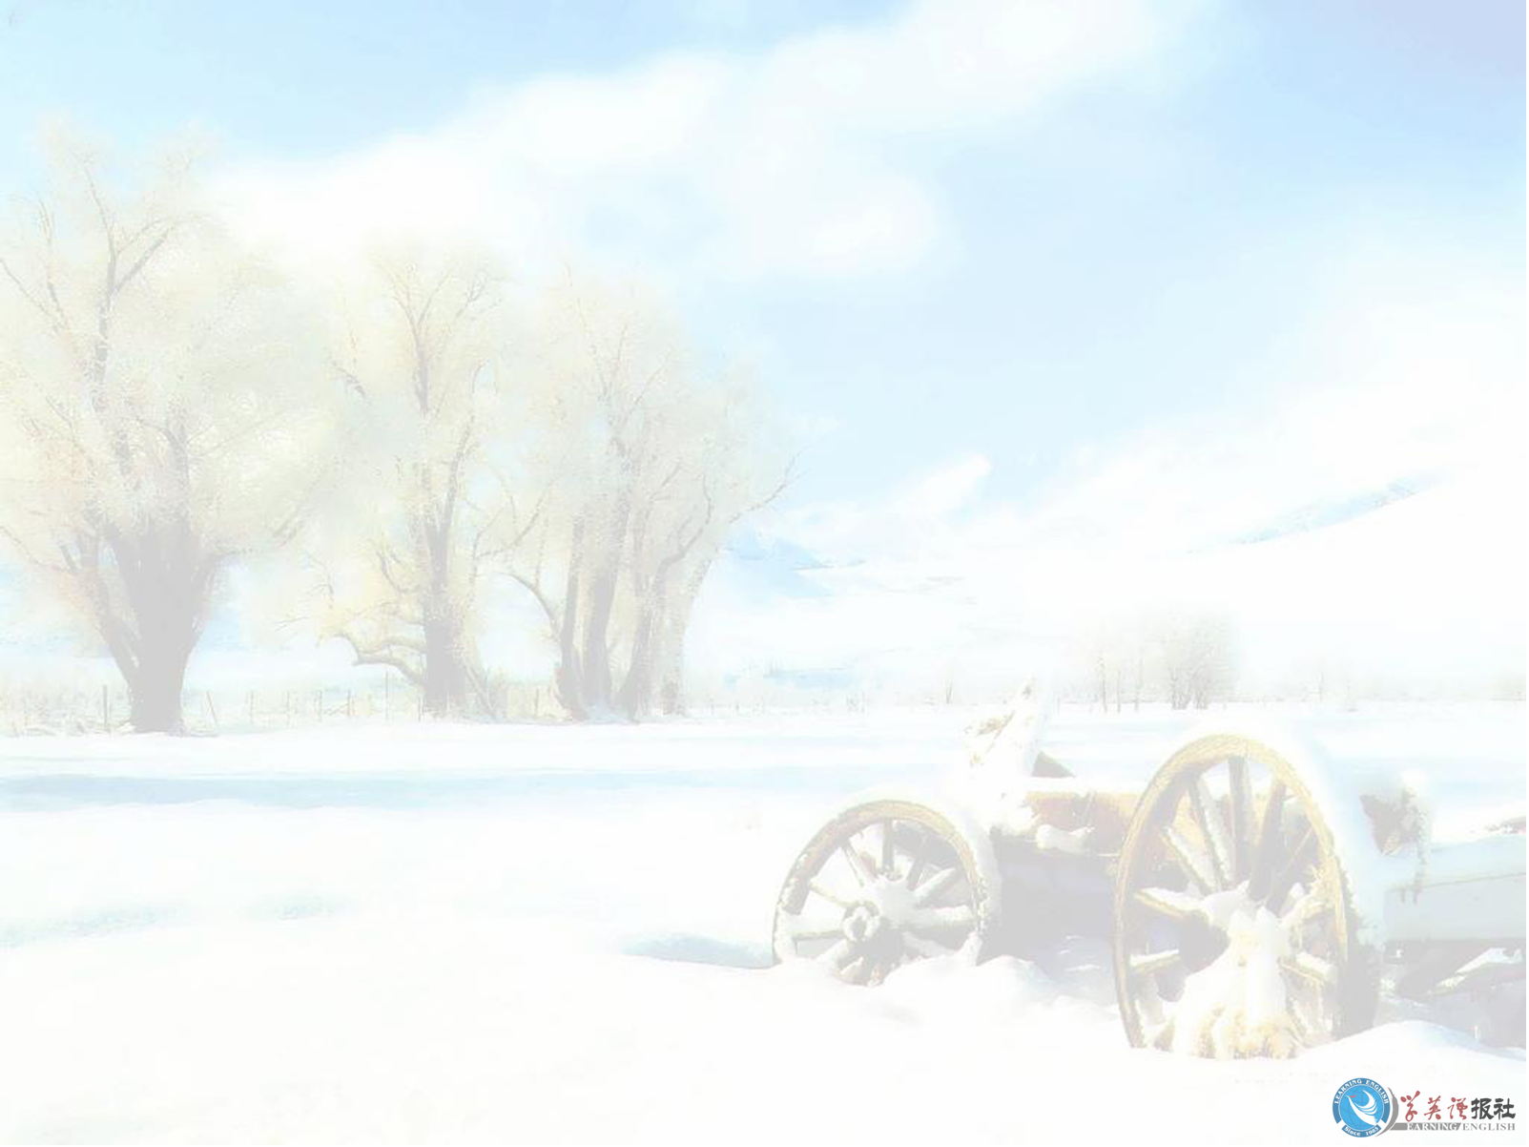
Listening text
( S = Steve Lee W = Wang Pei
X = Xiao Wei)
Mr Hang, the art teacher is leaving the school. Steve Lee, Wang Pei and Xiao Wei have decided to get him a present. Listen to them talking about what to get him.

Slide 8
S: Where’s Xiao Wei? She ought to be
here by now.
W: Here she is. She’s just coming into
the shop.
X: Hi, Steve, Wang Pei. Sorry, I’m late.
W: Never mind, you’re here now. Look,
We’ve already picked out these four
things. What do you think?

Slide 9
S: I like the vase best. Do you think
he’d like that?
X: Yes, I’m sure he would, Steve. It’s
beautiful and I wish I could have it.
But look at the price-it’s so expensive!
Otherwise it would be the perfect.
W: Well, what about these paints and
brushes then?

Slide 10
X: Don’t you think he’d prefer to
choose his own?
W: Yes. You’re probably right. So
that leaves the art book and the
wall hanging.

Slide 11
Part 2
S: I wish we’d talked to his wife before
we came shopping.
X: Me too. Anyway we’ll just have to do
the best we can.
W: Well, we know he loves art so what
about the book? It shows so many of
Qi Baishi’s paintings and everyone
loves them.

Slide 12
X: Yes but what if he’s already got it?
He’s probably got lots of art books.
W: OK, so if he’s got this one he can
change it! What do you think, Steve?
S: Hey, what a coincidence! He talked
about wall hangings in class only last
week. He said he loved that kind of
art. I think if he were here, he’d
choose the wall hanging.

Slide 13
X: Yes, I remember. So Wang Pei, what’s it to be-the wall hanging or the art book?
W: Perhaps he’d prefer… (fading)

Slide 14


Talking
Work in groups and discuss these
questions.
1 Who are your favourite artists, both from China and from other countries?
Give your reasons for your preference.

Slide 15
2 What kind of art do you prefer: traditional or modern, abstract paintings or photograph, two-dimensional or three-dimensional?
3 What kind of Chinese art do you like best? In your discussion include examples of folk art.

Slide 16

Listening task
Look at the artworks below.
In what period of Chinese history do you think they were created? Discuss with others in your class.

Slide 17
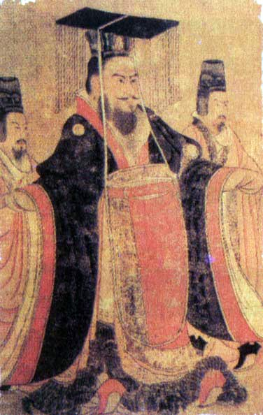
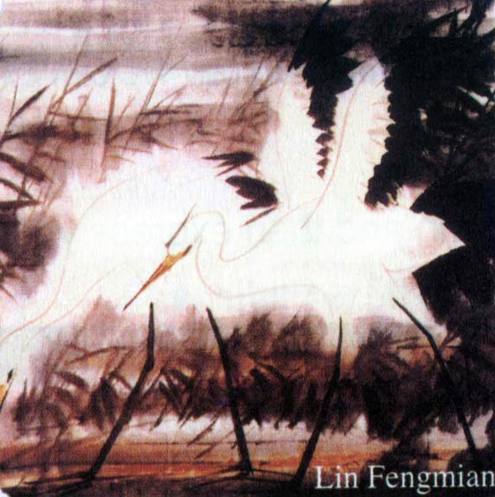
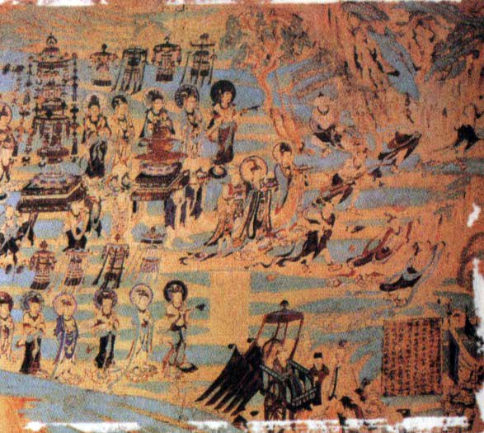
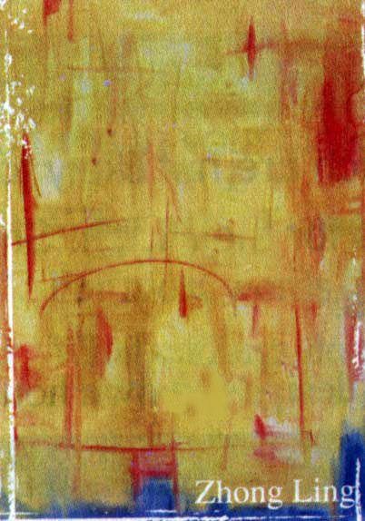
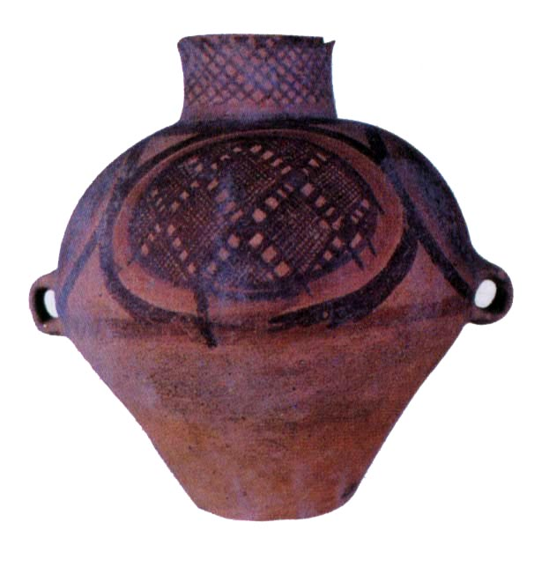
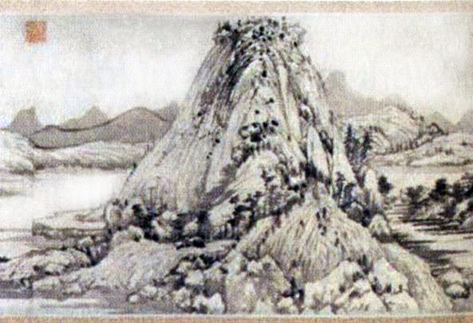

Slide 18
Listen to Zhang Lin’s talk all the
way through. Try and number the
artworks 1-6 to show the order in
which he talks about them.

Slide 19
3
5
2
6
1
4

Slide 20
Listen again to Parts 1-3 and add the historical period when each one was made.

Slide 21
Tang Dynasty
20th century
First century AD
20th century
5000-3000 BC
Yuan Dynasty

Slide 22

Listening text
Good morning, class. Today I’d like to show you some of my favourite paintings and pottery by Chinese artists.

Slide 23
Part 1
You may not know that Chinese artists have been creating art for over 7,000 years. In this picture you can see a piece of painted pottery that was made between 5000 and 3000 BC.
When Buddhism came to China in the first century AD, architecture,

Slide 24
sculpture and painting began to have a religious theme. This painting is from the Caves of The Thousand Buddhas near Dunhuang, Gansu. As you can see, artists at that time were good at drawing small delicate figures.

Slide 25
Part 2
By the time of the Tang Dynasty, from about 960 to 1279 AD, the traditional style of painting was well developed. Humans and scenes of palace life were popular for painting at this time, as you can see in this picture painted about 650 AD by Yan Liben.

Slide 26
During the Yuan Dynasty, human figures and pictures of still life became popular. This painting by Zhao Mengfu is typical of that period. As you can see, these artists did not try to paint nature realistically. Instead, they changed it to stress one part of the scenery.

Slide 27
They did this to show their feelings, thoughts and hopes through their paintings.
Part 3
Even today, Chinese artists continue the traditions of the old Chinese artists. However, many artists also experiment with Western techniques and styles in

Slide 28
their work. You can see Western influence in these two modern paintings. This one was painted by Lin Fengmian in 1974, while this abstract painting by Zhong Ling was done in the 1980s.

Slide 29
I’m afraid that’s all I have time to say for today. But if you are interested, I can give you more information after class and show you many examples of Chinese art from ancient to modern times. Thank you for listening to my talk.

Slide 30
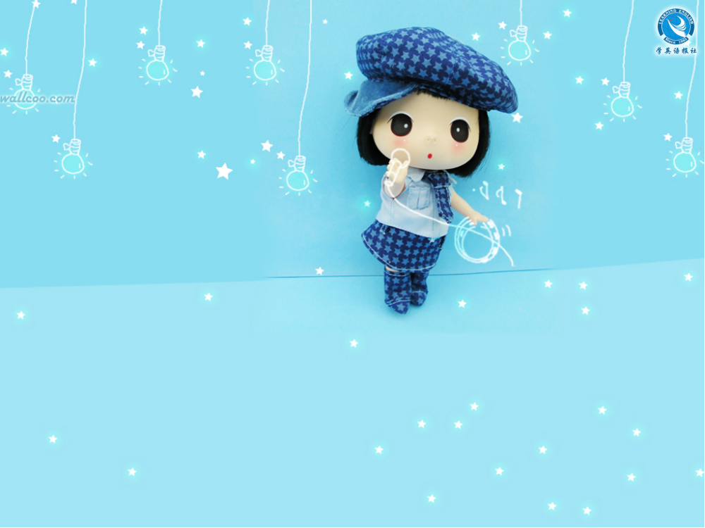
Thank you!

