Slide 1

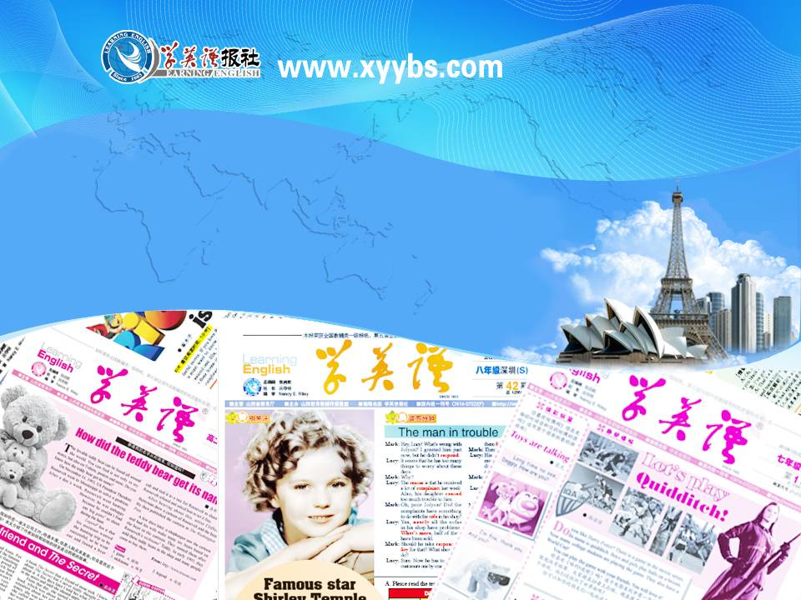
同步教学辅助课件
必修5

Slide 2



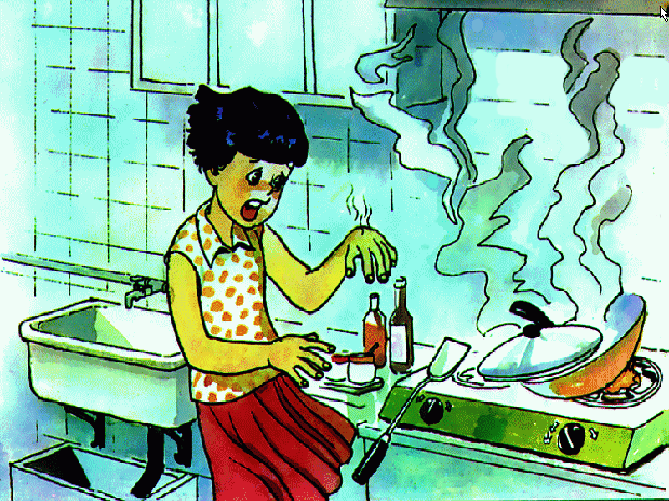
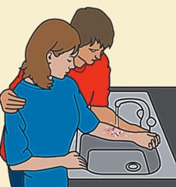
Unit 5
First aid
Reading
FIRST AID FOR BURNS

Slide 3

a piece of furniture or a small part of a room with a door or doors behind which there is space for storing things, usually on shelves
n. 橱柜; 衣柜
cupboard
the natural outer layer which covers a person, animal, fruit, etc.
n. 皮; 皮肤
skin
a part of the body of an animal or plant which performs a particular job
n. 器官
organ
an object like a fence that prevents people from moving forward from one place to another
n. 屏障; 障碍 (物)
barrier

Slide 4
a substance that can make people or animals ill or kill them if they eat or drink it
n. 毒药; 毒害
poison
to kill a person or animal or to make them very ill by giving them poison
vt. 毒害; 使中毒
poison
a narrow beam of light, heat, etc. travelling in a straight line from its place of origin
ray
n. 光线; 射线
difficult to understand or find an answer to because of having many different parts
adj. 复杂的
complex

Slide 5
the quality of not being the same or not doing the same thing all the time
n. 变化; 多样(化); 多变(性)
variety
a substance, such as water, that is not solid or a gas and that can be poured easily
n. 液体
liquid
a form of energy that comes from a nuclear reaction and that can be very dangerous to health
radiation
n. 辐射; 射线

Slide 6
not violent, severe or extreme
adj. 轻微的; 温和的; 温柔的
mild
slightly; not very much; in a gentle manner
adv. 轻微地; 温和地
mildly
a metal container that is round and often has a long handle and a lid, used for cooking things on top of a cooker
pan
n. 平底锅; 盘子
a piece of equipment which burns fuel or uses electricity in order to heat a place
n. 炉子; 火炉
stove

Slide 7
a group of connected cells in an animal or plant that are similar to each other, have the same purpose and form the stated part of the animal or plant; soft paper which is used for cleaning, esp. your nose, and is thrown away after use, or a small rectangular piece of this
n. (生物)组织; 薄的织物; 手巾纸
tissue
to become larger and rounder than usual; to (cause to) increase in size or amount
vi. & vt. (使) 膨胀; 隆起
swell

Slide 8
larger than normal, esp. as a result of a disease or an injury
adj. 肿胀的
swollen
a device used for cutting materials such as paper, cloth and hair, consisting of two sharp blades which are joined in the middle, and two handles with holes to put your fingers through
n. 剪刀
scissors
too painful or unpleasant for you to continue to experience
adj. 难以忍受的; 不能容忍的
unbearable

Slide 9
an open round container shaped like a bowl with sloping sides, used for holding food or liquid; a place where the earth's surface is lower than in other areas of the world
n. 盆; 盆地
basin
to press sth. firmly, esp. from all sides in order to change its shape, reduce its size or remove liquid from it
vt. & vi. 榨; 挤; 压榨
squeeze

Slide 10
a long narrow piece of cloth which is tied around an injury or a part of someone's body that has been hurt
n. 绷带
bandage
necessary for the success or continued existence of sth.; extremely important
vital
adj. 至关重要的; 生死攸关的
any feeling of illness or physical or mental change which is caused by a particular disease; any single problem which is caused by and shows a more serious and general problem
n. 症状；征兆
symptom

Slide 11
a covered metal or plastic container with a handle and a shaped opening for pouring, used for boiling water
n. (水)壶；罐
kettle
to make a substance flow from a container, especially into another container, by raising just one side of the container that the substance is in
vt. & vi. 倒；灌；注；涌
pour

Slide 12
the part of the body between the hand and the arm
n. 手腕
wrist
slightly wet, especially in a way that is not pleasant or comfortable
adj. 潮湿的
damp
the part of a piece of clothing that covers some or all of the arm
n. 袖子
sleeve
a shirt for a woman or girl
n. 女衬衫
blouse

