Slide 1

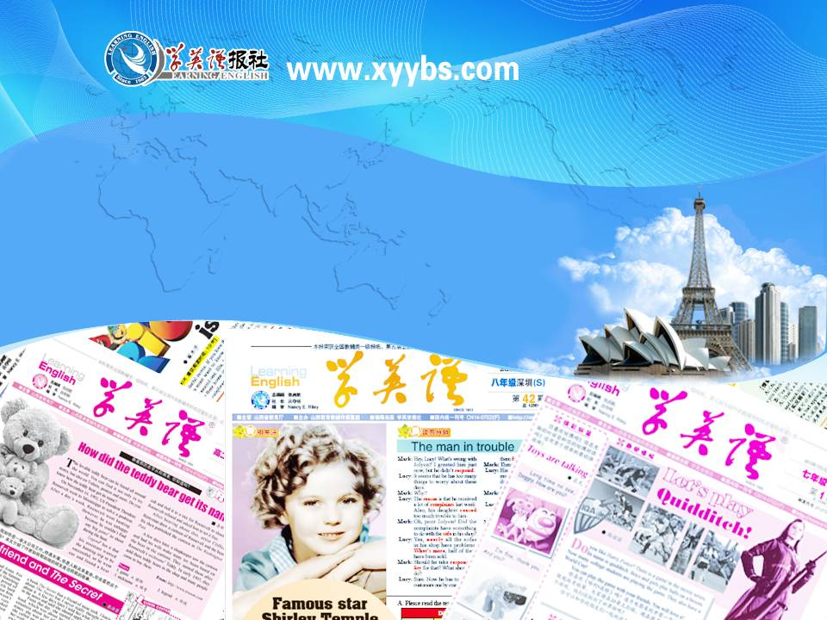
同步教学辅助课件
必修5

Slide 2

Objective
To learn some useful words and expressions in the passage
Focus on
Words:
skin, poison, complex, variety, liquid, mild, swell, unbearable, squeeze, vital, pour
Expressions:
electric shock, squeeze out, over and over again, in place

Slide 3

1. aid
【语境展示】
1) He aided me in business.
2) I aided her to continue her study.
3) At Christmas, many organizations
aid the poor.
vt. 帮助; 援助
n. 帮助; 援助 (不可数)
【语境展示】
They’ve made an urgent request for international aid.
他们紧急请求国际援助。

Slide 4
[拓展]
do/give/offer/carry out first aid 进行急救
in aid of ... 为了帮助
come to sb.’s aid 帮助某人
with the aid of 借助于
cut off aid （突然）终止援助
aid sb. in (doing) sth. 在某方面帮助某人
aid sb. to do sth. 帮助某人做某事
aid sb. with sth. 帮助某人某事

Slide 5


请根据汉语提示完成下列句子。
practice
with the aid
of the computer
1. The work should be done ____________
_______________ (用计算机协助完成).
2. He raised money _________________
(为了帮助穷人).
3. While one of you ________________
(进行急救), the other should call an
ambulance.
in aid of the poor
gives first aid

Slide 6
2. choke
vi. & vt. (使) 噎住; (使) 窒息
【语境展示】
The girl choked to death after breathing in smoke.
那位女孩吸入烟雾后窒息而亡。
The smoke almost choked me.
烟呛得我几乎喘不出气来。

Slide 7
请根据汉语提示完成下列句子。
practice
1. She ______________ (窒息而亡) on a
fish bone.
2. Children can ________________ (吃花
生会噎住)
3. Peanuts can __________________ (噎
住小孩).
choked to death
choke on peanuts
choke a small child

Slide 8
3. poison
n. 毒药; 毒害
【语境展示】
How did he die? Was it poison?
他是怎么死的？是中毒吗？
vt. 毒害; 使中毒; 在……放毒; 在……下毒
【语境展示】The rumours that she had poisoned him could never be proved.
说她毒死了他的谣言永远不可能得到证实。
Someone had been poisoning his food.
有人一直在他的食物里下毒。

Slide 9
请根据汉语提示完成下列句子。
practice
1. Her drink had been laced (掺入) with
a _____________ (致命的毒药).
2. He said that someone _____________
__________ (在他咖啡里下了毒).
deadly poison
had poisoned
his coffee

Slide 10
4. swell
【语境展示】
His ankles began to swell.
他的脚踝肿起来了。
The sprain made my ankle swell up.
我的脚踝扭伤肿了起来。
swollen
【语境展示】His eyelid is swollen.
他眼皮肿了。
vi. & vt. (使) 膨胀; 隆起
adj. 肿胀的

Slide 11
请根据汉语提示完成下列句子。
practice
1. Her arm was ___________________
(肿了起来) where the bee had stung
her.
2. Her eyes were ___________________
______ (哭得又红又肿).
beginning to swell up
red and swollen from
crying

Slide 12

5. squeeze
【语境展示】
Squeeze the oranges.
He squeezed everything into a suitcase.
vt. & vi. 榨; 挤; 挤入; 塞入
squeeze out
【语境展示】
The lemon looks dry to me, but you may be able to squeeze out a few drops.
那个柠檬看来已经干了，但也许你还能挤出几滴汁来。
榨出; 挤出

Slide 13
请根据汉语提示完成下列句子。
practice
1. Soak (浸泡) the cloth in warm water
and then _____________ (拧干).
2. We ___________________ (挤进了)
six people into the car.
squeeze it dry
managed to squeeze

Slide 14
6. treat
【语境展示】
He is being treated for a rare skin disease.
He treated his wife very badly.
Put your money away - I'm going to treat you.
vt. & vi. 治疗；对待；款待
n. 款待；招待
【语境展示】
No, you paid for dinner last time - this is my treat.

Slide 15
[点拨]
treat ... like/as … 把……当……对待
treat … seriously 认真对待……
treat sb. with respect / kindness 尊敬某人 / 善待某人
treat sb. to … 款待某人……
be one’s treat 某人请客
[拓展]
treatment n. 待遇；处理；治疗
treaty n. 条约，协议

Slide 16
请根据汉语提示完成下列句子。
1. — I’m sorry. I don’t have enough cash
for the meal.
— Take it easy. ____________ (我请客).
2. I really don’t understand why you
__________________ (那样对待她).
3. Now I try to _______________________
(尊重每一个人), no matter who they are.
practice
It’s my treat
treat her like that
treat everyone with respect

Slide 17
7. apply
【语境展示】
The paint should be applied thinly and evenly.
He wants a job in which he can apply his foreign languages.
vt. 涂；敷；搽；应用；运用
vi. 申请；请求；有关；涉及
【语境展示】
By the time I saw the job advertised it was already too late to apply.
What I am saying applies only to some of you.

Slide 18
[点拨]
apply … to …
把……涂在……上；把……应用于……
apply oneself/sth. to sth. / doing sth.
集中精力于(做)某事
apply to … 适用于……
apply (to …) for … (向……)申请……
[拓展]
applied adj. 应用的；实用的
applicant n. 申请人
application n. 申请；请求；应用；运用

Slide 19
请根据汉语提示完成下列句子。
practice
applied to join the army
1. He has ______________________
(报名参军).
2. Jane finally ___________________
(决心申请) American citizenship.
3. The new technology ____________
__________ (被应用于农业).
decided to apply for
was applied to farming

Slide 20




Let the word fly
Team racing
Two teams will have a race. The team that first give the proper meaning will get one point.
Ready?

Slide 21
keep
记下；记录；记载（日记、账目、记录等）
放；存放；贮存（在某处）
使耽搁；使延误
保有；留着；不退还
（使）保持；处于
遵守；笃守；恪守
开设；经营；管理（商店或餐馆）
继续；重复（做某事）
(一时)拥有；保管
供养；扶养；养活

Slide 22
Do you want this photograph back or can I keep it?
留着
I wish you'd keep quiet.
保持
He keeps trying to distract me.
重复（做某事）
He's very late, what's keeping him?
使耽搁；使延误
Everyone must keep the law.
遵守

Slide 23
Mary keeps a diary.
记
They kept a small hotel in the town.
经营
He needs more money to keep his wife and children.
供养；扶养；养活
We keep food in a refrigerator.
放，存放，贮存
Please keep the watch for me while I go swimming.
保管

Slide 24

Review
1. skin (n.) 皮；皮肤 →
skinny (adj.) 皮的，皮包骨的
2. poison (n.) 毒药；毒害 (vt.) 毒害；使中毒→
poisonous (adj.) 有毒的
3. variety (n.) 变化；多样(化)；多变(性) →
various (adj.) 各种各样的
4. mild (adj.) 轻微的；温和的；温柔的 →
mildly (adv.) 轻微地；温和地
5. swell (vi. & vt.) (使)膨胀；隆起 →
swollen (adj.) 肿胀的

Slide 25
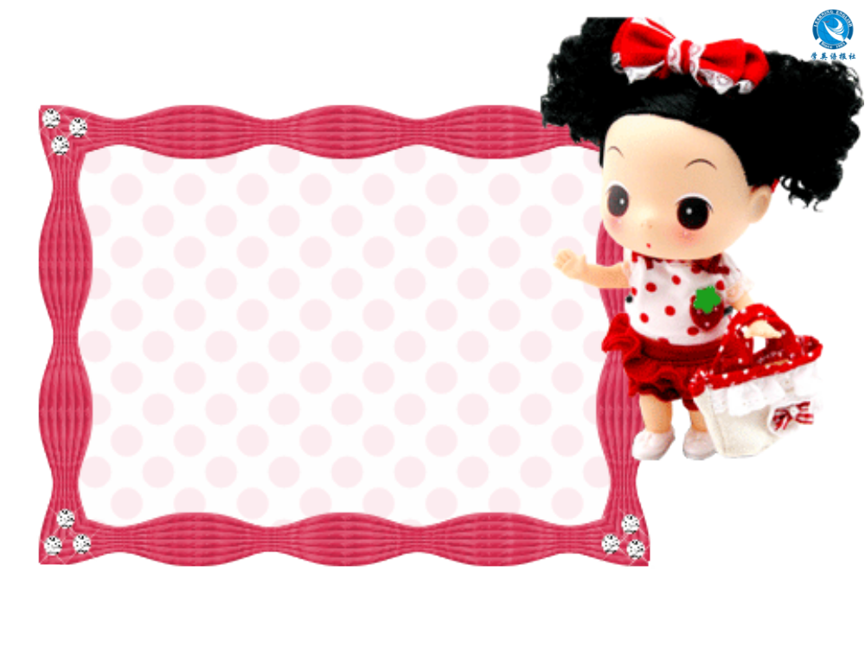


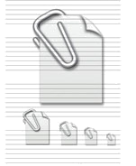
注: 另附 word 文档。
点击此处链接
Individual activity

Slide 26

Quiz I: Fill in the blanks.
1. Four members of the family had
been ________ (毒害), but not fatally.
2. A r___ of sunshine shone through a
gap in the clouds.
3. The film’s plot was so ________ (复杂
的) that I couldn't follow it.
poisoned
ray
complex

Slide 27
4. When preparing meals, you need to
think about _______ (多样化) and
taste as well as nutritional value.
5. Many servicemen suffered ra_______
sickness after the early atomic tests.
6. I was _____ (slightly) surprised to see
him here.
7. It was obvious that she had broken
her toe, because it immediately
started to s_____ (up).
variety
radiation
mildly
swell

Slide 28
8. All I remember of childbirth was the
__________ (intolerable) pain and the
relief when it was all over.
9. Cut the lemon in half and sq_____ the
juice into the bowl.
10. She had found out some information
of _____ (essential) importance.
unbearable
squeeze
vital

Slide 29
Quiz II: Translation.
Burns are called first, second or third degree burns, ___________________
_________________________ (根据皮肤烧伤的层次).
2. These affect both _________________
_____________________ (皮肤的最上层和第二层).
depending on which
layers of the skin are burned
the top and the
second layer of the skin

Slide 30
3. If burns are on arms or legs,
____________________________ (把
他们抬高到高于心脏的位置), if
possible.
4. I've warned you __________________
(反复; 多次) not to do that.
5. Before you leave the office,
everything should be put _______ (在
适当的位置).
keep them higher than the heart
over and over again
in place

