Slide 1

Subjunctive Mood (1)
Unit 1 Grammar
http://v.youku.com/v_show/id_XMzA4NTMxNDI4.html?from=s1.8-1-1.2

Slide 2

If I had my life to live over,
I'd dare to make more mistakes next time.
I'd relax, I would limber up.
I would be sillier than I have been this trip.
I would take fewer things seriously.
I would take more chances.
I would take more trips.
If I had my life to live over,
I would start barefoot earlier in the spring
and stay that way later in the fall.
I would go to more dances.
I would ride more merry-go-rounds (旋转木马).
I would pick more daisies (雏菊).

Slide 3
Our first football match
We should have won…
If Jack had scored that goal,
If we’d had just a few more minutes,
If we had trained harder,
If Ben had passed the ball to Joe,
If we’d had thousands of fans screaming,
If I hadn’t taken my eye off the ball,
If we hadn’t stayed up so late the night before,
If we hadn’t taken it easy,
If we hadn’t run out of energy.
We should have won…
If we’d been better!

Slide 4
Life is not based on “ifs”.
Many people are not happy because they base their life on “ifs”.
If I had a million
dollars, …

Slide 5

To learn to use the subjunctive mood

Slide 6
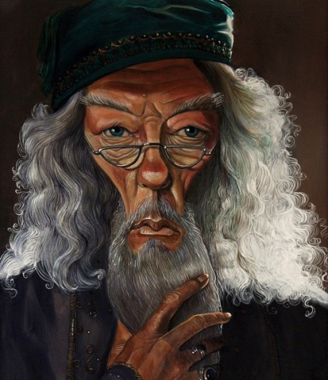
Have a look
Look at the following sentences.
1. If you could have three of these paintings on the walls of your classroom, which would you choose?
2. Have you ever wished you could paint as well as a professional artist?

Slide 7
3. If you were an artist, what kind of pictures would you paint?
4. What would you rather do — paint pictures, make sculptures, or design buildings? Why?
5. If the rules of perspective had not been discovered, no one would have been able to paint such realistic pictures.

Slide 8
6. Without the new paints and the new technique, we would not be able to see the many great masterpieces for which this period is famous.
7…, but without the Impressionists, many of these painting styles might not exist.
These are the sentences that use subjunctive mood from the text.

Slide 9
Guessing Game
1. to test your sense of observation
2. to test your ability of short-term memory
3. to test your ability to highlight the language points

Slide 10
1. If you __________three of these paintings on the walls of your classroom, which would you choose?
2. Have you ever wished you ______ paint as well as a professional artist?
3. _____ you ______ an artist, what kind of pictures would you paint?
could have
could
If
were

Slide 11
4. What ______ you rather do — paint pictures, make sculptures, or design buildings? Why?
5. If the rules of perspective ____ not been discovered, no one ______________ able to paint such realistic pictures.
6. ________ the new paints and the new technique, we would not be able to see the many great masterpieces for which this period is famous.
would
had
would have been
Without

Slide 12
Fill in the blanks.
1. Much labour would have been
saved if electronic computer
_________________ (invent) before.
had been invented
2.
If there were no air or water, there ___________(is) no living things on the earth.
would be
Notes:
“碰壁点拨式”教学法是素质教育的一种方式，这种教学法的基本模式是：编拟题组—练中碰壁—讲评点拨—巩固消化。该教学法以问题为载体，以训练为主线，目标导控，问题教学，先练后讲，碰壁点拨，反馈矫正。增强了学习的方向性、选择性及目标性，使学生在克服困难消除障碍的过程中发展自己的观察力、想象力和思维能力，使他们的智慧升华，创造思维得以开发。

Slide 13
3.
Another thing is, if you _____ to Brunei, you _______________ (reconsider) to take off your shoes before going into someone’s house.
were
would reconsider
4. Jean doesn’t want to work right
away because she thinks that if she
___________________________
(get) a job, she probably wouldn’t
be able to see her friends very
often.
were to get
/ should get / got

Slide 14

以上我们已经通过归纳总结和练习对本课的语法内容有了一定的了解，下面就让我们根据之前练习的考察情况进一步选择讲解该语法项的重难点。

Slide 15
Five “if clauses” below:
tell the differences
real
conditionals
unreal
conditionals

Slide 16
1. If a child buys these toys, he or she will learn nothing.
2. If I were you, I would take an umbrella.
3. She wouldn't have opened the box, if
she had been warned of danger.
4. If I were to be reborn, I would be a musician.
5. Sales of products fall if prices rise.

Slide 17
Subjunctive Mood
语气(mood)是用来表示谈话人的态度和看法的动词形式。
英语有三种语气:
①陈述语气(同陈述句)
②祈使语气(同祈使句)
③虚拟语气
虚拟语气不表示一个事实，而是表示一种假设情况(愿望<wish …>，建议<suggest …>，假设<if …>)。

Slide 18

虚拟语气用于条件状语从句
1 表示与现在事实相反的假设
条件状语从句用“一般过去式(be一般用
were)”，而主句谓语动词由
“would/should/could/might + 动词原
形”构成。
If I were a boy, I would join the army.

Slide 19
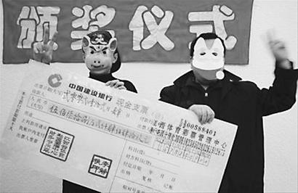
What would you do if you won the lottery?
If I won the lottery, I would …

Slide 20
I: Fill in the blanks.
a. If they _____ (be) here, they __________ (take) your advice.
b. If the world war _____ (burst) out again, what _____________ (happen) to our people on earth?
were
would take
burst
would happen

Slide 21
c. If the policeman ________ (be not) in that room, it ________ (be) very dangerous.
d. If I _____ (be) in your position,
I _________ (ask) for teacher’s
help.
were not
could be
were
would ask

Slide 22
2. 与过去的事实相反
从句的谓语用had + 过去分词，构成If I (we, you, he, they) + had + 过去分词的形式；
主句的谓语用should/would/could
/might have + 动词过去分词。
If you had been here yesterday, you would have seen her.

Slide 23
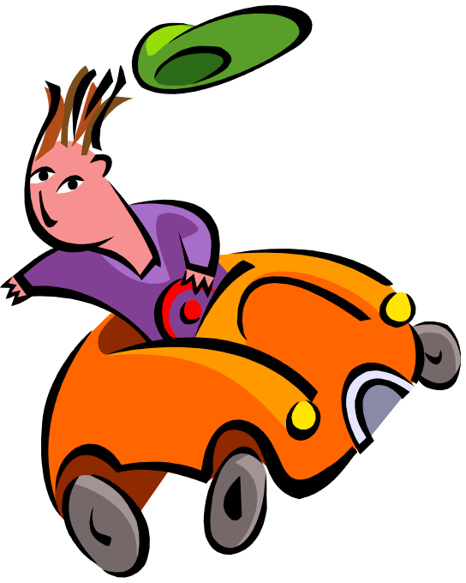

If he __________ more carefully, he _________________ the car accident yesterday.
had driven
would not have had

Slide 24
II: Fill in the blanks.
a. If Tom ________ (be) more careful in the exam, he ________________ (pass) it already.
b. If you _______ (get) up earlier, you ________________ (catch) the first train.
had been
would have passed
had got
would have caught

Slide 25
3. 与将来事实相反
从句谓语用动词过去式、were to do 或 should do 形式, 主句谓语用should /would/could/might + 动词原形。
If she were to be here next Monday, I would tell her about the matter.

Slide 26

If he ___________ here tomorrow,
should come
I would talk to him.

Slide 27
III: Translation.
1) 假如我要出国，我就会去法国。
If I were to go abroad, I would go to France.
2) 万一明天下雨，我们的郊游就推迟。
If it should rain tomorrow, our picnic would be put off.

Slide 28
我们已经学习了虚拟语气在条件句中的应用，同学们都掌握了么？现在就用表格的形式复习一下吧！

Slide 29

If条件句
虚拟情况 | 从句 | 主句
与现在事实相反
与过去事实相反
与将来事实相反
过去式(be的形式用were)
would / should / could / might +do
would / should / could / might + have done
had+过去分词
过去式/ should+
do/ were to do
would / should / could / might +do

Slide 30

虚拟语气中wish的用法
I wish I were a bird.
I wish I had been here last night.
I wish I could be of more use in the future.
现在：
过去：
将来：
did（were）
wish
had done
would (could) do
as if/ as though/ if only的用法与wish 一样。

Slide 31
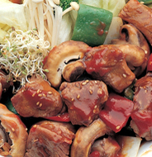
Pair work
Answer:
If I got the chance to talk to the manager, I would ask him to …
Question:
Statement:
If you got the chance to talk to the manager, what would you say?
The food in our
school canteen
is terrible.

Slide 32
Pair work
Answer:
If I were …, I would
Question:
If you were the girl, what would you do?
Statement:
The girl eats very little to lose weight.

Slide 33

Pair work
Answer:
Question:
If my father …
Statement:
What would you do if your father appeared in the net bar?
My father
doesn’t allow
me to go to
the net bar.

Slide 34

Review
1. 什么是虚拟语气。
2. 虚拟语气(和现在、过去、将来事
实相反)的用法。

