Slide 1

He was so kind a boy that he often his mother clean the table，even the furniture.
A.helped B.assisted
C.aided D.offered
解析：aid/help sb.with sth.帮助某人某事；assist sb.in doing sth.或assist sb.to do sth.协助某人做某事；offer sb.sth.提供某人某物或offer to do sth.主动做某事。只有help后的复合不定式能省去to。
答案：A

Slide 2
(2010•安徽合肥高三检测)Your sister is said in the supermarket when she was doing shopping yesterday.
A.to be treated badly
B.treating badly
C.being badly treated
D.to have been badly treated

Slide 3
(2010•江苏启东高三检测)Criticism from coaches，and other teammates，as well as to win can create an excessive amount of and anxiety for young athletes.
A.pressure B.reputation
C.standard D.permission
解析：考查名词词义辨析。pressure压力；reputation名声，声誉；standard标准；permission允许，许可。
答案：A

Slide 4
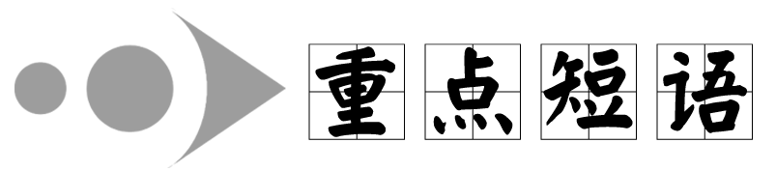
fall ill生病
He had the misfortune to fall ill on the day of the examination.他很倒霉，在考试当天生病了。

Slide 5
As she the newspaper，Granny asleep.
A.read；was falling B.was reading；fell
C.was reading；was falling D.read；fell
解析：句意：当她在读报时，奶奶睡着了。fall asleep入睡，非延续动词短语，故不能使用进行时。
答案：B

Slide 6
With everything needed ，she declared that the party began.
A.in the places B.taking place
C.out of place D.in place
解析：in place在适当的位置，everything needed in place意为“一切都准备妥当”；take place发生，举行；out of place不合适的，不适当的，由句意知D项符合。
答案：D

Slide 7
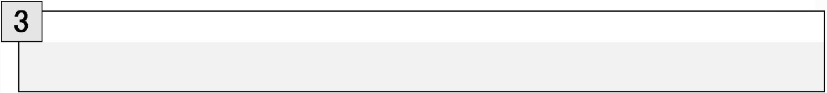
make a difference区别对待；有影响；起(重要)作用
The sea air has made a difference to her health.
海上的空气改善了她的健康状况。

Slide 8
Will it a difference whether he will come to the party？
A tell B.keep
C.make D.take
解析：句意：他来不来参加宴会有关系吗？make a difference“有关系，有影响”。
答案：C

Slide 9
We were just calling you up you came in.
A.about；when B.on the point of；while
C.on the point of；when D.on the point of；as
解析：主语＋ be on the point of doing sth.＋when...“……正要做某事就在这时……”。
答案：C

Slide 10
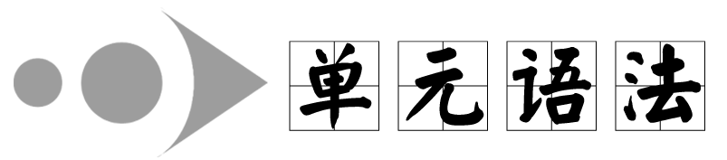
省略
1.(2007•全国卷Ⅰ)We all know that， ，the
situation will get worse.
A.not if dealt carefully with
B.if not carefully dealt with
C.if dealt not carefully with
D.not if carefully dealt with

Slide 11
解析： that后跟宾语从句，宾语从句中含有一个主从复合句，if从句使用了省略句式，完整的形式应为if it is not carefully dealt with，it指代主句中的situation。
答案：B

Slide 12
2.(2007•重庆高考)Do you have any idea what Paul does all day？
—As I know，he spends at least as much time playing as he
.
A.writes B.does writing
C.is writing D.does write
解析：考查用替代词的省略和固定短语。句意：——你知道保罗一整天在干什么吗？——据我所知，他至少用了同写作相同的时间去玩耍。spend time (in)doing sth.承前省去相同的内容，用does替代前面的spends。
答案：B

Slide 13
3.(2007•陕西高考)Though he started late，Mr.Guo played the
piano as well as，if Miss Liu.
A.not better than B.not better
C.no better than D.no better
解析：考查比较级的省略。句意：如果郭先生的钢琴弹得不比刘小姐好的话，至少是一样好。not better than不比……好；no better than和……一样不好。
答案：A

Slide 14
4.(2010•北京市西城区高三检测)What would have happened
as far as the river bank？
  A.Bob had walked farther
  B.if Bob should walk farther
  C.had Bob walked farther
  D.if Bob walked farther

Slide 15
解析：考查虚拟语气。句意：如果Bob走到远到河岸的地方会发生什么事情呢？可知是对过去情况的虚拟，故从句用过去完成时，省略if之后用倒装形式，还原后应为：if Bob had walked farther,...。故选C。
答案：C

Slide 16
5.(2009•浙江重点中学模拟)His advice that to next
  week as a result of lack of tools is acceptable.
  A.the work be postponed
  B.the work would be postponed
  C.the work should postpone
  D.the work can be postponed

Slide 17
解析：由于先行词为advice，故句中that引导的同位语从句应用should(可省略)＋动词原形的形式，又由于work和postpone之间为动宾关系，所以选择A项。
答案：A

Slide 18
6.(2009•沈阳质检)—Will the Smiths leave for Australia this
spring？
—No，they finally decided .
A.not to leave B.not leaving
C.not to D.not to be leaving
解析：考查动词不定式的省略。为了避免重复，动词不定式短语常可省略到to。故选C。
答案：C

Slide 19
7.(2010•上海交大附中高三检测)—Is there any place where we
can listen to some music？
—There is a teahouse where you can enjoy classical music，
having some Chinese tea or other soft drinks.
A.where B.unless
C.while D.when

Slide 20
解析：考查状语从句的省略。while having some Chinese tea＝while you are having some Chinese tea，因为两个动作同时进行，表示“边喝茶边欣赏音乐”，故不选D。
答案：D

Slide 21
8.(2010•江苏镇江高三检测)The lady jumped off the floor，
screaming，as if by a snake.
A.to have been bitten B.bitten
C.being bitten D.to be bitten
解析：考查省略结构。句意：那位女士尖叫着从地板上跳起来，好像被蛇咬了一样。后半句是as if she was bitten的省略形式。
答案：B

Slide 22
Ⅱ.情景交际
1.(2009•东北三校联合模拟)—Do remember to see a doctor
tomorrow！
— .
A.Got it B.Heard it
C.Made it D.Taken it
解析：考查交际用语。对方说“务必记住明天去看医生！”说话人回答说“知道了”。
答案：A

Slide 23
2.—Come to my wedding party to be held next Friday evening.
— .
A.I must.No problem B.I will.I promise
C.All right.That depends D.That's all right
解析：考查交际用语。根据上句“请来参加我的婚礼”可知，下句的回答应为“我会的，我保证”，故B项正确。
答案：B

Slide 24
3.—I failed today's math test！What shall I do？
— ！Try once more.
A.Cheer up B.Hurry up
C.Take it easy D.Don't mention it
解析：考查交际用语。结合答语Try once more“再试一次”可判断此处选Cheer up。说话人在安慰对方，希望对方“提起精神，振作起来”。
答案：A

Slide 25
4.— ，please drop in on me.
  —OK，I will.Maybe next Friday.
  A.If you're convenient
  B.If it will be convenient for you
  C.If you will be convenient
  D.If it's convenient for you
解析：考查交际用语与convenient的用法。convenient一词常用于It's convenient for sb.to do sth.结构。在if条件句中，常用一般现在时表将来。句意：“如果方便 ，请顺便来看看我。”“好的，我会的。或许下周五。”
答案：D

Slide 26
5.—Would you take this along to the office for me？
— .
A.With pleasure B.That's right
C.Never mind D.Don't mention it
解析：本题考查情景交际。当请求某人做某事时，对方一般是同意的，回答时，用With pleasure.十分愿意。
答案：A

Slide 27
Ⅲ.易错绣场
1.(2008•福建高考)Nancy enjoyed herself so much she
visited her friends in Sydney last year.
A.that B.which
C.when D.where
解析：句意：Nancy去年在悉尼拜访朋友时玩得很开心。when引导时间状语从句。本题干扰性最强的是A项，so...that...可引导结果状语从句，但根据语境，这里并没有因果关系的含义。
答案：C

Slide 28
2.(2008•辽宁高考)He was about half way through his meal a
familiar voice came to his ears.
A.why B.where
C.when D.while
解析：句意：他的饭刚吃一半，突然就听到一个熟悉的声音。本题考查be about...when...这个句型，“刚/正要……就在这时……”。when＝and at that time，故答案是C。
答案：C

Slide 29
3.How can you expect to learn anything you never
listen？
A.in case B.even if
C.unless D.when
解析：由下文语意可知，空白处应表示“既然”之意，四个选项中只有when可表达此意。
答案：D

Slide 30
4.Jasmine was holidaying with her family in a wildlife park
she was bitten on the leg by a lion.
A.when B.while
C.since D.once
解析： when＝and at that time。
答案：A

