Slide 1
Unit 2 Poems——诗歌

Slide 2
基础盘点自测自评
[核心单词]
1．_________ vt.传达;运送
2． _________ adj.具体的
3． _________ adj.灵活的;可弯曲的;柔顺的
4． _________ n．模式;式样;图案
5． _________ vi.&vt.取笑;招惹;戏弄
6． _________ adj.无穷的;无止境的
7． _________ n．枝条;支流;部门
8． ___________ adv.最后;终于
9． ____________ vi.& vt.转化;转换;改造;变换
convey
concrete
flexible
pattern
tease
endless
branch
eventually
transform

Slide 3
10．__________ n．悲伤;悲痛;懊悔
11． __________ n．交换;交流;互换 vt.& vi.调换;交换
12． _________ n．赞助人;主办者;倡议者vt.发起;举办;倡议
13． ____________ n．奖学金;学问;学术成就
14． _______ n．负担;负荷物(尤指沉重的)
15． _____________ n．翻译;译文→translate v．翻译→translator n．译员,翻译家
16． _____________ adj.适当的;正当的→inappropriate(反义词)adj.不适当的
17． __________ n．黑暗;漆黑→dark adj.黑暗的
18． __________ (n.)最低限度;最少量;最小数→maximum
n．最大值
sorrow
exchange
sponsor
scholarship
load
translation
appropriate
darkness
minimum

Slide 4
[高频短语]
1．__________ 熬夜,不睡觉;挺立
2．___________ 轻松;不紧张;从容
3．____________ 用完
4．________________ (多用于被动结构)由……构成
5．_______________ 转化成,改造为
6．_______________ 去远足
7．___________ 测试;试验
8．_________发出;放走
stay up
take it easy
run out of
be made up of
transform into
go for a hike
try out
let out

Slide 5
[典型句式]
1．...reason why……的原因
There are______________________ people write poetry.
人们写诗有许多原因。
2．way后定语从句的关系词
Some poems tell a story or describe something in a way ________________________a strong impression.Others try to convey certain emotions.
有的诗歌以一种令读者印象深刻的方式讲述故事或描述事
情。而有些诗歌是为了传递某些情感。
various reasons why
that will give the reader

Slide 6
3．“with＋n.＋to do sth.(未来动作)”结构
With so many different forms of poetry_______________, students may eventually want to write poems of their own.
因为有许多不同类型的诗可以选择,学生们可能最后都想写他们自己的诗歌了。
4．be likely to do sth.有可能做某事
Do you think the speaker in the poem____________________
a girlfriend/boyfriend or a parent？你认为诗中的说话者更有可能是一个女友、男友,还是一位父亲或母亲？
5．if省略的倒装句式
__________________________,this stone would utter speech.
行人归来石应语。
to choose from
is more likely to be
Should the traveller return

Slide 7
考点串讲讲练互动
[单词精研]
1.convey vt.传达,表达;运送;传导,传播
(2012·高考陕西卷·阅读理解D)Just as people convey messages about themselves with their appearances, so do companies. 正如人们通过外貌来传递有关自己的信息一样,公司也是如此.
归纳拓展
convey sth.to sb.向某人表达/传递某物
convey sb./sth.from A to B
把某人或某物从A地运送到B地
convey one’s feelings/meanings表达某人的感情/意思

Slide 8
①The police asked the driver to convey the passengers to the destination safely.
警察要求司机把乘客安全地送到目的地。
②Her letter clearly conveyed that she was determined to go to court over the matter.
她在信中清楚地表明她会就此事告上法庭。
③He seemed to be looking for precise words with which to convey his ideas.
他似乎在寻找准确的字眼来表达他的想法。
④Premier Wen Jiabao conveyed his sorrow for the dead and ordered the necessities should be conveyed immediately to the earthquake-hit areas.温家宝总理表达了对死者的哀悼,并命令立即把必需品运送到地震灾区。

Slide 9
2.transform vi.& vt.转化;转换;改造;变换
(牛津P₂₁₄₈)It was an event that would transform my life.
那是能够彻底改变我一生的一件事。
归纳拓展
(1)transform...into...把……变成……
transform sb./sth.from...把某人/物从……中转变
(2)transformation n．改变,变革

Slide 10
①In only 20 years the country has been transformed into an advanced industrial power.
这个国家只用了20年就变成了一个先进的工业强国。
②Every moment of every day, energy is being transformed from one form into another.
每时每刻,能量都在由一种形式转换成另一种形式。
③I’m fully aware that it’s the experience from my life abroad that has totally/completely transformed me.
我充分意识到,是在国外的生活经历完全改变了我。

Slide 11
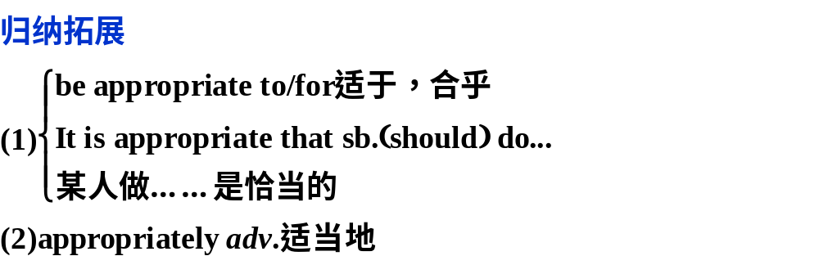
3.appropriate adj.适当的;正当的
(朗文P₈₄)We will take appropriate action once the investigation is over. 一旦调查结束我们将采取恰当的行动.

Slide 12
①(朗文P₈₄)It is not appropriate to ask such personal questions in an interview.
采访中问这样私人的问题不合适。
②(牛津P₈₃)The book was written in a style appropriate to the age of the children.这本书的文体适合儿童阅读。
③It is entirely appropriate that his music (should)be played at this festival.
他的音乐在这个节日里演奏是完全合适的。
④We all think it (is)not appropriate for you to wear such bright clothes for a job interview.我们认为你穿着如此鲜艳的衣服去参加求职面试是不适合的。

Slide 13
4.exchange n．交换;交流;互换 vt.& vi.调换;交换
(2012·高考北京卷·阅读理解A)If the course fails to provide complete satisfaction to you, you can easily exchange it for any other course that we offer.
如果这个课程无法让你完全满意,你可以很容易地把它换成我们提供的任何其他课程。
归纳拓展
(1)exchange sth.for sth.用……来交换……
exchange sth.with sb.与某人交换某物
(2)in exchange for 交换
(3)exchange student 交换生

Slide 14
①(牛津P₆₉₁)I shook hands and exchanged a few words with the manager.我与经理握手,相互交谈了几句。
②(牛津P₆₉₁)If it doesn’t fit,take it back and the store will exchange it.
如果不合适就把它拿回来,商店将给你调换。
③I have offered to paint the house in exchange for a week’s accommodation.
我主动粉刷房子来交换一周的住宿。
④Exchanging gifts is one of the modern ways of celebrating the Christmas in the world.
在世界各地交换礼物是欢度圣诞常见的方式之一。

Slide 15
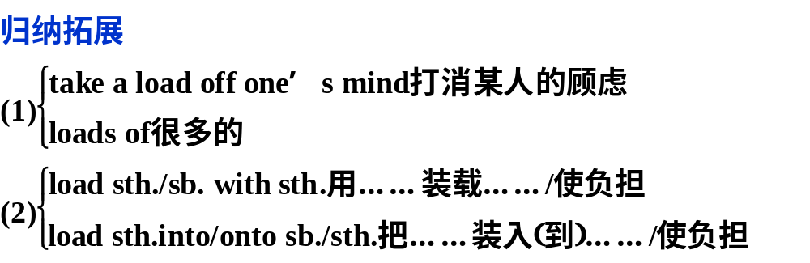
5.load n. 负担,负荷物(尤指沉重的)
v．装载,加重,把弹药装入(枪炮)
(牛津P₁₁₈₅)She thought she would not be able to bear the load of bringing up her family alone.
她认为她无法独自一人担负起养家的重任。

Slide 16
①(2011·高考江苏卷·书面表达)The burden of students has been a hot topic for years,but the load of parents has received little attention.多年来学生的负担一直是个热门话题,但是父母的负担却很少受到关注。
②(牛津P₁₁₈₅)Knowing that they had arrived safely took a load off my mind.得知他们平安到达后我如释重负。
③Standing on the bank, the children watched the ship loaded with all kinds of goods.
孩子们站在岸边看着满载各种货物的轮船。

Slide 17
[跟踪训练]
Ⅰ.完成句子
1．Now that the problem has been found out,we should _______________________________(采取适当措施解决它)．
2．The table ________________ (摆满了)delicious food of many different kinds.
3．I will take full advantage of the chance to __________________________(与他们交换观点)．
4．We must work hard so as to _______________________
(使中国变成)an advanced industrial country.
5．As a teacher rich in experience,he knows exactly how to_____________________________(向学生表达他的想法)．
take appropriate action to solve it
was loaded with
exchange views with them
transform China into
convey his ideas to the students

Slide 18
Ⅱ.单项填空
1．(2012·襄阳四中高三英语模拟)Media staff ought to grasp the news contents precisely,apply their own voices and techniques to________the positive news values accurately.
A．broadcast B．predict
C．convey D．consult
解析：选C。句意：媒体工作人员应当清晰地把握新闻内容,运用自己的声音和技巧来准确地传达积极的新闻价值观。broadcast意为“广播,散布,撒播”;predict意为“预言,预
测”;convey意为“表达,传达,运输”;consult意为“查阅,商讨”。根据句意可知C项正确。

Slide 19
2．(2012·安徽皖南八校三联)General Manager of Walmart.com announced that viewers could watch shows and movies for free________watching advertising.
A．in charge of B．in favor of
C．in case of D．in exchange for
解析：选D。考查介词短语辨析。句意：Walmart.com的总经理宣布观众可以通过看广告以换取免费收看节目和电影。A.主管,负责;B赞成,支持;C.以防,万一;D.作为……的交换。

Slide 20
3．People wrote letters to get in touch.Nowadays email has __________ the way people communicate.
A．conveyed B．translated
C．transformed D．exchanged
解析：选C。考查动词辨析。convey传达;translate使变成; exchange交换,交流;transform彻底改变,改善。句意：过去
人们通过写信相互联系,而如今电子邮件改变了人们的交流方式。

Slide 21
4．The workers are loading the goods________a car,that is,they’re loading the car________goods.
A．with;with B．into;into
C．into;with D．with;into
解析：选C。考查load的用法。load sth.into...把……装入; load sth.with sth.用……装载……,故选C。

Slide 22
5．(2013·湖北稳派密卷) We had expected the weather would be very bad.But as it turned out,it was sunny and ________ for all outside activities.
A．appropriate B．exact
C．particular D．adequate
解析:选A。句意：我们原预料天气会很糟糕,但结果天气很好,而且适合做各种户外活动。A项“合适的,适当的”,B项“精确的”,C项“特殊的,挑剔的”,D项“充足的,足够的”.

Slide 23
[短语精释]
1.take it easy(＝take things easy) 轻松;不紧张;从容
(牛津P₆₃₃)The doctor told me to take it easy for a few weeks. 医生叫我休息几周。
归纳拓展
take one’s time 别着急,慢慢来
take sth.seriously 重视某事,对某事严肃对待
take...for granted 认为……理所当然
take...as...把……当作……

Slide 24
①Take it(things)easy for a few days and you will be able to go to work again.
放松几天你就能再次工作了。
②Children need excitement and activity on holiday as much as adults need to take it easy.孩子们在假期里需要兴奋和活动,就如同成年人需要放松一样。
③Believe it or not,I always take your suggestions seriously.信不信由你,我总是认真对待你的建议。
④Some of us always take it for granted that our parents or grandparents should take care of us.我们中的有些人理所当然地认为父母或者祖父母应该照顾我们。

Slide 25
2.run out of 用尽,用完
(2012·高考山东卷·阅读理解A)Soon people realized that they had a terrible problem—their phosphate was running out.很快人们意识到他们遇到了一个严重的问题——他们的磷酸盐快用完了。
①My car broke down on the way to the beach because it had run out of petrol.
在去海滩的路上,我的车因为汽油耗尽而抛锚了。

Slide 26
[易混辨析] run out of,run out,give out,use up
run out of | “用完了”,是及物动词短语,表示主动意义,主语一般是人
run out | “……用完了”,是不及物动词短语,其主语通常为时间、食物、金钱等名词
give out | “用尽,精疲力竭”,为不及物动词短语
use up | “用完,消耗尽”,为及物动词短语

Slide 27
②Her money has been run out of/used up and her patience is also running out.
她的钱已经用完了,她的耐心也要耗尽了。
③With his food running out,the men had to come out of his hiding-place.
由于食物吃完了,那人才不得不从藏身处出来。
④If we hadn’t run out of energy,we would have finished the work.如果我们没有精疲力竭,我们就把那项工作做完了。
⑤His strength gave out after he ran that long distance.
跑完这么长一段距离,他已精疲力竭。

Slide 28
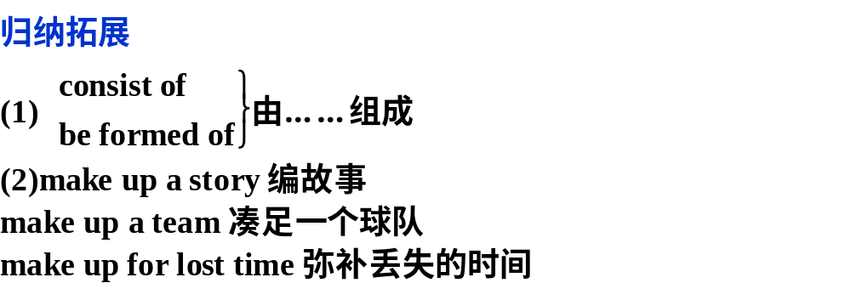
3.be made up of 由……构成
(2012·高考广东卷·阅读理解D)It is made up of people from the highest income groups in the United States, including many lawyers and business managers.它(观众)由美国收入最高的群体组成,包括许多律师和业务经理。

Slide 29
①(牛津P₁₂₂₂)After all the delays,we were anxious to make up for lost time.
耽搁了这么久,我们急着想弥补失去的时间。
②Society is made up of a variety of people; some are good, others (are) bad, and still others (are) in between.社会是由形形色色的人组成的。有些人很好,有些人很坏,也有些人介乎两者之间。
③The medical team made up of/consisting of two doctors and five nurses had arrived.
由两位大夫和五位护士组成的医疗队已经到达。
④(牛津P₁₂₂₂)We need one more person to make up a team.我们还需要一个人才能组成一个队。

Slide 30
4.let out 释放;放走;发出(叫喊声等);
泄露(消息、秘密等);透露
(教材P₁₆)Slowly the blackbird lets out a cry.
慢慢地, 画眉发出一声叫。
归纳拓展
let alone 更不用说;更谈不上
let sb./sth.alone 对某人/某事放任不管;置之不理
let down 把……放下来;使(某人)失望/情绪低沉
let in 允许进入;容许;许可
let go 放开,松手

Slide 31
①Throwing their hats into the air,the fans of the winning team let out loud shouts of victory.
获胜队的粉丝们发出胜利的欢呼声,同时大家都将帽子抛向了空中。
②He accidentally let out that he hadn’t been home for three weeks.他无意中泄露出他已经三个周没回家了。
③I hardly had time to think these days,let alone relax.
我这些天几乎都没时间思考,更不用说休息了。
④The glass doors have taken the place of the wooden ones at the entrance,letting in the natural light during the day.
入口处的玻璃门已取代了木门,在白天好让自然光照进来。

Slide 32
[跟踪训练]
Ⅰ.完成句子
1．The whole meal was good but the wine________________(尤其,特别)was excellent.
2．He accidentally __________(泄露)he had quarreled with his wife and he hadn’t been home for a couple of weeks.
3．—Susan ___________________(熬夜看)the late movie
last night.
—No wonder she was late for school.
in particular
let out
stayed up to watch

Slide 33
4．It is well-known that up to 70% of your total body weight ____________________(由水组成)．
5．I wasn’t feeling too good,so I thought I’d _____________________________(放松几天)．
6．We have to look for a gas station as soon as possible,because our car ___________________________(汽油很快用完了)．
is made up of water
take it easy for a couple of days
will run out of gas soon

Slide 34
Ⅱ.单项填空
1．(2012·高考江苏卷)—OK, I’ve had enough of it.I give up.
—You can’t ________ your responsibilities.
A．run off with B．run up against
C．run out of D．run away from
解析：选D。run away from意为“逃离,躲避”,run off with意为“偷走;与……私奔”;run up against意为“偶遇”;run out of意为“用完”。句意：——好了,我已受够了,我放弃。——你不能逃避你的责任。根据句意,应选D项。

Slide 35
2．(2012·南昌二模)The photographer needs to charge up the digital camera every day as the battery________quickly.
A．shuts up B．ends up
C．runs out D．turns out
解析：选C。考查动词短语辨析。句意：这位摄影师每天都需要给数码相机充电,因为电池很快就快用完了。run out表示“用完;用尽”。

Slide 36
3．(2013·江西省六校联考)The secretary has a lot of things
to ________ in the office since she has been away for quite
a few days.
A．take up B．make up
C．work out D．carry out
解析：选B。 句意：秘书要把办公室留下的许多事补回来,因为她已外出好多天了。make up“弥补”,符合语境,而take up“占据”,work out“算出”,carry out“执行”,都不符
合句意。

Slide 37
4．—I feel nervous before the exam.
—________.It won’t be too difficult for you to pass.
A．Take it easily B．Take things easy
C．Take your time D．Take things easily
解析：选B。take things easy指在心理上放松。
5．—I’m sorry to keep you waiting.I’ll make short of this.
—________.I’m not in a hurry.
A．Take it easy B．Take your time
C．Not at all D．Do as you like
解析：选B。由后面答语“I’m not in a hurry.”可知,说话者不慌,故B项正确。

Slide 38
[句型精析]
1.(教材P₁₀)There are various reasons why people write poetry. 人们写诗有许多原因。
[句法分析]
本句中含有先行词为reason的定语从句。其常见的基本句式是：The reason why/for which...;The reason that/which...。
①The reason why he died young was that he paid no attention to health.
他英年早逝的原因是他不注意自己的身体健康。
②The reason for which he failed the English exam was that he didn’t learn it well.
他英语考试不及格的原因是他没学好。

Slide 39
③The reason that/which he explained to us is that he hadn’t read it before.
他给我们解释的理由是他之前没有读过。
【温馨提示】 the reason后的定语从句是用why/for which还是关系代词that/which引导,取决于关系词在从句中充当的成分。关系词在从句中充当状语时用why/for which,充当主语、宾语或表语时用that/which。

Slide 40
2.(教材P₁₁)With so many different forms of poetry to choose from,students may eventually want to write poems of their own. 因为有如此多不同类型的诗可以选择,学生们可能最后都想写他们自己的诗歌了。
[句法分析]
句中的With so many different forms of poetry to choose from 为with的复合结构作状语。

Slide 41
归纳拓展
其结构如下：
(1)with＋宾语＋doing(doing表主动或正在进行的动作)
(2)with＋宾语＋done(done表被动或已完成的动作)
(3)with＋宾语＋to do(to do表示将来的动作)
(4)with＋宾语＋介词短语/adj./adv.

Slide 42
①With a lot of homework to do,I can’t go skating with you.因为有很多作业要做,我不能和你一起去滑冰了。
②With more and more forests/trees cut down, some animals are facing the danger of dying out.由于越来越多的森林被砍伐,一些动物正面临着灭绝的危险。
③With time going by,they have grown into big boys and big girls.随着时间的流逝,他们都长成小伙子和大姑娘了。
④In summer,she usually sleeps with the windows open.
夏天,她通常开着窗子睡觉。

Slide 43
[跟踪训练]
1．(2012·高考辽宁卷)The old couple often take a walk after supper in the park with their pet dog________them.
A．to follow B．following
C．followed D．follows
解析：选B。with的宾语后面可加形容词、副词、分词、不定式、名词等作宾补,这儿pet dog与follow构成主谓关系,所以用following。

Slide 44
2．(2013·开封市第一次模拟)With so many people________in English every day,we can see it will be more and more important________a good knowledge of English.
A．to communicate;have
B．communicate;having
C．communicating;to have
D．communicated;to have

Slide 45
解析：选C。句意：很多人每天用英语交流,我们可以了解到拥有丰富的英语知识会越来越重要。With so many people________in English every day是with的复合结构,在句中作原因状语,宾语so many people和communicate构成逻辑上的主谓关系,故用communicating...作宾语补足语。在It’s＋adj./n.＋to do sth./doing sth.句型中,只有当表语部分是no use/no good/useless时,后面才用doing sth.作真正的主语,
所以选C。

Slide 46
3．(2012·四级英语)The reason why he has been such a success is ________ he never gives up.
A．what B．that
C．because D．how
解析：选B。考查名词性从句的连接词。句意：他能如此成功的原因是他永不放弃。The reason why...is that...这是个固定句型表示“……的原因是……”。

Slide 47
4．Is this the reason ________at the meeting for his carelessness in his work?
A．he explained B．what he explained
C．how he explained D．why he explained
解析：选A。此题考查定语从句,排除B、C两项。explain为及物动词,其句式为explain sth.to sb.,通过分析可知,定语从句中缺少宾语,故应用关系代词which或that或省略。

Slide 48
5．(2012·浙江考前模拟)Do you have any idea of the reason ________he referred to?
A．that B．where
C．why D．when
解析：选A。考查定语从句。refer to缺少宾语,故应用关系代词which或that或省略。

