Slide 1
Unit 1 Art——艺术

Slide 2
考点串讲讲练互动
[单词精研]
1.aim n．目标;目的 vi.&vt.瞄准;(向某方向)努力
(2012·高考江苏卷·阅读理解B)The Department of Agriculture has programs aimed at developing more farmers and at increasing interest in locally grown food.
农业部制定了计划,目标是发动更多的农民并增加本地农产品的利润。

Slide 3
归纳拓展
(1)achieve one’s aim达到目的;实现目标
without aim 漫无目的地
with the aim of 以……为目标,意在……
(2)aim sth.at sb./sth.用某物朝向/瞄准某人或某物
aim at/for sth.力求达到
aim at doing sth./aim to do sth.意欲、企图、力求做某事
(3)be aimed at 目的是,旨在

Slide 4
achieve one’s aim ; with the aim of ; aim (sth).at sb./sth.
aim at/for sth. ; aim at doing sth./aim to do sth. ; be aimed at
1.Teamwork is required in order to achieve these aims.
2. She went to London with the aim of finding a job.
3. We should aim at/for a better grade.
4.However,the programmes have to be aimed at their age group— children have no benefits from watching TV designed for adults.
5.The government carried out an energy programme aiming at/which aimed at reducing depending on oversea coal.
6. The China Dream is aimed at improving the quality of life for all the people.

Slide 5
2.adopt vt. 采用;采纳;收养
(教材P₂)People began to concentrate less on religious themes and adopt a more humanistic attitude to life.
人们开始淡化宗教主题,并且采纳更人性化的人生态度。
归纳拓展
adopt one’s suggestion/advice 采纳某人的建议
adopt sb.as... 收养某人为……;挑选……为……
an adopted son 养子
adapt oneself to 适应于

Slide 6
①Many people are eager to adopt the children losing their parents in the earthquake.
许多人都期望可以收养在地震中失去双亲的孩子。
②The schools must adopt a new method of teaching foreign languages.学校应采用新的外语教学法。
③The girl was uncertain what to do, or what tone of voice
to adopt.
女孩不知道该做什么,也不知道该用什么口气说。
④If they had adopted the above mentioned measures, they could have achieved their goals.
如果他们采取了上述措施,他们就会实现目标的。

Slide 7
【一言辨异】
The young couple had no children of their own and adopted an orphan. After a few months, the child came to adapt to his new life.
这对年轻夫妇没有亲生孩子,领养了一名孤儿。几个月后,这个孩子渐渐适应了他的新生活。

Slide 8
3.possession n．占有,拥有,所有;所有物,财产,财富(pl.)
(教材P₂)They paid famous artists to paint pictures of themselves, their houses and possessions as well as their activities and achievements.
他们出价聘请著名艺术家来为自己画像,画自己的房屋和其他财物以及他们的活动和成就。

Slide 9
归纳拓展
(1)in possession of 拥有;持有
in the possession of sb./in one’s possession 为某人所有
(2) come into one’s possession
被某人占有;落入某人之手
take/get/gain possession of 拿到……;占有;占领
(3) possess vt.占有,拥有,控制
be possessed of 具有(某品质)

Slide 10
①Technical progress would put our firm in possession of the home market.
科技的进步使我们公司占有了国内市场。
②Having been cheated by that company, he lost all his possessions.
被那家公司所骗,他失去了所有的财产。
③—Does the young man standing there have possession of the company?
—No.The company is in the possession of his father.
——站在那儿的那个年轻人拥有这个公司吗？
——不,他父亲拥有这个公司。

Slide 11
④(牛津P₁₅₄₂)You can’t legally take possession of the property until three weeks after the contract is signed.
契约签署三周以后,你才能合法取得这份产业的所有权。
⑤To possess wealth is not always to be happy.
拥有财富未必一定幸福。

Slide 12
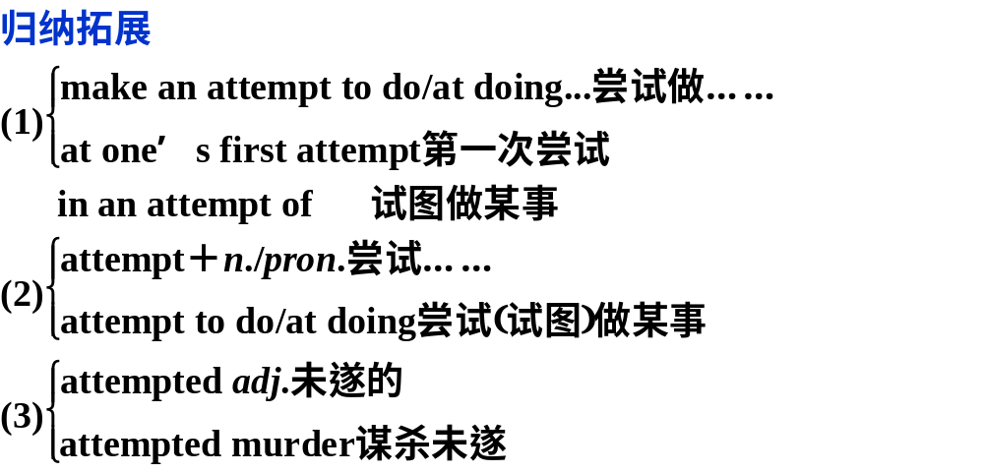
4.attempt n．努力;尝试;企图 vt.尝试;企图
(2012·高考天津卷·阅读表达)Nyad attempted to swim the distance between Florida and Cuba in 1978.
1978年,尼娅德尝试着游过佛罗里达和古巴之间的那段距离.

Slide 13
①A man is being questioned in relation to the attempted murder last night.
与昨晚企图谋杀有关的一位男子正在被审问。
②I passed my driving test at the first attempt.
我考汽车驾驶执照一次就通过了。
③The boys made an attempt to leave for camping but were stopped by their parents.
男孩子们想去野营但被他们的父母们拦住了。
④Every time I attempted to persuade her,I failed completely.每一次我都试图说服她,但全然不起作用。

Slide 14
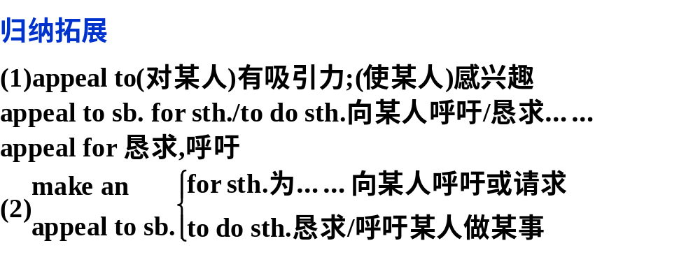
6.appeal vi.有吸引力;呼吁;求助 n．呼吁,恳求；吸引力；上诉
(2011·高考江西卷·阅读表达)Moreover, sport has become an important form of entertainment, appealing to both men
and women.
体育运动已成为一种重要的娱乐形式,吸引着男男女女。

Slide 15
①—How did you like Nick’s performance last night?
—To be honest, his singing didn’t appeal to me much.
——你觉得尼克昨天晚上的表演怎么样？
——说实话,他的演唱对我没多大吸引力。
②We advocate solving international dispute by negotiation, instead of appealing to arms.
我们主张通过协商解决国际争端,而不主张诉诸武力。
③(牛津P₇₉)The police made an appeal to the public to remain calm.警方呼吁公众保持镇静。

Slide 16
[跟踪训练]
Ⅰ.完成句子
1．The girl is careful to choose her food because she wants very much to ________________(保持身材)．
3．New teaching methods __________________ (已被采用) to improve the result of education.
keep her figure
have been adopted

Slide 17
4．This anti­smoking campaign _________________(主要针对)young teenagers.
5．This doesn’t mean trying ________________(想出,弄明
白) what’s wrong with the other person.
6．The police is said____________________________(正呼吁公众)for information about the crime.
is mainly aimed at
to figure out
to be appealing to the public

Slide 18
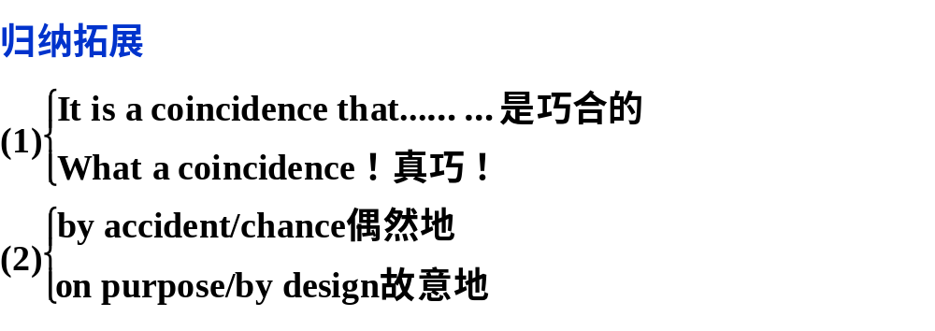
[短语精释]
1.by coincidence 巧合地
(教材P₂)By coincidence,oil paints were also developed at this time,which made the colours used in paintings look richer and deeper. 巧合地是,这一时期油画颜料也得到了发展,它使得绘画的色彩看上去更丰富、更深沉。

Slide 19
①It can’t be a(n)coincidence that four jewelry stores were robbed in one night.
四家珠宝店在一夜被抢劫一定不是巧合。
②By coincidence, I met the person we’d been discussing the next day.真是巧了,我在第二天就遇见了我们一直在谈论的那个人。
③What a coincidence！I wasn’t expecting to see you here.真巧！我没料到会在这里见到你。

Slide 20
2.a great deal 许多;大量
(教材P₂)In the late 19th century, Europe changed a great deal,from a mostly agricultural society to a mostly industrial one. 19世纪后期,欧洲发生了巨大的变化,从以农业为主的社会变成了以工业为主的社会。
归纳拓展
(1)a great deal＝a good deal大量,该短语可用作名词或副词.
(2)a great deal (名词短语)“大量,许多”,作主语、宾语。
(3)a great deal (副词短语)“大量地,非常多地”,修饰动词或比较级。
(4)a great deal of修饰不可数名词表示“大量的,非常多的”.

Slide 21
①He knows a great deal more about computers than I do.他的计算机知识比我丰富得多。
②Joan passed her exam,which surprised me a great deal.
琼通过了考试,这让我很惊讶。
③A great deal of money has been spent in saving the lives of the trapped miners since last week.
自上周以来,挽救被困矿工的生命已花费了大量金钱。
【温馨提示】 常用于修饰比较级的词还有much,far,rather,a lot,a little,a bit,even,still,by far(常用于比较级之后),any。
④After two years’ research, we now have a far better understanding of the disease.经过两年的研究,现在我们对这种疾病,有了更进一步的了解。

Slide 22
3.on the other hand (可是)另一方面(常与on the one hand 对应使用)
(牛津P₉₂₂)On the one hand they’d love to have kids,but on the other(hand),they don’t want to give up their freedom. 一方面他们想要孩子,但是另一方面,他们又不想放弃自由自在的生活。
归纳拓展
(1)on(the)one hand...,on the other hand...一方面……,另一方面(却)……
(2)first(ly)．..;second(ly)．..第一……;第二……
(3)for one thing...,for another...一则……,二则……
(4) To begin with… what’s more/ besides

Slide 23
①Many college graduates are out of work now, but on the other hand, they won’t take jobs that do not pay much.
现在许多大学毕业生没有工作,但另一方面,他们又不愿意干薪水低的工作。
②I’m not going to buy it; for one thing I don’t like the colour, and for another it’s far too expensive.
我不打算买它：一是我不喜欢这颜色,二是它太贵了。
③To improve your English, firstly, you should listen more; secondly, you should read more.为了提高你的英语水平,第一,你应该多听;第二,你应该多读。

Slide 24
[跟踪训练]
Ⅰ.选词填空
scores of；in the flesh；on the other hand；by coincidence；a great deal of；appeal to
1．I want to sell the house,but___________________ I can’t bear the thought of moving.
2．________________ work has been done to improve the people’s living standard.
3．The fans were very excited for they saw the superstar ______________ at the theatre.
on the other hand
A great deal of
in the flesh

Slide 25
4．________________,my friend Ken went to the park,too,so we had a good time together.
5．In fact,what ____________ me about her painting is not the style but the colours she uses.
6．There are no side effects from this drug,but __________ people may be allergic to it.
By coincidence
appeals to
scores of

Slide 26
[句型精析]
1.(教材P₂)By coincidence, oil paints were also developed at this time, which made the colours used in paintings look richer and deeper. 巧合地是,这一时期油画颜料也得到了发展,使得画的颜色看上去更丰富、更深沉。

Slide 27
[句法分析]
本句为复合句,含有which引导的非限制性定语从句,对前面的整个句子进一步补充说明。
①After graduating from college, I took some time off to go travelling, which turned out to be a wise decision.
大学毕业之后,我休息了一段时间去旅游,结果证明这是一个明智的决定。
②Tom was late again, which made the boss very angry.
汤姆又迟到了,这使老板非常生气。

Slide 28
2.(教材P₂)Without the new paints and the new technique,we would not be able to see the many great masterpieces for which this period is famous. 没有新的颜料和新的(绘画)手法,我们就不能看到很多这一时期著名的作品。

Slide 29
[句法分析]
without意为“若不是”“要不是”,与but for用法相同。此句中without引导的介词短语是一个暗含的非真实条件,所以主句用了虚拟语气。
①Without your help, I wouldn’t have made such rapid progress.
(＝If you hadn’t helped me, I wouldn’t have made such rapid progress.)没有你的帮助,我不会取得这么大的进步。
②Without plenty of rain, we couldn’t have so good a harvest.没有足够的雨水,我们就不可能有这么好的收成。
③Without your timely help, I couldn’t have finished the work on time.没有你及时的帮助,我不可能按时完成工作。

Slide 30
归纳拓展
表示“若不是”的虚拟语气句型
英语中有几个表示“若不是”“要不是”的固定表达,它们总是用于引出虚拟条件句,句子谓语总是用虚拟语气。这几个句型是:
(1)but for意为“要不是有……”“若不是因为……”,习惯上与虚拟语气连用。
(2)if it were not for主要用于谈论现在的情况,意为 “要不是有……”“若不是因为……”,相应的主句总是用虚拟语气.
(3)if it had not been for主要用于谈论过去的情况,意为“要不是有……”“若不是因为……”,相应的主句总是用虚拟语气。

Slide 31
④But for the storm, I would have been home before eight.
要不是因为这场风暴,我早在8点钟以前就回到家里了。
⑤If it were not for you, our team would not win.若没有你,我们球队是不会赢的。
⑥If it hadn’t been for the doctor’s care, I wouldn’t have recovered so soon.
要不是医生的照顾,我不会痊愈得这么快。

Slide 32
3.(教材P₂)Among the painters who broke away from the traditional style of painting were the Impressionists, who lived and worked in Paris. 在这些脱离传统绘画风格的画家中就有生活和工作在巴黎的印象派艺术家们。
[句法分析]
此句是一个倒装句,正常语序应为The Impressionists who lived and worked in Paris were among the painters who broke away from the traditional style of painting.
此句为表语部分提前而引起的完全倒装结构。

Slide 33
①Just in front of the bus lies an injured old man all covered with blood.
在公共汽车的前面躺着一位受伤的老人,浑身是血。
②Into the dark apartment walked David, who was quite surprised when everyone shouted Happy Birthday.大卫走进了黑暗的房间,当大家喊生日快乐时,他感到很惊讶。
③Present at the evening party was our favorable teacher.出席晚会的有我们喜欢的老师。
④They arrived at an old church, in front of which stood a big crowd of people.
他们到达了一个古老的教堂,前面有很多的人群。

