Slide 1
常用结构：
There is no need… 没有必要…
There is no question… 是没有问题的…
There is no reason… 没有理由…
There is no possibility that… 是没有可能的…
There is no knowing/telling…没法知道/说…
It is a/no wonder that …真奇怪/真令人吃惊…
It is no use/good that…
It is no use/good doing sth…

Slide 2
常 以v-ing form 作结果状语的词有: make, reach, leave…….
The song “Notebook” is sung throughout the country,making it the most popular song.
他父亲死 了,什么也没留下给他们.
His father died, leaving nothing to them

Slide 3
result in 产生，导致（lead to, cause sth to happen)
result from 由…引起，产生( lie in, occur as a result of/because of )
from
The accident resulted _______ the driver’s carelessness, which resulted ______ the death of two passengers.
in

Slide 4
The experiment _____ the discovery of a cure for cancer. A. resulted in B. lead to C. resulted from D. was caused by
2. He slipped and broke his leg. ______, he will have to be away from school for two or three months. A. Resulting in B. With the result that C. As a result D. The result is that

Slide 5
His sickness was caused by eating too much.
His sickness _______ ______ eating too much.
He was ill __________ he had too much.
He was ill ______ ______ eating too much.
___ ___ _____ ___ eating too much, he was ill.
Eating too much ______ ______ his illness.
Eating too much ______ ______ his illness.
He had too much. ____ ___ ____, he was ill.
resulted from
because
because of
As a result of
resulted in
led to
As a result
同义表达

Slide 6
as low as 低至… as much as 高至….
多达150名读者簇拥在那位名作家周围.
As many as 150 readers crowded round the famous writer.
去欧洲旅游之费用高达50 000元人民币.
The cost of travelling to Europe is as much as 50 000 yuan.

Slide 7
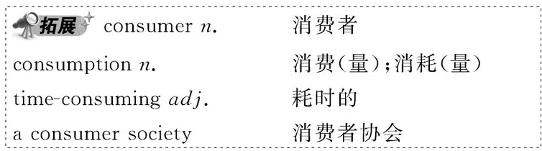
1. Consume
Sth Run out
Sb Give out

Slide 8
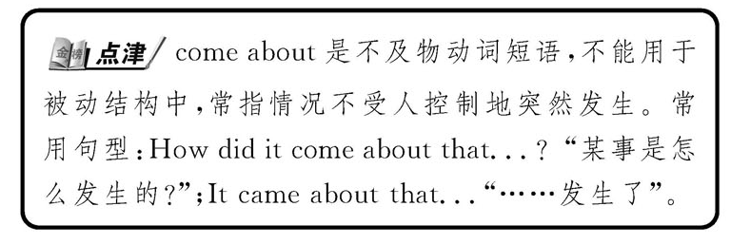
3. Come about

Slide 9

短语come about意为“发生”，你还知道哪些词或短语表示“发生”这个意义吗？请举例说明它们的用法。
【思考提示】常见的这类词或短语还有happen, take place, break out, occur等，它们都不能用于被动语态。
(1) happen常用来指某个事件偶然发生。其后也可接动词不定式或用于It happens that. . . 句型表示“碰巧”。
How did the car accident happen？
车祸是怎么发生的？

Slide 10
(2) take place 多指按计划发生的事情。
When will their wedding take place？
他们的婚礼什么时间举行？
(3) break out 指“(战争、火灾、疾病等)突然发生”。
Fire broke out during the night.
夜间突然发生了火灾。
(4) occur是比较正式的用法。
It occurs to sb. that. . . 某人突然想起……
When exactly did the incident occur?
这一事件究竟是什么时候发生的？

Slide 11

As is known to us all, the 2012 Olympic Games will _____ in London.
A. come about B. break out
C. take place D. be happened
【解析】选C。句意：众所周知，2012年奥运会将在伦敦举行。take place根据安排或计划发生；come about多指事情已经发生，但还不知道原因；break out爆发；happen(偶然)发生，不用于被动语态。

Slide 12
拓展：
come across 偶然碰见，无意中找到
come on 跟着来，跟上来；[口]得啦，快点
come out 出来，出现；(芽)生出来；(花)开；出版，发行
come to 总计，达到；归纳为
come up 走近；上(楼)去；(从土中)长出，发芽；被提出
come up with 赶上；提出(建议)

Slide 13
①可数名词和不可数名词均可修饰：
lots of=a lot of, a quantity of =quantities of, a mass of =masses of, plenty of
②只修饰可数名词：
many, a great/large number of = large numbers of, a good/great many, scores of, dozens of
③只修饰不可数名词：
much, a great/large amount of= large amounts of, a great/good deal of

Slide 14
  in quantity / in large amounts / in large quantities
大量地
a quantity of / quantities of 大量的

Slide 15
—Why does the lake smell terrible?
—Because large quantities of water _____.
A. have polluted B. is being polluted
C. has been polluted D. have been polluted
【解析】选D。“quantities of+名词”作主语时谓语动词用复数形式。水是被污染的，要用被动语态，故选D。

Slide 16
3. compare v． 比较
  (1)compare...with/to... 把……与……比较；对照
compare...to... 把……比作……
compare...and... 比较……和……
compare notes (with sb.) (与某人)交换看法或意见

Slide 17
(2)comparison n．比较，对照，对比
for comparison 供比较，对照
by comparison 比较起来，较之
by/in comparison (with...) (与……)相比较
comparable adj. 可比较的，类似的
compared to/with... 与……相比较而言(常置于句首作状语)
(3)在作“与……比较”讲时，既可以用compare...with...，也可用compare...to...，但是在作“把……比作……”讲时，只能用to。

Slide 18
4. at random= randomly adv. 随机地，任意地

Slide 19
  5. average adj. 平均的；普通的；正常的；平常的
  n． 平均数；平均水平；一般水准
  v． 平均为；计算出……的平均数
(1)an average rate/cost/price 平均比率/成本/价格
above/below average 高于/低于平均水平
on average 平均地；通常；按平均值
up to average 达到平均数，达到一般水准
(2)average sth. out 算出……的平均数

Slide 20
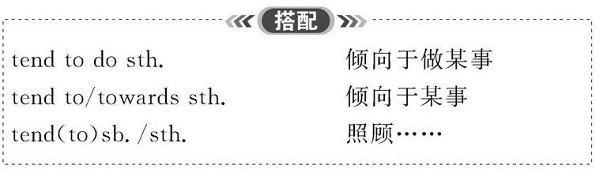
6. Tend

